Slide 1
Data Carpentry Visualization in R Using ggplot2
January 17, 2019
Maria Kamenetsky
mkamenetsky@wisc.edu
@mkamenets
Adapted from Karl Broman and Data Carpentry curriculum

Slide 2
Key Concepts
Prep Data
ggplot() function
geoms
challenge!
Other aesthetics
challenge!
Layering
challenge!
Facetting
challenge!
Themes
Saving plots

Slide 3
Prep Data
Create 4 datasets using dplyr:
just_dm
Only species==“DM”.
stat_summary
Mean weight, mean height, & observation count by species.
year_summary
Mean weight, mean height, and observation count by species, year, and sex.
count_by_year
Observation count by year.

Slide 4
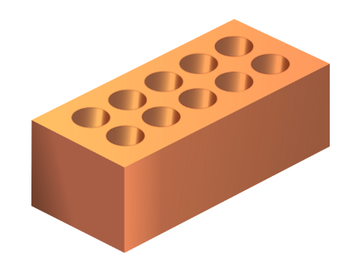
ggplot() function
ggplot(______, aes(x= _____, y= _____))
Data frame name
X-axis variable name
y-axis variable name
aes = “aesthetics”; map features of data to features of visualization
1

Slide 5
geoms
geom = what gets plotted
Add a geom to ggplot() with +
Ex: scatter plot = + geom_point()
2

Slide 6
CHALLENGE #1
Make a scatterplot of hindfoot_length vs. weight, but only for the species_id "DM".
Use the dataset we’d created, just_dm
Use our ggplot2 code above but with this new dataset in place of surveys.
2

Slide 7
Other Aesthetics
Commonly used aesthetics:
shape
color
size
alpha (= opacity)
You can assign aesthetics to:
Values and codes
Data
3

Slide 8
CHALLENGE #2
Make a scatterplot of mean hindfoot_length vs. mean weight, where each point is a species and where the sizes of the points indicate the sample size.
Use the dataset we’d created, stat_summary
Use our ggplot2 code above with the aesthetics x=mean_wt and y=mean_hfl, plus size=n.
2

Slide 9
Layering
Can add layers to ggplots
Order matters
Example:
geom_boxplot() + geom_jitter() ≠
geom_jitter() + geom_boxplot()
Can add multiple geoms to each other using +
Example:
geom_line() + geom_point()
There are multiple ways to get the same plot when it comes to layering
4

Slide 10
CHALLENGE #3
Use the year_summary dataset to make a line plot of counts of each species by year, with a different colored line for each species.
Use aes(linetype=sex) to have different line types for the two sexes.
2

Slide 11
Facetting
Allows you to split plot into multiple panes based on a factor in the dataset.
facet_wrap()
Extracts plots into an arbitrary number of dimensions to allow the to fit on one page.
facet_grid()
Allows you to explicitly specify how you want your plots to be arranged via formula notation (rows ~ columns)
- a . can be used as a placeholder that indicates only 1 row or 1 column.
5

Slide 12
CHALLENGE #4
Use the year_summary dataset and make scatterplots of mean hindfoot length vs. mean weight (with each point being a species), faceting by year.
Use aesthetics x=mean_wt and y=mean_hfl
Use geom_point(aes(color=species_id, shape=sex))
Use facet_wrap(~year)
2

Slide 13
Themes
Grey background can be omitted
Variety of themes can be applied to change the overall appearance of the plot.
Example:
+ theme_bw()
6

Slide 14
Saving Plots
Use the ggsave() function
Can specify figure height/width, type (tiff, pdf, jpeg), dpi.
7

Slide 15
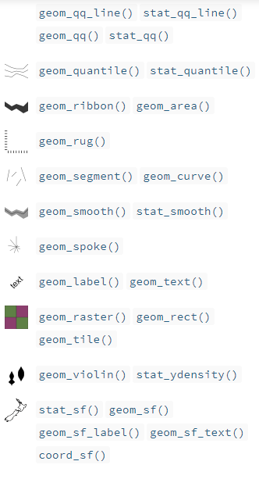
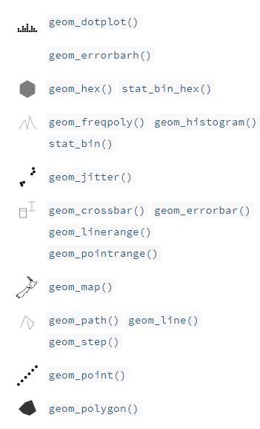
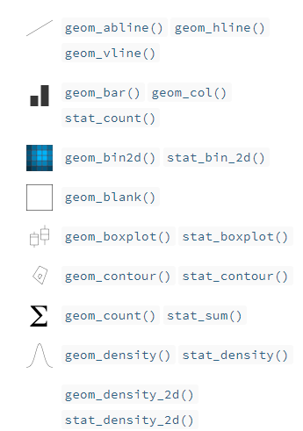
geoms
2

