Slide 1

Quantum Key Distribution Using the BB84 Protocol: A Simulation-Based Approach
Presented By:
Mohammad Kamil(29464)
Institute of Business Administration, Karachi

Slide 2
Quantum Key Distribution (QKD)
Method of secure communication that uses quantum mechanics principles to distribute encryption keys
Secure encryption key over an insecure channel
Classical encryption methods
Use three Quantum Characteristic
Quantum Superposition
Quantum Entanglement
Uncertainty Principle

Slide 3
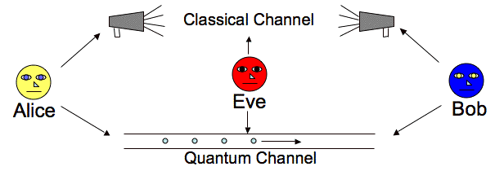
Traditional encryption methods are vulnerable to quantum computing attacks
If any attempt to intercept the key by third parties(Eve) will disturb the quantum state, alerting the communicating parties and allowing them to discard the compromised key.

Slide 4
Why QKD?
RSA & ECA Algorithms limitations
Faster
Shor’s Algorithm
Grover’s Algorithm
Offer security base on fundamental laws of physics
Quantum-resistant

Slide 5
Key Principles of Quantum Mechanics
1- Superposition
Many states exist for a quantum at a same time
2- Quantum Entanglement
Particles can remain connected, such that the physical properties of one will affect the other. No matter the distance between them
3- Uncertainty Principle
Measuring observables which are not commuting observables

Slide 6
QKD Protocols
BB84 Protocol
E91 Protocol
B92 Protocol
SARG04 Protocol
DPS Protocol

Slide 7
The BB84 Protocol
Proposed by Charles Bennett and Gilles Brassard in 1984
Enables two parties to generate a shared, secret key using quantum bits (qubits)
Measurement of a quantum state disturbs it, revealing any eavesdropping
Alice can transmit a random secret key to Bob by sending a string of photons with the private key encoded in their polarization.
The no-cloning theorem guarantees that Eve cannot measure these photons and transmit them to Bob without disturbing the photon’s state in a detectable way

Slide 8
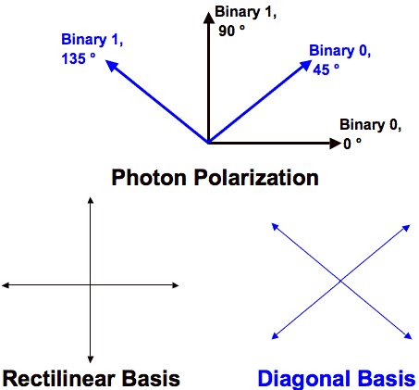
Photons as Qubits
Photons are qubits for their state of polarization
Polarization
Elliptical
Linear
Diagonal
Rectilinear
Horizantol
Vertical
Polarization of 0° on the rectilinear basis or 45° on the diagonal basis as binary 0. Binary 1 can be 90° on a rectilinear basis and 135° on a diagonal basis

Slide 9
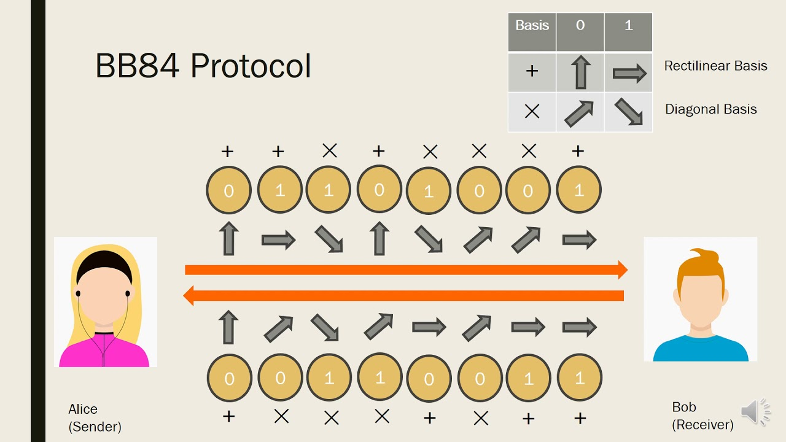

Slide 10
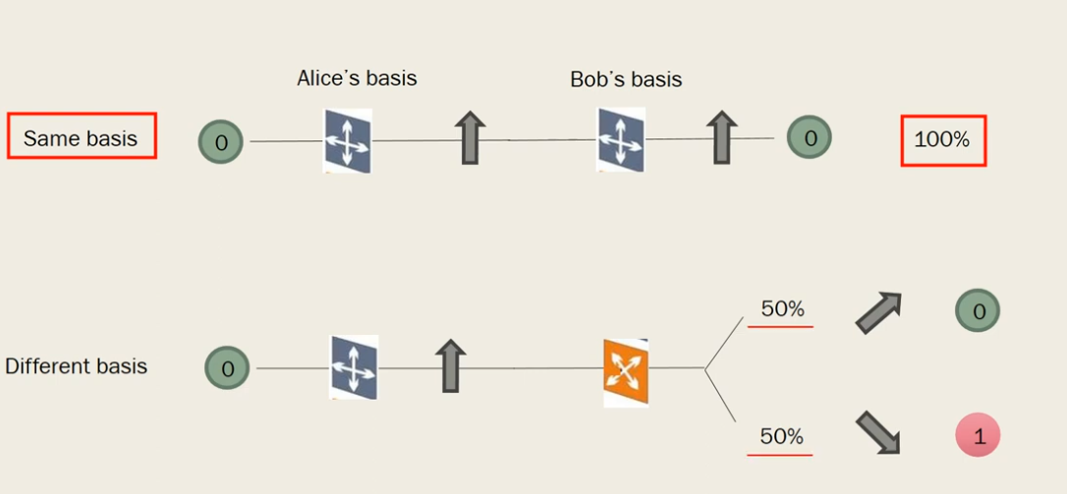
Comparing Basis

Slide 11
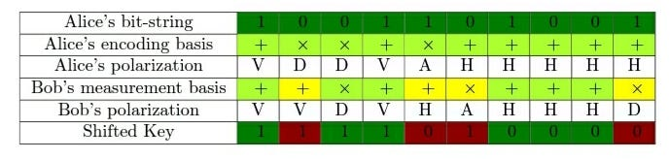
Alice generates a random sequence of bits.
Alice randomly chooses a basis (rectilinear or diagonal) for each bit.
Alice sends photons polarized according to the chosen bases.
Bob randomly selects a basis to measure each incoming photon.
Alice and Bob communicate over a public channel to compare bases.
Bits where bases match are kept to form the secret key.

Slide 12
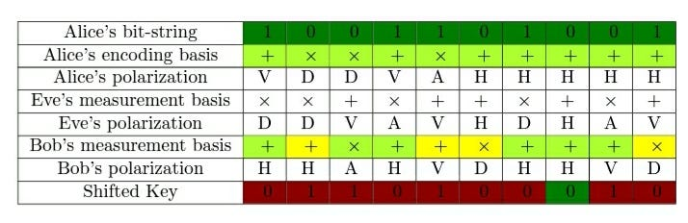
Eavesdropping (Eve) Intercept

Slide 13
Alice and Bob take the first k bits of their secret key and compare them.
If any of them don’t match then they know that someone has been eavesdropping. So they can start the whole process again

Slide 14
Use Cases
Secure communication in government and military
Financial institutions for secure transactions
Healthcare for protecting patient data

Slide 15
Drawbacks
Requires a Quantum Channel
Sensitive to Noise and Loss
Limited Distance
Low Key Generation Rate

Slide 16
Short Quiz
What is the main goal of the BB84 protocol?
Why do Alice and Bob discard bits where their bases don’t match?
What are the two types of bases used in the BB84 protocol?
What happens if Bob uses a different basis than Alice to measure a qubit?
How is the final shared key created between Alice and Bob?

