Slide 1

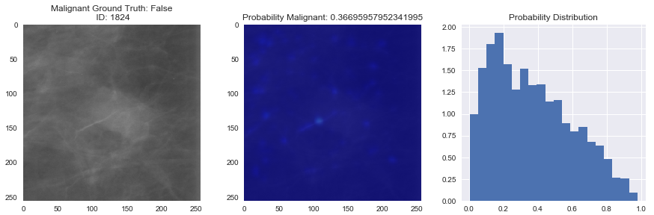
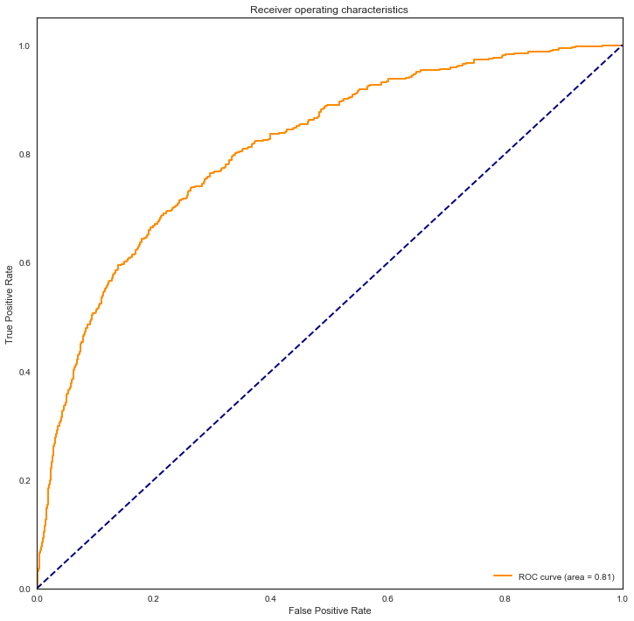
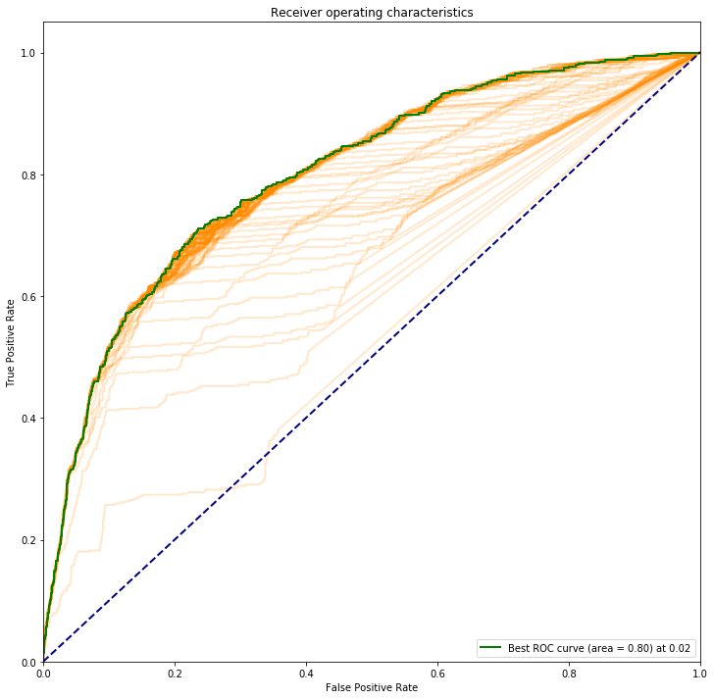
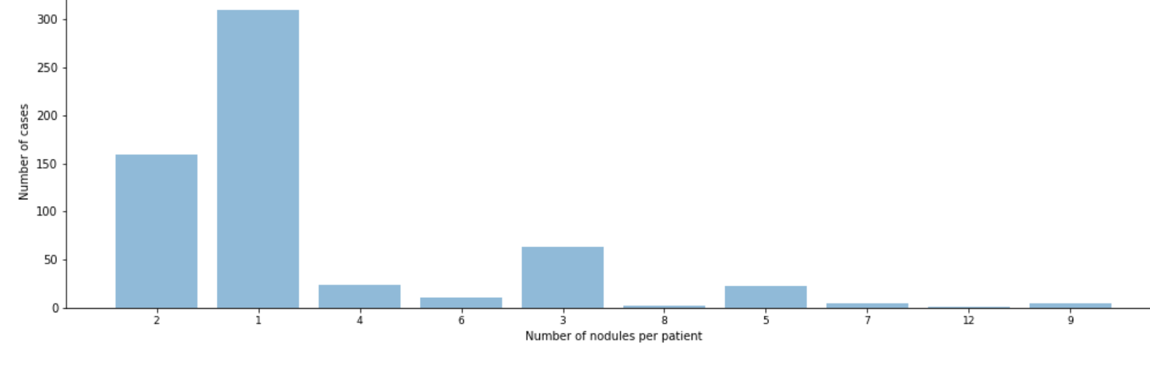
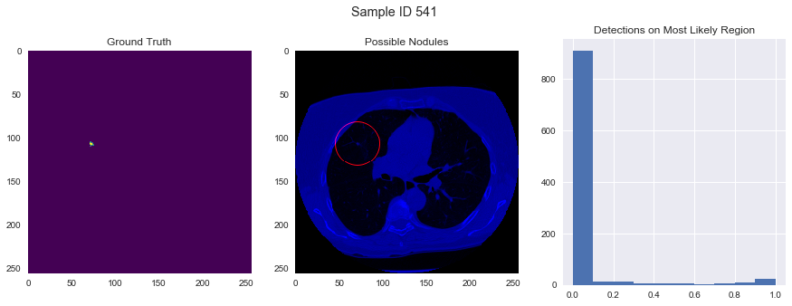
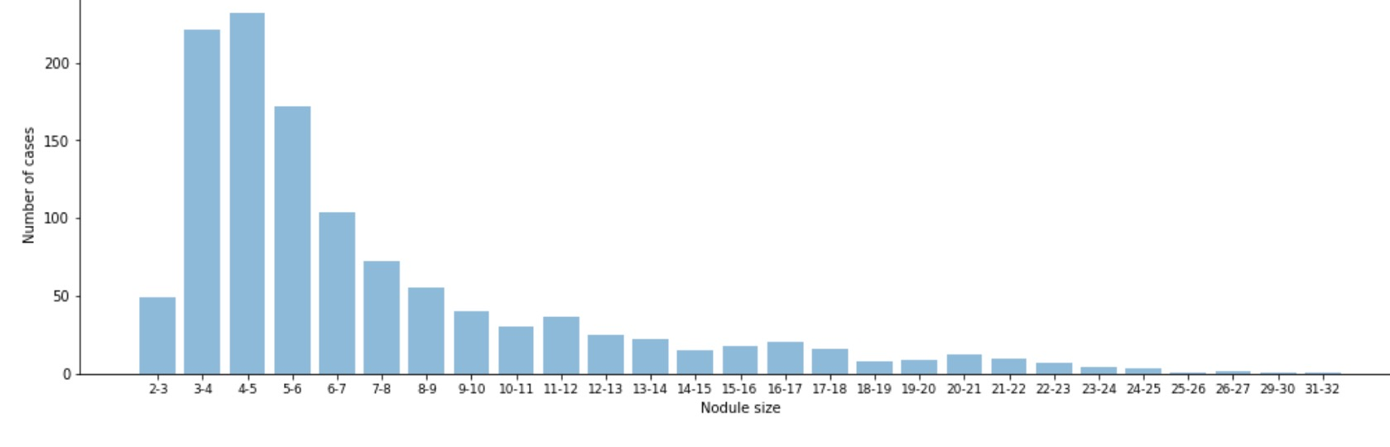
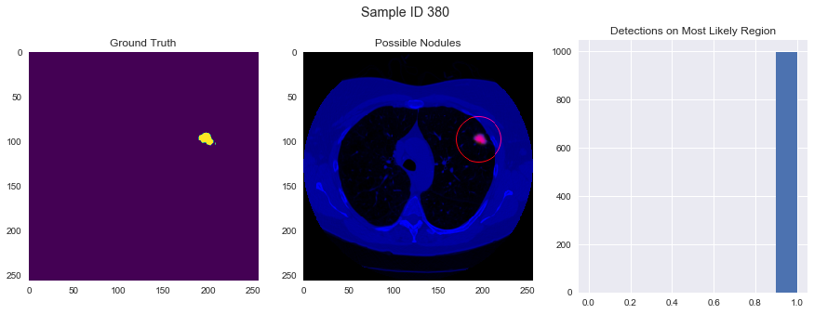
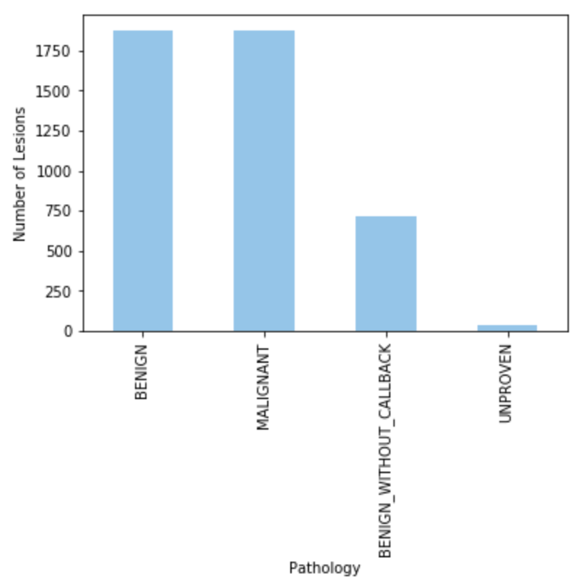
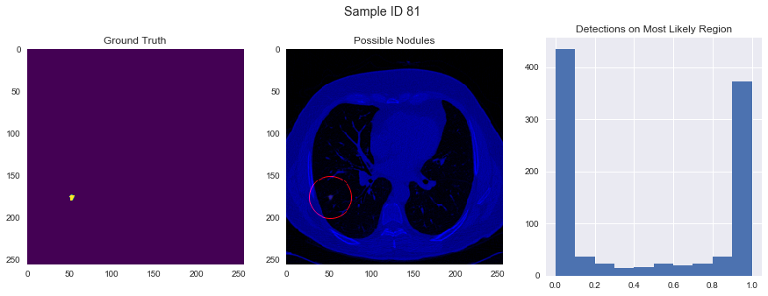
Bayesian Medicine: Communicating Relevancy with Visualization and Uncertainty with Bayesian Methods
CS109b & STAT121b
Spring 2018
Dor Baruch (Harvard College), Michaela Kane (Harvard College), David Loving (Harvard Extension School), & Brandon Walker (Harvard Graduate School)
Goals
Methodology
Results
Create and train a Bayesian U-Net on lung nodule data from LUng Nodule Analysis (LUNA) [5] to identify and locate cancerous lesions
Develop a Bayesian neural network on mammography data from the Digital Database for Screening Mammography (DDSM) [2] to classify lesion type and malignancy
Use these Bayesian methods to increase network explainability by creating probability distributions for classification
Created a U-Net to locate lesions using 2D slices of the 3D images from LUNA data
  Used dropout to approximate Bayesian inference
Trained InceptionResNetV2 on DDSM data to classify malignant/benign images
  Used intermediate features to train a Bayesian network to perform classification
Using dropout to approximate Bayesian inference helps reflect model uncertainty with no real loss in accuracy
The Bayesian visualizations enhance explainability by:
  Indicating the area of the highest detection probability
  Using a histogram to plot the distribution of probabilities that a sample of pixels in the image is cancerous
With these visualizations, radiologists can decide whether to run more tests on certain cases
Fig 4. DDSM raw image, saliency map, and Bayesian probability distribution for classification
Data Exploration
Conclusions
LUNA CT Scan Data
Contains 888 3-dimensional CT scans of patients’ lungs
  601 patients with diagnosed cancer
  287 without diagnosed cancer
Observed no loss in model accuracy from Bayesian approximation
These Bayesian methods give insight into the network’s process and enhance explainability
Radiologists can use the recolored images and probability distributions to inform decision making rather than dictate it
Future work includes:
  Applying both the U-Net and Inception ResNet to the same dataset and analyzing results
  Expanding the U-Net to operate on 3D images rather than extract 2D slices
  Modifying U-Net output to identify global clusters and perform analysis on them rather than on single pixels
Fig 5. ROC curves for without and with approximate Bayesian inference
Fig 1. Histogram of number of nodules per patient
Fig 6. Bayesian visualization and probability distribution for scan unlikely to have lesions
Fig 2. Histogram of nodule sizes
Citations and Links
Fig 7. Bayesian visualizations and probability distribution for scan likely to have lesions
DDSM Mammography Data
Contains over 10,000 mammographies
  4,505 with lesions (includes info
  on lesion type and pathology)
  6,206 without lesions
Baker, Darren, et al. Predicting Lung Cancer Incidence from CT Imagery. Stanford University, 2017.
DDSM Mammography Dataset <https://www.ncbi.nlm.nih.gov/pmc/articles/PMC3041807/>.
Doshi-Velez, Finale, et al. “Accountability of AI Under the Law: The Role of Explanation.” SSRN Electronic Journal, 2017, doi:10.2139/ssrn.3064761.
Gal, Yarin, and Zoubin Ghahramani. Dropout as a Bayesian Approximation: Representing Model Uncertainty in Deep Learning. University of Cambridge, 2016.
He, Kaiming, et al. “Deep Residual Learning for Image Recognition.” 2016 IEEE Conference on Computer Vision and Pattern Recognition (CVPR), 2016, doi:10.1109/cvpr.2016.90.
LIDC-IDRI CT Scan Dataset <https://wiki.cancerimagingarchive.net/display/Public/LIDC-IDRI>.
Ronneberger, Olaf, et al. “U-Net Convolutional Networks for Biomedical Image Segmentation.” Informatik Aktuell Bildverarbeitung Für Die Medizin, 2017, doi:10.1007/978-3-662-54345-0_3.
Fig 3. Histogram of lesion pathologies
Fig 8. Bayesian visualizations and probability distribution for scan which network finds contentious
School of Engineering and Applied Sciences

