Slide 1

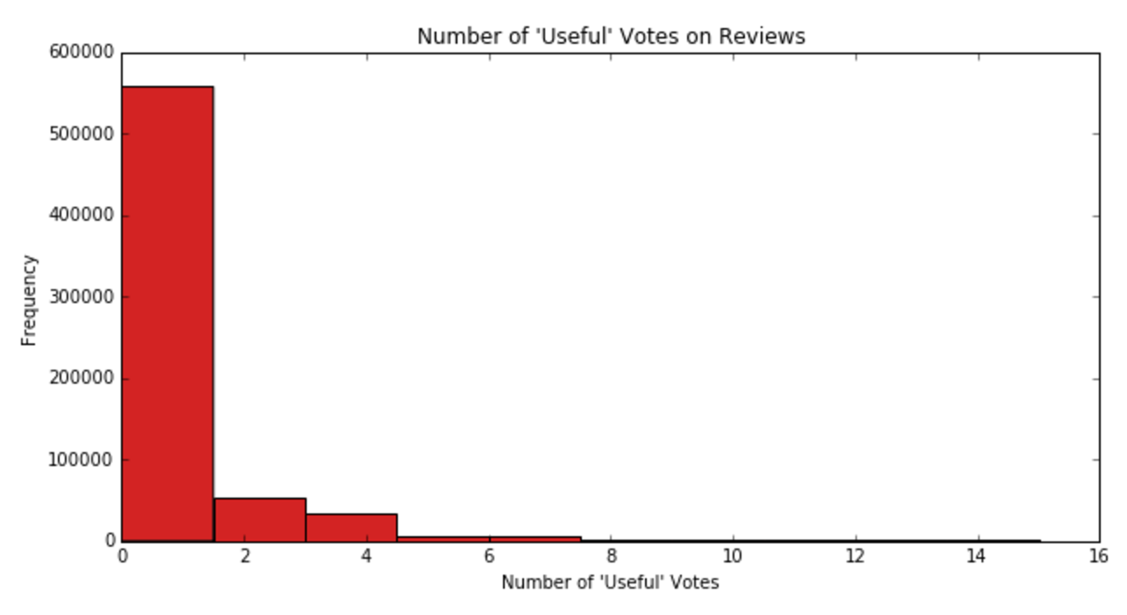
Reviewing Reviews: A Study of the Helpfulness of Yelp User Reviews
John Bowers, Michaela Kane, Jarele Soyinka, & Nisha Swarup
Data Collection & Visualization
Data Modelling and Prediction
  To start, we downloaded a large archive of Yelp reviews (about 2 million total) from a Yelp-sponsored data competition page. To make the data easier to work with, we chose to sample only those reviews which were published in 2015 (about 600,000 total). After some simple cleaning to remove duplicates and verify the data’s integrity, we began initial data visualization. Our first histogram of a sample of 50,000 reviews from the data revealed the following:
  Given that we were working with text data, our first step was to get the reviews into a form interpretable by our model. After experimenting with a number of methods, we settled on non-binary count vectorization with Tf-idf weighting, a word-based tokenizer, and a no stemming algorithm. This configuration seemed to give the best and most stable results overall. It seems that using stemming algorithms, word pairs, and other enhancements failed to boost our results.
  After vectorizing the reviews we tried 4 different classification algorithms for sentiment analysis: Random Forests, AdaBoost with Random Forests and Logistic Regression, Linear SVC, and Logistic Regression. Each algorithm was fit and tested on all three different vote types. Class weights were set to “balanced” in each case to compensate for our imbalanced sample: only a minority reviews received any votes. Unfortunately, Random Forests and AdaBoost did not perform particularly well on our dataset despite intensive tuning. Linear SVC and Logistic Regression performed comparably well, so we compared their finer points.
  Linear SVC seemed more sensitive to its tuning parameter than Logistic Regression, often fluctuating in accuracy for both classes with minor changes. Furthermore, as the samples tested became larger Linear SVC experienced significantly longer fit times than Logistic Regression. Finally – and perhaps most importantly for our project – Logistic Regression can natively provide class probabilities while making predictions. This would be extremely useful in ranking reviews that have not yet been voted on. While SVC is capable of making probability estimates, it does so through an extremely expensive cross validation procedure. As such, we decided that Logistic Regression provided the best model for our particular objectives.
Introduction
  For our project, we decided to investigate how users rated other users’ reviews on the popular restaurant ranking site Yelp. In particular, we wanted to investigate what made a post helpful to other users: does word length impact the usefulness of a post? How about the ranking of the restaurant in question? In this study, we hope to determine what sorts of reviews are most useful to other users.
Objective
  Clearly, many reviews are not receiving any votes for usefulness, which brings us to our list of issues to consider when dealing with this dataset:
  Our model must be capable of dealing with large training and test sets due to the massive volume of reviews published on Yelp
  Due to the nature of Yelp’s review rating system, our training data is inherently flawed – reviews might not receive votes because they are:
    actually not useful/funny/cool (this is optimal), or
    despite being useful/funny/cool, the review simply did not receive any exposure and so received zero votes.
  By determining what characteristics of reviews contribute to their usefulness, we can help predict how useful a review will be. This can help sites like Yelp give their users the best experience by providing them with what are considered the most useful reviews for a given business.
  By creating a model to predict the usefulness of a review given the unique characteristics of that review, we hope to help companies such as Yelp determine in what order reviews should be shown, rather than showing relatively useless reviews or burying the useful ones under other posts.
Conclusion
  Conclusions
  Limitations
    Yelp data won’t tell us how many people have viewed a review → a review that 1K people have seen could only get only 3 ‘helpful’ ratings and would still be considered ‘helpful’

