Slide 1
Tracing calories thru SUAs and FBSs
Different calorie contents at FBS level
The current standardization process
Creating information
Aggregating information
The role of extraction rates vs calorie conversion factors
Pre-standardization, implications and possible solutions
Notes:
<number>

Slide 2
What and how big is the problem?
Notes:
<number>

Slide 3
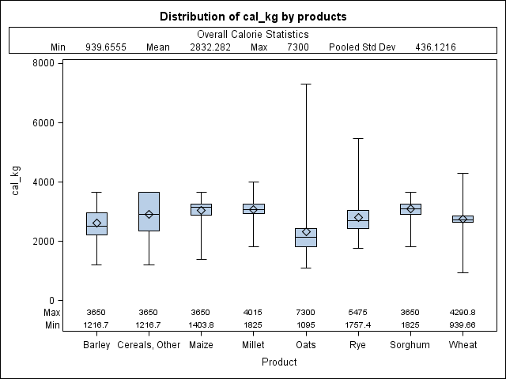
Implicit calorie contents: Cereals
Notes:
<number>

Slide 4
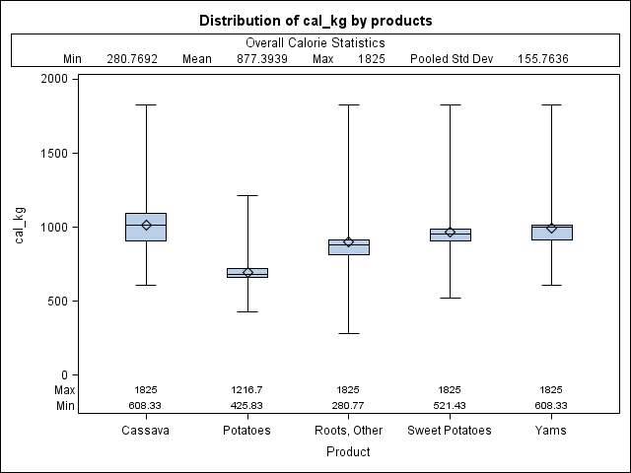
Implicit calorie contents: Roots and Tubers
Notes:
<number>

Slide 5
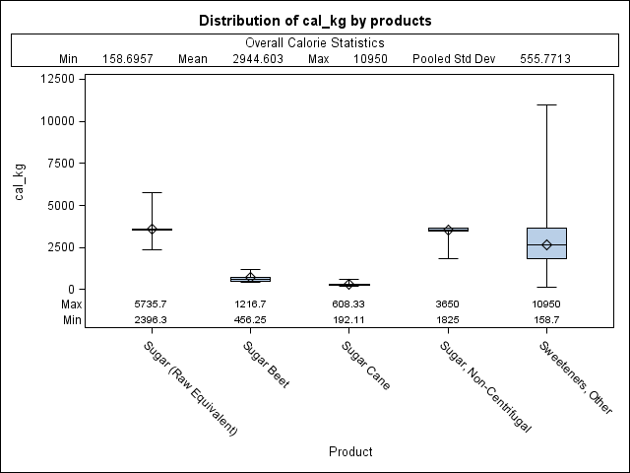
Implicit calorie contents: Sugar & Sweeteners
Notes:
<number>

Slide 6
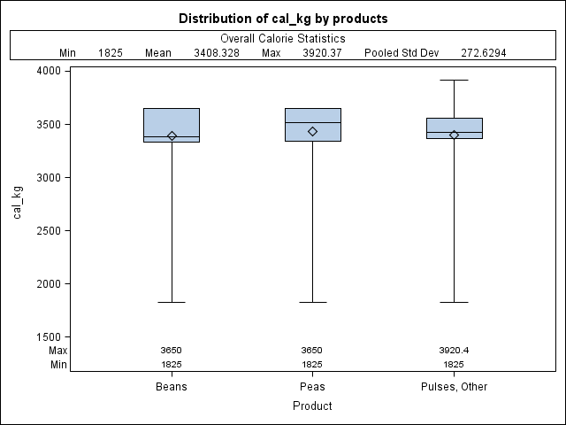
Implicit calorie contents: Pulses
Notes:
<number>

Slide 7
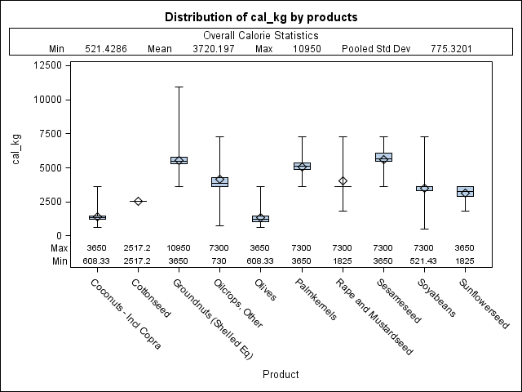
Implicit calorie contents: Oilseeds
Notes:
<number>

Slide 8
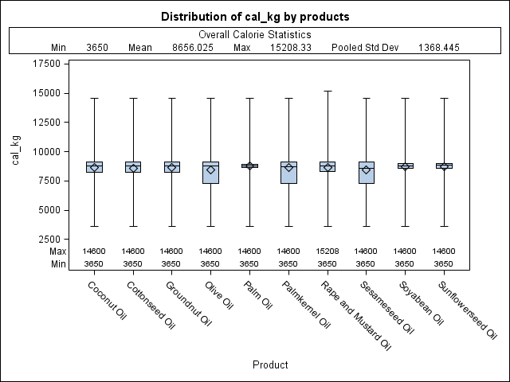
Implicit calorie contents: Oils
Notes:
<number>

Slide 9
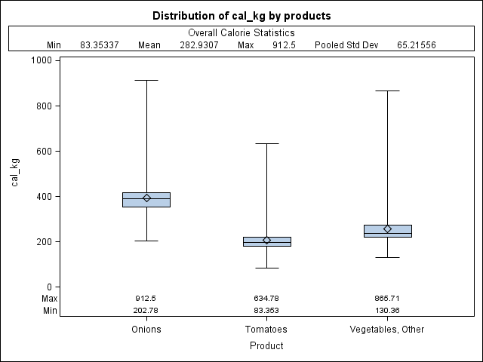
Implicit calorie contents: Vegetables
Notes:
<number>

Slide 10
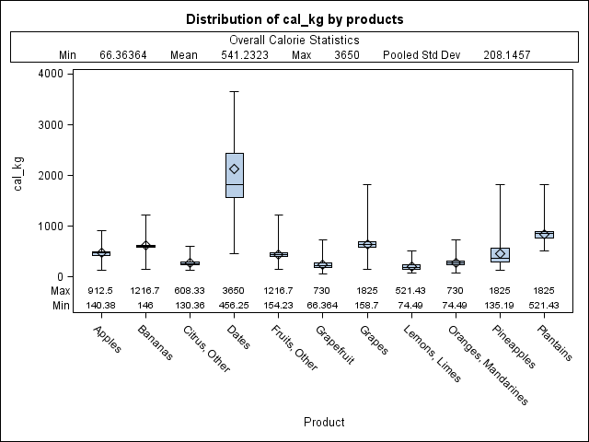
Implicit calorie contents: Fruit
Notes:
<number>

Slide 11
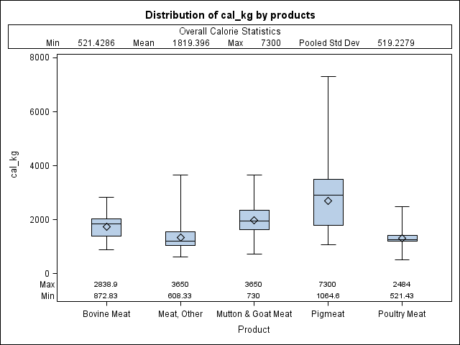
Implicit calorie contents: Fruit
Notes:
<number>

Slide 12
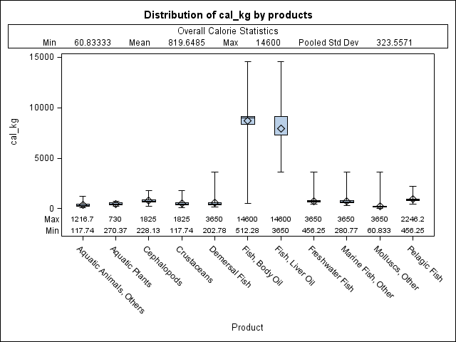
Implicit calorie contents: Fish
Notes:
<number>

Slide 13
Tracing calories thru SUAs and FBSs
Different calorie contents at FBS level
The current standardization process
Creating information!
Aggregating information?
The role of extraction rates vs calorie conversion factors
Pre-standardization, implications and possible solutions
Notes:
<number>

Slide 14
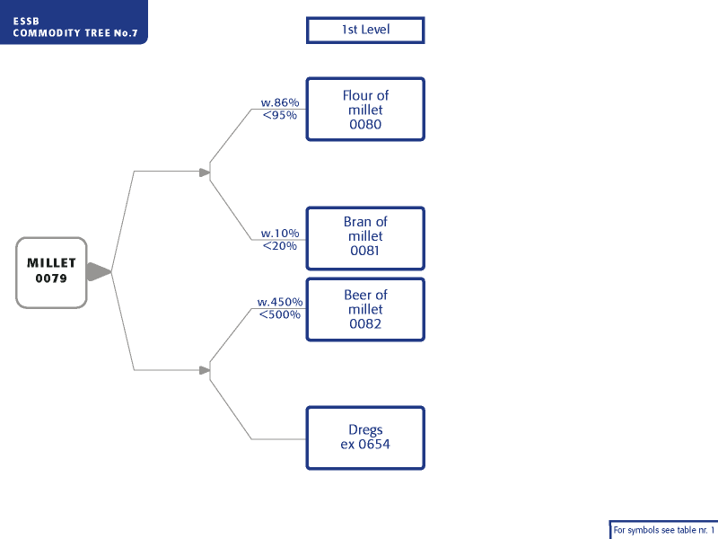
Standardizing the millet SUA – a simple example
Notes:
<number>

Slide 15
Calories in the SUA/FBS standardization process
Processed (food primary) * Extraction Rate = Production of processed Production of processed * Cal/kg = Calories from domestic processed + Imports of processed * Cal/kg = Calories from imports - Exports of processed * Cal/kg = Calories from exports Calories available from processed products at domestic market
1. | Primary | P | I | X | dSt | = | Processed | Feed | Seed | Waste | O_Use
2. | Derived | Processed |  | * | Extr. Rate | = | Production of processed Product | * | Cal/kg | = | Cal
3. |  | + | Imports of derived product |  |  |  |  | * | Cal/kg | = | Cal
4. |  | - |  | Exports of derived product |  |  |  | * | Cal/kg | = | Cal
5. |  |  |  |  |  |  | Availability of processed products |  |  |  | Sum of calories of processed products
Notes:
<number>

Slide 16
Millet, Niger 1981
 | 1 | Primary |  | I | X | dSt |  | = | Processed | Feed | Seed | Waste | O_Use
 | P | Calories
 |  | Millet | 1313900 | 1607 | 40000 | -125000 |  |  | 814838 | 157861 | 46257 | 131551 | 0
 |  |  |  |  |  |  | Extr. Rate |  |  |  | cal/kg
 | 2 | Flour | 814838 |  | * |  | 7000 | = | 570387 | * | 3520 | = |  | 2007762
 | 3 |  | + | 708 |  |  |  |  | 708 | * | 3520 | = |  | 2492
 | 4 |  | - |  | -31 |  |  |  |  | * | 3520 | = |  | -109
 | 5 |  |  |  |  |  |  |  | 570387 |  |  |  |  | 2010145
 |  |  |  | 1011 | -44
 | FBS |  | 1,314.00 | 3 | 40 | -,125.00 |  |  | 816 | 158 | 46 |  | 132
 | 1,314,000 | 2,618 | 40,044 | -125,000 |  |  | 815,500 | 157,861 | 46,257 |  | 131,551
Notes:
<number>

Slide 17
Tracing calories thru SUAs and FBSs
Different calorie contents at FBS level
The current standardization process
Creating information
Aggregating information
The role of extraction rates vs calorie conversion factors
Pre-standardization, implications and possible solutions
Notes:
<number>

Slide 18
Importance of extr rates vs calorie conversion factors
Year | Extr Rate | cal_kg
1961-2007
Min: | 6,380 | 3,320
Max: | 9,722 | 3,870
 | 52% | 17%
Processed (food primary) * Extraction Rate = Production of processed
Production of processed * Cal/kg = Calories from domestic processed
+ Imports of processed * Cal/kg = Calories from imports
- Exports of processed * Cal/kg = Calories from exports
Calories available from processed products at domestic market
Processed (food primary) * Extraction Rate * Cal/kg = Calories from domestic processed
Notes:
<number>

Slide 19
Simple example: Millet, Niger 1981
1 | Primary | P | I | X | dSt |  | = | Processed | Feed | Seed | Waste | O_Use
Calories
 | Millet | 2781928 | 1188 | 0 | -120000 |  |  | 1948397 | 333974 | 102433 | 278312 | 0
 | Flour Of Millet |  |  |  |  | Extr. Rate |  |  |  | cal/kg
2 | Flour Of Millet | 1948397 |  | * |  | 7000 | = | 1363878 | * | 3520 | = |  | 4800851
3 | Flour Of Millet | + | 0 |  |  |  |  |  | * | 3520 | = |  | 0
4 | Flour Of Millet | - |  | 0 |  |  |  |  | * | 3520 | = |  | 0
5 | Flour Of Millet |  |  |  |  |  |  | 1363878 |  |  |  |  | 4800851
6 | Implicit calories/kg |  |  |  |  |  |  |  |  |  | 2464
Notes:
<number>

Slide 20
Notes:
<number>

Slide 21
Extraction rates over time: Declining for Japan?
Notes:
<number>

Slide 22
Extraction rates: What do they reflect?
What is the meaning of the extraction rates? 14% bran but 95% flour extraction rate?
Are they a combination of technical efficiency, losses and forms of use?
Current data published in 1972, technical efficiencies of the mid 1960s (50 years)
Notes:
<number>

Slide 23
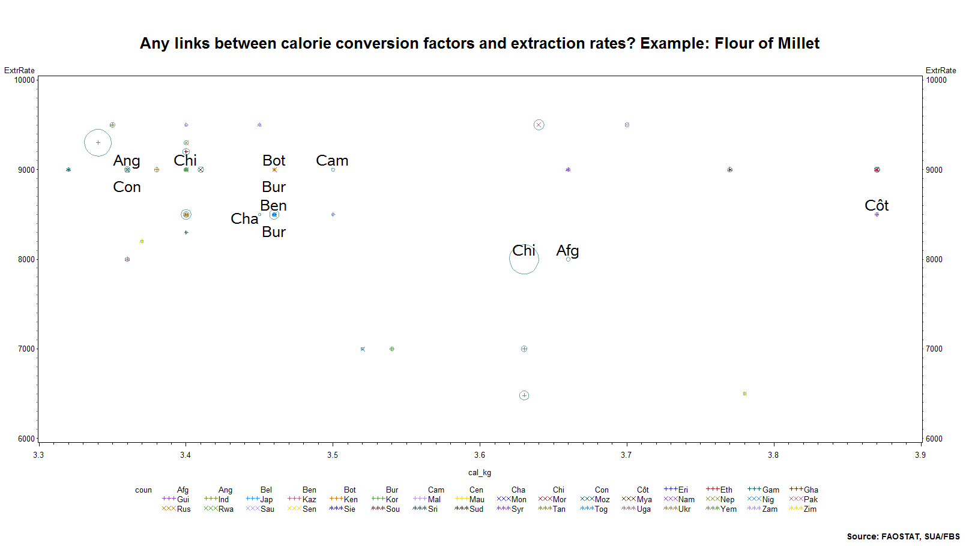
Notes:
<number>

Slide 24
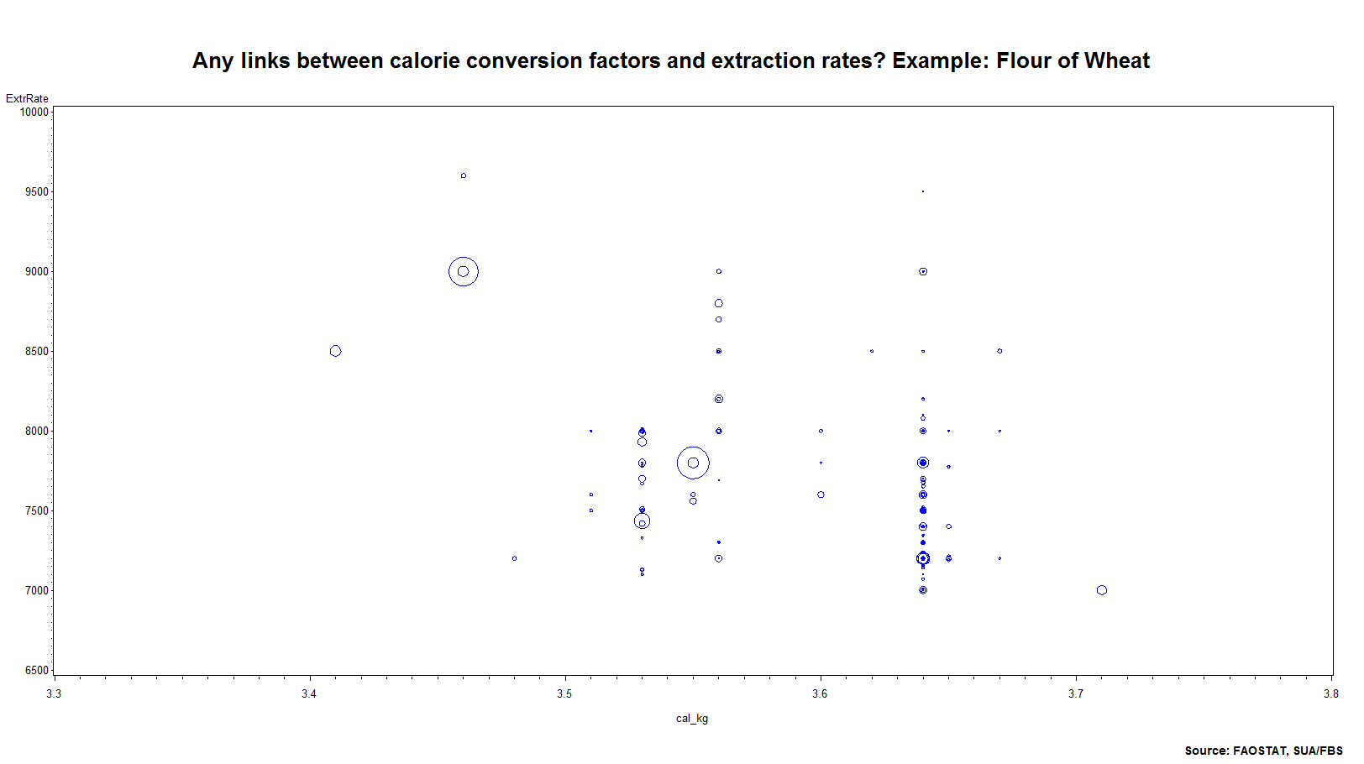
Notes:
<number>

Slide 25
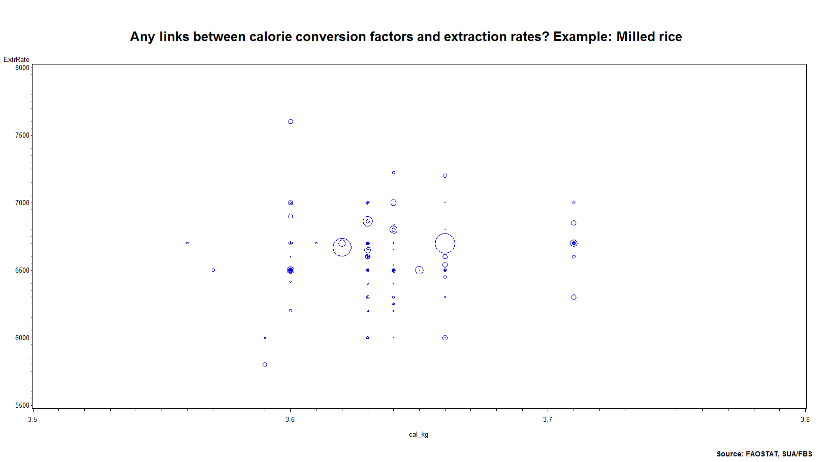
Notes:
<number>

Slide 26
Solutions
Problem remains under pre-standardization: need to identify a calorie conversion factor that can be applied to the primary product
Introducing a new column that reflects inefficiencies/losses in processing
Max extraction rates-actual extraction rate?
Keeping existing calorie factors
Notes:
<number>

