Slide 1
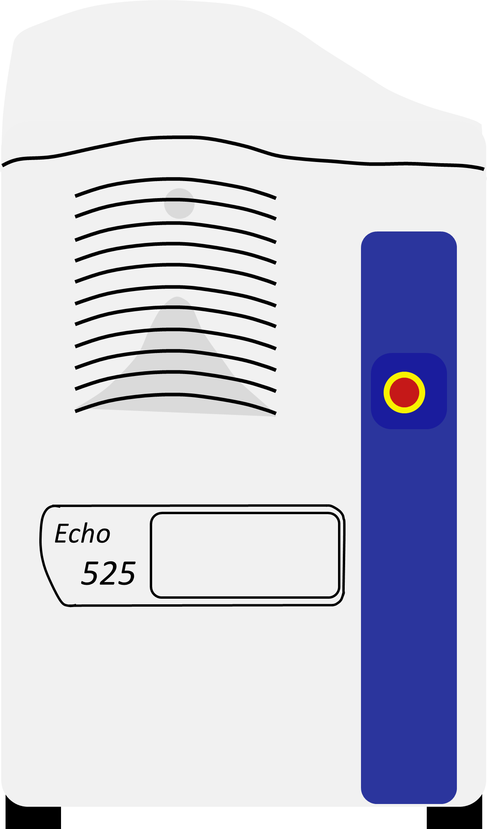

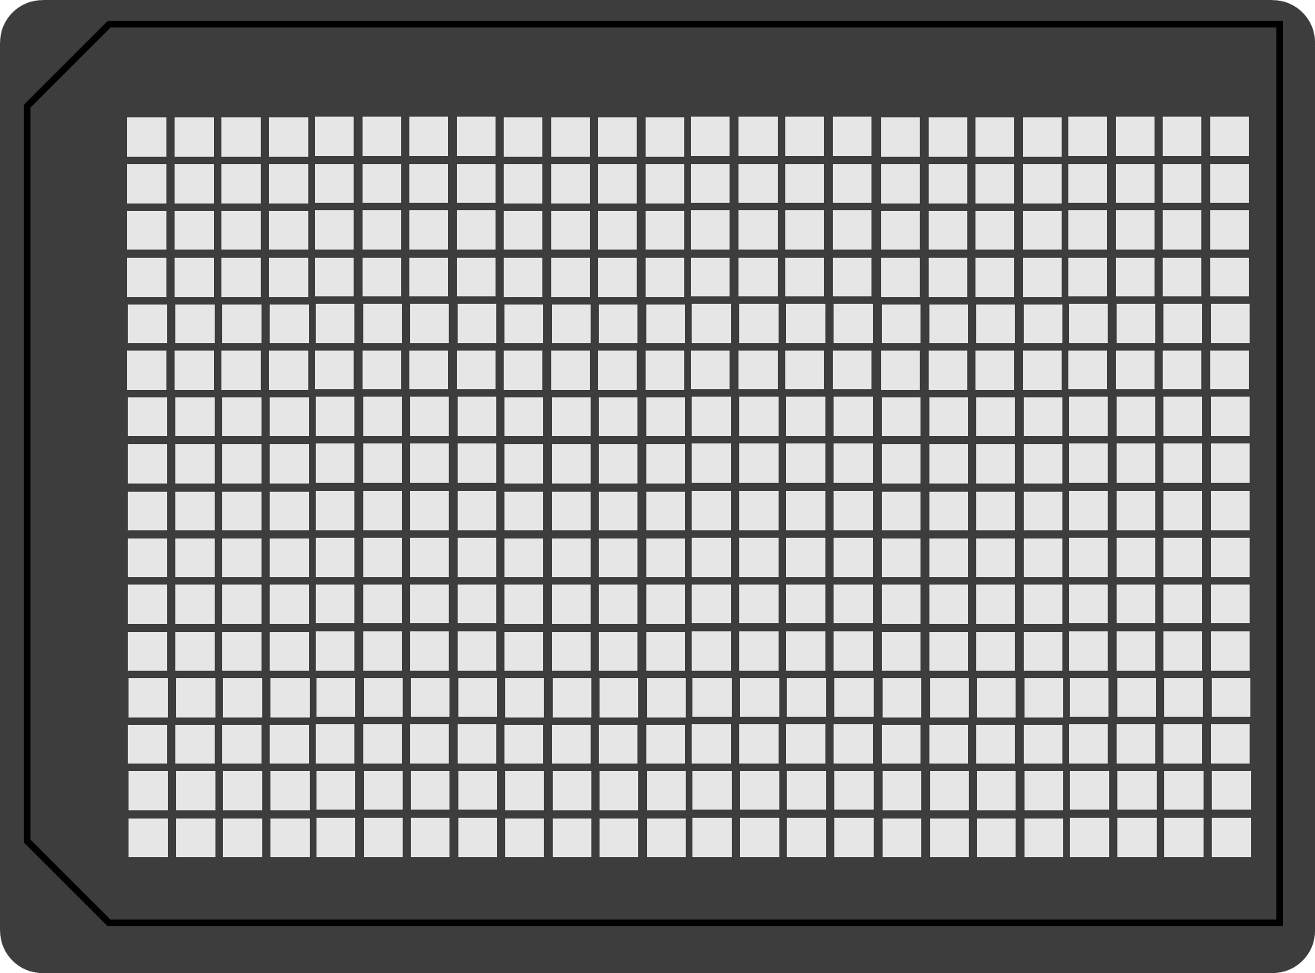
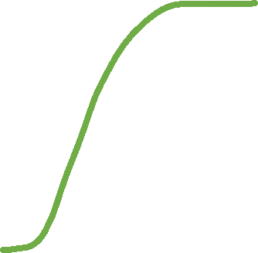
MG
deGFP
MGapt
*
Integrated MG aptamer
Fuel
Mg²⁺
Time
Echo 525 Liquid Handler
deGFP
Maximum deGFP
Time
10µL reactions in 384-well plate
TX-TL reaction mixture

Slide 2
MGapt
Integrated MG aptamer
Time
deGFP
Maximum deGFP
Time

Slide 3
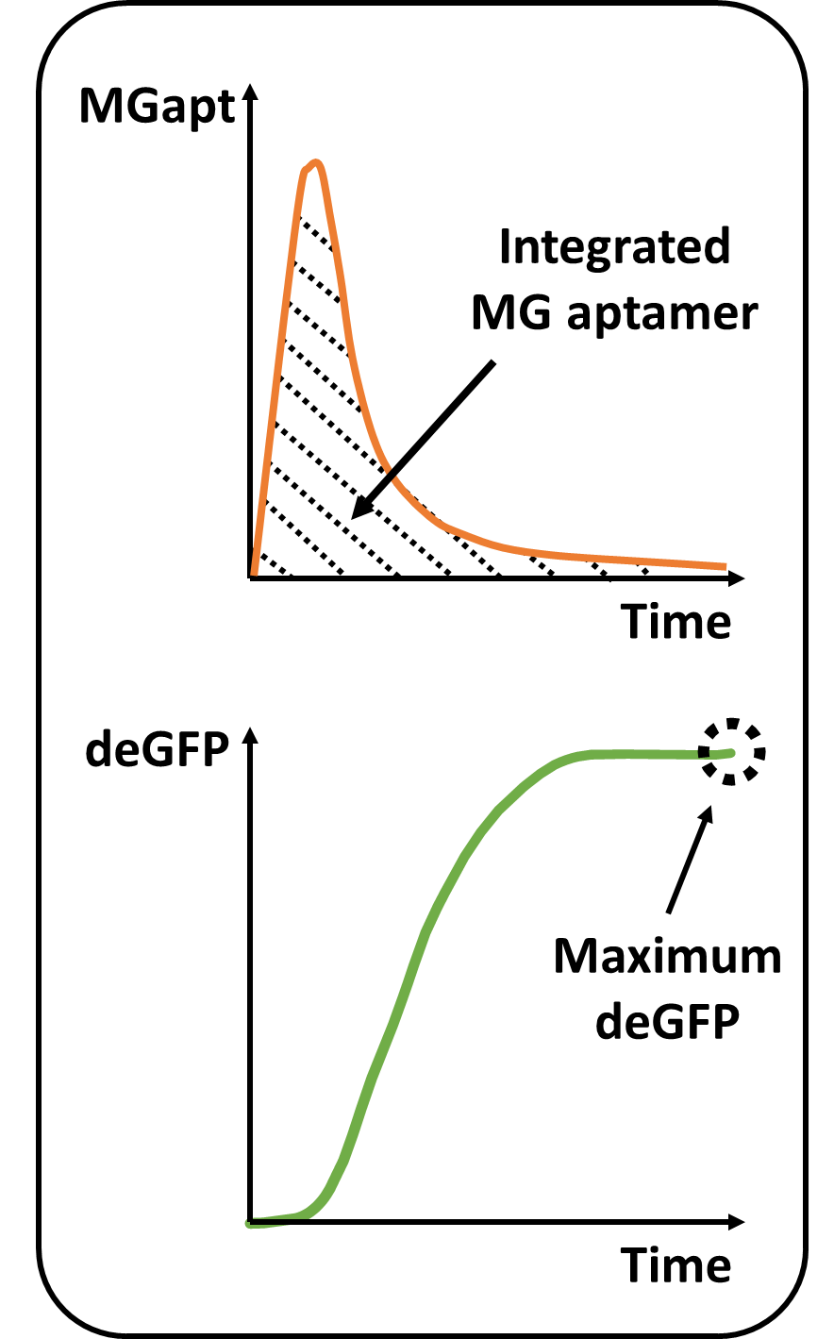
MG
deGFP
*
Fuel
Mg²⁺
Echo 525 Liquid Handler
10µL reactions in 384-well plate
TX-TL reaction mixture

Slide 4

MG
MGapt
deGFP
Integrated MG aptamer
*
Fuel
Mg²⁺
Echo 525 Liquid Handler
Time
deGFP
10µL reactions in 384-well plate
Maximum deGFP
TX-TL reaction mixture
Time

Slide 5
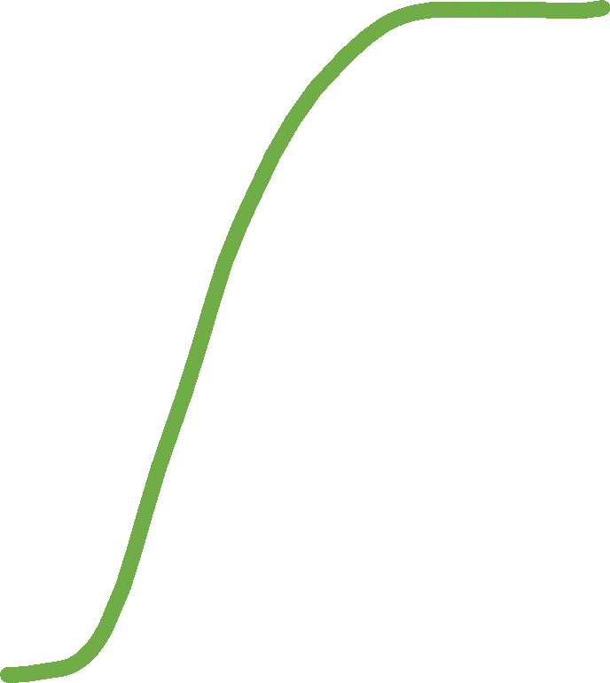
MG
MGapt
Integrated MG aptamer
deGFP
*
Fuel
Mg²⁺
Echo 525 Liquid Handler
Time
deGFP
10µL reactions in 384-well plate
Maximum deGFP
TX-TL reaction mixture
Time

