Slide 1
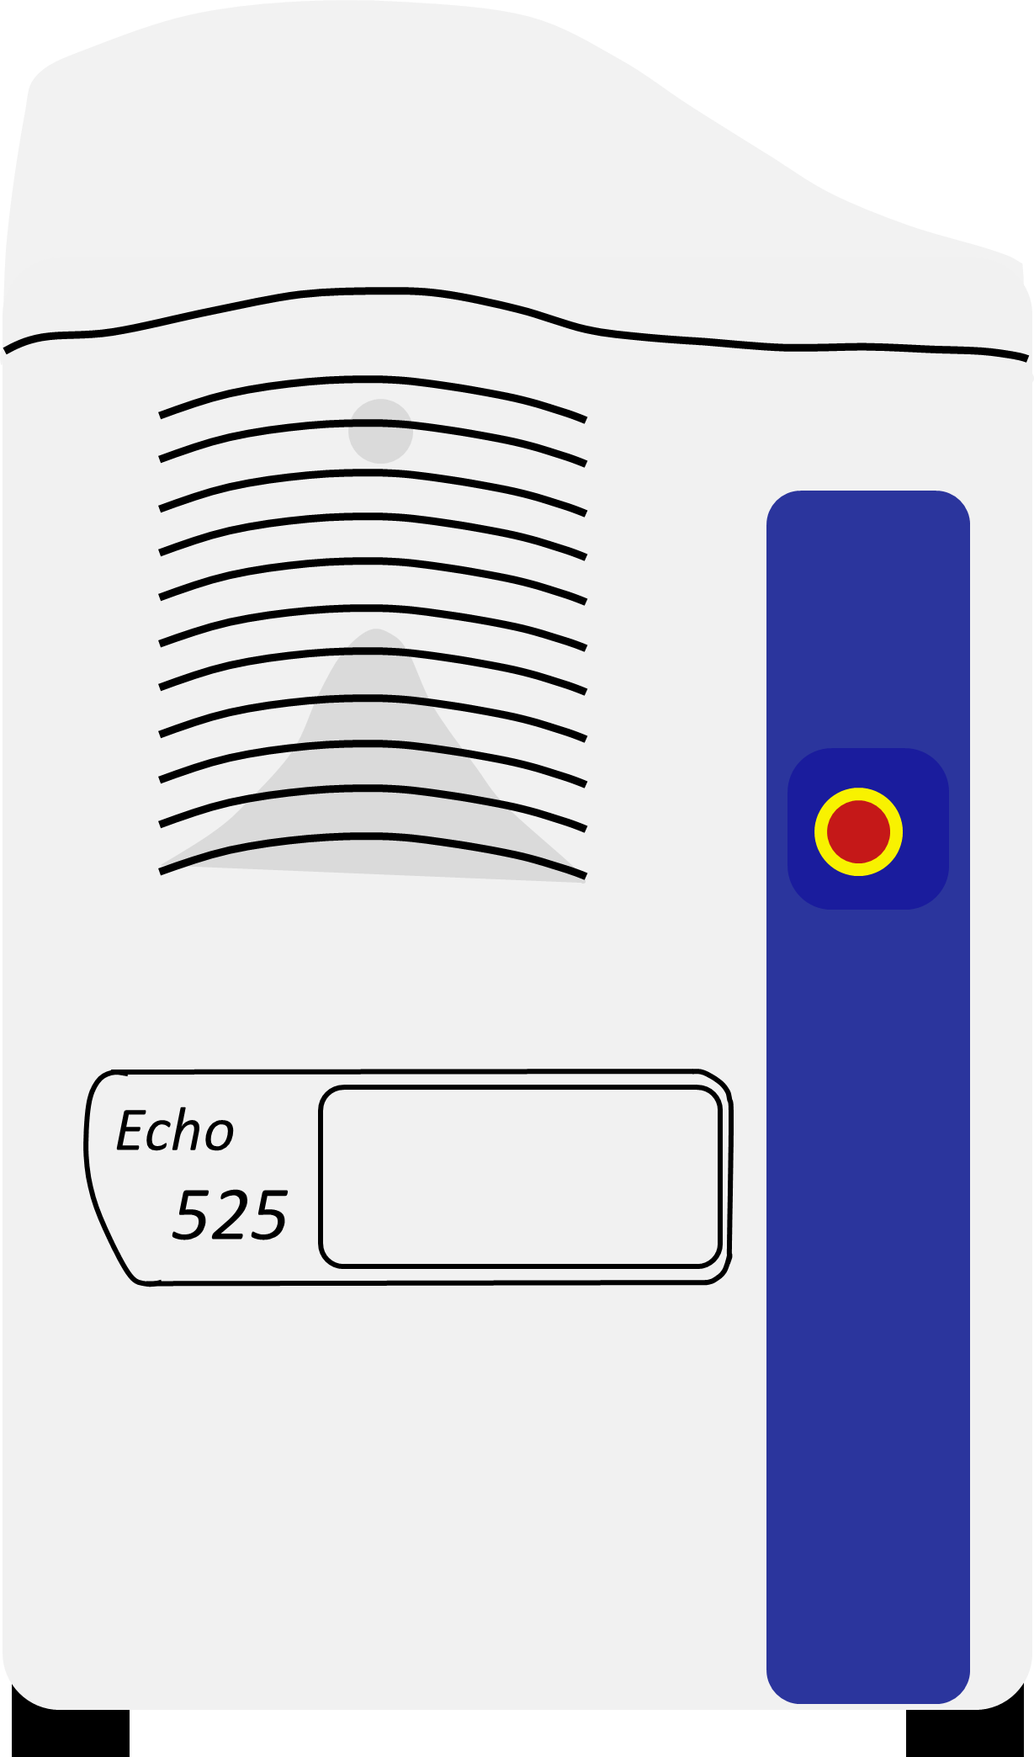

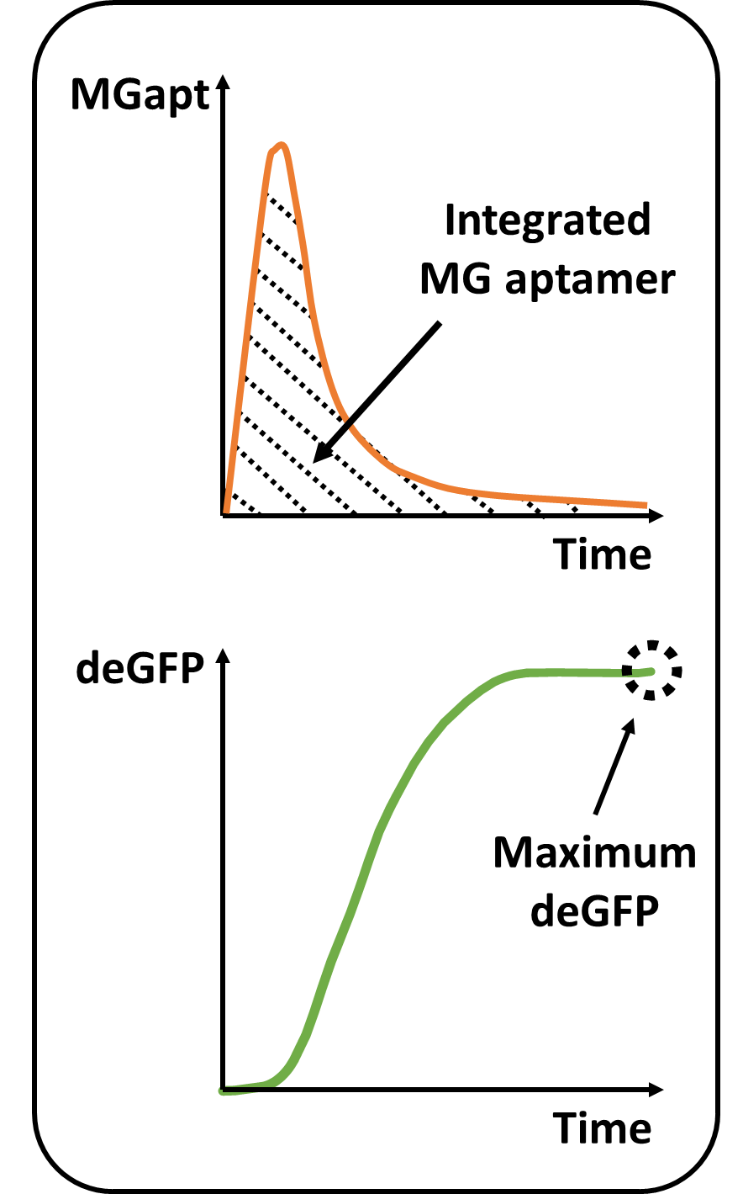
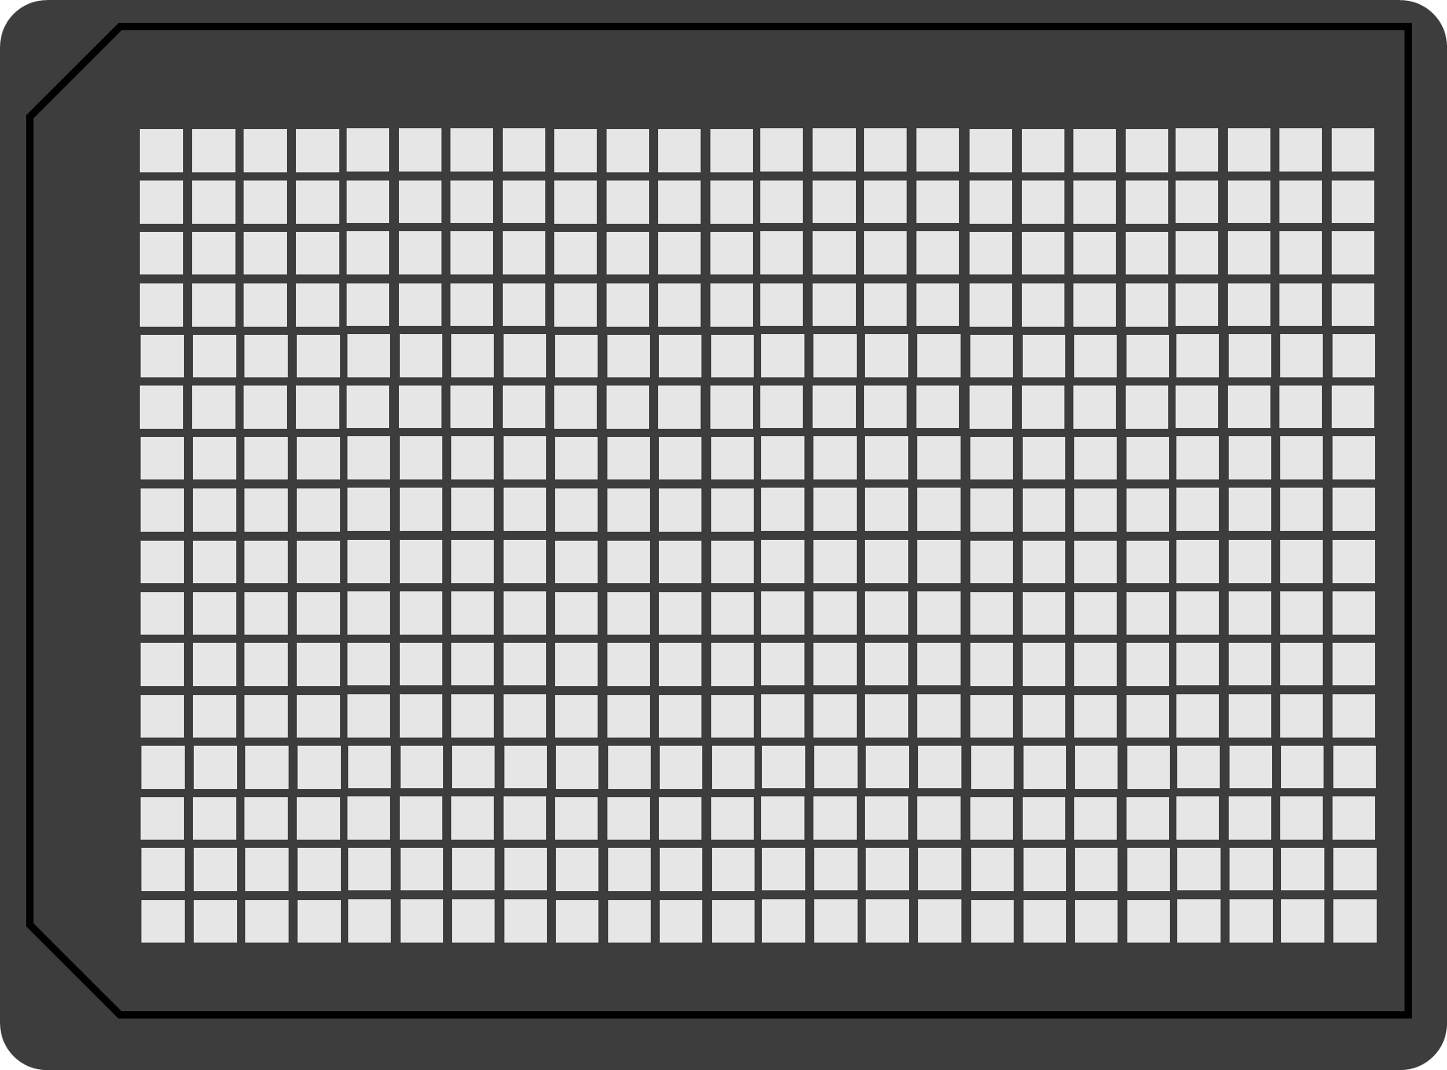
MG
deGFP
*
Fuel
Mg²⁺
Echo 525 Liquid Handler
10µL reactions in 384-well plate
TX-TL reaction mixture

