Slide 1
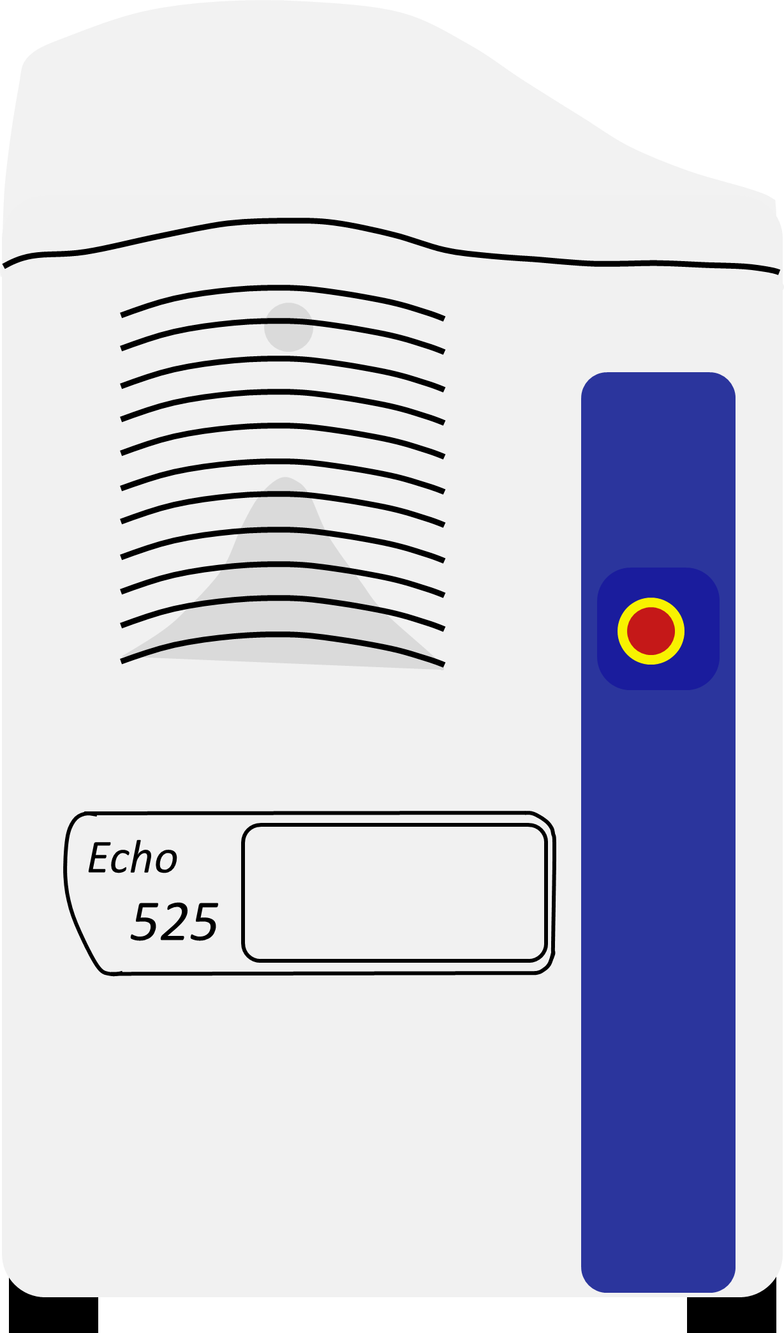

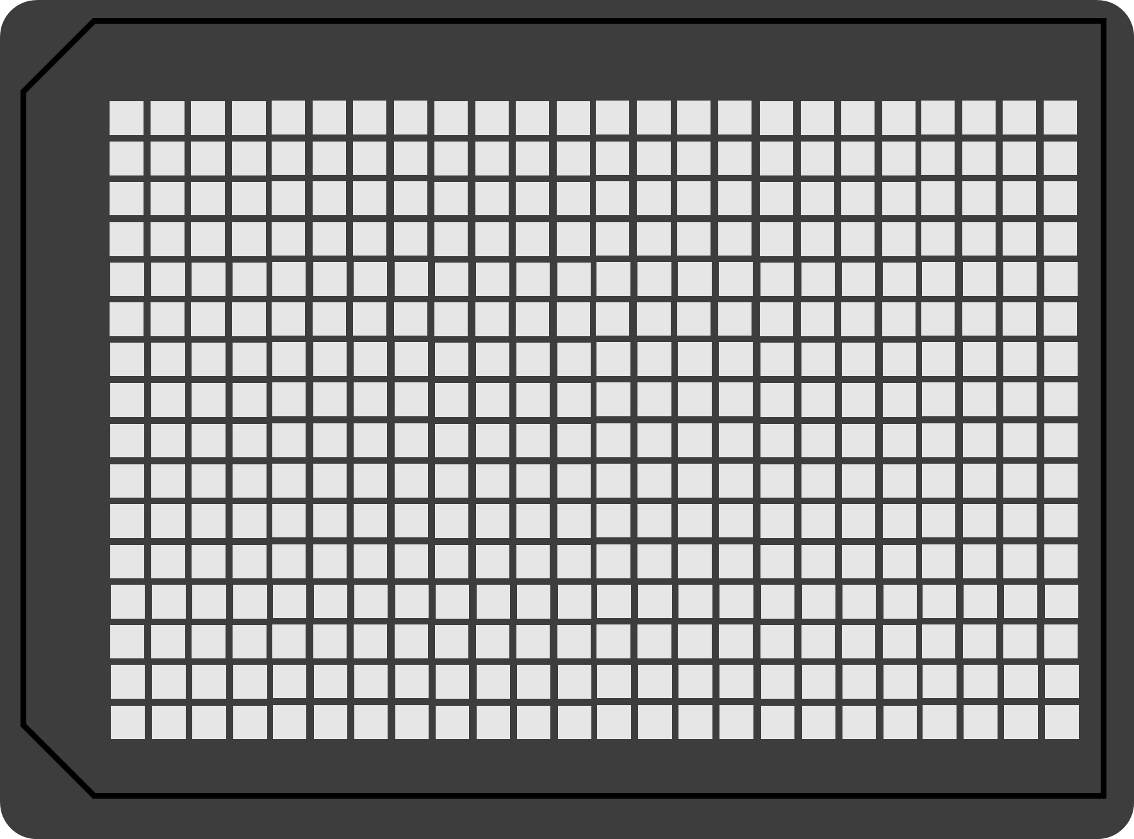
MG
deGFP
ATP
NTPs
GTP
Echo 525 Liquid Handler
10µL reactions in 384-well plate
[NTPs]
[Added ATP]
[Added GTP]
TX-TL reaction mixture

