Slide 1
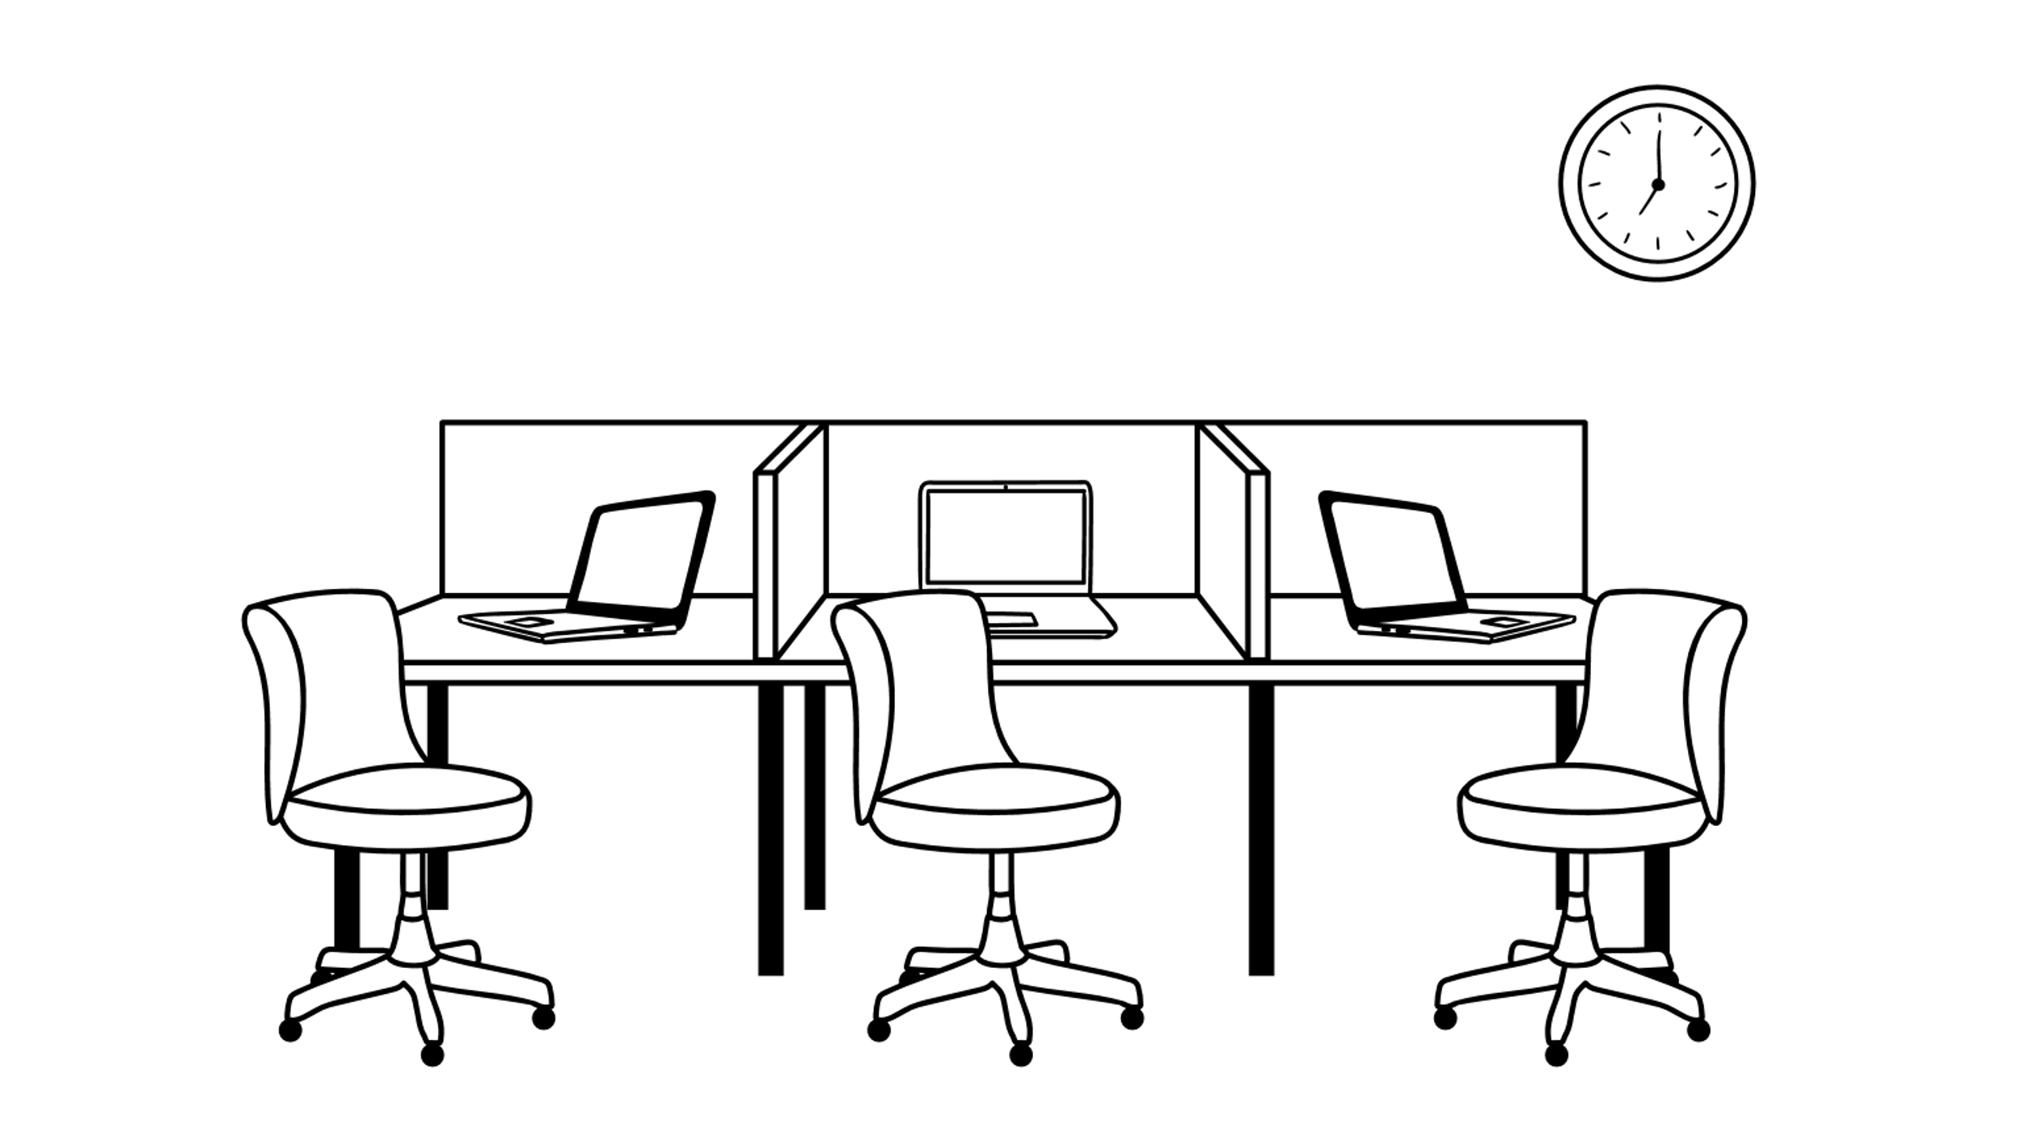










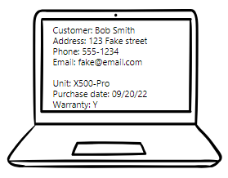
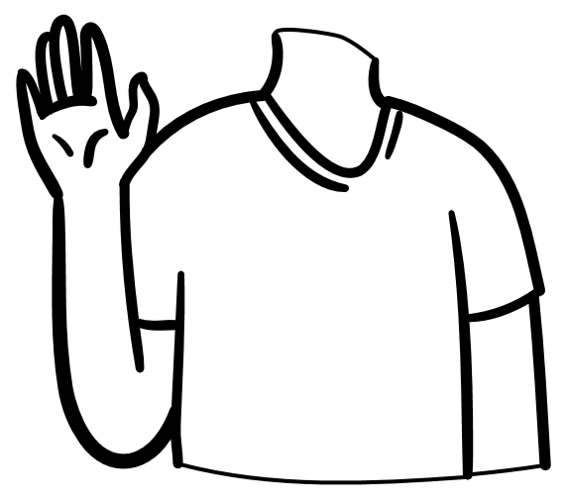



Storyboard
1. A customer walks into Emma's Small Engines and is greeted by an employee.
2. The customer has concerns regarding a previous purchase. They explain their issue to welcome ears.
3. With the newly implemented app the employee quickly locates the customer's information. The intuitive design aids in locating necessary equipment and warranty details.
4. After a brief back and forth a resolution is found. The customer happy not to have spent his whole afternoon in the store leaves with a smile.

