Slide 1

IST769 Advanced Big Data Management
Images are forillustrative purposes only.
School of Information Sciences
Kabir Thakur
Adarsh Shetty Andar
Mugdha Karodkar

Slide 2
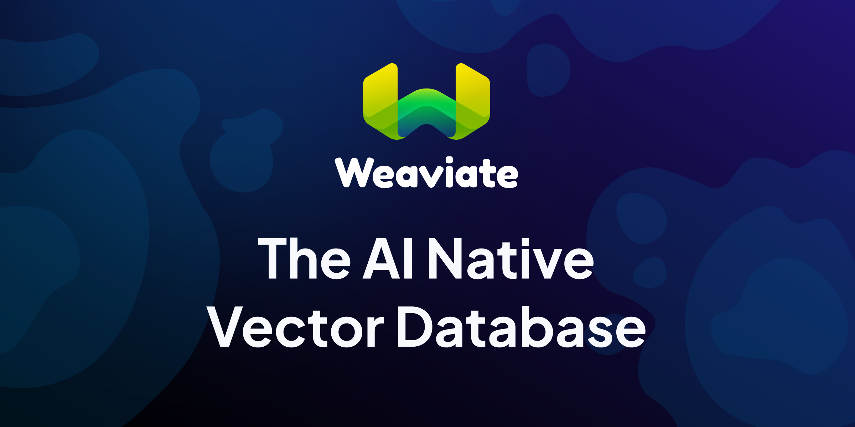
Syracuse University

Slide 3
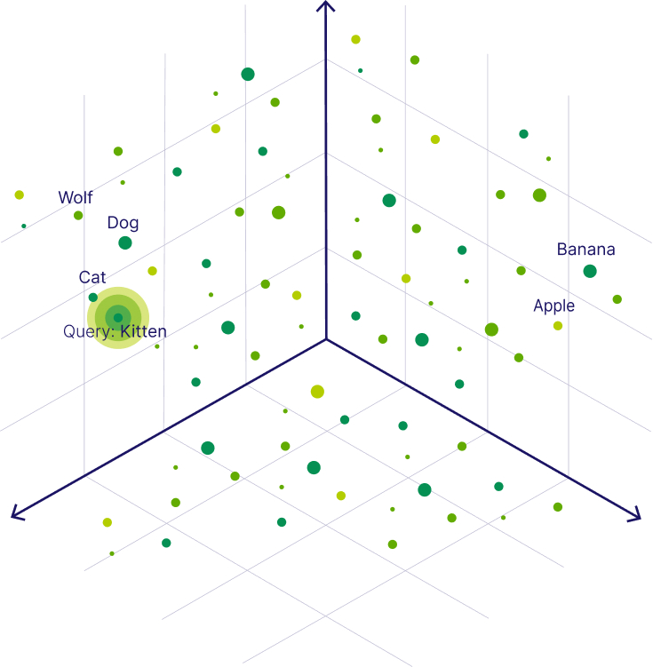
Vector Database
A vector database indexes, stores and provides access to structured or unstructured data alongside it’s vector embeddings.
It allows users to find and retrieve similar objects quickly at scale in production
Vector Embeddings
Vector embeddings list of numbers that can capture the semantic meaning of text
Vector Search
Vector embeddings allow us to find and retrieve similar objects from the vector database by searching for objects that are close to each other in the vector space, which is called vector search, similarity search, or semantic search.
Syracuse University

Slide 4
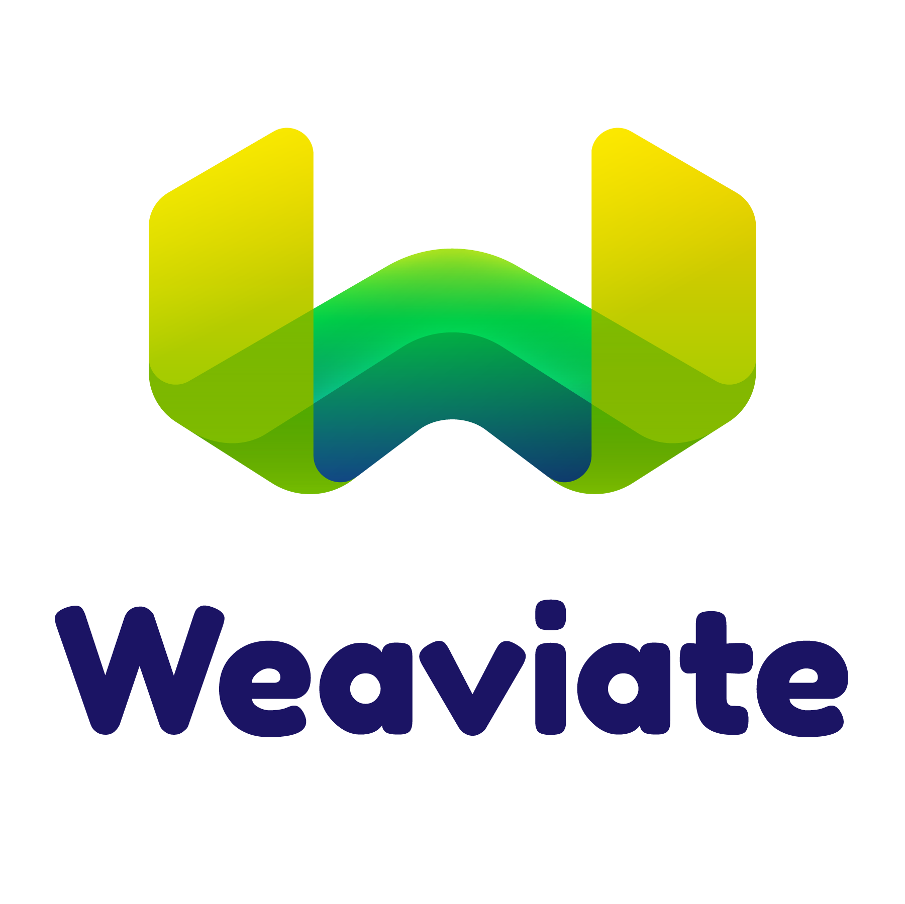
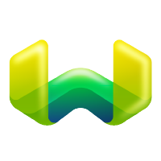
Weaviate in a nutshell:
Weaviate is a fast open-source vector database.
Weaviate allows you to store and retrieve data objects based on their semantic properties by indexing them with vectors.
Weaviate can be used stand-alone (aka bring your vectors) or with a variety of modules that can do the vectorization for you and extend the core capabilities.
Weaviate has a GraphQL-API to access your data easily.
Fast Queries
Vector + Scalar Search
Horizontally scalable
Real Time and Persistant
High
Availability
Any Media (Text/images)
Supports GraphQL
Syracuse University
Notes:
Fast queries
Weaviate typically performs nearest neighbor (NN) searches of millions of objects in considerably less than 100ms. You can find more information on our benchmark page.
Ingest any media type with Weaviate Modules
Use State-of-the-Art AI model inference (e.g., Transformers) for accessing data (text, images, etc.) at search-and-query time to let Weaviate manage the process of vectorizing data for you - or provide your own vectors.
Combine vector and scalar search
Weaviate allows for efficient, combined vector and scalar searches. For example, "articles related to the COVID-19 pandemic published within the past 7 days." Weaviate stores both objects and vectors and ensures the retrieval of both is always efficient. There is no need for a third-party object storage.
Real-time and persistent
Weaviate lets you search through your data even if it's currently being imported or updated. In addition, every write is written to a Write-Ahead-Log (WAL) for immediately persisted writes - even when a crash occurs.
Horizontal Scalability
Scale Weaviate for your exact needs, e.g., maximum ingestion, largest possible dataset size, maximum queries per second, etc.
High-Availability
Is on our roadmap and will be released later this year.
Cost-Effectiveness
Very large datasets do not need to be kept entirely in-memory in Weaviate. At the same time, available memory can be used to increase the speed of queries. This allows for a conscious speed/cost trade-off to suit every use case.
Graph-like connections between objects
Make arbitrary connections between your objects in a graph-like fashion to resemble real-life connections between your data points. Traverse those connections using GraphQL.

Slide 5
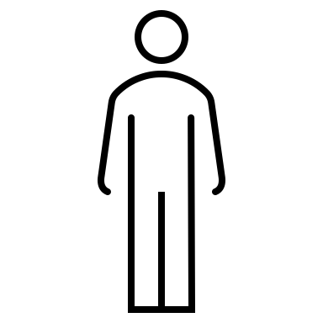

Models
Define the logical and physical storage model of Weaviate
Physical Model
Shards: Each collection is physically stored as one or more shards. A shard contains:
Object Store (key-value store for object data)
Inverted Index (for text search)
Vector Index (HNSW for vector search)
Efficient Storage
Vector Index is independent for high-performance vector queries
Vector Support
Multiple named vector representations per object
Separate indexes, compression, and vectorizers for each vector
Logical Model
Data Structures: Each data object in Weaviate belongs to a collection and has one or more properties.
Relationships: data objects can be related by cross references.
Indexing and Querying: Employs inverted indexes for full-text search and nearest neighbor search for vector data.
Schema Definition: Defined with a GraphQL-like syntax, accommodating both traditional and vector data types.
Syracuse University

Slide 6
Horizontal Scaling
Tell me how Weaviate scales
Tell me how Weaviate scales
Weaviate scales horizontally by running on multiple nodes in a cluster. Here's how
Sharding
To handle larger datasets that exceed the capacity of a single node, Weaviate shards the data across multiple nodes in a cluster.
Each class (collection) is divided into multiple shards, and these shards are distributed across the nodes.
Weaviate automatically orchestrates data import and queries across the sharded nodes.
Users only need to specify the desired shard count for a class during setup.
Replication
For high availability and fault tolerance, Weaviate can replicate class shards across multiple nodes.
If a node fails, the replicated shards on other nodes can continue serving queries.
Replication also enables zero-downtime updates and maintenance.
Users specify the desired replication factor to enable this feature.
Syracuse University
Notes:
Weaviate is NOT OLAP or OLTP. It’s strength lies at querying vectors with a similarity search and it not meant to handle Weaviate also does not support OLAP operations:It is not optimized for complex analytical queries and reporting over large volumes of historical data, which is the primary purpose of OLAP systems. It is not optimized for handling a high volume of transactional operations like insertions, updates, and deletions of individual records.

Slide 7
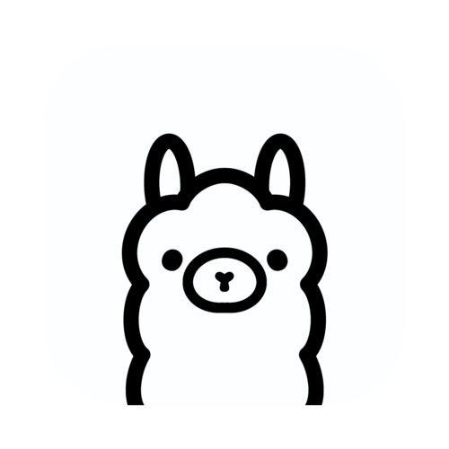
Implementing RAG
Retrieval-Augmented Generation (RAG) is a technique that enhances the accuracy and reliability of large language models (LLMs) by allowing them to retrieve and incorporate relevant information from external sources like a vector database during the generation process.
For this project our goal is to store information about course syllabus into Weaviate so that when a student asks a questions about the course, the right course information is pulled from Weaviate and pushed into the language model for answers.
Prompt : Which course teaches me about artificial intelligence?
[-1.45, 3.23,…]
Top n responses
Search for vectors similar to question vector
CIS 467/667: Introduction to Artificial Intelligence
Syracuse University

Slide 8
Implementation
We can use weaviate-client to connect to our Weaviate docker container running locally.
The spark jar “io.weaviate:spark-connector_2.12:1.3.2” enables our spark session to talk to Weaviate database.
We start with using the Weaviate client to create a custom schema. We created a custom schema with courseName, courseDescription etc and chose to vectorize the course description column.
We can choose to bring our own vectors which is what we would be doing for this project. To build the vectors I used the distil-bert-base-uncased model which is very lightweight.
We push the data and vectors to Weaviate using PySpark.
We then generate the vectors for our question and run a similarity search using near_vector query mode of Weaviate.
Syracuse University

Slide 9
Reflection
What we learnt
How to containerize images and ensure that the versioning is correct.
Dockerhub does not support the latest images for jupyterhub!
Finding the right jars from maven.
We learnt a lot about how vector databases (Weaviate in particular) work.
Designing the schema for a RAG model requires careful consideration of what information would be queried by the user.
Vector similarity searches don’t always work as expected when using simple custom models. Using inbuilt models would be good and using OpenAI embeddings would be great. In essence similarity search depends on the quality of vectors.
Syracuse University

Slide 10
Improvements
This project can be a nice end-to-end project where we also run a containerized version of Ollama.
Essentially a student would be able to talk to the LLM running on Ollama and ask questions about the courses they can take, what faculty takes those course, what are the office hours for that faculty.
We only showed one way to query the database using near_vector format. However, there are many other ways to query data in Weaviate depending on the use case.
We can event create different collections for faculty or departments and form relationships by cross referencing for a more complicated design.
Syracuse University

Slide 11
References
https://weaviate.io/developers/weaviate/introduction
https://weaviate.io/developers/weaviate/quickstart
https://weaviate.io/developers/weaviate/concepts/data
https://weaviate.io/developers/weaviate/tutorials/spark-connector
https://weaviate.io/developers/weaviate/starter-guides/schema
Syracuse University

