Slide 1
Meeting – 22/5/2022
Non-modal (Transient) Growth (TG)
Eigenfunction basis
What is SVD?
Why SVD?
Reynolds-Orr equation
Orr mechanism
Lift-up mechanism
Additional reading
Trefethen & Bau – Numerical Linear Algebra (SVD)
Schmid & Henningson (TG)

Slide 2
Non-modal (Transient) Growth
Modal analysis actually describes an asymptotic response (long time)
General response of a linear system
The solution is
The transient response is the solution behavior at short times
Eigensolutions
Decompose I.C.

Slide 3
Eigenfunction basis
In fact, the response is analyzed by moving to the ‘eigenfunction basis’
In the ‘eigenfunction basis’ the coefficients respond independently
In matrix form , where e^{A} is a matrix exponential (expm)

Slide 4
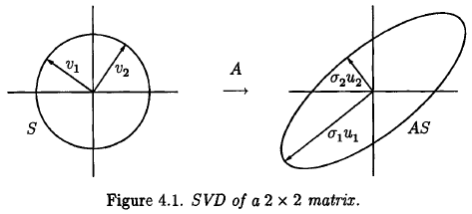
What is SVD?
The singular value decomposition (SVD) is a useful factorization of matrix A
Given a unit sphere ‘S’, the image of the unit sphere, AS, is a hyperellipse
The singular values of A are the principal semiaxes of the hyperellipse, these are σ₁, σ₂ …(usually numbered in decreasing order)
The left singular vectors, u₁, u₂ …, are unit vectors along the principal axes
The right singular vectors, v₁, v₂ …, are the (unit) preimages of u₁, u₂
u_{j} are orthonormal
v_{j} are orthonormal

Slide 5
What is SVD?
Rewrite
σ – singular values
V – right singular vectors
U – left singular vectors
U and V are unitary matrices (U⁻¹=U*, V⁻¹=V*) where * is the Hermitian (conjugate) transpose

Slide 6
Why SVD?
Allows moving to a diagonal basis: if b’=U*b and x’=V*x then b=Ax ⇔ b’=Σ x’ which can be helpful when solving for x (calc b’, then x’, then x)
But, the real power of SVD is low-rank approximation – each singular value captures as much of the “energy” of A as possible, where “energy” can represent some norm (usually L₂-norm) e.g. what is the best approximation of a 2-d ellipse by a line? longest axis what is the best approximation of an ellipsoid by a 2-d ellipse? σ₁ and σ₂ in general, each step we add the largest remaining axis

Slide 7
Reynolds Orr eq.
This is an equation for the disturbance kinetic energy in a volume V
Nonlinear terms zero-out, implying that they do not generate energy, only redistribute it between different wavelengths
What is the disturbance leading to the largest (transient) energy growth?

Slide 8
Transient growth (1)
What is the disturbance maximizing the energy gain at some target time t?
where F is the Cholesky factorization (chol) of the symmetric matrix M
and M is the energy norm matrix, given by M_{i,j}=(q_{i},q_{j}), thus

Slide 9
Transient growth (2)
What is the disturbance maximizing the energy gain at some target time t?
The answer is given by the SVD of the right-hand-side
There exists an energy stability Reynolds number, below which no growth occurring at all
Monotonic decay
Transient growth

Slide 10
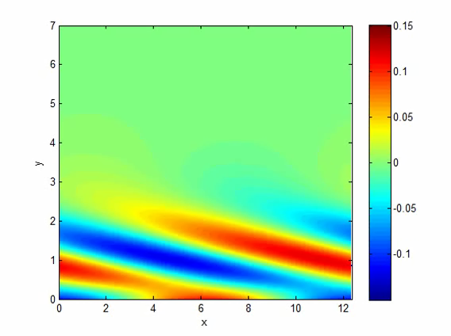
Two-dimensional transient growth (1)
We take a two-dimensional disturbance with some α
Orr mechanism, due to tilting of vortices by the shear

Slide 11
Two-dimensional transient growth (2)
Optimal growth envelope, and few representative i.c.

Slide 12
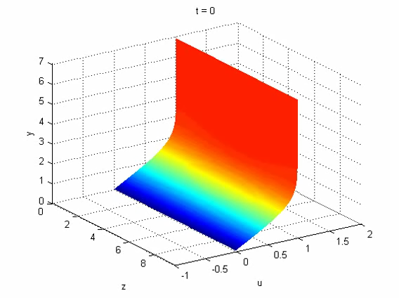
Lift-up mechanism (1)
Now let us take a streamwise independent disturbance, α=0, with some β
This is a very efficient growth mechanism, since cross-stream velocity v₀ leads to u=O(Re v₀)
y
x
z

Slide 13
Lift-up mechanism (2)
y
+
-
+
-
x
z
y
z
x

Slide 14
Lift-up mechanism (3)
Linearized equations (streamwise independent)
Cross-stream components decay, while energizing streamwise component

Slide 15
Lift-up mechanism (4)
Optimal growth envelope, and few representative i.c.

Slide 16
General three-dimensional cases

Slide 17
Extensions
Spatial TG, for some (ω,β)
Compressible flows (many ways to define energy)
Curved surfaces (effect of centrifugal force, relation to Gortler vortices)

