Slide 1
MPW Financial Corporation
By
Michael Ward

Slide 2
The Problem:
Confidently match two inputted names to the same individual to determine if the person is likely to be a sanctioned individual and stop the payment if necessary.
Notes:
MPW Financial Corporation is a Fintech company that processes payment transactions. The company needs to identify whether a person listed on a financial transaction is the same individual that is documented on government sanctions lists in order to prevent payments related to drug cartel members, weapons dealers, terrorist organization members, etc. Programmatic comparisons of individuals' names is a very difficult business problem.

Slide 3
The Solution:
Create a machine learning model that confidently predicts whether a pair of first and last names are the same based on fuzzy variations
Notes:
People can enter their names in different formats. For example, they can use shortened names such as “Mike” for “Michael”. People also have hyphenated surnames and could use a portion of the surname. In Latin and Arabic populations, it is common to have multiple first names and last names such as “Jose Miguel Castillo Diaz” and they may only enter a portion of their name such as “Miguel Diaz”. There is also the possibility of misspellings, transposed letters, etc.

Slide 4
Data Wrangling
Real and synthetic data used
Real data labeled as match / no match based on FuzzyWuzzy similarity score
Drop rows with missing names, numeric names, and duplicate keys
Synthetic data first name pairs combined with common last names for match records
Synthetic names copied and shuffled for no-match records
Target Variable: is_match
Original datasets had ~450,000 name pairs including first and last names with fuzzy variations
Data Sources
Real Data: (confidential)
Synthetic Data: https://github.dev/Christopher-Thornton/hmni & https://github.com/arineng/arincli/blob/master/lib/last-names.txt
Notes:
I was able to obtain a file of real names from an actual company’s transactions. The names were joined with other transactions based on a common hashed key. The names were filtered where either the first names or last names did not match. This data is confidential and is not uploaded to GitHub or exposed in the notebooks.
I also created a file of synthetic names to be used in the analysis which are not confidential. The first names were obtained from a GitHub repository https://github.dev/Christopher-Thornton/hmni. This file has a list of over 17,000 first name pairs which has the first name as well as alternative variations of each name. I was also able to obtain a file of common last names from a GitHub repository https://github.com/arineng/arincli/blob/master/lib/last-names.txt. I combined these files to create a dataset of name pairs which includes the first name, alternative variation, and last name.

Slide 5
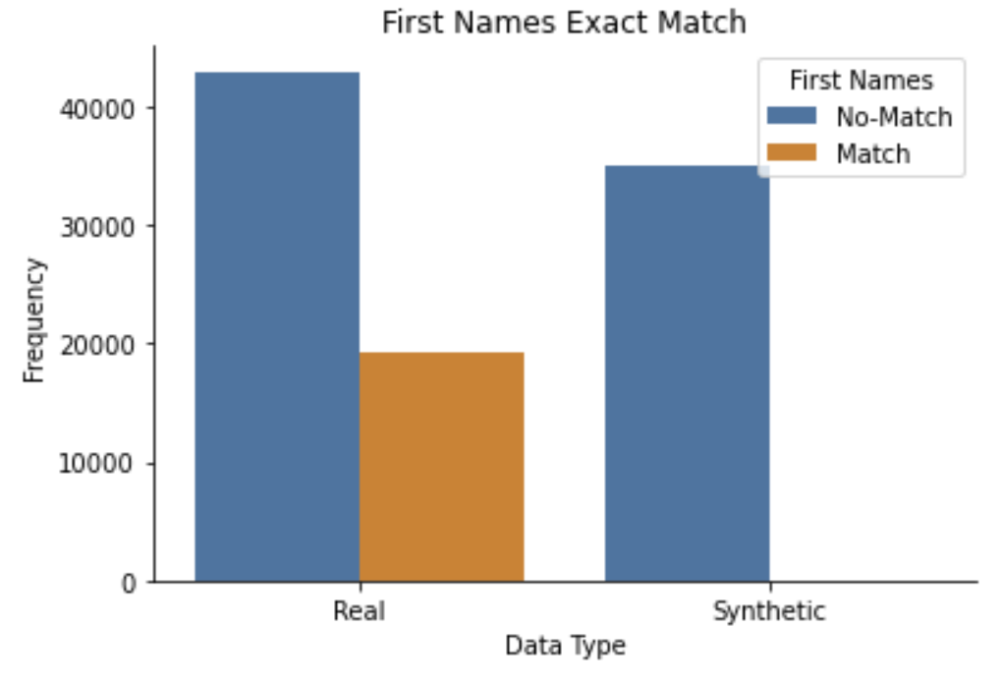
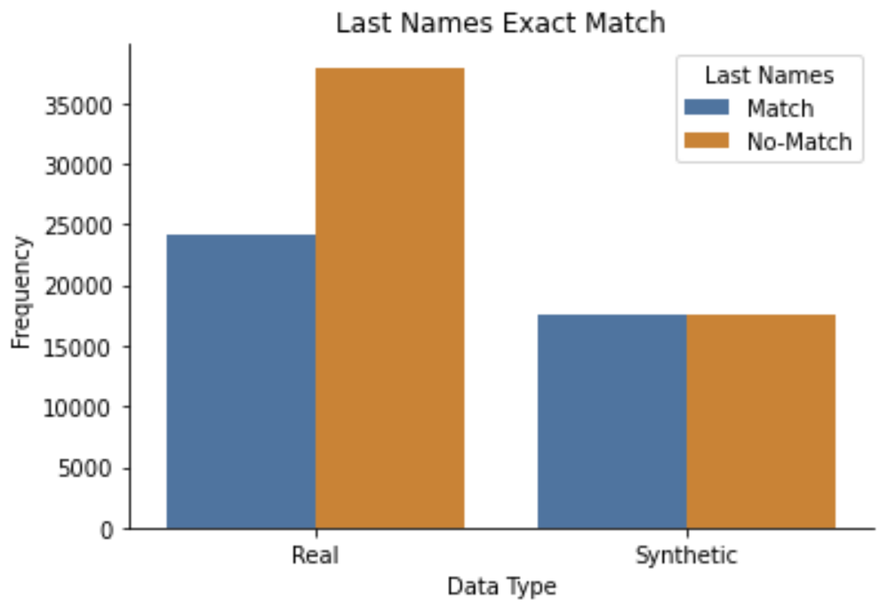
Exploratory Data Analysis
Exact matches on first or last names
Notes:
The synthetic data does not have any first name matches as the match records were duplicated and then the names shuffled. Most the real data have first names that do not match. In the cases where the real data first names do match, the last names should not be exact matches. The synthetic data has exactly the same number of matches and no matches. This is because the matches only contain variations of first names. Most the real data have last names that do not match. In the cases where the real data last names do match, the first names should not be exact matches.

Slide 6
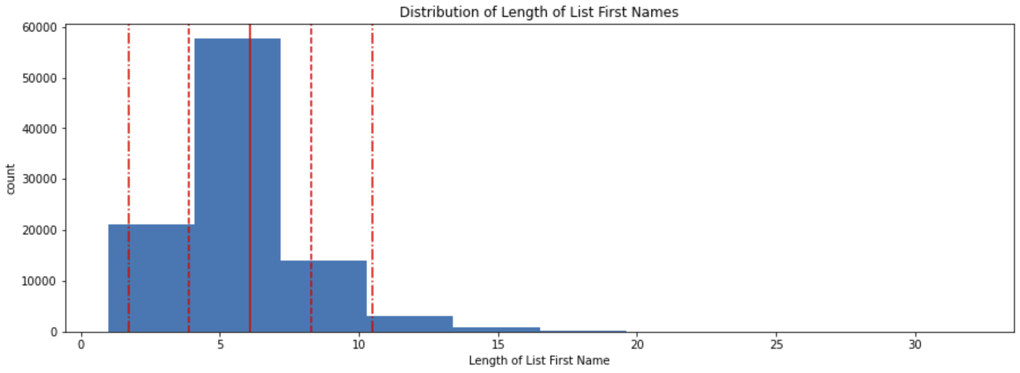
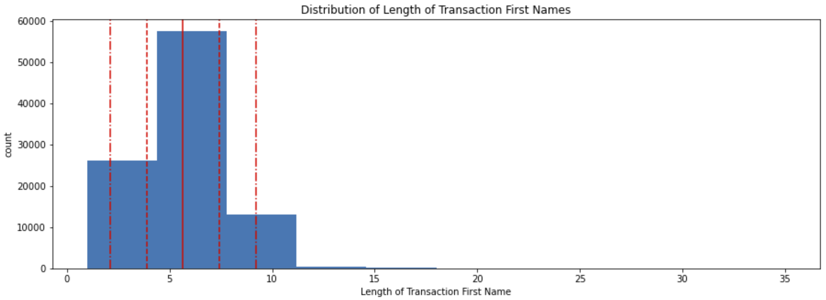
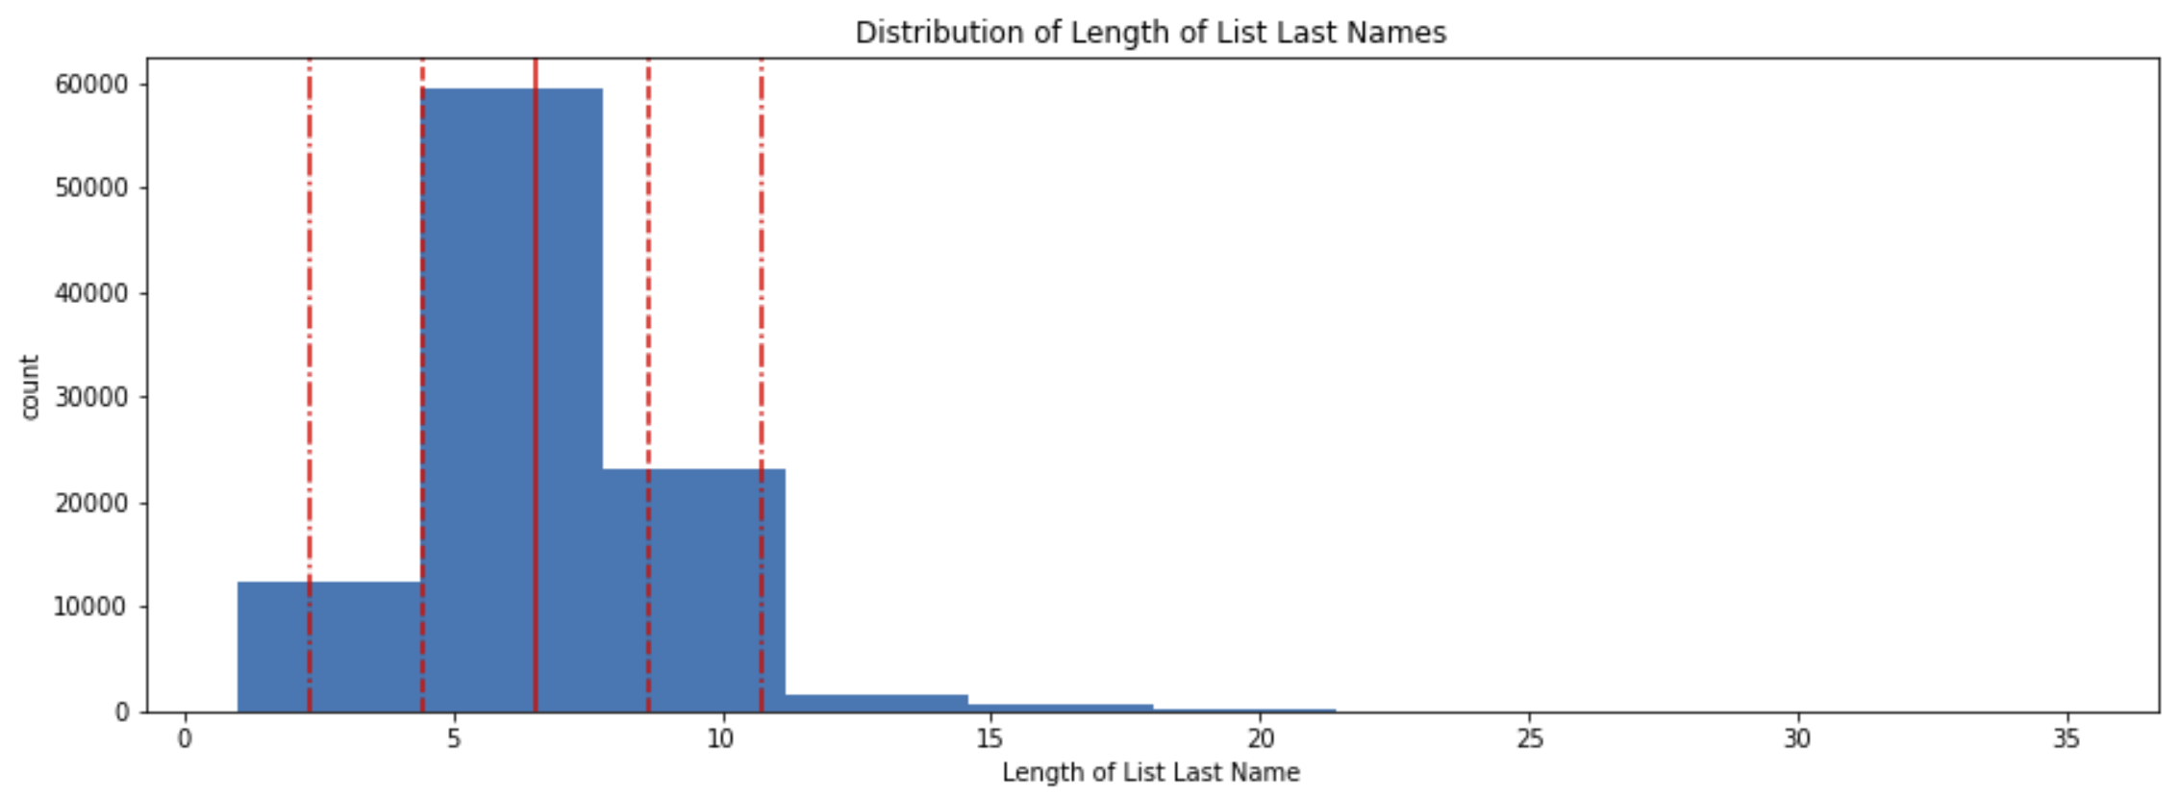
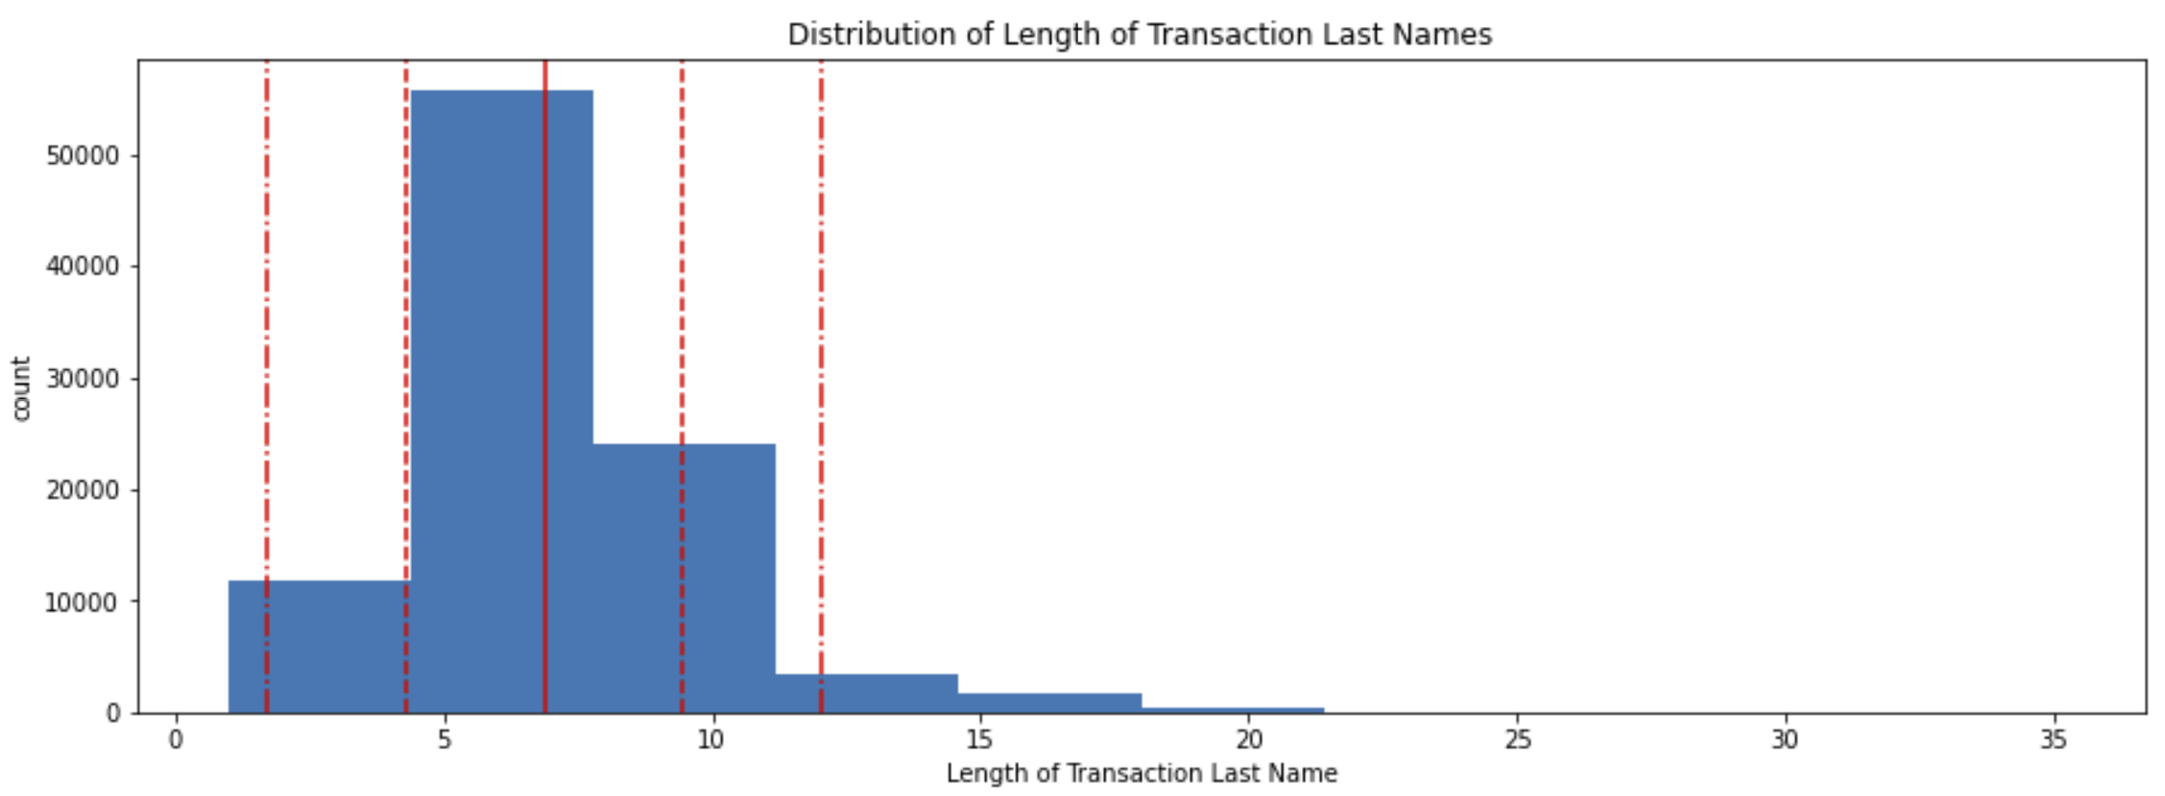
Length of Names
Average length of first and last names are 6-7 characters
Notes:
The length of first names on the list range from 1 (first initial only) to >30 with a mean of 6 letters. The length of first names on the transactions were similar to the list first names with a range from 1 (first initial only) to >30 and a mean of 6 letters.
The length of last names on the list range from 1 (initial only) to >35 with a mean of 6-7 letters. The length of last names on the transactions were similar to the list last names with a range from 1 (initial only) to >35 with a mean of 7-8 letters.

Slide 7
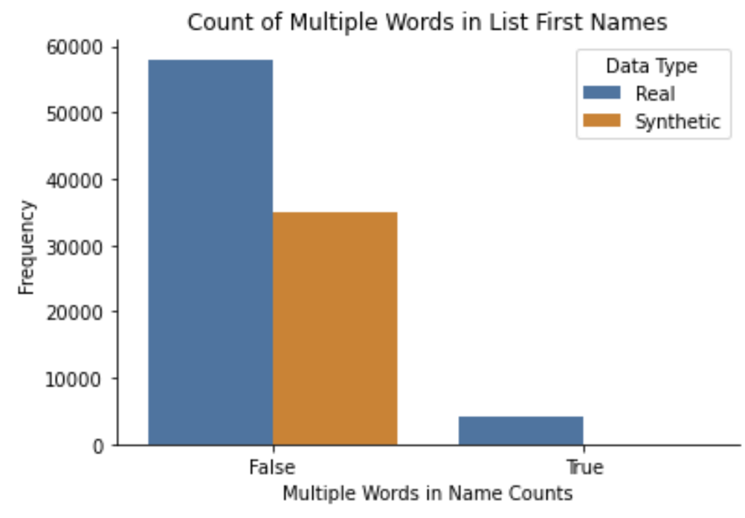
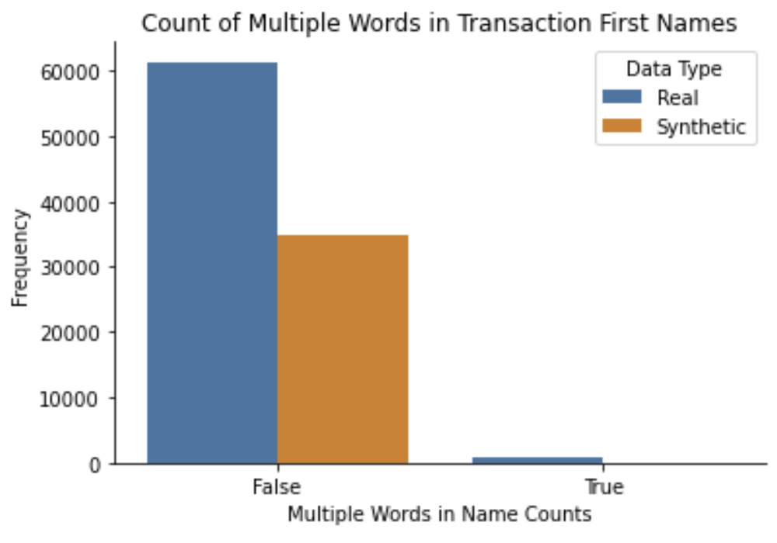
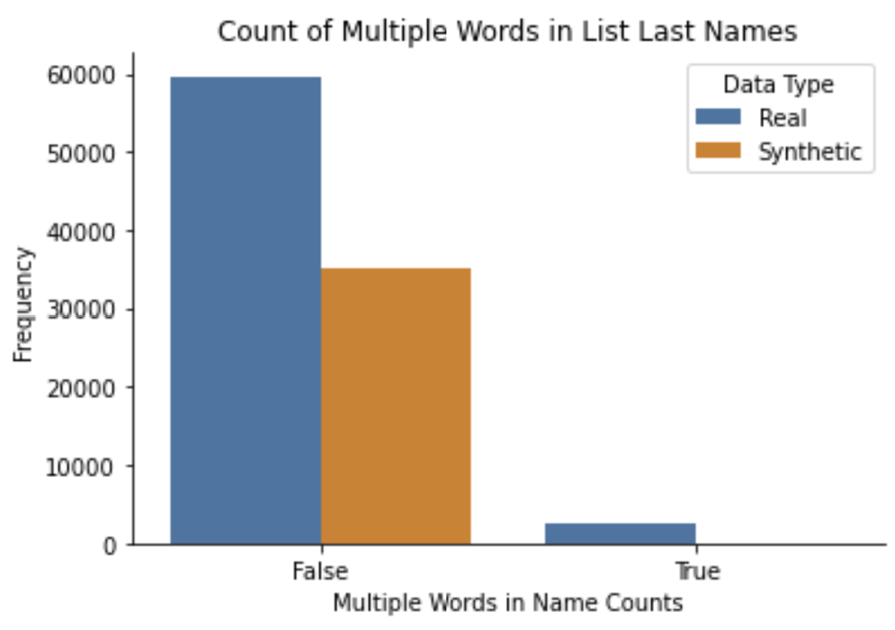
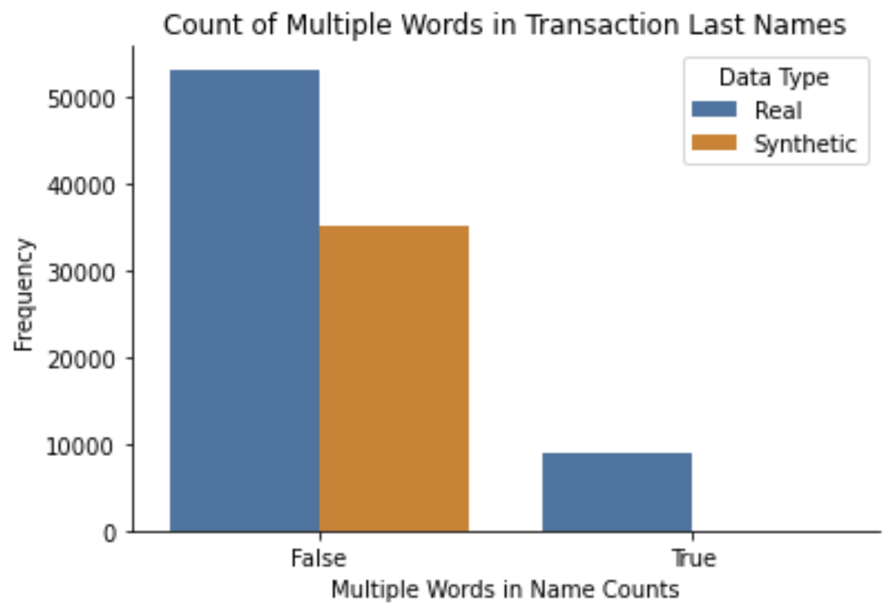
Multiple Words in Names
Notes:
The real data have approximately 4000 first names on the list that contain multiple words. The synthetic data does not have any first names on the list that contain multiple words. The real data have a small number of first names on the transactions that contain multiple words. The synthetic data does not have any first names on the transactions that contain multiple words.
The real data have approximately 2000 last names on the list that contain multiple words. The synthetic data does not have any last names on the list that contain multiple words. The real data have just under 10,000 last names on the transactions that contain multiple words. The synthetic data does not have any last names on the transactions that contain multiple words.

Slide 8
Feature Engineering
Features:
Partial Ratio
Token Sort Ratio
Token Set Ratio
Sum IPA (International Phonetic Alphabet) features
PSHP Soundex First
Iterative Substring
BI-SIM similarity
Discounted Levenshtein
Prefix Distance
Longest Common Substring (LCSstr)
Modified Language-Independent Product Name Search (MLIPNS)
Strcmp95 Distance
Match Rating Algorithm (MRA) Comparison
Editex
Syllable Alignment Pattern Searching (SAPS) Similarity
FlexMetric Distance
Jaro-Winkler Distance
Higuera-Mico contextual normalized edit distance
Sift4 Distance
Eudex Distance
ALINE Distance
Covington Distance
Phonetic Edit Distance
HMNI
Libraries
FuzzyWuzzy
Abydos NLP/IR
HMNI
https://github.com/Christopher-Thornton/hmni
Notes:
In order to engineer features that could be used by the models, numeric features needed to be created based on the first and last names. In order to build these features, I leveraged code from https://github.com/Christopher-Thornton/hmni.
I utilized a “syllables” function to decompose each name into a list of syllables. The FuzzyWuzzy library was then used to convert the syllables into the following features for both the first and last names.
The Abydos NLP/IR library provides phonetic algorithms, string distance measures & metrics, stemmers, and string fingerprinters. This library was used to create the following features for the first and last names.
Finally, I leveraged the HMNI (Hello My Name Is) library to engineer HMNI Similarity features for the first and last names.
I opted to skip the Covington Distance feature because it was taking many hours to create these features.

Slide 9
Model Selection
Target Metric:
Precision
Ranking
Extreme Gradient Boosting Classifier
Logistic Regression Classifier
Decision Tree Classifier
Model | Precision | Recall | ROC / AUC
XGBClassifier | 0.98 | 0.98 | 0.998
LogisticRegression | 0.96 | 0.97 | 0.995
DecisionTreeClassifier | 0.92 | 0.98 | 0.993
Notes:
This project required a classification model as the target feature of “is_match” is a categorical variable. I tested three different models in order to determine which was most useful for this problem.
The metrics that I focused on while training and testing the models was the accuracy scores using precision and recall. I chose this because I wanted to maximize the precision of identifying name matches while also ensuring that the model had high recall.

Slide 10
Hyperparameter Tuning
Extreme Gradient Boosting Classifier
Best Parameters:
n_estimators: 500
max_depth: 10
learning_rate: 0.05
min_child_weight: 1
Randomized Search
5 –Fold Cross Validation
Notes:
In order to optimize the hyper parameters, I used a Randomized Search with 5-fold Cross-Validation. Randomized Search was chosen over Grid Search in order to reduce processing due to the size of the data. The following hyperparameters were tested for each model.
Decision Tree (DecisionTreeRegressor)
Splitter: "best","random"
max_depth: 1,4,8,12
min_samples_leaf: 3,5,7,9
min_weight_fraction_leaf: 0,0.5
max_features: "auto","log2","sqrt",None
max_leaf_nodes: None,10,30,50,70,90
Logistic Regression (LinearRegression)
logspace: -4, 4, 20
Extreme Gradient Boosting (XGBRegressor)
n_estimators: 10, 50, 100, 500, 1000
max_depth: 2, 3, 5, 10, 15
learning_rate: 0.05, 0.1, 0.15, 0.20
min_child_weight: 1, 2, 3, 4

Slide 11
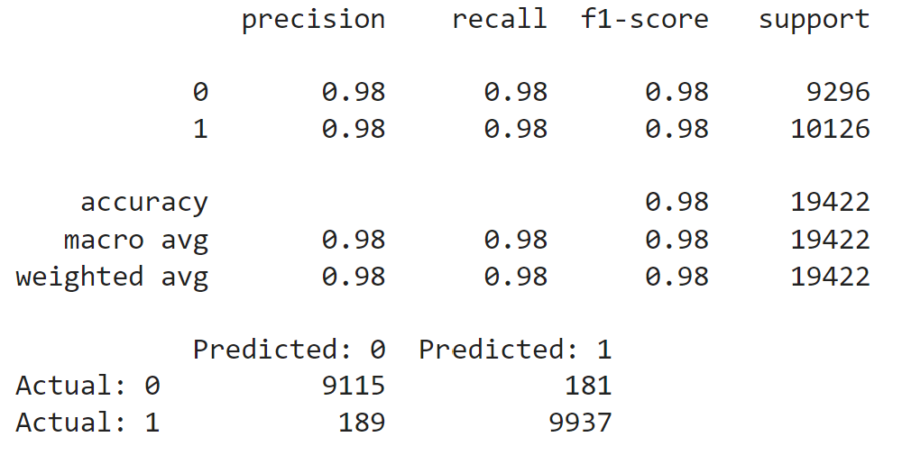
Best Model: Extreme Gradient Boosting
Model predicted matching names with 98% accuracy
Notes:
I decided to select the Extreme Gradient Boosting (XGB) model with the following hyperparameters as this resulted in the highest precision (0.98), recall (0.98), ROC/AUC score (0.998).
n_estimators: 500
max_depth: 10
learning_rate: 0.05
min_child_weight: 1
The XGB model predicted matching names with 98% accuracty

Slide 12
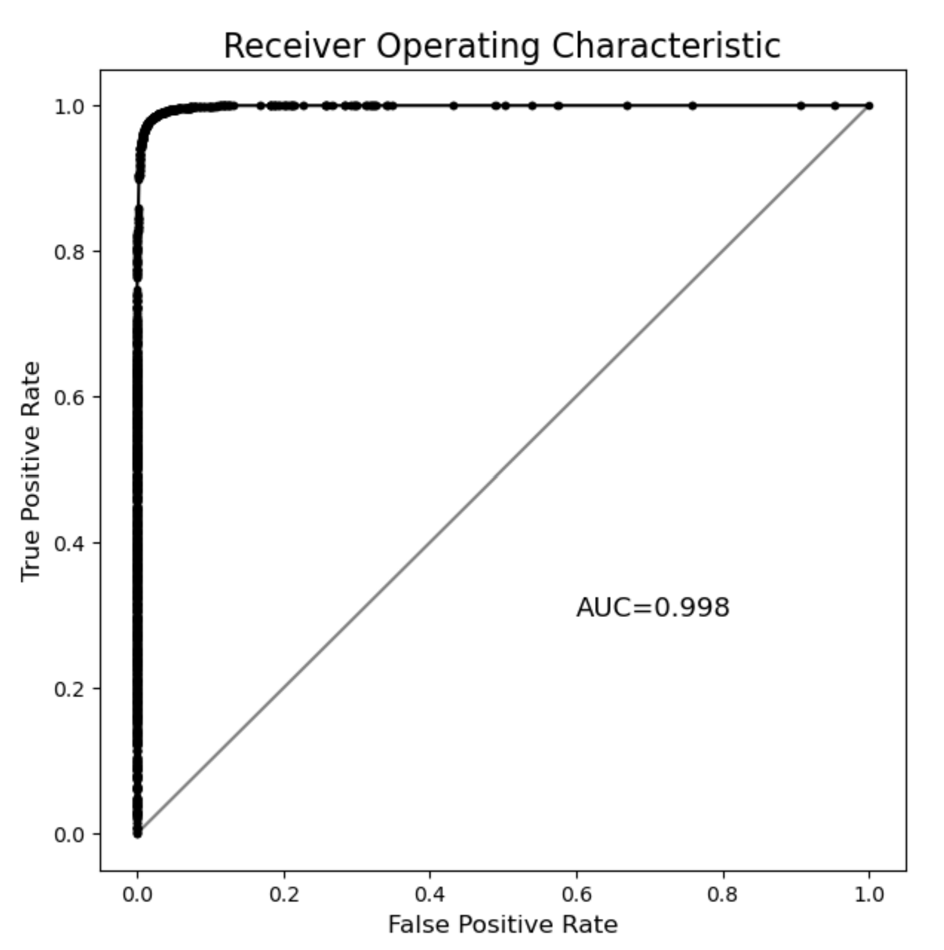
Best Model: Extreme Gradient Boosting
Receiver Operating Characteristic – Area Under Curve = 0.998

Slide 13
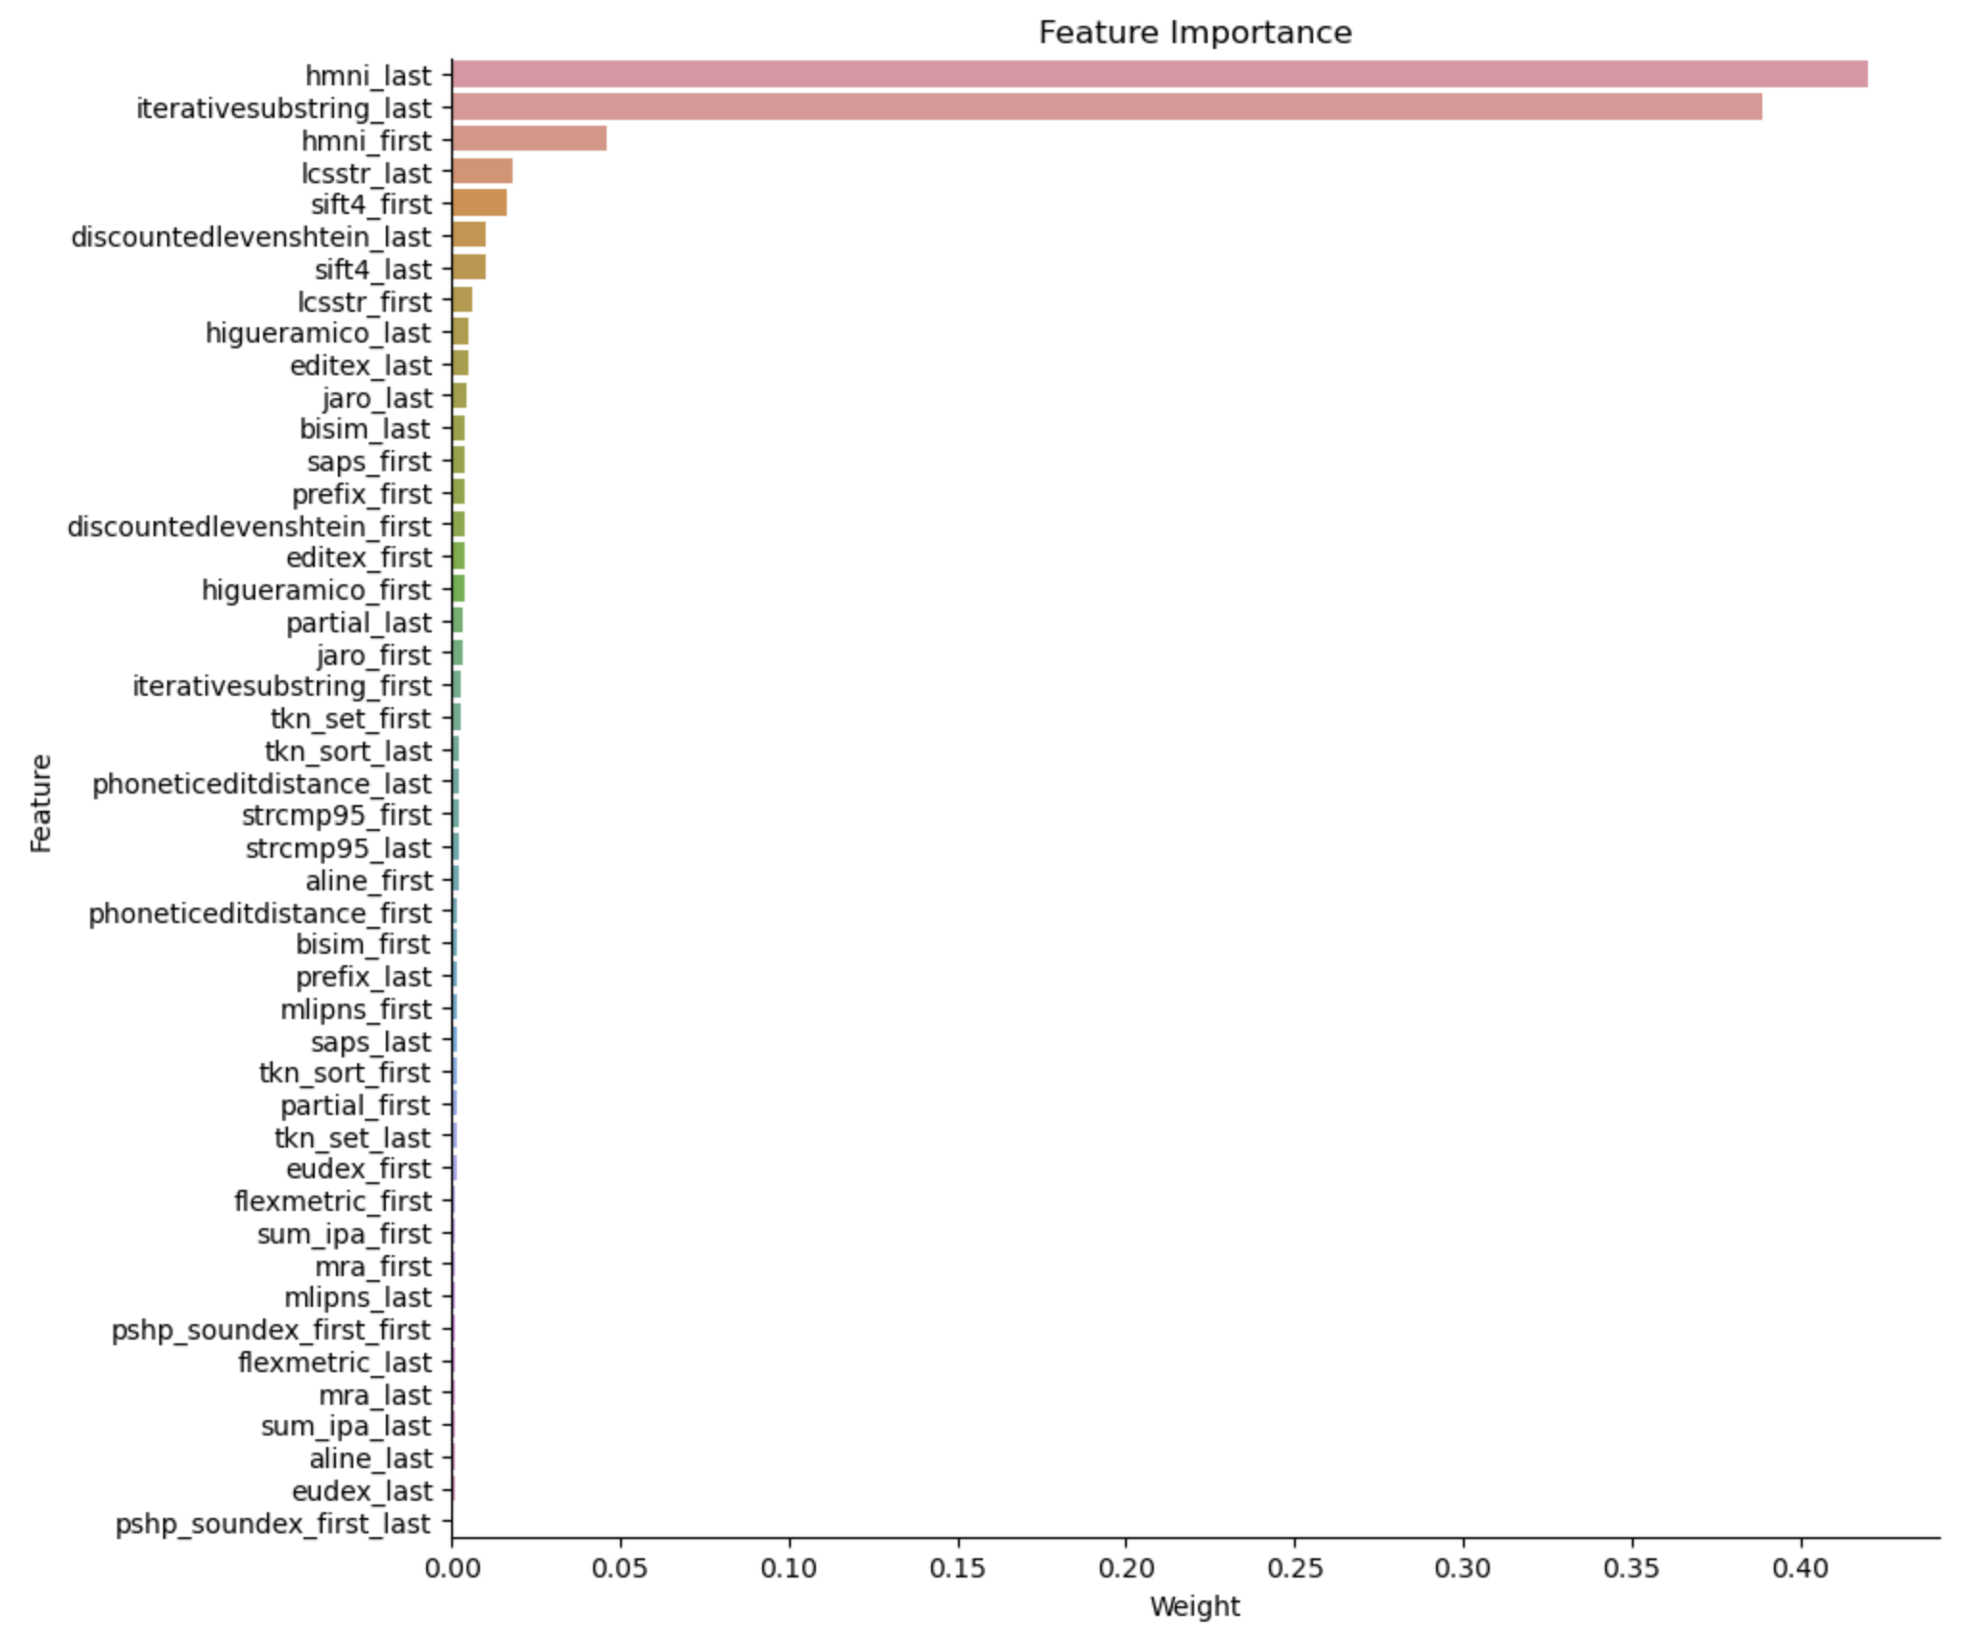
Top Features in Predicting Matching Names
Notes:
HMNI scores for last and first names were the #1 and #3 features
Iterative Substring for last name was #2

Slide 14
Takeaways
XGBoost Classifier was best model
Precision 98%
Covington Distance feature took an extremely long time to run and was excluded from the model
XGBoost Classifier model took an extremely long time to fit
Logistic Regression classifier fit ran quickly and is a good alternative with Precision = 96% if training speed is an issue

Slide 15
Future Research
Real data improved data quality for match / no-match
Synthetic data include last name variations
Include international names
Include Covington Distance feature
Analyze with other classification and deep learning models
Notes:
The real data had some quality issues where the names were not similar even though they had the same key. Due to this issue, the “is_match” label had to be manufactured based on the FuzzyWuzzy similarity scores.
The synthetic data had a comprehensive list of first name pairs that helped to identify variations such as “Richard” being the same as “Dick”. However, the last names had to be created based on a separate list of common last names. This resulted in each first name pair having the exact same last name.
Acquiring more accurate, real data would help to build a better model.
The name data was primarily from the US. Adding more international names such as Latin, Asian, Arabic, and Eastern European names would improve the model.
The Covington Distance feature was excluded due to the length of time that it took to build the features. This feature could be added to improve the model.
Other models could be tested and analyzed in order to improve the results. This could include other classification and deep learning models such as Siamese networks.

Slide 16
Questions?

