Slide 1
TB Real Estate Corporation
By
Michael Ward

Slide 2
The Problem:
Identify residential property investment opportunities in the Tampa Bay area
Notes:
TB Real Estate Corporation is a real estate investment firm in the Tampa Bay, Florida area. The real estate market in the Tampa Bay area is very active. Single family homes are selling quickly. TB Real Estate Corporation needs to be able to assess the value of homes coming onto the market quickly and accurately so that they can beat the competition in making a competitive offer. They need to be able to evaluate the listing price against the predicted sale price in order to identify properties that may be priced below market value and would make good investments.

Slide 3
The Solution:
Beat the competition
to contracting purchases
by reducing time and expense in identifying
the best investment opportunities.
Notes:
My proposed solution is to identify the best areas of Hillsborough County to invest in and then use machine learning to quickly identify properties that are listed for sale below the market value in order to beat the competition in making an offer and securing a Purchase & Sale contract.

Slide 4
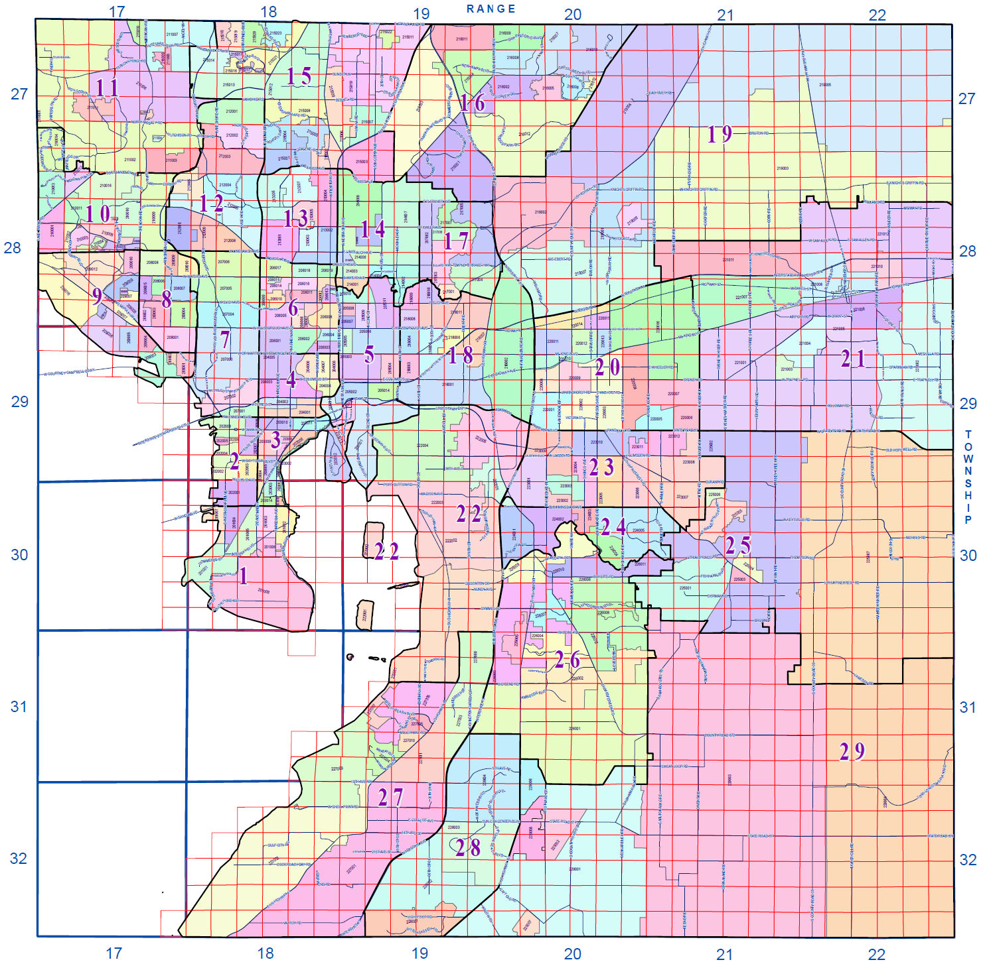
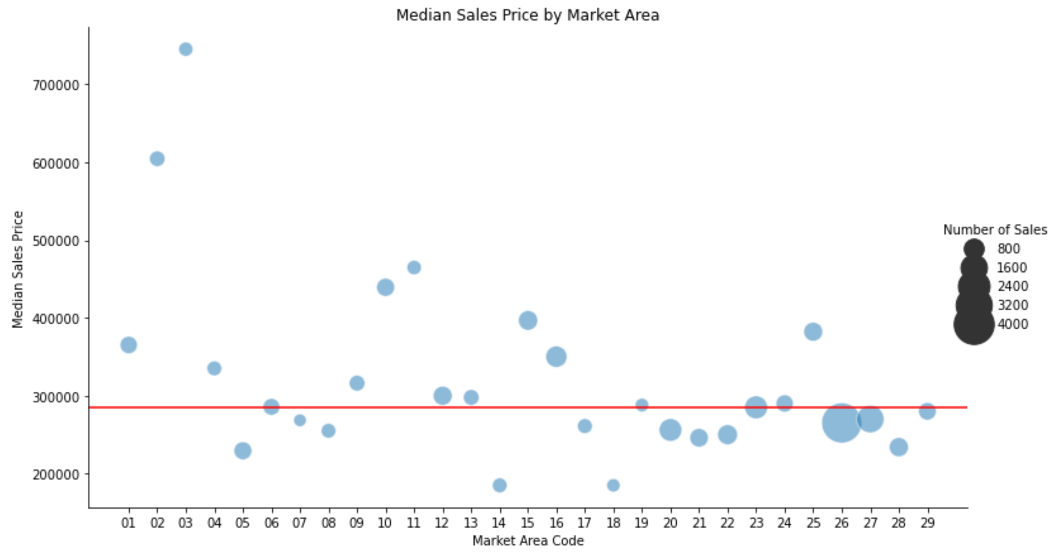
Hottest Market - Riverview (#26)
Most home sales over the past year
Median sales prices < county median
Highest growth area for new homes
Notes:
Market Areas 26 and 27 (Riverview and Southbay) had the most property sales over the year and the median sales prices that are slightly below the median for the county.
These Southeastern Market Areas are attractive for investments due to the following features:
Most home sales over the past year
Lowest median age of homes sold
Median sales prices below the county median sales price
Of the top-10 Neighborhoods for number of sales, 7 of them are in Market Areas 26 and 27.

Slide 5
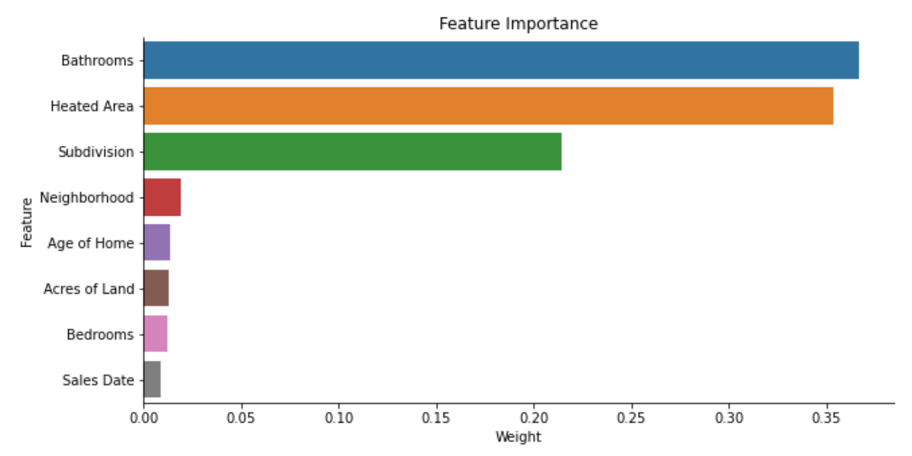
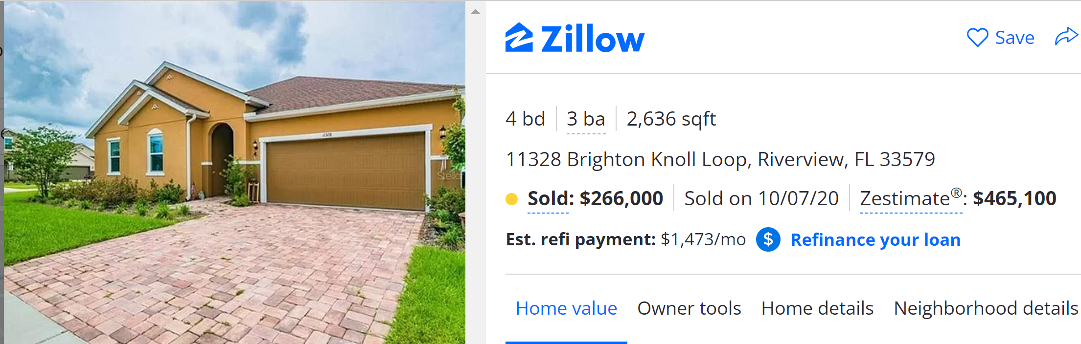
Top Features in Predicting Sales Price
Riverview Market Area
Single Family Homes
3 – 5 Bedrooms
1 – 4 Bathrooms
< 20 Years Old
Predicted Price: $316K
Sold Oct 2020: $266K
Current Value *: $465K
Total $ Gain: $199K
Total % Gain: 75%
* According to Zillow, the current Zestimate® is $465,100
https://www.zillow.com/homes/11328-Brighton-Knoll-Loop-Riverview,-FL-33579_rb/125990862_zpid/
Notes:
Based on the Exploratory Data Analysis, I determined that the following features would be good candidates for modeling.
Types of Sales
Single Family Residential Homes (DOR Code 0100)
Qualified (verified as free-market sales)
Improved (post-construction sales – not vacant land)
Sales from the 2020 calendar year
Home Features
Bedrooms (3 to 5)
Bathrooms (1 to 4)
Buildings / Units (1 only)
Stories (1 to 2 only)
Age of Home (less than 20 years old)
Heated Area
Acres of Land
Property Locations
Market Area (26 – Riverview)
Neighborhood Code
Subdivision Code
Taxable Values of Properties
None (invalid predictors)

Slide 6
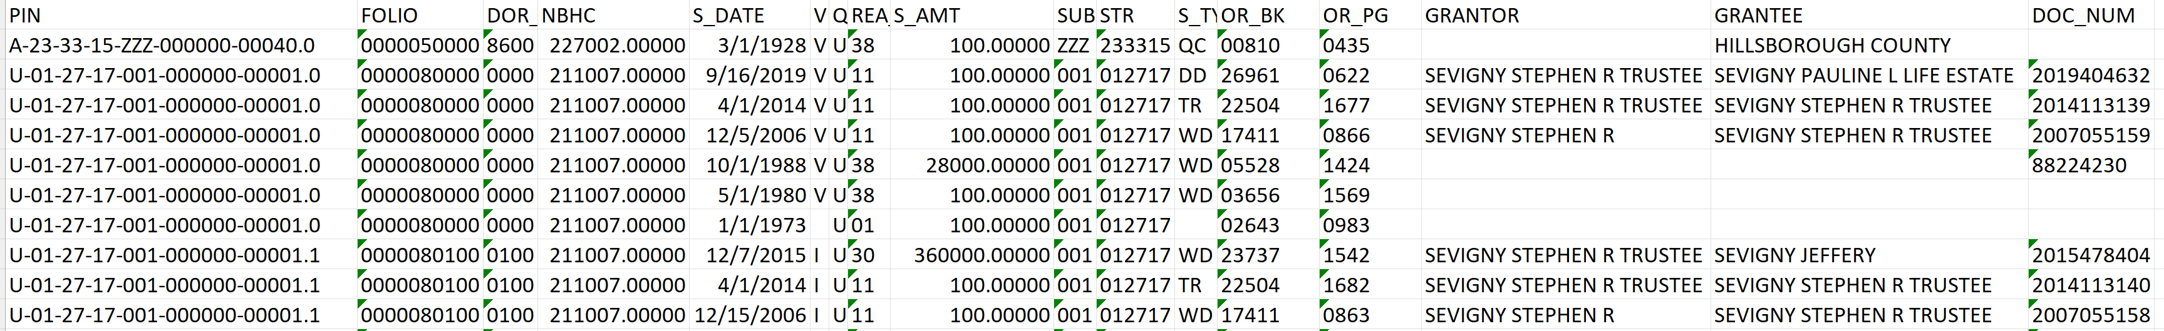
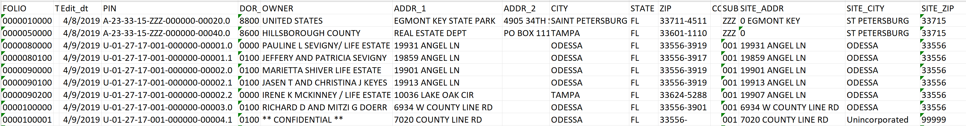
The Data
Property Sales Records
Property Detail Records
Data Source: https://downloads.hcpafl.org/
Notes:
The HCPA provides new zip files each week on their website which contain the most current sales data, parcel data, supporting files, and explanatory documents. The sales and parcel data files are in database file format (*.dbf). The parcel file included all 512,206 parcels in Hillsborough County with 47 features to describe each parcel. The sales file contained 2,166,282 property sale records dating back to 1980. Each sale is made up of 17 features.

Slide 7
Data Wrangling
Only consider data from Jan 1, 2000 and later
Only consider sites on 2016 map
Drop redundant columns
Drop rows with more than 30% of data missing
Forward fill blank values with most recent measurement at same site
Target Variable: Chlorophyll A
Original dataset had ~80,000 rows and 100 columns and not a single complete row
Notes:
Wanted a large enough time span to capture multiple climate anomalies
Wanted to focus on sites actively being sampled
Reduced the size and scope considerably by dumping redundant data
Imputed values based on old measurements
Chose chlorphyll as my target vairable because it has far reaching and tangible, immediate effects on an ecosystem such as fish death and drops in dissolved oxygen

Slide 8
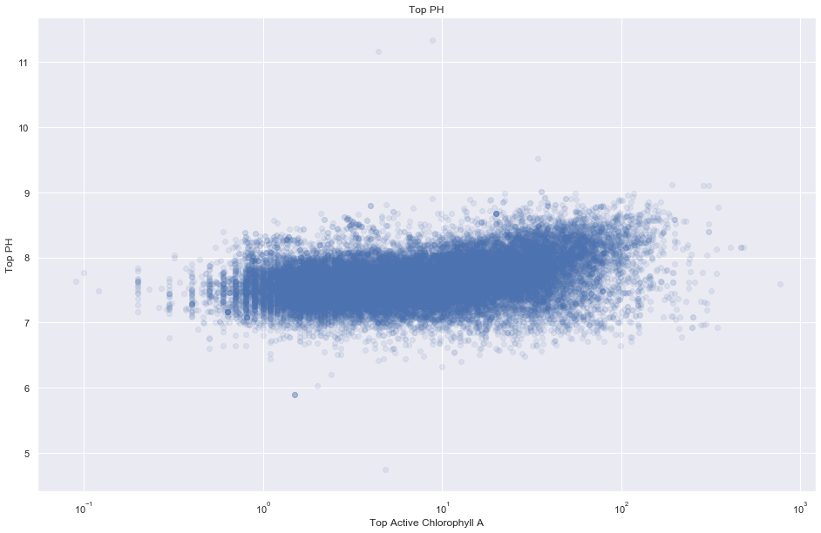
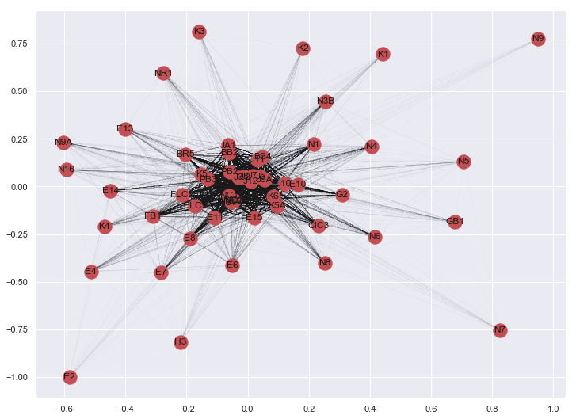
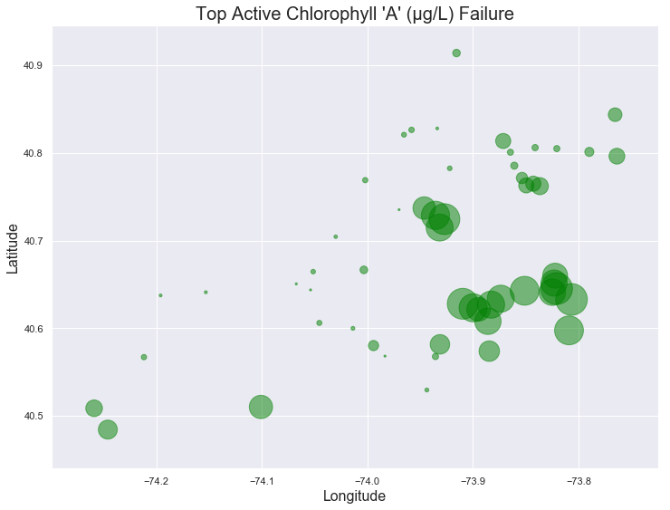
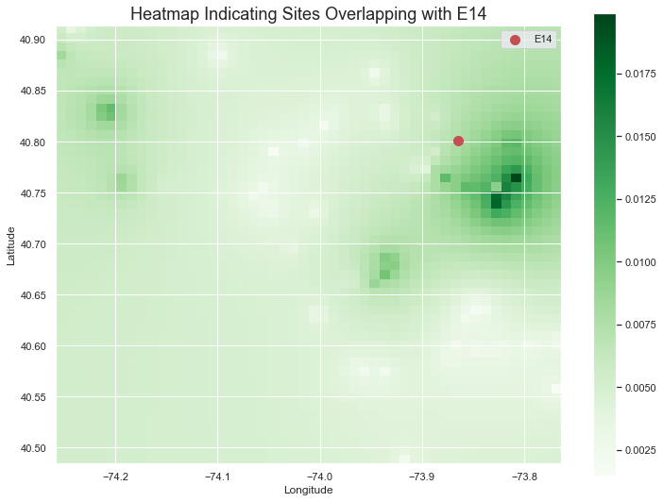
Exploratory
Data Analysis
Notes:
Top left: Scatter plot of chlorophyll and pH. There’s a slight correlation, but overall it’s very difficult to tell. This was common for a lot of the measurements.
Top right: Multigraph representation of overlapping failed tests. If two sites had overlimit readings in the same month, an edge was drawn between the nodes
Bottom left: geographic representation of probability of failed chlorophyll test at each site. Circles are arranged by lat/long and their size is their probability of failing a test.
Bottom right: Inverse Weighted Distance map. Sites that fail tests at the same time are darker, but this graph also takes into account how far away the sites are from each other.
Using these graphs and more, I was able to narrow down my features and the sites I was going to look at

Slide 9
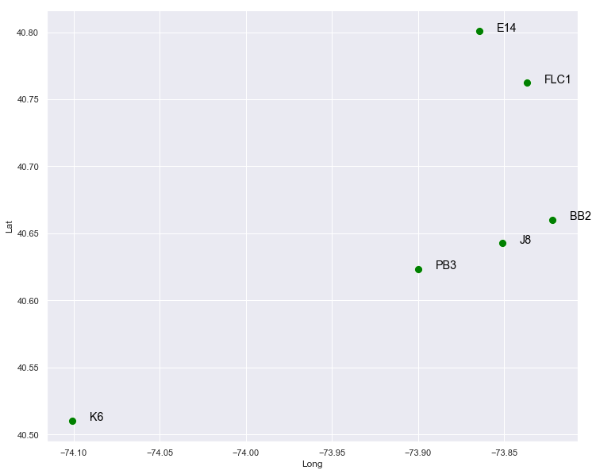
Site Selection
Model Selection
Selected 6 sites
Logistic Regression
Random Forest Classifier
XGBoost Classifier

Slide 10
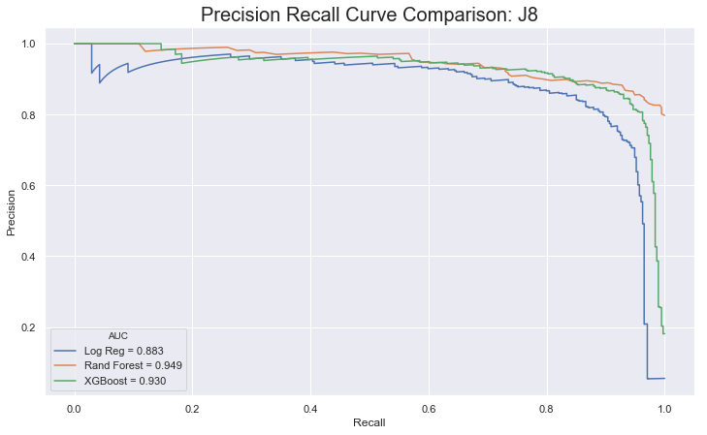
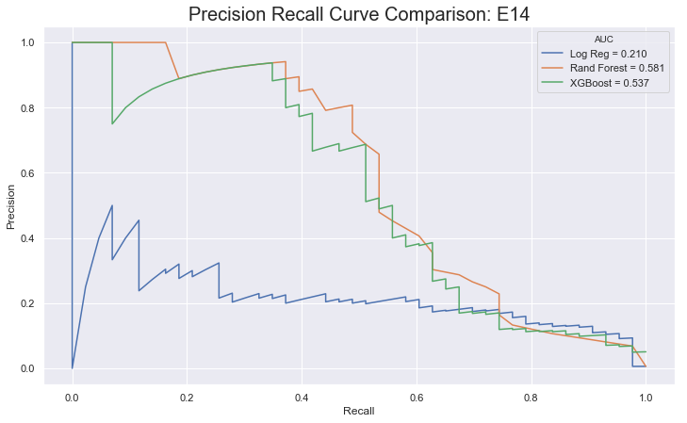
Site Comparisons: Precision Recall
Notes:
Here are the precision recall curves for two distinct sites.
The one on the left is one with good predicatability and the one on the right is one with poor.
I looked at 6 sites and found 3 with good predictability. Those are the ones that I developed models for.

Slide 11
Hyperparameter Tuning
Precision Increase by Site
BB2: 80% to 85%
J8: 92% to 95%
PB3: 78% to 87%
Grid Search Cross Validation
Notes:
When tuning my parameters, I used Grid Search Cross Validation
The m

Slide 12
Takeaways
XGBoost was best model
Phosphorus measurement matter most
A lot of features are not important (Reduced columns from 100 to 28)
Different sites have different predictability

Slide 13
Future Research
Expand to more sites
Expand to more parameters
Develop a short term model (data from <5 years)
Integrate physical connectivity

Slide 14
Thank You!
New York EPA for monitoring the waterways
New York Open Data for making data publicly available
Aiden Johnson for guidance during project

Slide 15
Questions?

