Slide 1

PIG

Slide 2
Why PIG ?
Pig is a platform for analyzing large data sets that consists of a high-level language for expressing data analysis programs
Faster Development
Fewer lines of Code
Flexible
Metadata is optional
Extensible
Procedural programming
# Math Functions
-------------------------
ABS
ACOS
ASIN
ATAN
CBRT
CEIL
COSH
COS
EXP
FLOOR
LOG
LOG10
RANDOM
ROUND
SIN
SINH
SQRT
TAN
TANH
#Eval Functions
------------------------
AVG
CONCAT
Example
COUNT
COUNT_STAR
DIFF
IsEmpty
MAX
MIN
SIZE
SUM
TOKENIZE
Pig Type | Java Class
bytearray | DataByteArray
chararray | String
int | Integer
long | Long
float | Float
double | Double
tuple | Tuple
bag | DataBag
map | Map<Object, Object>
PIG Features :
---------------------
Join Datasets
Sort Datasets
Filter
Data Types
Group By
User Defined Function

Slide 3
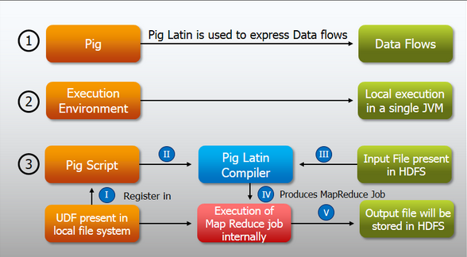

Slide 4
PIG Hands-On Document

Slide 5
Tutorial Overview
This tutorial will enable you to gain a working knowledge of Pig and hands-on experience creating Pig scripts to carry out essential data operations and tasks.
In this tutorial, you will first read in two data files that contain New York Stock Exchange dividend prices and stock prices, and then use these files to perform a number of Pig operations including :
Define a relation with and without schema
Define a new relation from an existing relation
Select specific columns from within a relation
Join two relations
Sort the data using ‘ORDER BY’
FILTER and Group the data using ‘GROUP BY’

Slide 6
Download the Data
You’ll need sample data for this tutorial. The data set you will be using is stock ticker data from the New York Stock Exchange from the years 2000-2001. Download this sample data from the following location:
https://s3.amazonaws.com/hw-sandbox/tutorial1/infochimps_dataset_4778_download_16677-csv.zip
The file is about 11 megabytes, and might take a few minutes to download.
Open the folder infochimps_dataset_4778_download_16677 > NYSE and locate the two data files that you will be using for this tutorial:
NYSE_daily_prices_A.csv
NYSE_dividends_A.csv

Slide 7
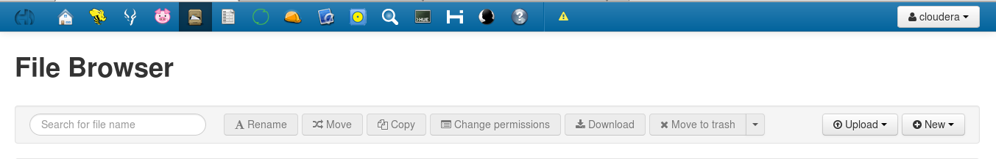
Step 1: Upload the data files
Select the File Browser from the top tool bar. The File Browser allows you to view the Cloudera Hadoop file store. The file system is separate from the local file system.

Slide 8
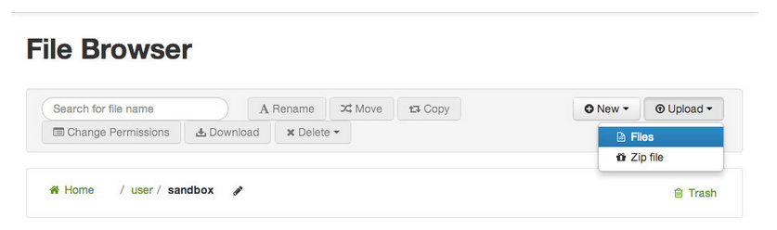
Step 1: Upload the data files – Contd.
Click Upload and select Files to load data to HDFS:

Slide 9
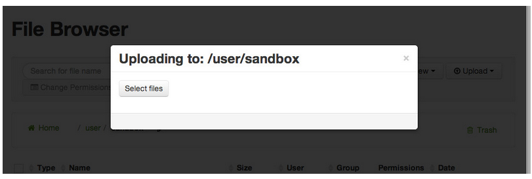
Step 1: Upload the data files – Contd.
This action brings up the following dialog box:

Slide 10
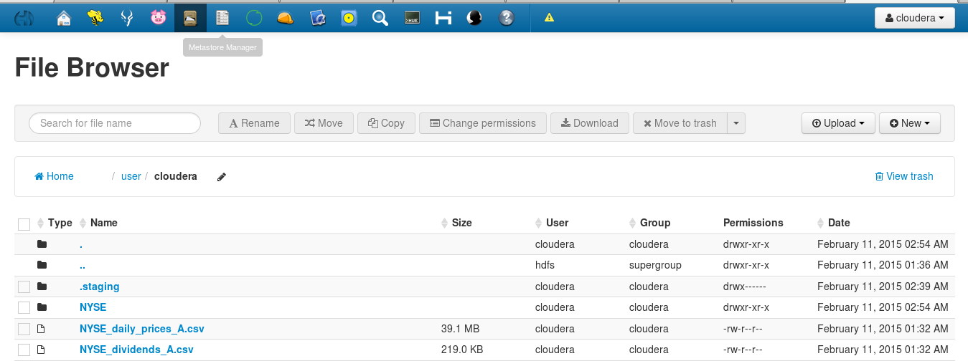
Step 1: Upload the data files – Contd.
Click Select files, navigate to and select the NYSE_daily_prices_A.csv file from your computer. Upload the NYSE_dividends_A.csv file in the same way. When finished, notice that both files are now in HDFS.

Slide 11
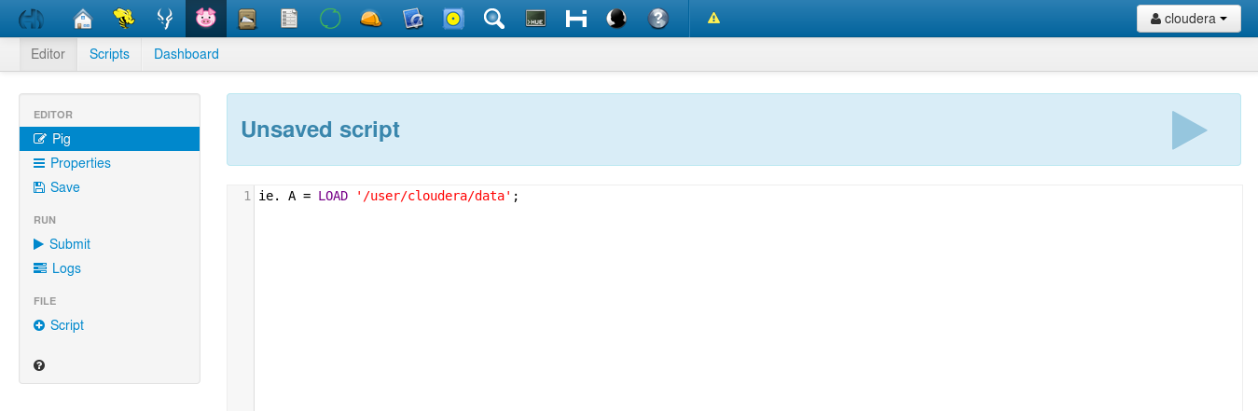
Step 2: Create Your Script
Open the Pig interface by clicking the Pig icon at the top of the screen. On the left pane is a list of your scripts and on the right pane is a composition area for writing and editing scripts.

Slide 12
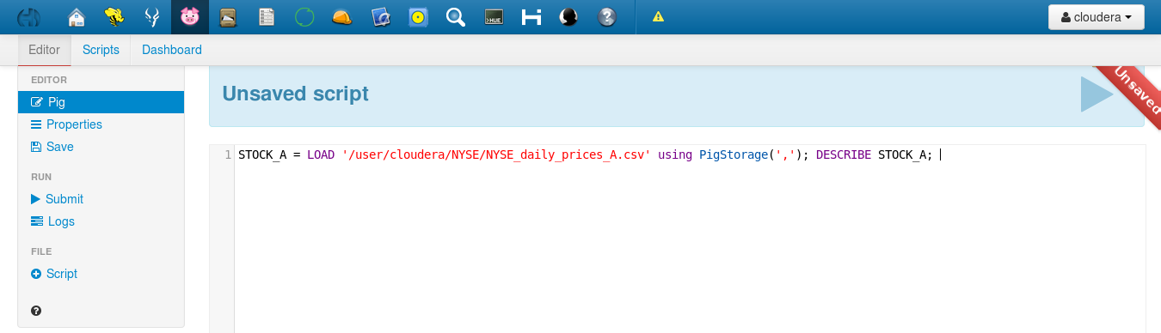
Step 3: Define a relation
In this step, you will create a script to load the data and define a relation.
On line 1 define a relation named STOCK_A that represents the NYSE stocks that start with the letter “A”
On line 2 use the DESCRIBE command to view the STOCK_A relation
The completed code will look like:
STOCK_A = LOAD 'nyse/NYSE_daily_prices_A.csv' using PigStorage(','); DESCRIBE STOCK_A;

Slide 13
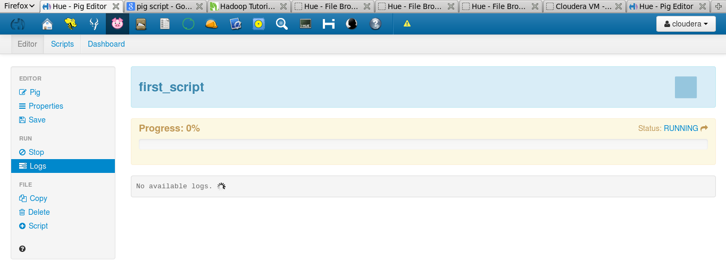
Step 4: Save and Execute the Script
Click the Save button to save your changes to the script. Click Submit to run the script. This action creates one or more MapReduce jobs. After a moment, the script starts and the Execute button changes to a Stop button in case you want to stop the job.
Below the Execute/Kill job button is a progress bar that shows the job’s status. The progress bar can be blue (indicating job is in process), red (job has a problem), or green (job is complete).

Slide 14
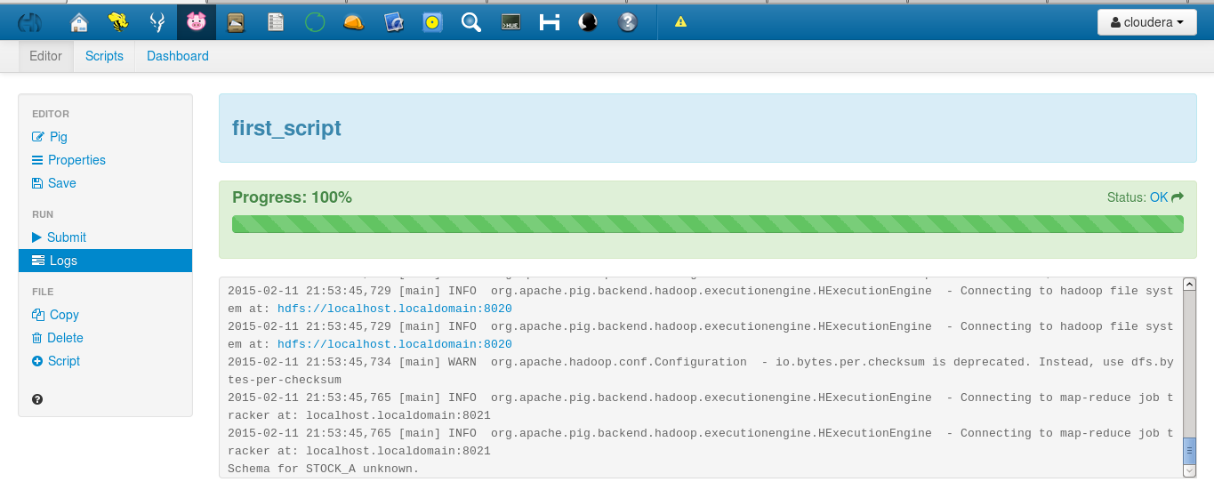
Step 4: Save and Execute the Script – Contd.

Slide 15
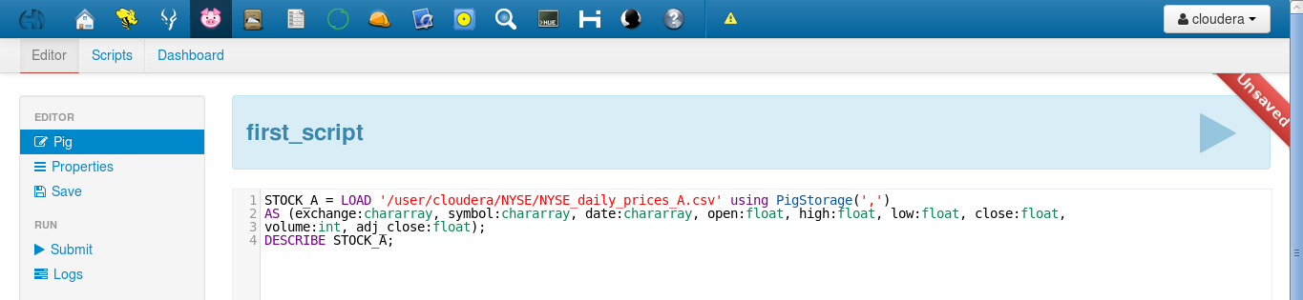
Step 5: Define a Relation with a Schema
Let’s use the above code but this time with a schema. Modify line 1 of your script and add the following “AS”” clause to define a schema for the daily stock price data. The complete code will be:
STOCK_A = LOAD ‘/user/Cloudera/NYSE/NYSE_daily_prices_A.csv' using PigStorage(',') AS (exchange:chararray, symbol:chararray, date:chararray, open:float, high:float, low:float, close:float, volume:int, adj_close:float);
DESCRIBE STOCK_A;

Slide 16
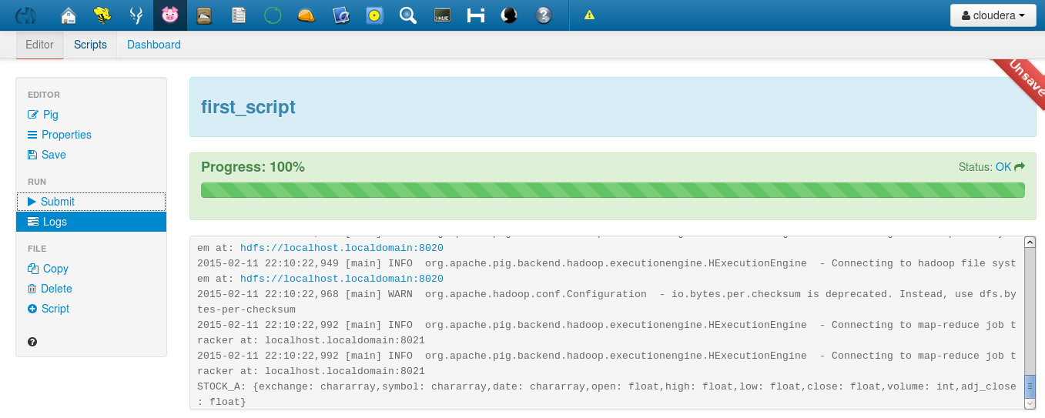
Step 5: Define a Relation with a Schema – Contd.
Save and execute the script again. This time you should see the schema for the STOCK_A relation:

Slide 17
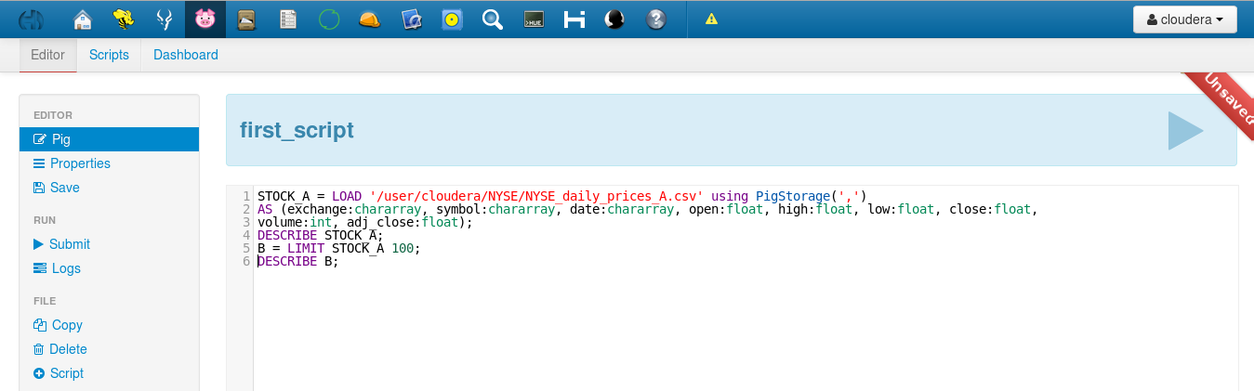
Step 6: Define a new relation from an existing relation
You can define a new relation based on an existing one. For example, define the following B relation, which is a collection of 100 entries (arbitrarily selected) from the STOCK_A relation.
Add the following line to the end of your code:
Save and execute the code. Notice B has the same schema as STOCK_A, because B is a subset of A relation

Slide 18
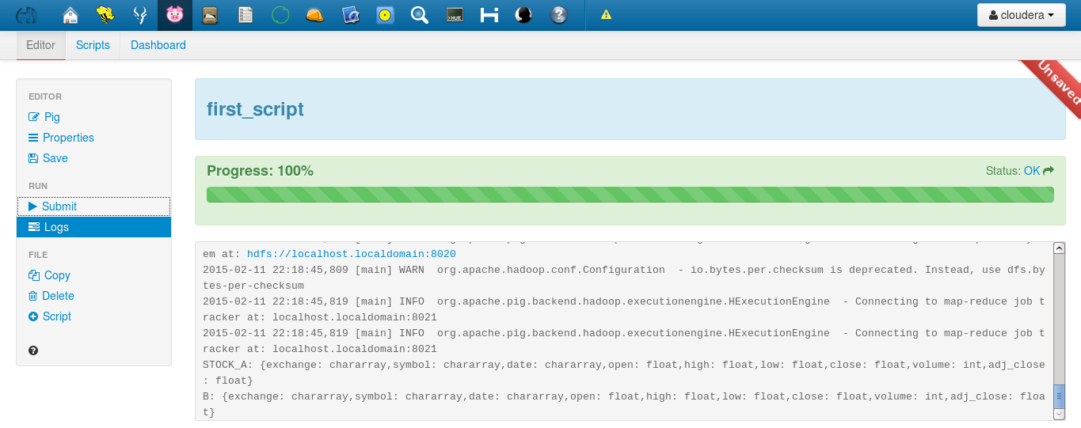
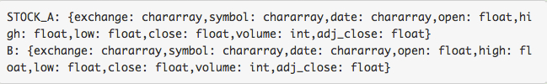
Step 6: Define a new relation from an existing relation – Contd.

Slide 19
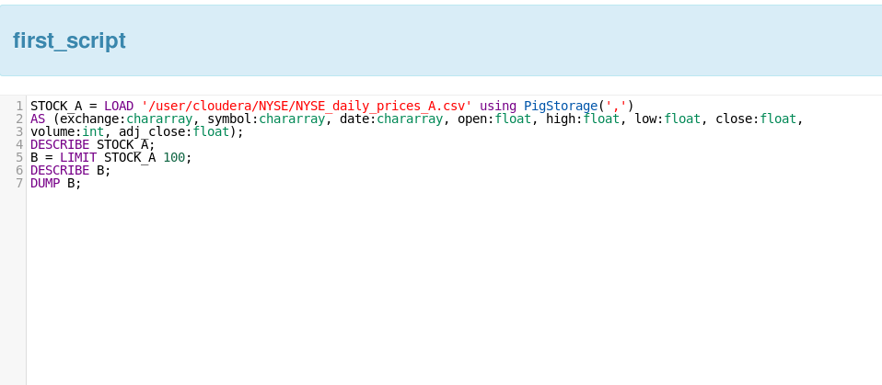
Step 7: View the Data
To view the data of a relation, use the DUMP command.
Add the following DUMP command to your Pig script, then save and execute it again:

Slide 20
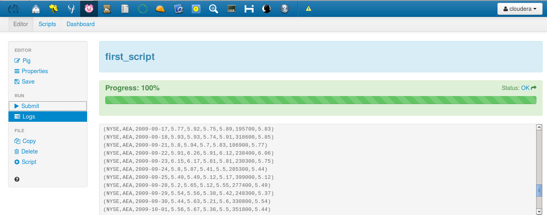
Step 7: View the Data – Contd.
The command requires a MapReduce job to execute, so you will need to wait a minute or two for the job to complete. The output should be 100 entries from the contents of NYSE_daily_prices_A.csv (and not necessarily the ones shown below, because again, entries are arbitrarily chosen):

Slide 21
Step 8: Select specific columns from a relation
Delete the DESCRIBE STOCK_A, DESCRIBE B, and DUMP B commands from your Pig script; you will no longer need those.
One of the key uses of Pig is data transformation. You can define a new relation based on the fields of an existing relation using the FOREACH command. Define a new relation C, which will contain only the symbol, date and close fields from relation B.
Now the complete code is:
STOCK_A = LOAD ‘/user/cloudera/NYSE/NYSE_daily_prices_A.csv' using PigStorage(',') AS (exchange:chararray, symbol:chararray, date:chararray, open:float, high:float, low:float, close:float, volume:int, adj_close:float); B = LIMIT STOCK_A 100; C = FOREACH B GENERATE symbol, date, close; DESCRIBE C;

Slide 22
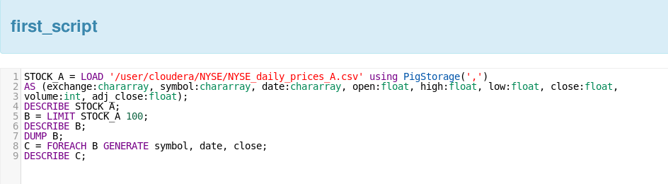
Step 8: Select specific columns from a relation – Contd.
Save and execute the script and your output will look like the following:

Slide 23
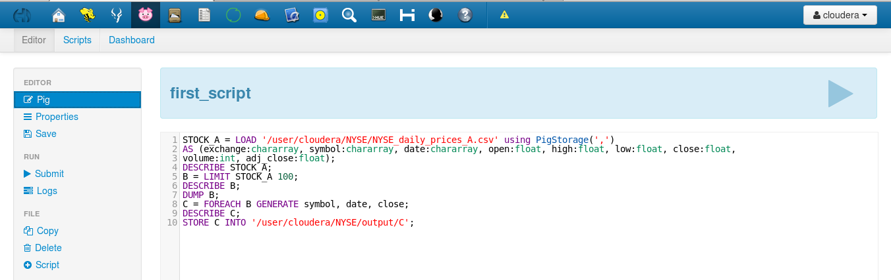
Step 9: Store relationship data into a HDFS File
In this step, you will use the STORE command to output a relation into a new file in HDFS. Enter the following command to output the C relation to a folder named output/C (then save and execute):
STORE C INTO ‘/user/cloudera/NYSE/output/C';

Slide 24
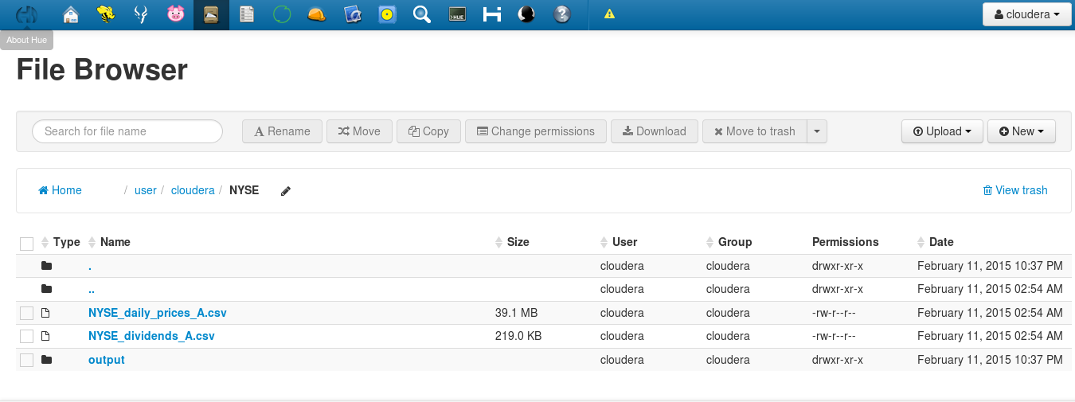
Step 9: Store relationship data into a HDFS File – Contd.
Again, this requires a MapReduce job (just like the DUMP command), so you will need to wait a minute for the job to complete.
Once the job is finished, go to File Browser and look for a newly created folder called “output”:

Slide 25
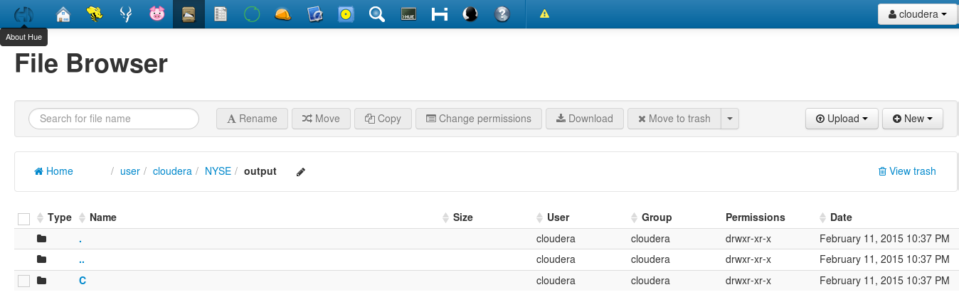
Step 9: Store relationship data into a HDFS File – Contd.
Click on “output” folder. You will find a subfolder named “C”.

Slide 26
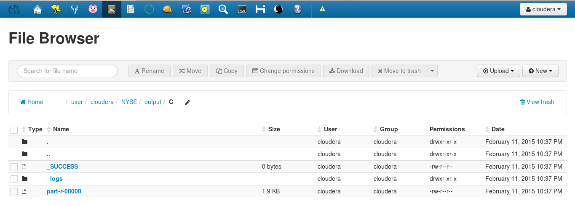
Step 9: Store relationship data into a HDFS File – Contd.
Click on “C” folder. You will see an output file called “part-r-00000″:

Slide 27
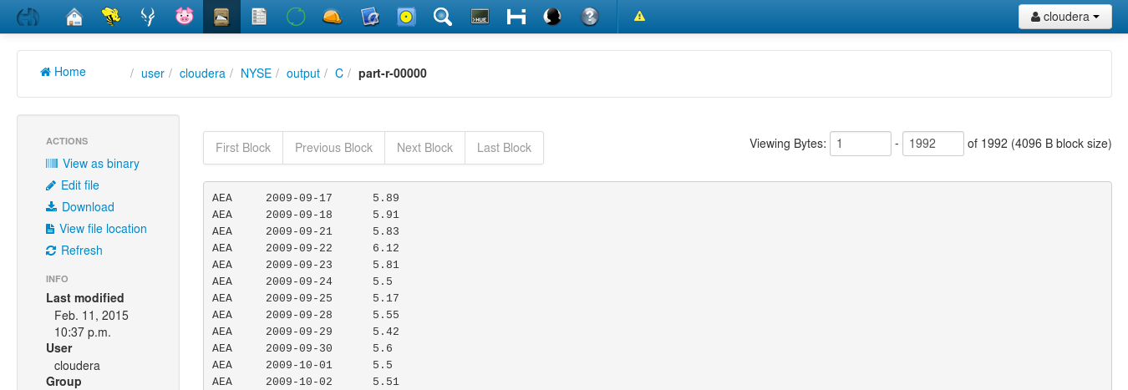
Step 9: Store relationship data into a HDFS File – Contd.
Click on the file “part-r-00000″. It will show data stored in the file:

Slide 28
Step 10: Perform a join between 2 relations
In this step, you will perform a join on two NYSE data sets: the daily prices and the dividend prices. Dividends prices are shown for the quarter, while stock prices are represented on a daily basis.
You have already defined a relation for the stocks named STOCK_A. Create a new Pig script named “Pig-Join”. Then define a new relation named DIV_A that represents the dividends for stocks that start with an “A”, then join A and B by both the symbol and date and describe the schema of the new relation C.
The complete code will be:
STOCK_A = LOAD ‘/user/cloudera/NYSE/NYSE_daily_prices_A.csv' using PigStorage(',') AS (exchange:chararray, symbol:chararray, date:chararray, open:float, high:float, low:float, close:float, volume:int, adj_close:float); DIV_A = LOAD 'NYSE_dividends_A.csv' using PigStorage(',') AS (exchange:chararray, symbol:chararray, date:chararray, dividend:float); C = JOIN STOCK_A BY (symbol, date), DIV_A BY (symbol, date); DESCRIBE C;

Slide 29
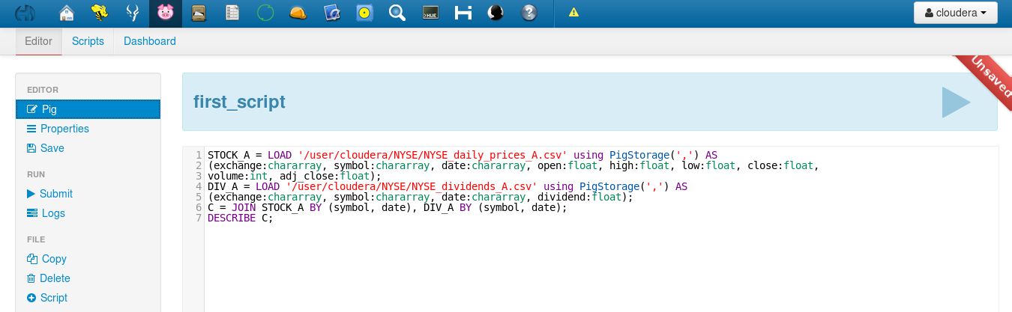
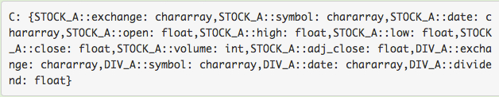
Step 10: Perform a join between 2 relations – Contd.
Save the script and execute it. Notice C contains all the fields of both STOCK_A and DIV_A. You can use the DUMP command to see the data stored in the relation C:

Slide 30
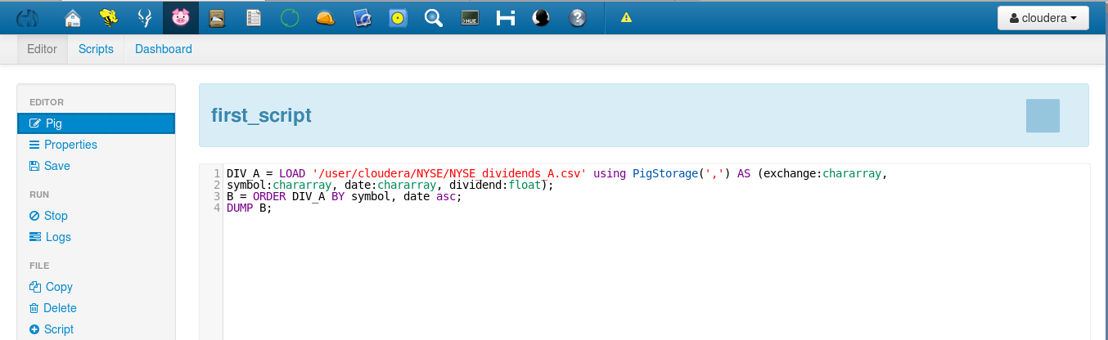
Step 11: Sort the data using “ORDER BY”
Use the ORDER BY command to sort a relation by one or more of its fields. Create a new Pig script named “Pig-sort” and enter the following commands to sort the dividends by symbol then date in ascending order:
DIV_A = LOAD ‘/user/cloudera/NYSE/NYSE_dividends_A.csv' using PigStorage(',') AS (exchange:chararray, symbol:chararray, date:chararray, dividend:float); B = ORDER DIV_A BY symbol, date asc; DUMP B;

Slide 31
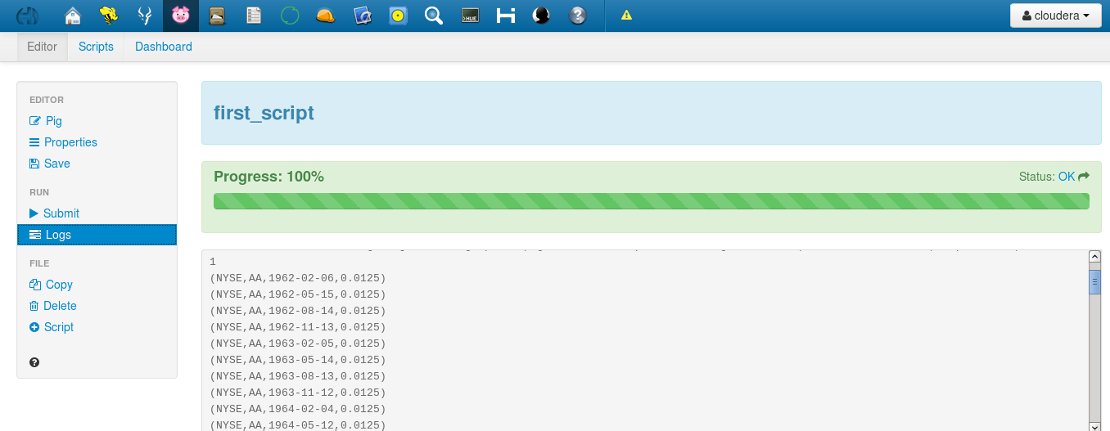
Step 11: Sort the data using “ORDER BY”
Save and execute the script. Your output should be sorted as shown here:

Slide 32
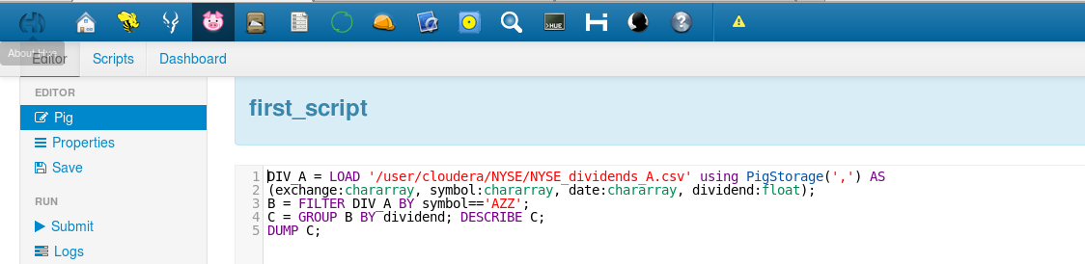
Step 12: Filter and Group the data using “GROUP BY”
The GROUP command allows you to group a relation by one of its fields. Create a new Pig script named “Pig-group”. Then, enter the following commands, which group the DIV_A relation by the dividend price for the “AZZ” stock.
DIV_A = LOAD ‘/user/cloudera/NYSE/NYSE_dividends_A.csv' using PigStorage(',') AS (exchange:chararray, symbol:chararray, date:chararray, dividend:float); B = FILTER DIV_A BY symbol=='AZZ'; C = GROUP B BY dividend; DESCRIBE C; DUMP C;

Slide 33
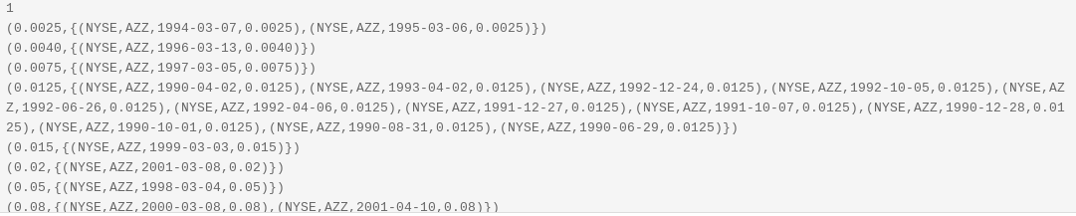
Step 12: Filter and Group the data using “GROUP BY”
Save and execute. Notice that the data for stock symbol “AZZ” is grouped together for each dividend.

Slide 34
Average Divdend:
dividends = load '/home/Downloads/NYSE_dividends' as (exchange, symbol, date, dividend);
grouped = group dividends by symbol;
avg = foreach grouped generate group, AVG(dividends.dividend);
store avg into 'average_dividend';

Slide 35
No Schema
daily = load '/home/Downloads/NYSE_daily';
calcs = foreach daily generate $7 / 1000000, $3 * 100.0, SUBSTRING($0, 0, 1), $6 - $3;
dump calcs;

Slide 36
No Schema and Filter Operation
daily = load 'NYSE_daily';
fltrd = filter daily by $6 > $3;
dump fltrd;

Slide 37
No Schema and Join Operation
divs = load 'NYSE_dividends' as (exchange, stock_symbol, date, dividends);
daily = load 'NYSE_daily';
jnd = join divs by stock_symbol, daily by $1;
dump jnd;

Slide 38
Total Trade Estimate:
daily = load 'NYSE_daily' as (exchange:chararray, symbol:chararray,date:chararray, open:float,
high:float, low:float, close:float,volume:int, adj_close:float);
rough = foreach daily generate volume * close;
dump rough;

Slide 39
Count
daily = load 'NYSE_daily' as (exchange, stock);
grpd = group daily by stock;
cnt = foreach grpd generate group, COUNT(daily);
dump cnt;

Slide 40
Count All :
daily = load 'NYSE_daily' as (exchange, stock);
grpd = group daily all;
cnt = foreach grpd generate COUNT(daily);
dump cnt;

Slide 41
Thanks

