Slide 1
Course Title - Web System Engineering
Topic Title - BUILD INTERFCAES USING BOOTSTARP
Introduction to web design from an evolutionary perspective, user interface design through bootstrap, containers,
tables, jumbotrons, list, cards, carousal, navigation, modals, flex and forms, responsive web page design, basic UI
grid structure.
Presenter’s Name - M ArunKumar
Presenter’s ID - IARE11151
Department Name - CSE ( Artificial Intelligence, and Machine Learning )
Lecture Number - #
Presentation Date - 17/02/2025

Slide 2
carousal, navigation, modals, flex and forms, responsive web page design,basic UI grid structure.
Add some navigation header (or block) with Bootstrap’s

Slide 3
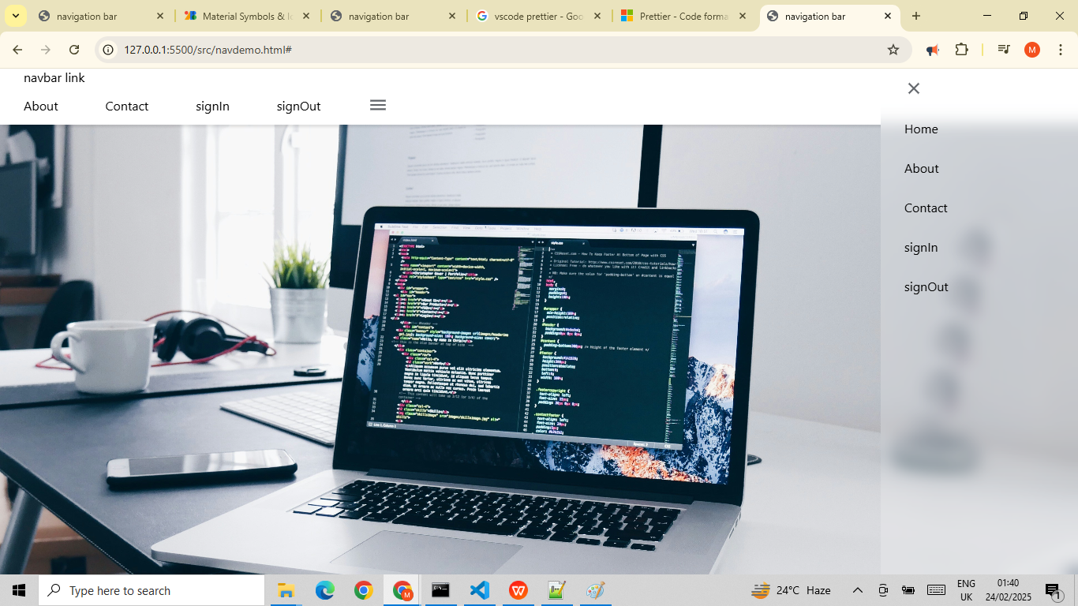
HTML: Layout

Slide 4
navigation : HTML & CSS properties

Slide 5
Thank You

