Slide 1
Polymer
Notes:
Polymer is a web library built on top of Web Components. It is designed to leverage the evolving web platform on modern browsers.
Polymer allows you to create custom elements (resuable web components). Your browser knows how to handle these elements (ex: takes care of default HTML and JS handling).

Slide 2
Web Components
Polymer allows you to create custom elements.
Notes:
The path to a custom element uses the component name listed in this element's bower.json file—rather than the actual directory name.
Elements are reusable and organized to be used alongside other elements, so components are referenced outside the project.

Slide 3
Local DOM
Notes:
Local (/Shadow) DOM is the set of DOM elements managed by your element.
Local DOM lets you add a scoped DOM tree inside an element, with local styles and markup that are decoupled from the rest of the web page.

Slide 4
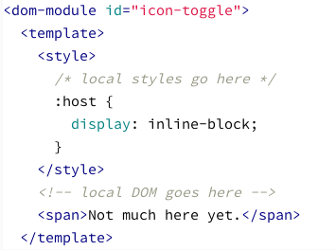
Define Element: Local DOM
Notes:
"dom-module" wraps the element's local DOM definition.
"template" is where you specify your element's stucture and style.
Styles within the "style" tag are scoped to the local DOM and won't affect the rest of your document.

Slide 5
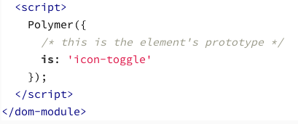
The Polymer call registers the element so it’s recognized by the browser.
Notes:
The argument to the Polymer call is the new element’s prototype.
The "is" property on the prototype is the new element’s name. It needs to match the id on the that contains the element’s template.

