Slide 1
Machine Learning Challenge
Big Data Citizen Program
Team Name : Country
Michael Kaudi
Specialist: Radio Planning and Optimization
South Africa
Technology
" Why did you join the Citizen Data Science Programme"
Mohau Masukela
Specialist: Radio Planning and Optimization
South Africa
Technology
" Why did you join the Citizen Data Science Programme"
Further together

Slide 2
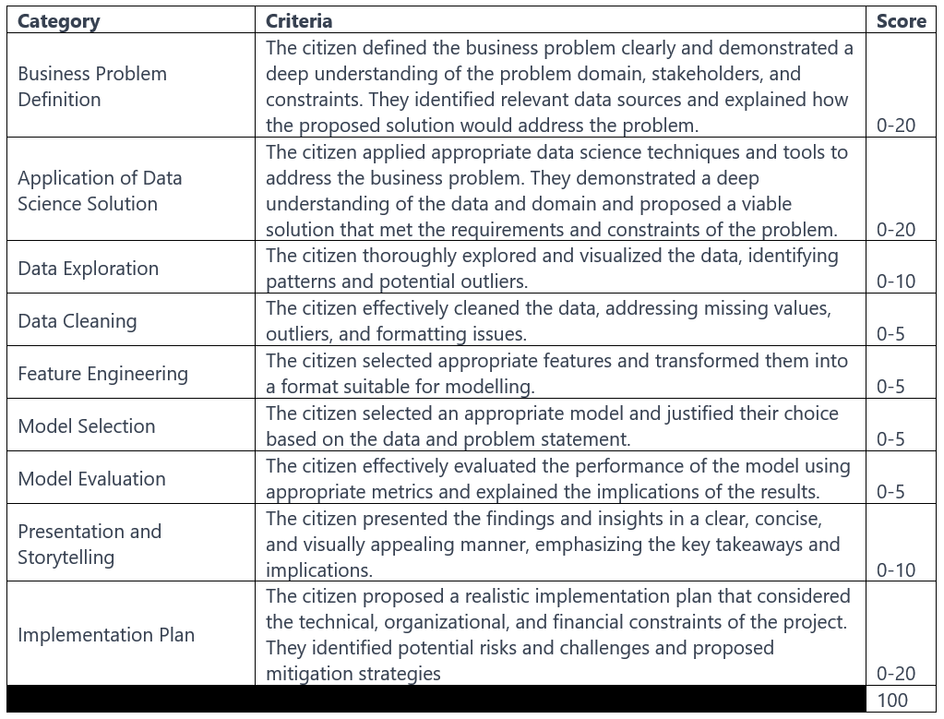
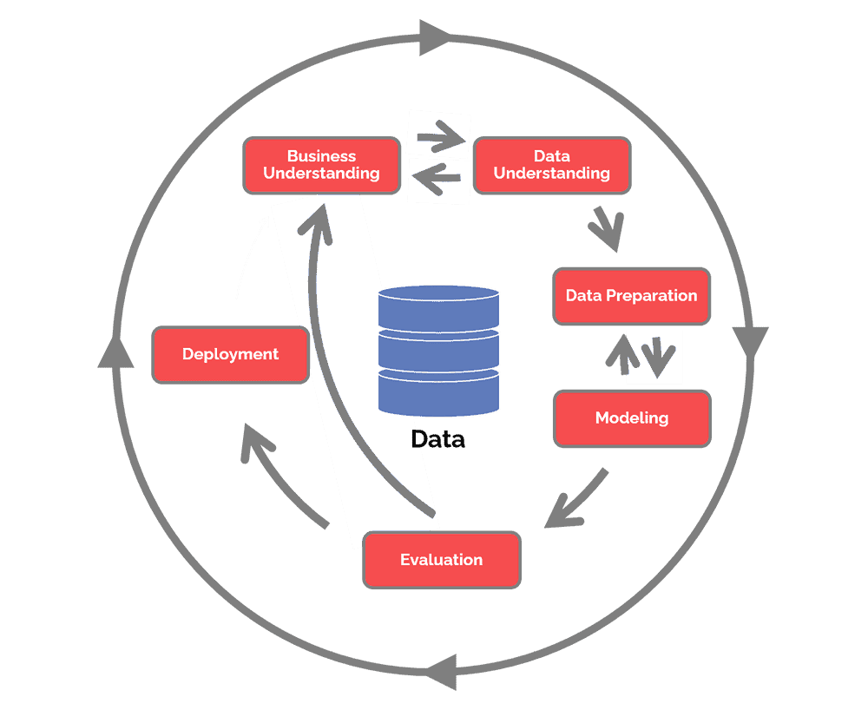
Business Problem
(Be guided by the rubric for each section)

Slide 3
Business Poblem | <…..name of the problem>
What are you trying to solve?
Why this matters for Vodacom
What Data Are you using ?

Slide 4
Data Exploration
Insert your plots, insights and visualisations

Slide 5
EDA : Exploratory Data analysis
Interesting Facts about the data and how they relate to the business problem
Why this matter for Vodacom

Slide 6
Attributes Mind Map: Key Data points to Predict ….....
Data Usage ….
Predicting Inactivity
Calling Pattersn

Slide 7

Data Science Solution
What : Data Prep
What : Modelling
What : Output
Voucher Recharge
Amount and Frequency
In-Bundle Activity
Minutes and Call count
MPESA Recharge
Amount and Frequency
Voice and Data Revenue
Out-of-Bundle Activity
Minutes and Call count
Probability of success in Airtime Advance campaigns
Modelling data
XGBoost classification model
Customer
Notes:
Summarize your range of features in the circle above.

Slide 8
Data Wrangling
In this section, summarize your data cleaning and feature engineering efforts. For example, how you worked with datetime columns provided; How you dealt with missing values etc.

Slide 9
Model snapshot : how accurate is you model
Model name | Big Data Citizen Program: <MARKET> <Challenge name>
Business goal | To identify customers that have a high probability of …
Model Base: | Active mobile portfolio
Training Data | e.g. Customer base where three months prior there was zero usage of Airtime Advance, followed by active usage.
Training period | January 2021 to March 2022, observing customer groups over this period.
Modelling Method | e.g.. Binary Classification (Extreme Gradient Boosting Classifier)
Justification for choice of algorithm
AUC, Sensitivity, Specificity on Test data | 0.86, 0.79, 0.76
Train / Test
 | Train | Test
AUC | 0.87 | 0.86
Sensitivity | 0.79 | 0.79
Specificity | 0.77 | 0.76
Notes:
Got a good sense of the context of the model, here is the snapshot of methods and output.
Specificity and Sensitivity: A higher sensitivity indicates a lower false positive rate and conversely a higher specificity indicates a lower false negative rate.

Slide 10
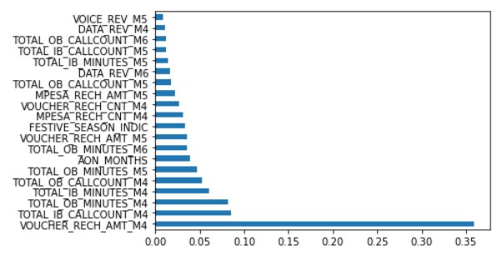
Feature Importance
Feature X is most predictive of the target variable whilst Feature Y is least predictive
Mention if any of your engineered features ranked highly
Top 5 Features
Feature 1 : This is why this make sense for this feature to be high for predicting XXXX
Feature 2 : This is why this make sense for this feature to be high for predicting XXXX
Feature 3 : This is why this make sense for this feature to be high for predicting XXXX
Feature 4 : This is why this make sense for this feature to be high for predicting XXXX
Notes:
feature_importance = pd.DataFrame(xgmodel.feature_importances_,index = X.columns,columns=['importance']).sort_values('importance',ascending=False)
feat_importances = pd.Series(xgmodel.feature_importances_, index=X.columns)
feat_importances.nlargest(30).plot(kind='barh')

Slide 11
Implementation plan
Key Performance Indicators
E.g. revenue uplift
E.g. Increased number of participants in market
Feasibility Study
Timelines and Work plan
E.g. Model development and implementation to be completed by 21st of August 2023.
First pilot will be run from the 30th October 2023.
The target base should be divided into 2 groups: one group that receives zero prompts (left alone to use product through own motivations) and another group that receives the campaign prompts via USSD.
Bonus if you can quantify the size of the opportunity
E.g. X number of customers churn each month. Average revenue per customer is Y amount. If the model can help retain 10% of customers who would otherwise churn, the company would retain Z amount of revenue.

Slide 12




Thank you Merci beaucoup Asante sana Ke a leboha Obrigado
Notes:
Demo of finished model aimed at increasing the uptake and usage of the Airtime Advance facility.
Use case summary, Training data design, Model flow, design and performance, EDA insights into chosen features and finally campaign strategy and pilot discussions

