Slide 1
Artificial Intelligence ECE 596A
Customer Segment Analysis via Clustering
AI Investigator
Mohit Kaushik - V01036315

Slide 2
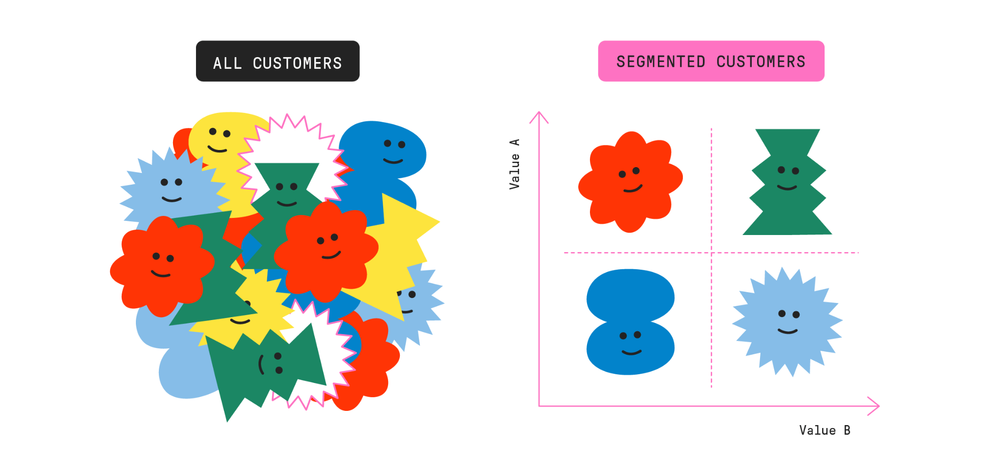

Slide 3
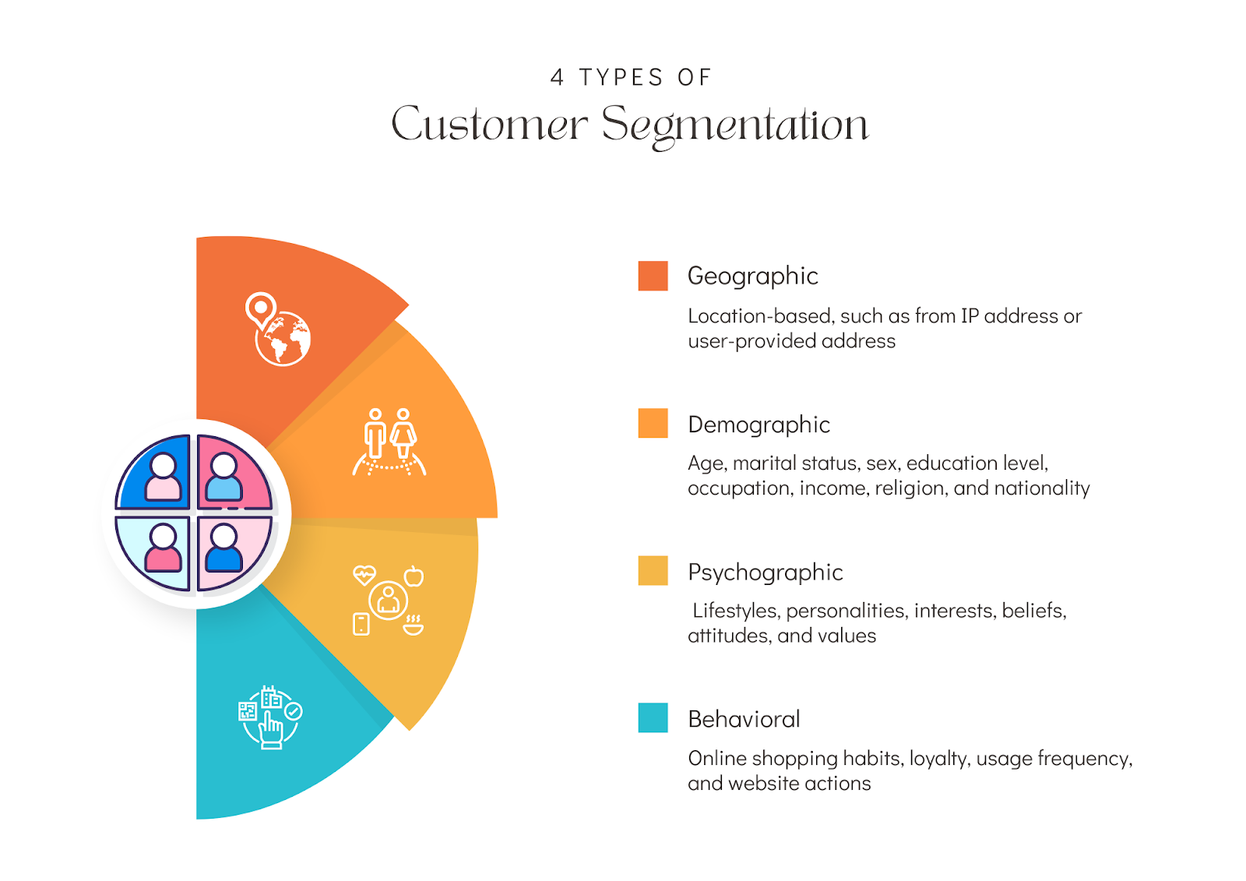

Slide 4
PROBLEM FORMULATION
Main goal is to create a customer segmentation system for the retail industry using agglomerative and divisive clustering. The objective is to determine which clustering algorithm is most appropriate by comparing the two clustering techniques.
Segmenting customer base is essential to the success of business. Customer segmentation improves customer engagement and retention while also boosting revenue for the company.
By resolving this issue, the company can identify unique customer segments, obtain insightful knowledge about its clientele, and create marketing plans that are specifically tailored to meet the needs of each group.

Slide 5
METHODOLOGY
Data collection
CRM ( customer relationship database) is used for customer segmentation, which is consisting of customers history regarding purchases, interaction, and demographic information.
Contains Purchases, amount spent, and time stamp of transaction.
Data Preprocessing
Data cleaning to remove null values.
Data Transformation: Normalization, encoding of categorical values, and converting data into standard format.
Dimensionality reduction using PCA.

Slide 6
Exploring categorical variables
Categorical Variable
Education
Marital Status
Graduation 1116
PhD 481
Master 365
2n Cycle 200
Basic 54
Married 857
Together 573
Single 471
Divorced 232
Widow 76
Alone 3
Absurd 2
YOLO 2

Slide 7
Feature Engineering
Customer's age is calculated from the birth year.
Total amount spent by a customer is found by summing up the values spend on Products.
Various categories of living status are converted into either couple or single. Number of Children are calculated by adding up the Teenhome and Kidhome. Summing up the Living status and Children for calculating the Family Size.
Segmenting the Education levels into 2 groups Undergraduate and Postgraduate.
Finally dropping the unwanted data variables such as Marital Status, Dt_Customer, Cost Contact, Revenue, Year Birth and ID.

Slide 8
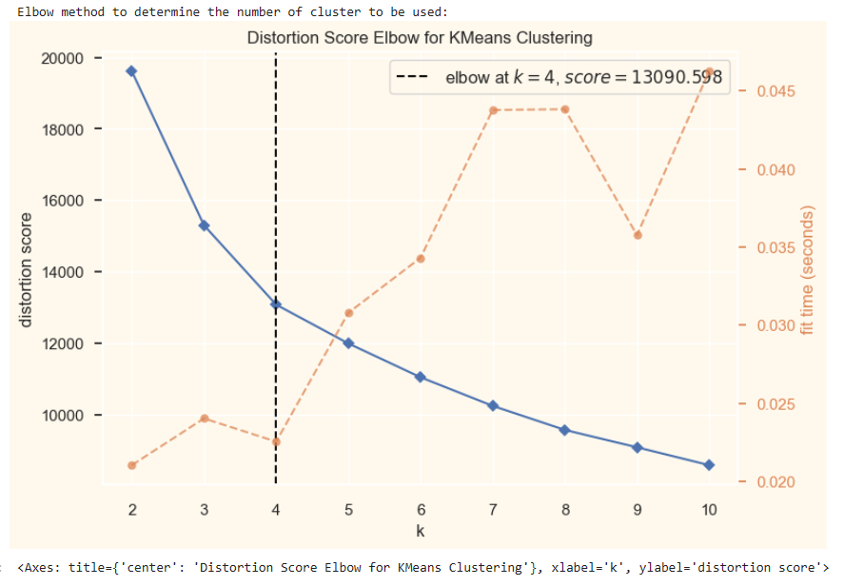
We used elbow method
to detect the number of
optimal clusters to be used
for this dataset
We found out that 4 will
be the optimal features we can
create for this problem.

Slide 9
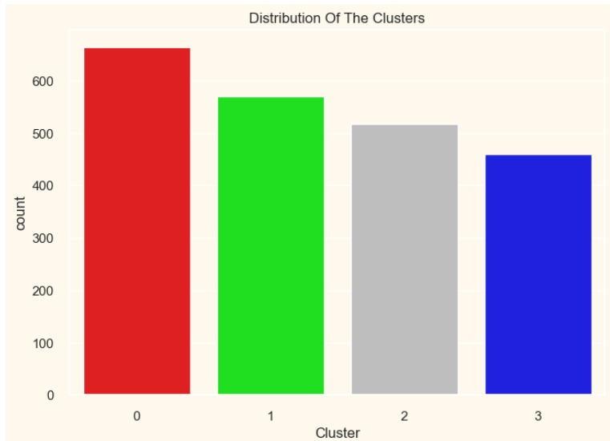
Agglomerative Clustering
The bar chart shows the number of data points
in each cluster
Cluster 0 (red) is the largest, followed by
cluster 1 (green), then cluster 2 (gray), and
cluster 3 (purple) is the smallest.
This suggests that there might be a dominant
customer profile or behavior captured by
cluster 0 that many customers share.

Slide 10
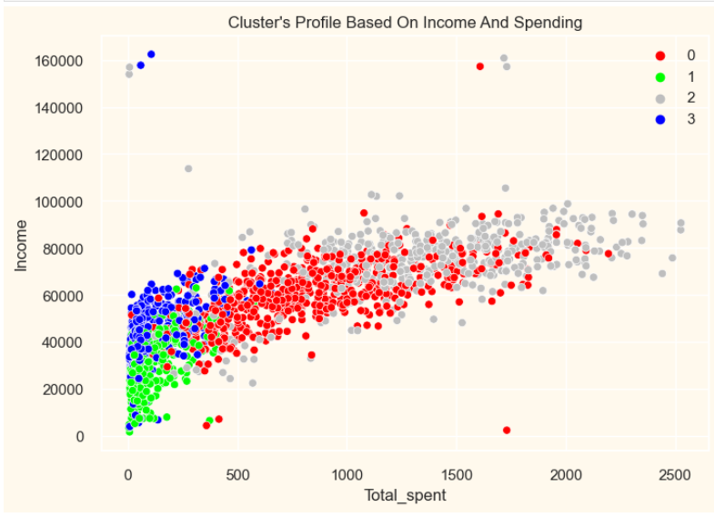
Agglomerative Clustering
The scatter plot shows a relatively clear differentiation between the clusters in terms of income and total spent.
group 0: high spending & average income
group 1: low spending & low income
group 2: high spending & high income
group 3: low spending & high income

Slide 11
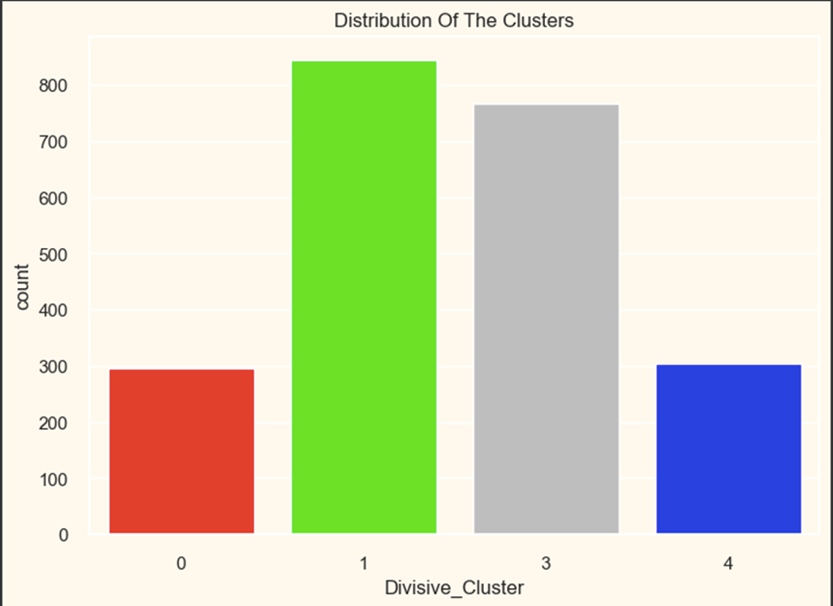
Divisive Clustering
The first bar chart indicates the number of
customers in each divisive cluster.
Cluster 1 is the largest, suggesting a common
set of characteristics shared by many customers
in this group. Clusters 0 and 4 are the smallest,
which might represent more unique customer
behaviors.

Slide 12
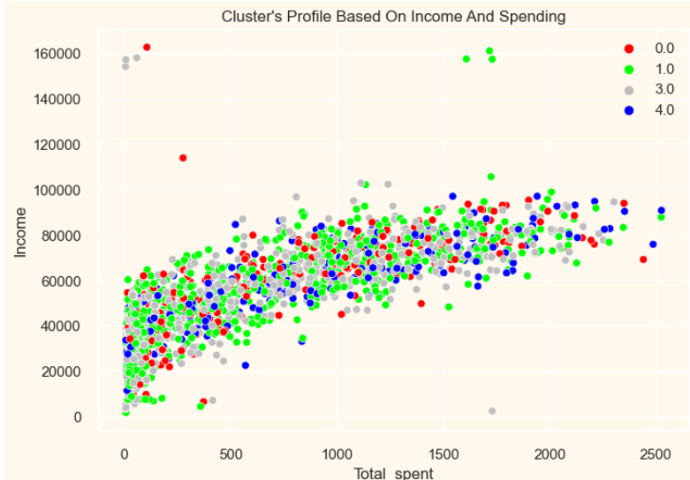
Divisive Clustering
Customers in divisive clusters display a range
of income and spending behaviors.
group 0: low spending & low income
group 1: low spending & spread income
group 2: average spending & average income
group 3: high spending & high income

Slide 13
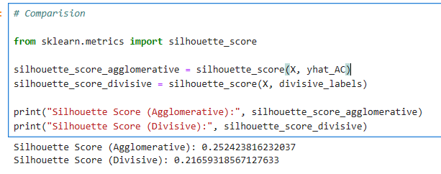
Result & Comparison
A score close to +1 indicates
that the object is well matched
A score close to -1 indicates
assigned to the wrong cluster
Agglomerative cluster perform
better than Divisive Clustering
on the basis of score.

Slide 14
FUTURE WORK
Expanding dataset to get additional information regarding each customer such as Social media usage, location and customer service call logs.
Integrating Machine learning models to predict the future buying behaviour of the customers. This potentially increase more personalized engagement with each customers.

