Slide 1

MEDICAL INSURANCE COST PREDICTION
J-Component Final Review
Team Members:-
- Ankan Roy
- Mohit Kaushik

Slide 2
Introduction :
A health insurance company can only make money if it collects more than it spends on the medical care of its beneficiaries. On the other hand, even though some conditions are more prevalent for certain segments of the population, medical costs are difficult to predict since most money comes from rare conditions of the patients.

Slide 3
Literature Survey/Motivation:
To predict things have been never so easy. Everyone used to wonder how Insurance amount is charged normally. So, in the mean time we came across this dataset and thought of working on it! Using this we wanted to know how few features determine our insurance amount!

Slide 4
Objectives:
Insurance is a policy that eliminates or decreases loss costs occurred by various risks. Various factors influence the cost of insurance.
The objective of this project is to accurately predict insurance costs based on people’s data, including age, Body Mass Index, smoking or not, etc.

Slide 5
Methodology:
We will determine what the most important variable influencing insurance costs is. These estimates could be used to create actuarial tables that set the price of yearly premiums higher or lower according to the expected treatment costs. This is a regression problem.

Slide 6
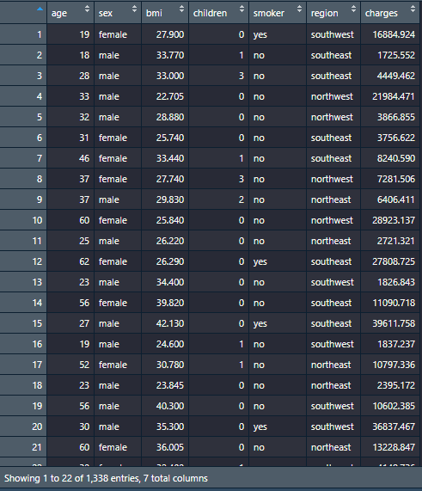
Data Sample:

Slide 7
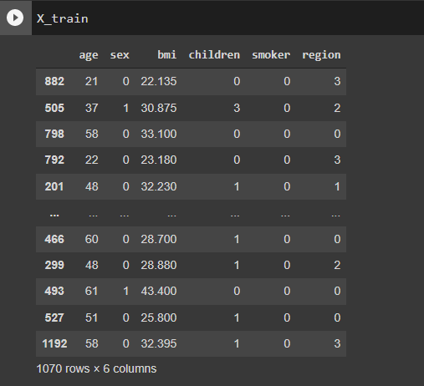
Train Data :

Slide 8
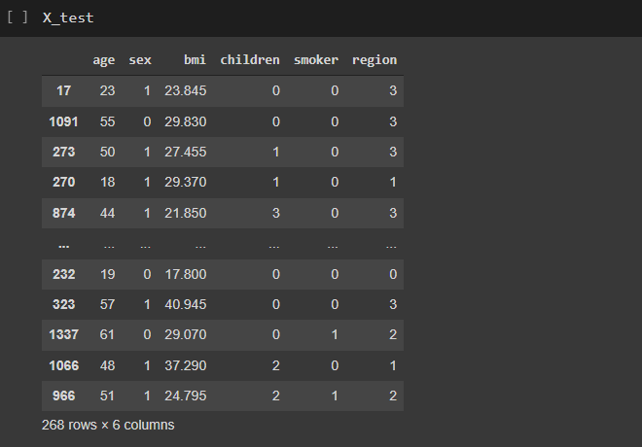
Test Data :

Slide 9
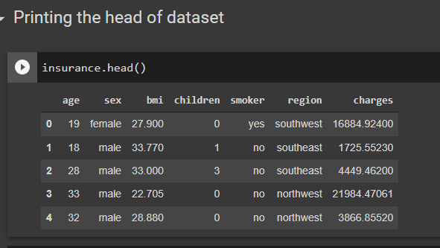
Implementation:

Slide 10
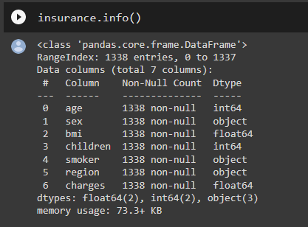
Dataset Information :

Slide 11
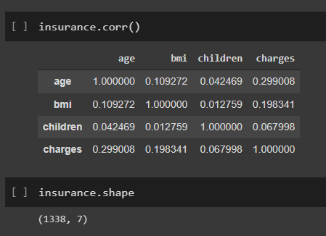
Correlation :

Slide 12
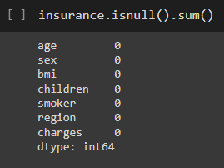
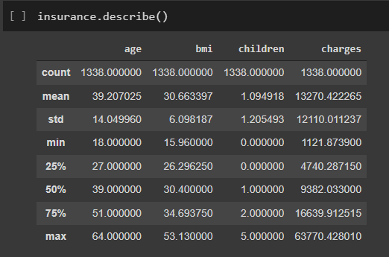
Data Pre-Processing :

Slide 13
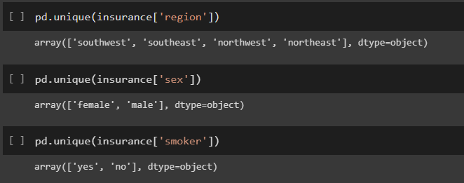

Slide 14
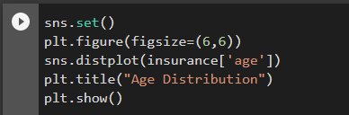
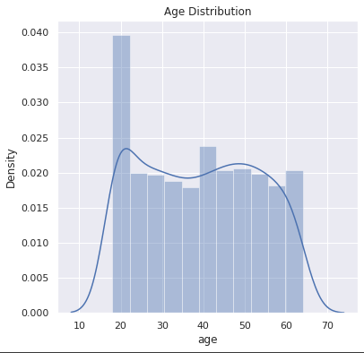
Data Visualization :

Slide 15
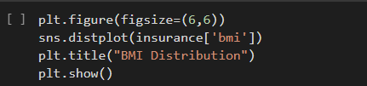
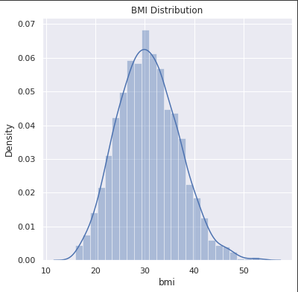

Slide 16
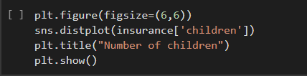
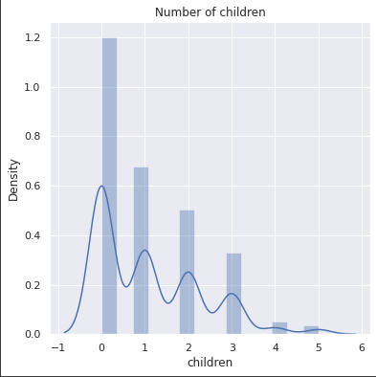

Slide 17
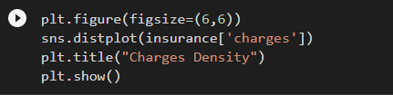
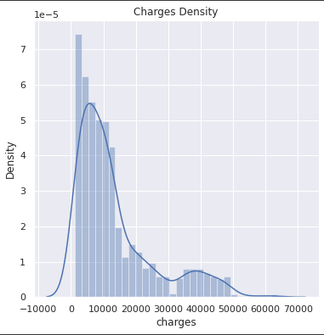

Slide 18
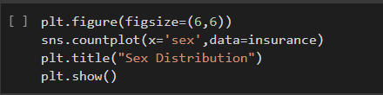
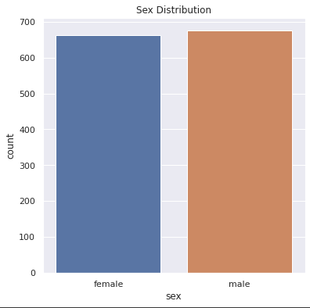

Slide 19
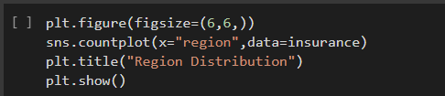
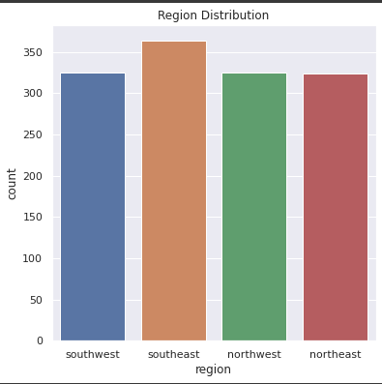

Slide 20
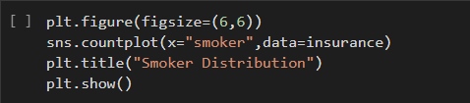
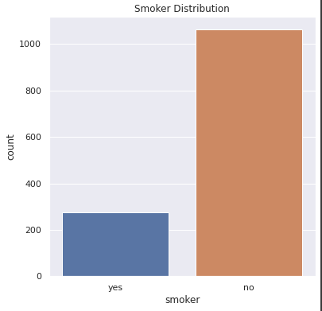

Slide 21
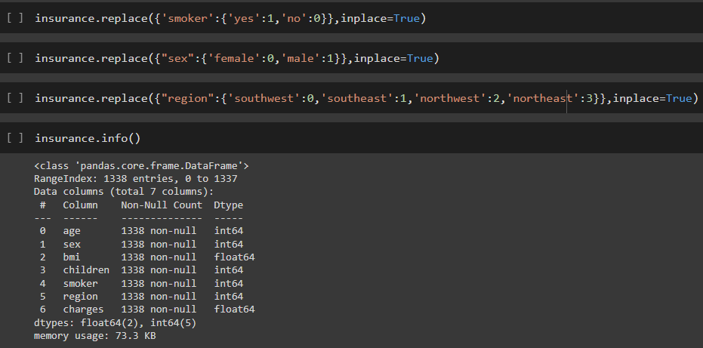
Encoding the Categorical value

Slide 22
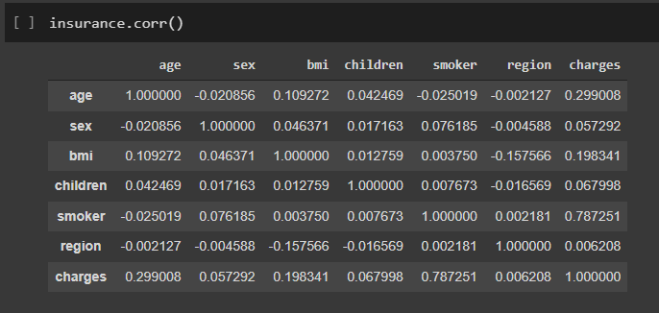
New Correlation Table :

Slide 23
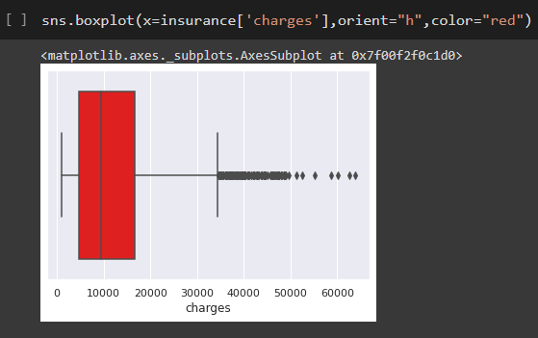
Outlier Detection and Correction

Slide 24
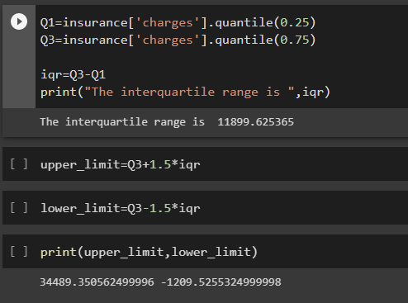
Outlier Detection and Correction

Slide 25
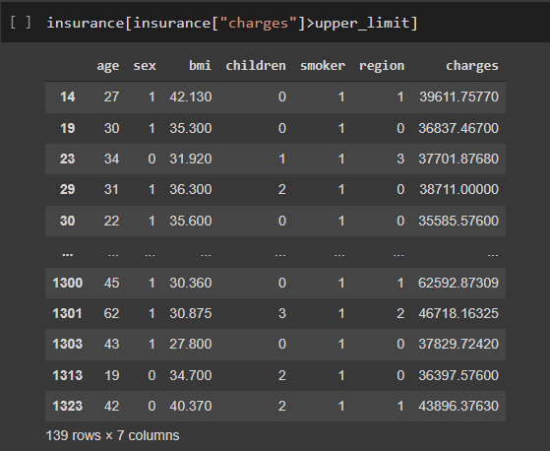
Values greater than Upper Limit

Slide 26
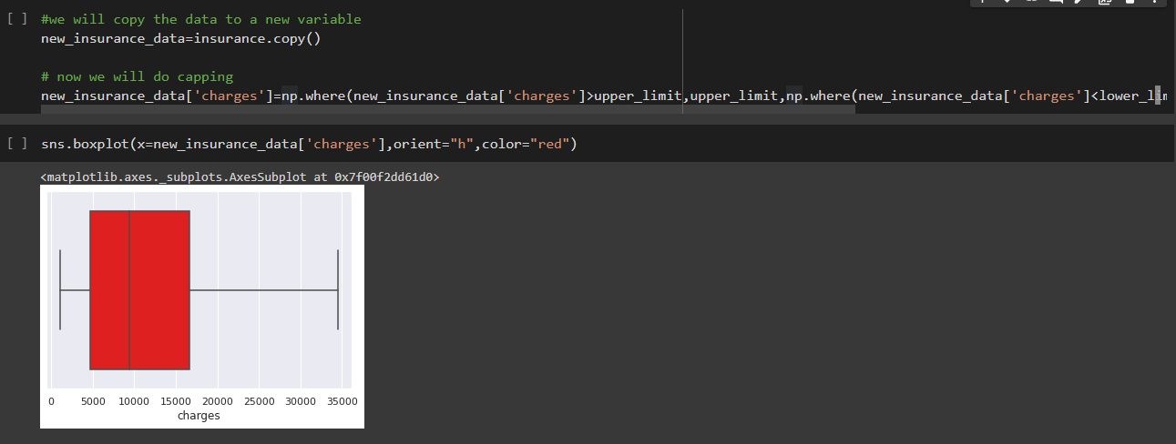
Outlier capping

Slide 27
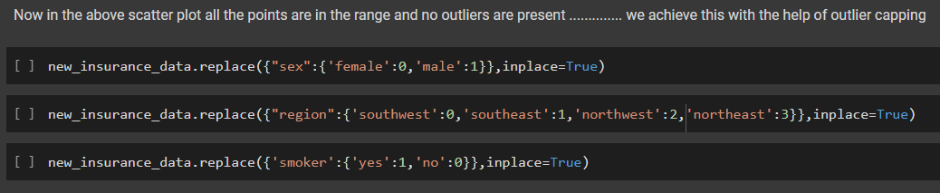

Slide 28
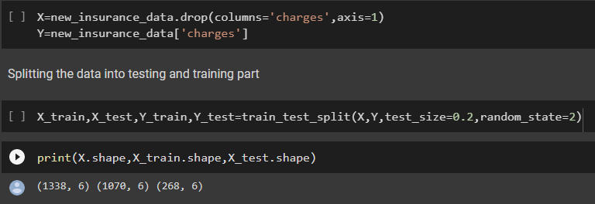
Splitting into Target and Feature(input) Attribute

Slide 29
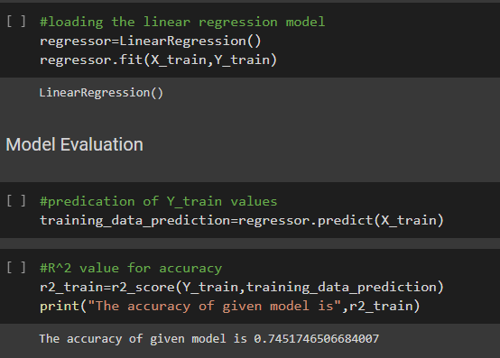
Model Training

Slide 30
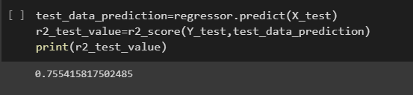
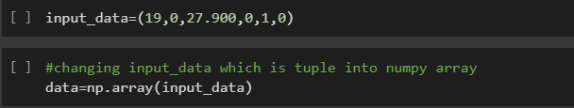
Prediction on test data
Prediction of value on the basis of given attribute

Slide 31
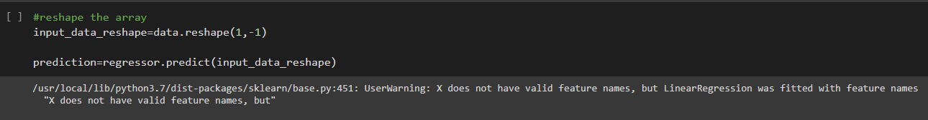


Slide 32
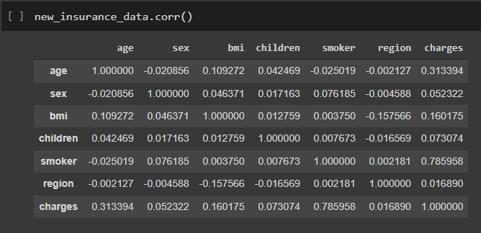

Slide 33
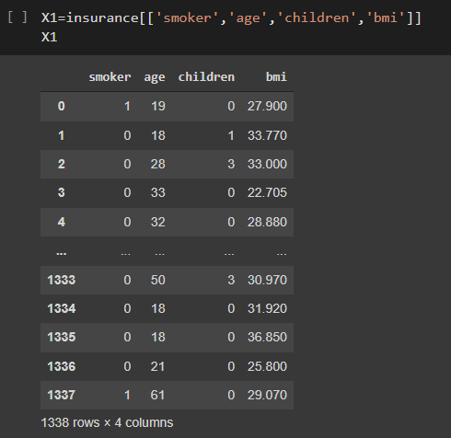
Multiple linear regression

Slide 34
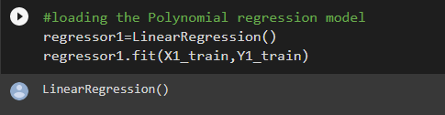
Multiple linear regression

Slide 35

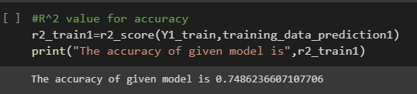
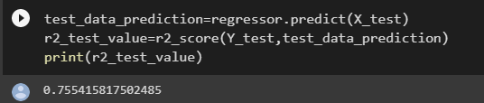
Multiple linear regression

Slide 36
Result:
#Accuracy value of both the model
Linear Regression Model
Accuracy value = 0.7451746506684007
Multiple Linear Regression Model
Accuracy value = 0.7486236607107706

Slide 37
Inferences :
We can conclude from the given result that the Polynomial Regression model gives more accurate result as compared to Linear Regression Model. However, some assumptions on Linear Regression may break down in the process. Also, smoking is not good for your wallet and health!!

Slide 38
References :
A. K. Dutta, N. Ali Aljarallah, T. Abirami et al., “Optimal deep-learning-enabled intelligent decision support system for SARS-CoV-2 classification,” Journal of Healthcare Engineering, vol. 2022, Article ID 4130674, 14 pages, 2022.
J. Mohana, B. Yakkala, S. Vimalnath et al., “Application of internet of things on the healthcare field using convolutional neural network processing,” Journal of Healthcare Engineering, vol. 2022, Article ID 1892123, 2022.
L. Hu, L. Li, J. Ji, and M. Sanderson, “Identifying and understanding determinants of high healthcare costs for breast cancer: a quantile regression machine learning approach,” BMC Health Services Research, vol. 20, no. 1, pp. 1066–1110.

Slide 39
M. A. Aefa, M. Mahmoud, and M. M. Nassar, “Parameter estimation for a mixture of inverse chen and inverse compound Rayleigh distribution based on type-I hybrid censoring scheme,” Journal of Statistics Applications & Probability, vol. 10, no. 3, pp. 647–663,
W. A. Afifi and A. H. El-Bagoury, “Optimal multiplicative generalized linear search plan for a discrete randomly located target,” Information Sciences Letters, vol. 10, no. 1, pp. 153–158, 2021.
Davenport, T. H., Harris, J. G., Competing on Analytics: The New Science of Winning, Harvard Business School Press.
Bailey, R. A., Simon, L. J., “An Actuarial Note on the Credibility of a Single Private Passenger Car”, Proceedings of Casualty Actuarial Society, Vol. LVII, Casualty Actuarial Society.
Bulhmann, H., “Experience Rating and Credibility”, ASTIN Bulletin IV, Part III

