Slide 1
DISASTER RECOVERY with IBM Cloud Virtual Servers
Phase 4: Development Part 2
In this part you will continue building your project:

Slide 2
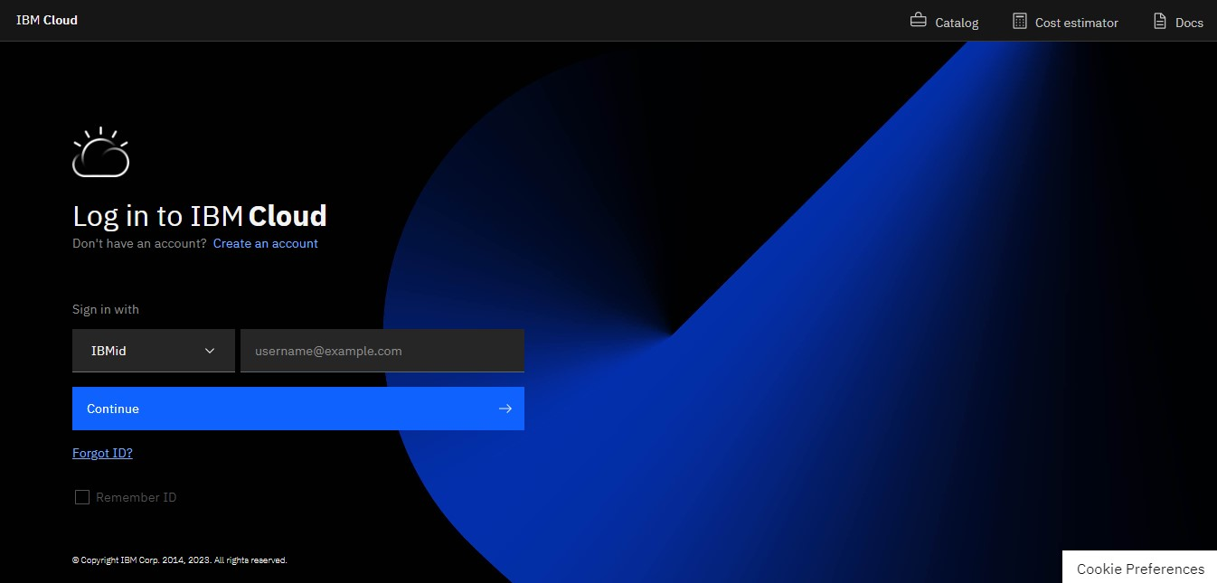
STEP1 :Login to IBM cloud

Slide 3
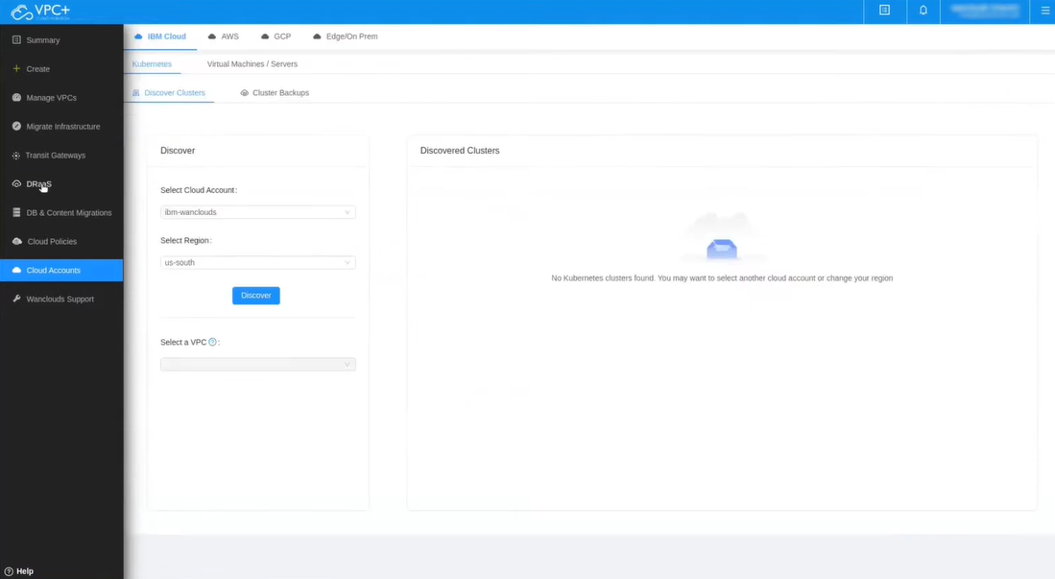
STEP2 : Visit DRaaS

Slide 4
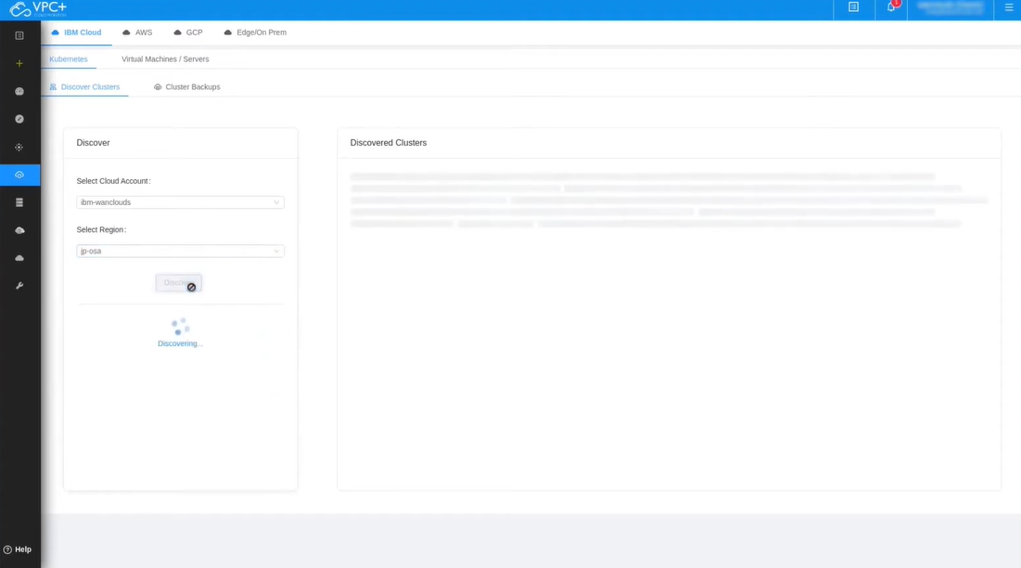
STEP3 : To discover the cluster select the appropriate cloud account,cloud region and select the VPC.

Slide 5
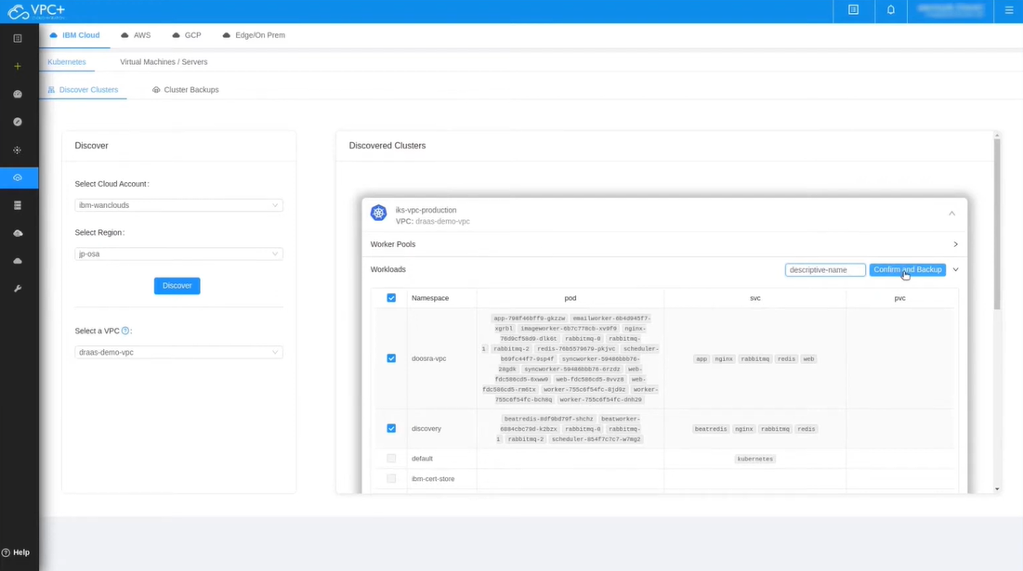
STEP4 : Then go to worker pools and add workloads and create backup with valid name.

Slide 6
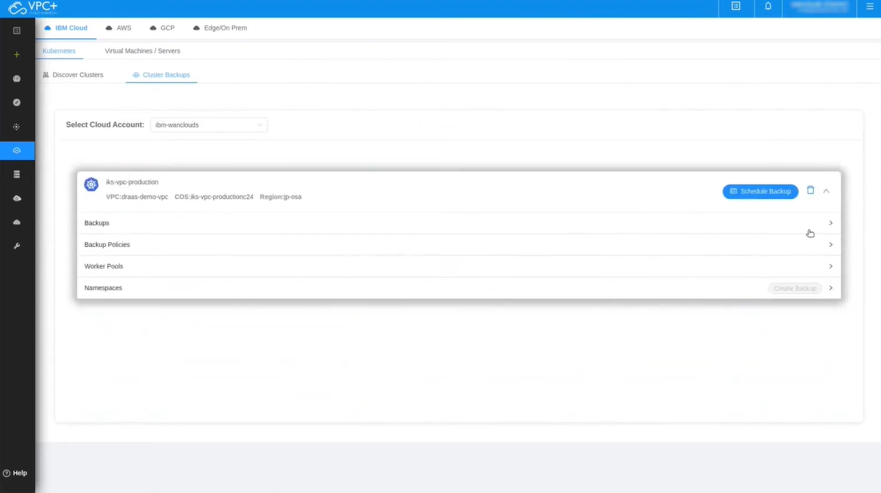
STEP5 : Then go to cluster backups and schedule the backups.

Slide 7
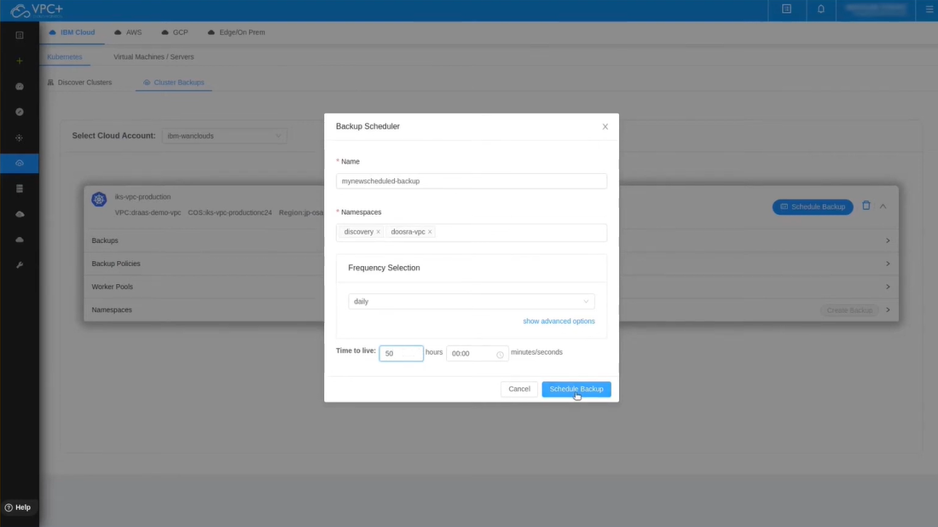
STEP6 : Fill the name,namespace and frequency Selection and time to live and click schedule backup.

Slide 8
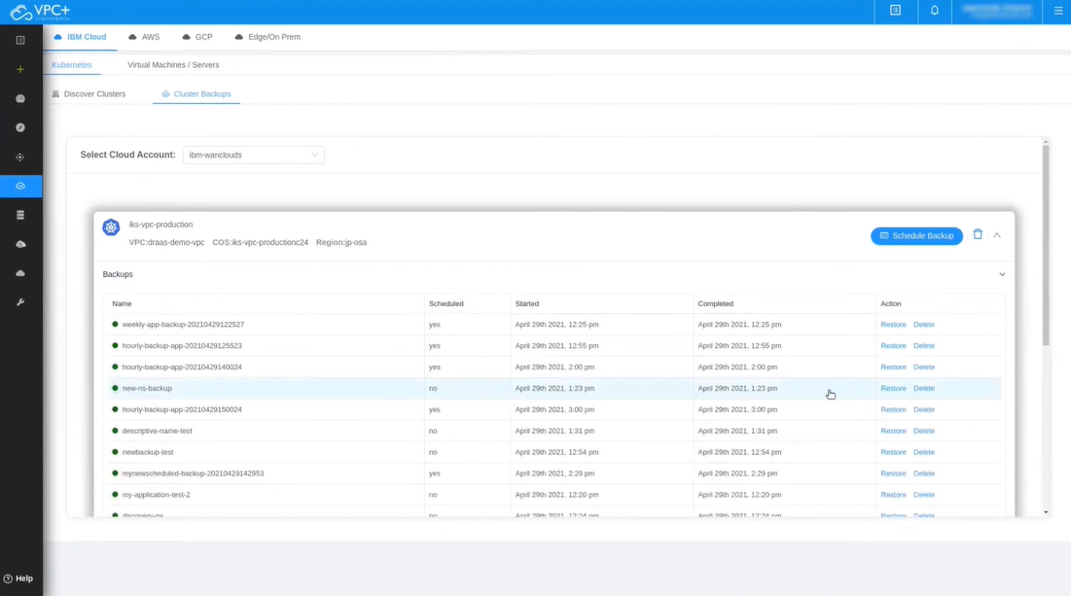
STEP7 : Go to backups and find the backup which was created in the previous step.

Slide 9
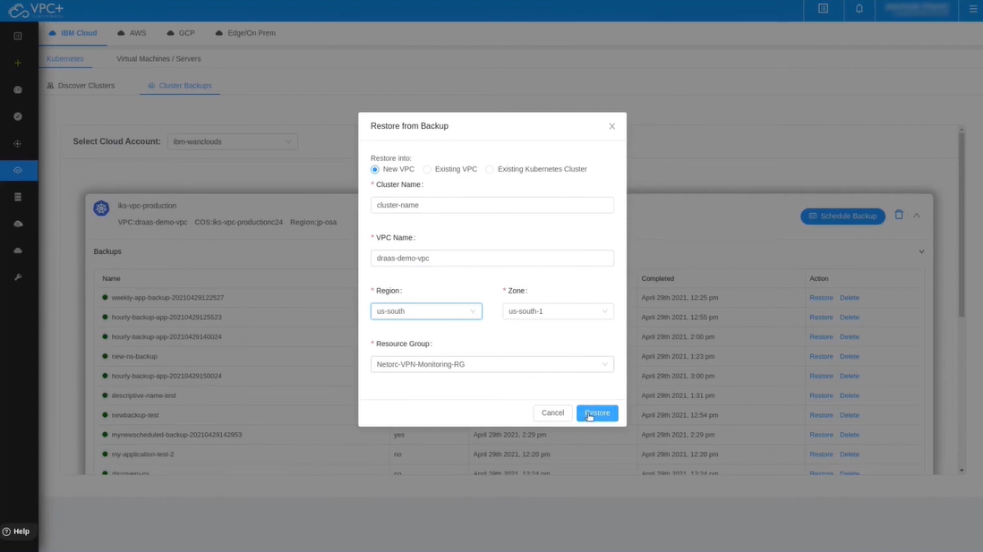
STEP8 : Select new vpc option and fill the appropriate details of the cluster and vpc.

Slide 10
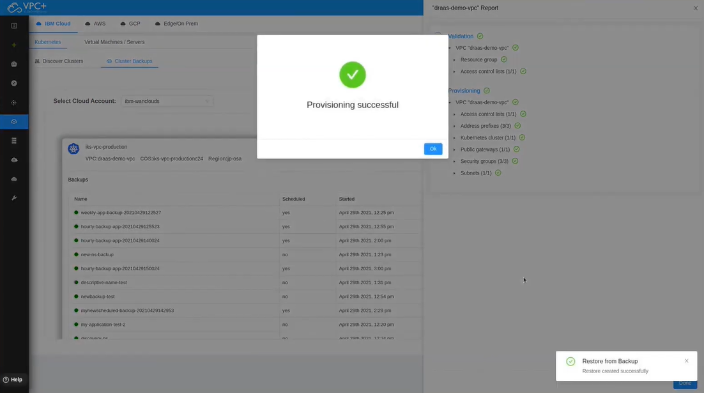
STEP9 : At the end , we finally created the disaster recovery plan.

Slide 11
BUSINESS PERSPECTIVE
Cost-Effective Solution:
IBM Cloud offers a pay-as-you-go pricing model, which can be more cost-effective than traditional disaster recovery solutions that require significant upfront investments in hardware and infrastructure.
Geographic Redundancy:
IBM Cloud provides multiple data centers and regions worldwide, allowing businesses to replicate their data and applications across geographically diverse locations for redundancy and data protection.
Hybrid Cloud Integration:
IBM Cloud can seamlessly integrate with on-premises infrastructure or other cloud providers, enabling businesses to create a hybrid disaster recovery strategy that fits their needs.
Disaster Recovery as a Service (DRaaS):
IBM Cloud offers Disaster Recovery as a Service, allowing businesses to implement a comprehensive disaster recovery plan without the need for extensive in-house expertise. This reduces the burden on IT staff and accelerates recovery efforts.

