Slide 1
DISASTER RECOVERY with IBM Cloud Virtual Servers
Phase 4: Development Part 2
In this part you will continue building your project:

Slide 2
Innovation ideas
1)Cognitive Recovery Validation: Implement AI-driven simulations for recovery testing, allowing for more comprehensive and predictive testing scenarios, reducing downtime risk. 2)Dynamic Continuity Management: Integrate AI to dynamically adjust the disaster recovery plan based on real-time data, ensuring alignment with the evolving business continuity strategy. 3)Cognitive Forecasting disaster: Implement AI-driven disaster prediction models that can forecast potential disasters, enabling proactive disaster recovery planning. 4)AI-Enhanced Backup Strategies: Utilize AI algorithms to intelligently schedule backups, prioritizing critical data and configurations, and optimizing resource allocation.

Slide 3
Advantages of using these features
*Proactive planning: Predicting disasters in advance allows for proactive preparation, reducing the element of surprise during disaster events and ensuring timely response *Resource optimization: AI-driven backups optimize resource allocation, ensuring efficient use of storage and computing resources, reducing costs, and minimizing data loss. *Comprehensive testing: AI-driven simulations enable more thorough and predictive testing, reducing downtime risk and ensuring the effectiveness of recovery procedures.

Slide 4
Types of Failures in IBM Cloud:
Software Failures:
Operating System or Application Failures: Software glitches, crashes, or misconfigurations can lead to service disruptions.
Cyberattacks:
DDoS Attacks: Distributed Denial of Service attacks can overwhelm IBM Cloud services, causing unavailability.
Data Breaches: Unauthorized access or data theft can compromise the confidentiality and integrity of data.
Malware and Ransomware: Malicious software can infect systems, encrypt data, and demand ransoms.
Human Errors:
Configuration Mistakes: Misconfigurations can lead to data loss or service disruptions.
Accidental Data Deletion: Inadvertent data deletion can cause data loss.
Regulatory and Compliance Issues:
Non-Compliance: Violation of regulatory requirements can lead to service interruptions or legal consequences.
Data Center Outages:
Data Center Failures: Entire data centers can experience outages due to various causes.

Slide 5
Ideas:
Cognitive Disaster Preparedness:
Implement AI-driven disaster prediction models that can forecast potential disasters, enabling proactive disaster recovery planning.
AI-Enhanced Backup Strategies:
Utilize AI algorithms to intelligently schedule backups, prioritizing critical data and configurations, and optimizing resource allocation.
Blockchain-Based Immutable Replication:
Employ blockchain technology to create immutable and secure data replication to IBM Cloud Virtual Servers, ensuring data integrity and security.
AI-Powered Recovery Testing:
Implement AI-driven simulations for recovery testing, allowing for more comprehensive and predictive testing scenarios, reducing downtime risk.
Adaptive Business Continuity:
Integrate AI to dynamically adjust the disaster recovery plan based on real-time data, ensuring alignment with the evolving business continuity strategy.

Slide 6
Recovery Strategy:
A disaster recovery strategy is a comprehensive plan that an organization develops to recover its IT systems and data in the event of a disruptive incident, such as natural disasters, hardware failures, cyberattacks, or other emergencies.
Recovery Time Objective (RTO):
RTO is a crucial metric that defines the maximum allowable downtime for IT systems and services after a disaster. It specifies the target time within which systems, applications, and data must be restored to full functionality.
Recovery Point Objective (RPO):
RPO is another important metric that determines the maximum acceptable data loss in the event of a disaster. It represents the point in time to which an organization is willing to recover its data.
Priority of Virtual Machines:
When designing a disaster recovery strategy, it's essential to classify virtual machines (VMs) based on their importance and impact on business operations.

Slide 7

STEP1 :Login to IBM cloud

Slide 8
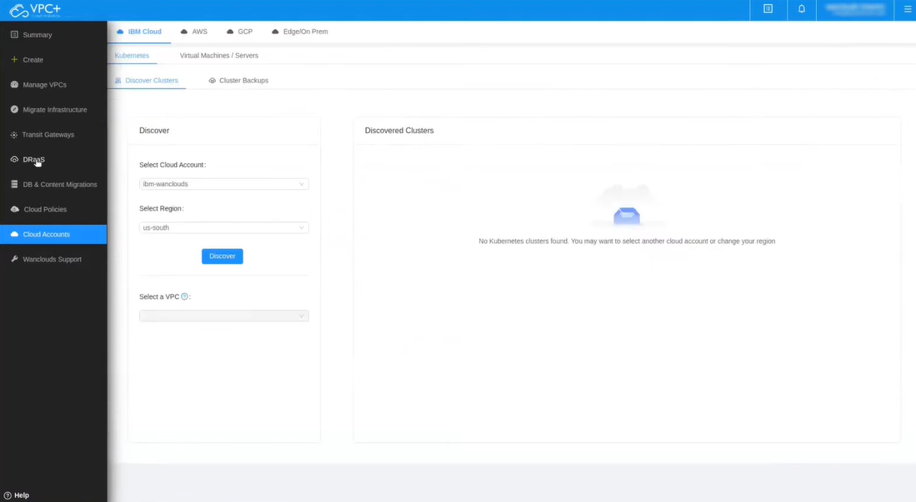
STEP2 : Visit DRaaS

Slide 9
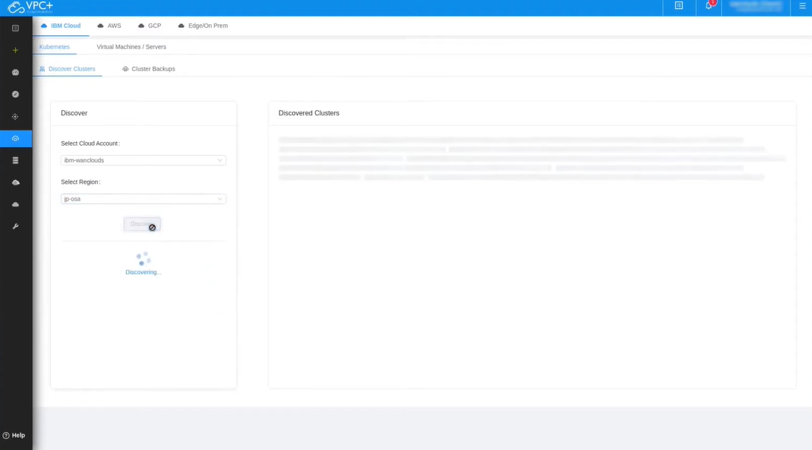
STEP3 : To discover the cluster select the appropriate cloud account,cloud region and select the VPC.

Slide 10
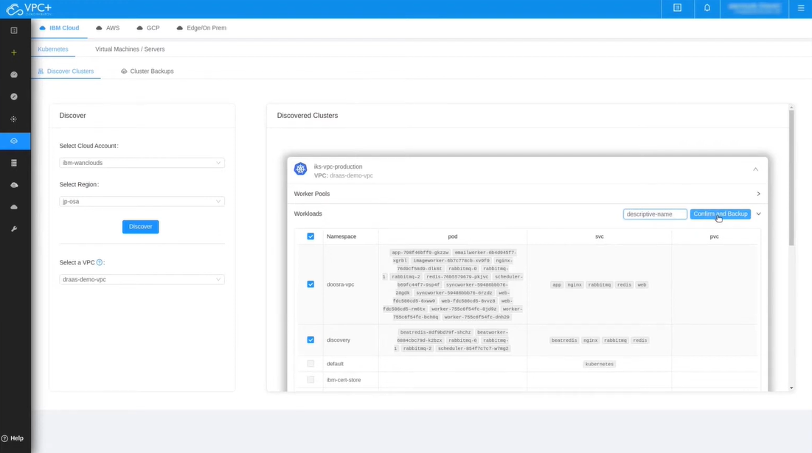
STEP4 : Then go to worker pools and add workloads and create backup with valid name.

Slide 11
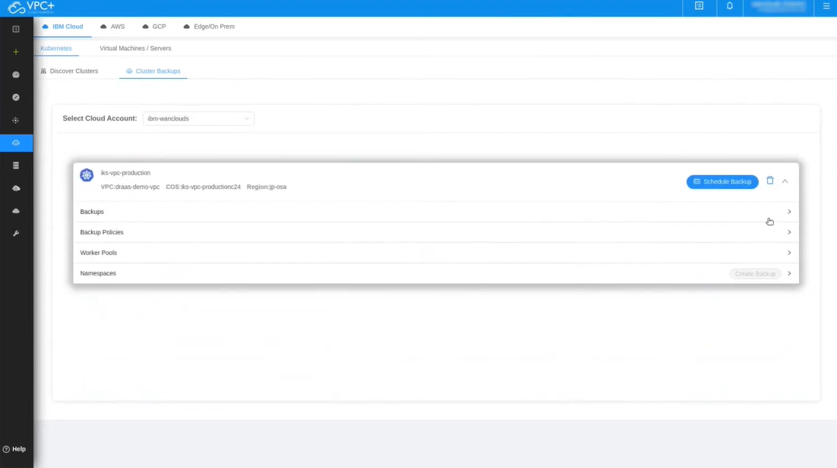
STEP5 : Then go to cluster backups and schedule the backups.

Slide 12
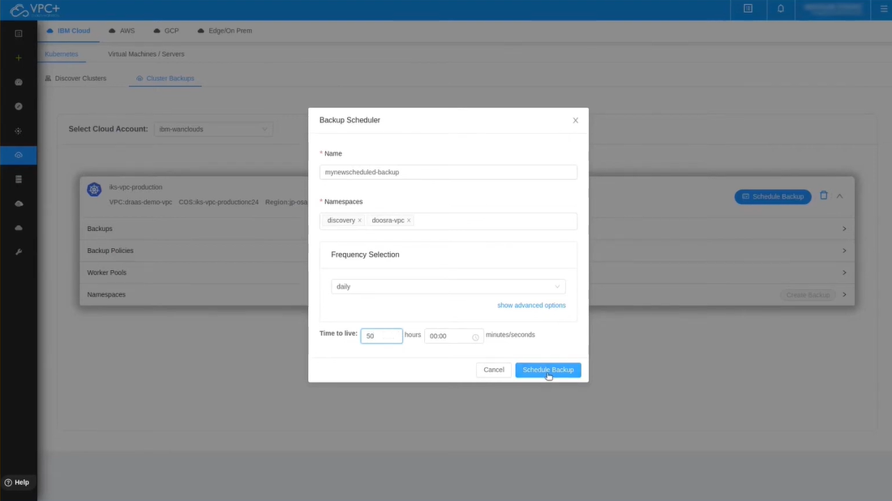
STEP6 : Fill the name,namespace and frequency Selection and time to live and click schedule backup.

Slide 13
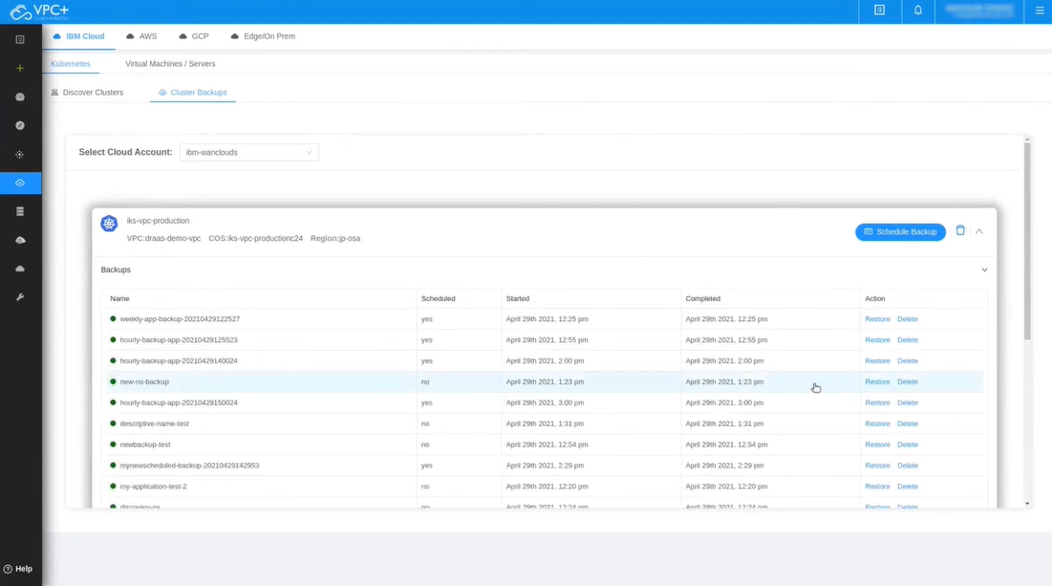
STEP7 : Go to backups and find the backup which was created in the previous step.

Slide 14
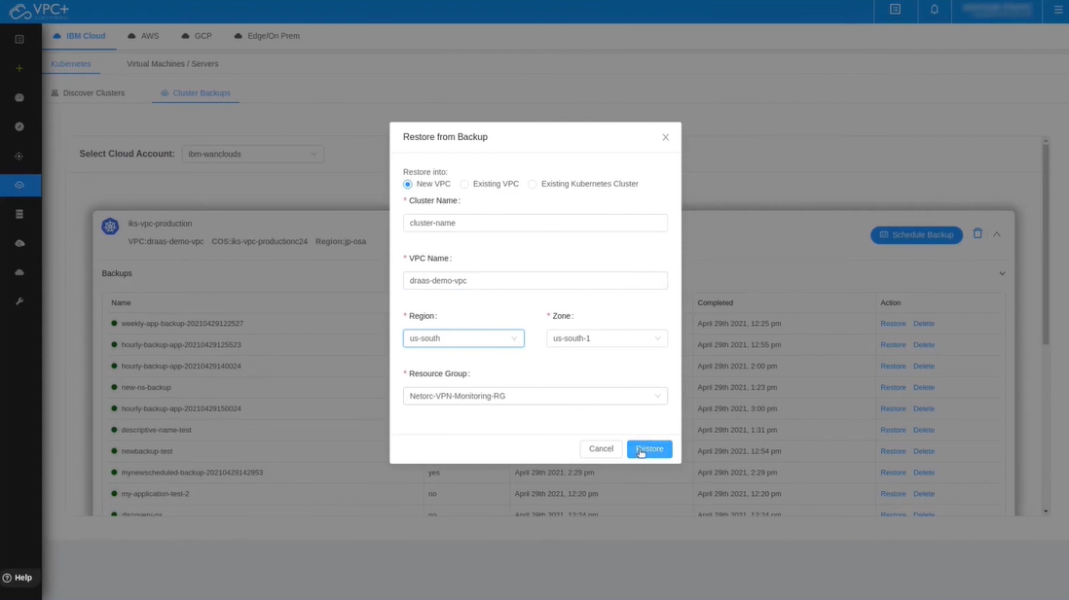
STEP8 : Select new vpc option and fill the appropriate details of the cluster and vpc.

Slide 15
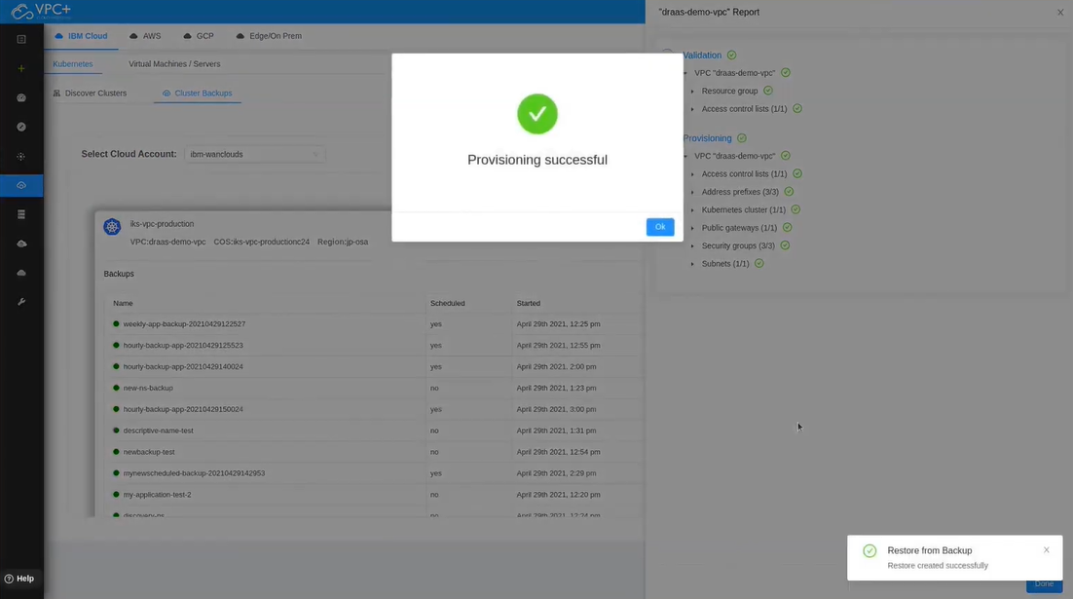
STEP9 : At the end , we finally created the disaster recovery plan.

Slide 16
BUSINESS PERSPECTIVE
Cost-Effective Solution:
IBM Cloud offers a pay-as-you-go pricing model, which can be more cost-effective than traditional disaster recovery solutions that require significant upfront investments in hardware and infrastructure.
Geographic Redundancy:
IBM Cloud provides multiple data centers and regions worldwide, allowing businesses to replicate their data and applications across geographically diverse locations for redundancy and data protection.
Hybrid Cloud Integration:
IBM Cloud can seamlessly integrate with on-premises infrastructure or other cloud providers, enabling businesses to create a hybrid disaster recovery strategy that fits their needs.
Disaster Recovery as a Service (DRaaS):
IBM Cloud offers Disaster Recovery as a Service, allowing businesses to implement a comprehensive disaster recovery plan without the need for extensive in-house expertise. This reduces the burden on IT staff and accelerates recovery efforts.

Slide 17
conclusion

