Slide 1







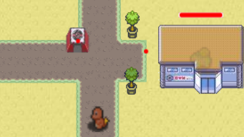
Retired from your days as a Pokémon trainer, you decided to build yourself a nice Pokémon gym, and settle down to a quiet life of battling any challenging trainers. One day, however, you discover that a rival gym master has set up a gym just across the river from you, and is intent upon sending his Pokémon to destroy your gym. You vow that you will not let this mystery trainer destroy you. After all, you want to be the very best….
Purchase and train Pokémon to attack the other gym
2. Purchase and place buildings to defend your own gym
3. Run the round to see how your Pokémon faired that day

