Slide 1

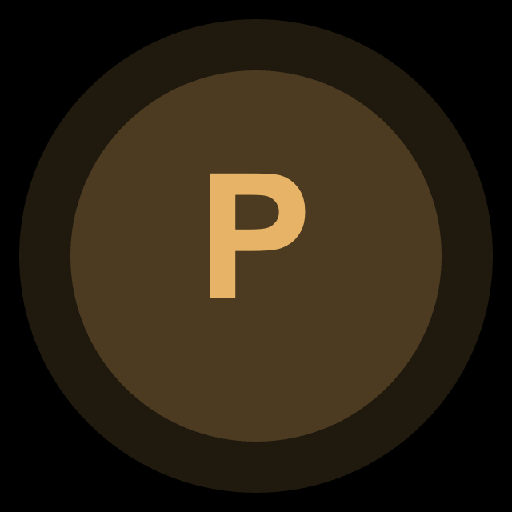

Business Milestone 3 | Simplified Current Solution
A 3-step owner-first workflow that turns accident chaos into a structured, AI-supported claim.
ACCIDENT
OUTPUT
OUTPUT
1. Claim preparation
2. Structured case package
3. Post-submission copilot
At-scene capture: time, GPS, photos, other driver info
One-click packaging compiles facts, timeline, and attachments
Multi-party chat connects owner, adjuster, shop, and family
Guided checklist prevents missing key evidence
Creates a standard claim packet instead of scattered screenshots and calls
AI answers policy / regulation questions in real time
Back-home writing assistant turns raw notes into a clean narrative
The case starts with context already organized
Dispute detector + deadline reminders support fair follow-up
Core idea: ClaimMate is not just a chatbot. It converts unstructured accident information into a shared case context before communication starts.
Based on the team's original proposal and slides (technical architecture + moat sections).

Slide 2
How ClaimMate is Different from Existing Solutions
Existing tools optimize insurer operations. ClaimMate gives the information advantage to the car owner.
Existing insurer-first tools
B2B
ClaimMate owner-first model
B2C
Sold to insurers to lower handling cost and automate internal workflows
Single → multi-party growth
Dual-knowledge RAG
User policy
+
Authoritative legal / claims documents
The owner gets value alone first, then invites adjusters / repair shops into an already-structured case.
User (car owner) is mostly a data source, not the decision center
Little transparency on coverage, deadlines, or dispute rights
Less hallucination, more verifiable answers.
Solves cold start naturally.
Communication remains fragmented across calls, emails, and portals
Why it is novel
Typical workflow
Instead of helping insurers process claims faster, we help owners understand coverage, track deadlines, and negotiate with evidence and legal context.
Owner reports
Insurer decides
Owner waits

Slide 3
Why Our Team Can Build It
Novelty is not only the idea; it is the integration of domain workflow, architecture, and product strategy.
Integrated technical stack
Why us
UI layer
Application layer
AI core
1
We understand the domain pain point
The proposal is grounded in real claim friction: missing evidence, unclear coverage, slow adjuster responses, and unfair negotiation.
Web app
WebSocket group chat
Dual-knowledge RAG
Android flow
Accident form generator
Dispute detector
2
We designed a defensible technical moat
Dual-knowledge RAG + dispute/deadline logic is more than a generic chatbot wrapper.
Invitation link system
Deadline reminder
Photo guidance
3
We solved adoption at the workflow level
Owner-first usage creates immediate value; invitation links bring professionals into the same context without a forced platform rollout.
These pieces only create value when they work together in one claim workflow.
Closing message: ClaimMate is novel because it changes who AI is built for in claims — and credible because our architecture and product flow are already designed around that shift.

