Slide 1

AMD Unsloth GRPO Fine-tuning
Malini Bhandaru | Shailen Sobhee
Notes:
Welcome. Today we fine-tune a small open model with Unsloth on an AMD Radeon GPU, and we teach it to play Sudoku using GRPO reinforcement learning. Hands-on: everyone gets a hosted Jupyter notebook on a real AMD GPU.

Slide 2

Notebook access
notebooks.amd.com/ind-dev
Password: RadeonUnslothTuning

Slide 3

Agenda
01
Fine-tuning: what and when
The problem it solves
02
Types of fine-tuning
LoRA, QLoRA, SFT, GRPO
03
The Unsloth advantage
Faster, leaner, no-code
04
A game of Sudoku
Our reward-driven task
05
AMD Radeon GPU
rocm-smi and rocminfo
06
Hands-on notebook
Run it yourself
Notes:
Six blocks. First half is concepts, second half is hands-on on the GPU.

Slide 4
Part 1: The Concepts
What a model is, what fine-tuning changes, and how GRPO learns from rewards
Notes:
Quick grounding before we touch the GPU.

Slide 5

What is a Large Language Model?
A neural network trained on a huge amount of text so it can predict the next token given what came before.
That one simple skill, done at enormous scale, is enough to chat, summarise, write code and reason.
next-token prediction
prompt > The capital of France is
Paris 0.94
a city 0.03
located 0.01
Base models
Instruct models
Generalists
Raw next-token predictors. Great starting point for training, awkward to chat with.
Further trained to follow instructions and hold a conversation.
Llama, Qwen, Mistral on Hugging Face know a bit of everything, your job in particular: no.
Notes:
An LLM predicts the next token. Base versus instruct matters when you pick a checkpoint: for GRPO from scratch we usually start from a base or a small instruct model.

Slide 6

What is fine-tuning? Why do it?
Take a pre-trained model and keep training it a little more on YOUR data, so it adapts to YOUR task, domain, tone or format.
1
2
3
4
Voice
Domain
Format
Focus
Speak in a specific style or persona: your brand, your support agent.
Know legal, medical, or your own product documentation.
Always return JSON. Always cite sources. Every time.
Do one narrow task extremely well, cheaply, on a small model.
Often cheaper and more reliable than stuffing everything into a giant prompt, or paying for an even bigger model. It lets a small model punch above its weight.
Notes:
Fine-tuning is not about teaching new facts so much as new behaviour: style, format, and task focus. It is frequently cheaper than prompt engineering at scale.

Slide 7

LoRA and QLoRA
Parameter-efficient fine-tuning: freeze the giant model, train a tiny adapter.
LoRA
Low-Rank Adaptation
QLoRA
Quantized Low-Rank Adaptation
• Inject small low-rank matrices into chosen layers
• Original weights stay frozen, only adapters train
• Trainable parameters drop by orders of magnitude
• Everything LoRA does, plus a 4-bit base model
• Cuts VRAM again, so bigger models fit on one GPU
• The usual answer to an out-of-memory error
~0.1%
4-bit
Comparable
of parameters trained
base weights under QLoRA
quality to full fine-tuning
Notes:
LoRA freezes the base model and trains small adapter matrices. QLoRA adds 4-bit quantization of the frozen base, which is what lets a workshop-size GPU handle a real model.

Slide 8
Training methodology: SFT and GRPO
Two ways to tell a model it did well. One shows the answer, the other scores attempts.
SFT
Supervised Fine-Tuning
GRPO
Group Relative Policy Optimization
• Uses labelled data: prompt in, correct answer out
• The model imitates the answers you supply
• No labelled answer needed, only a way to score one
• Model generates a group of attempts and compares them
{"instruction": "Summarize in one line.",
"input": "<article text>",
"output": "<summary>"}
1
Generate several candidate answers
2
Score each with a reward function
3
Prefer the ones that scored above the group
Notes:
SFT needs the right answer written down. GRPO only needs a judge. For Sudoku we can check a board programmatically, so a reward function is easy and GRPO is the natural fit.

Slide 9
The fine-tuning pipeline
Same spine either way. The data step is what differs.
SFT: pick data
Hugging Face, public sets, or upload your own
Pick a model
Choose
Train
Evaluate
Start small
LoRA or QLoRA
GRPO: generate data
Define the reward function
Training knobs
learning rate
number of steps
time limit
max sequence length
Notes:
Pick a small model first. SFT path: find or upload data. GRPO path: generate attempts and write a reward function. Then choose LoRA or QLoRA, train, evaluate. The knobs at the bottom are the ones you will actually touch in the notebook.

Slide 10
Unsloth
An open-source, no-code framework and UI for training, running and exporting LLMs locally, tuned for speed, memory efficiency and accessibility.
It sits as an optimized layer on top of Hugging Face Transformers, so your existing workflow still applies.
LoRA and QLoRA
Quantization
Optimized kernels
Consumer hardware
built in, no glue code
4-bit and 8-bit paths
faster attention and MLP
one GPU is enough
In this workshop
Unsloth is what makes a GRPO run finish inside a session slot instead of overnight.
Notes:
Unsloth is the accelerator layer. Same Transformers API, materially less memory and time.

Slide 11

Part 2: Hands-On
A game of Sudoku, an AMD Radeon GPU, and a notebook you drive yourself
Notes:
Now we switch to the machine.

Slide 12
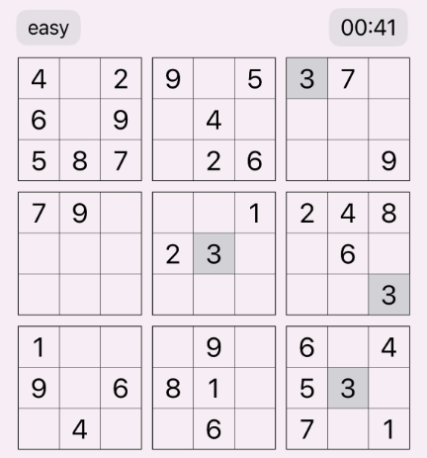
A game of Sudoku
Sudoku means “single number” in Japanese.
A logic puzzle: place digits 1 to 9 so every row, every column and every 3x3 box contains each digit exactly once.
Verifiable
A board is right or wrong. No human judge needed.
Reward-friendly
Score partial credit per correct cell, row and box.
Genuinely hard
A general model gets it wrong. Improvement is visible.
Our training task: an easy grid, scored cell by cell
Notes:
Why Sudoku for GRPO: correctness is checkable in code, so the reward function is a few lines. That is exactly the property GRPO needs.

Slide 13
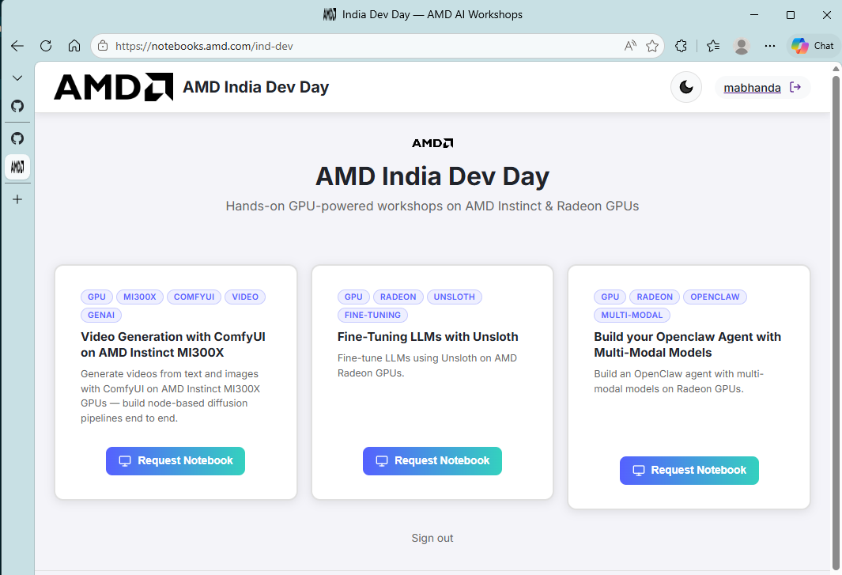
AMD Unsloth fine-tuning workshop
1
Open the portal
notebooks.amd.com/ind-dev
2
Enter the password
3
Pick the Unsloth card
Lands you on an AMD Radeon GPU
It is a real GPU, not a simulator
Hosted Jupyter, nothing to install locally
Notes:
Everyone go to notebooks.amd.com/ind-dev now. Password RadeonUnslothTuning. Choose the Fine-Tuning LLMs with Unsloth card.

Slide 14
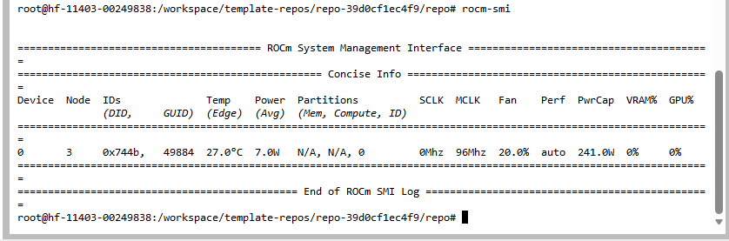
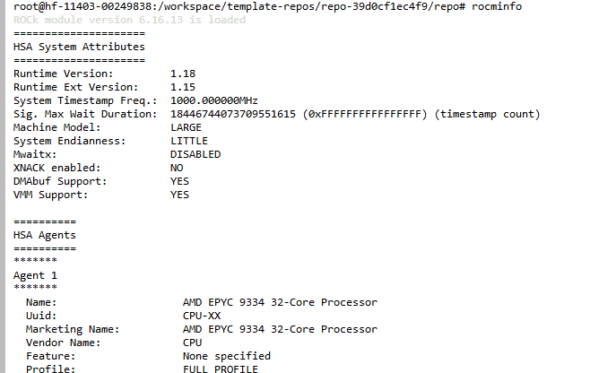
GPU visibility and health
Open a terminal inside Jupyter and confirm the GPU is really there before you train.
terminal
$ rocm-smi
$ rocminfo
rocm-smi
Live view: temperature, power, clocks, VRAM use
rocminfo
Static view: agents, ROCm version, GPU identity
rocminfo confirms the ROCm runtime version and every agent the host exposes, GPU and CPU alike.
GPU busy at 0% while a cell runs? It is not training.
Notes:
rocm-smi is the one you will keep open in a second tab. If utilisation is flat at zero while a cell shows an asterisk, something is running on CPU.

Slide 15
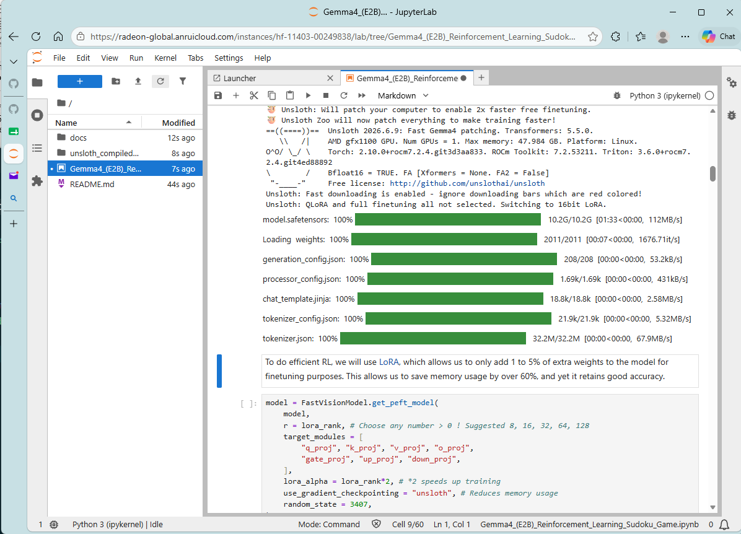
Driving the notebook
Run cells top to bottom. The first model load is the slow one.
Watch the marker
In [*] means still running, In [7] means done
Do not skip ahead
Later cells depend on variables the earlier ones define
Keep an eye on the GPU
Second terminal tab running rocm-smi
Cold start is normal
First load pulls weights. Retry a timed-out chat, the warm model is fast
Notes:
Cells run in order. The asterisk means the kernel is busy. Model download happens once.

Slide 16
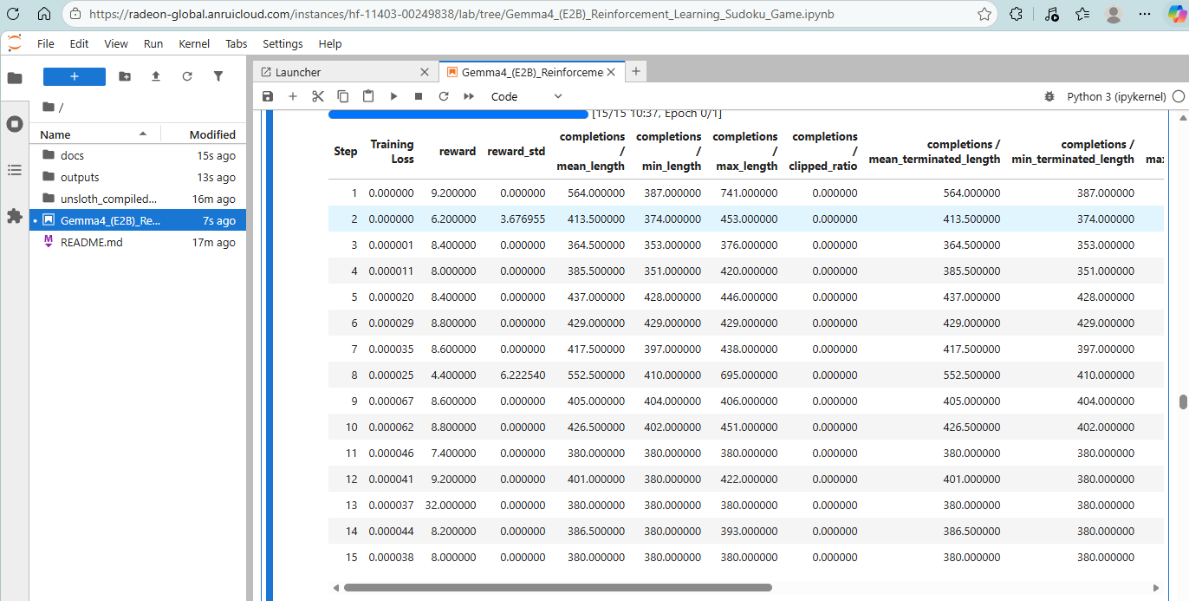
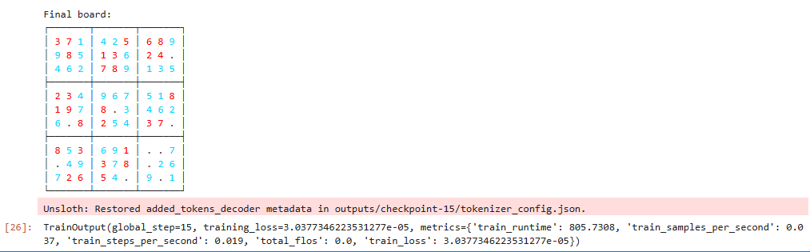
Fine-tuning complete
Fifteen GRPO steps on a Radeon GPU, and the reward curve moves.
DEMO: 15 STEPS
Final board produced by the tuned model
What to look for
• Reward trending up, not the absolute value
• A structurally valid board, no repeated digits
Per-step training loss and reward, straight from the notebook
Notes:
Fifteen steps is a demo, not a converged run. What matters is that the reward is trending and the board output is structurally valid.

Slide 17
Troubleshooting
SYMPTOM
FIX
First chat response times out
Cold model load. Retry, the warm model answers fast.
Training data format issues
Check the Alpaca fields: instruction, input, output.
Out of memory during training
Smaller model, enable QLoRA 4-bit, lower batch size or sequence length.
Loss not decreasing
Raise the learning rate a little, train more steps, re-check the dataset format.
Cell never completes
Run rocm-smi. GPU use drops to zero when training is actually finished.
Need a first experiment idea?
Start with SFT on a Hugging Face set, then GRPO on math where answers are checkable.
Notes:
Most workshop issues are one of these six. Out of memory is the most common: QLoRA and a shorter sequence length fix it almost every time.

Slide 18
Learn more
Unsloth
github.com/unslothai/unsloth
The framework itself
Unsloth docs
docs.unsloth.ai
Guides, notebooks, supported models
LoRA paper
arxiv.org/abs/2106.09685
Low-Rank Adaptation, Hu et al.
QLoRA paper
arxiv.org/abs/2305.14314
4-bit finetuning, Dettmers et al.
GRPO / DeepSeekMath
arxiv.org/abs/2402.03300
Where GRPO is introduced
Workshop notebook
notebooks.amd.com/ind-dev
Password: RadeonUnslothTuning
Notes:
All links are on this slide. The notebook stays up after the session.

Slide 19

Notes:
Thank you. Questions.

