Slide 1
CCA / CONTRACT CAPSULE AUTHORIZATION
A working access control plane—ready for a bounded connector pilot
Purpose-bound authorization across SAP and data platforms, with explainable decisions and reversible lifecycle controls.
VERIFIED LOCAL CORE · EXTERNAL CONNECTORS BLOCKED
16 AUGUST 2026
Notes:
[Sources]
- Internal product boundary: README.md and docs/ARCHITECTURE.md.
- Internal verification: npm run preflight on 16 August 2026 — 194/194 tests, all typechecks, and all builds passed.
- Dependency audits: production-only and complete package graph — 0 vulnerabilities.
[Boundary]
This is a verified local single-node reference and a bounded connector-pilot candidate. It is not evidence that any external SAP, BW, Elasticsearch, ADF, warehouse-native, or BI target has been changed.

Slide 2
CCA
PROBLEM STATEMENT
02
The problem: policy fragments as data moves
S/4, BW, ES, ADF, and BOBJ converge in one synthetic test store; isolation is validated across 100K records.
SAP
BW
ELASTICSEARCH
WAREHOUSE
BI
01
02
03
Coarse roles multiply
Offboarding is partial
Evidence fragments
Target-by-target roles duplicate purpose, row, field, and classification policy.
Removing one group cannot prove every downstream grant, copy, or token is closed.
Requests, reviews, decisions, effective target state, and drift do not reconcile.
Notes:
[Sources]
- Internal architecture: docs/ARCHITECTURE.md — mixed target estate and target-specific enforcement.
- Internal product and dataset: README.md and apps/api/src/warehouse.ts.
[Problem statement and use case]
S/4 vendor facts, BW process-chain events, Elasticsearch/ADF/BOBJ telemetry, and business records converge in one deterministic synthetic local store. Authorization isolation is tested with 100,000 records. Support, vendor, data, application, and platform teams need different rows, fields, actions, purposes, and classifications without duplicating coarse roles across every target. A single canonical contract must preserve those decisions and make onboarding, offboarding, review, and evidence reversible.

Slide 3
CCA
SOLUTION DELIVERED
03
What we built to solve the problem
A runnable control plane connects business intent to governed policy, deterministic decisions, and filtered release.
01
02
03
Model
Govern
Enforce
Business intent becomes policy
Every change follows lifecycle
Data is minimized before release
Persona: actions + ceiling. Capsule: purpose + scope. Contract: dataset + predicate + field rules.
Frozen request → standing/candidate SoD → Data Owner + Governance Admin approvals → assignment-bound recertify or revoke.
The API revalidates identity; the PDP filters rows and fields; the warehouse enforces locally; target plans are generated.
Working path: responsive web console → real API → PDP → CCA Unified Data Store + generated desired-state artifacts.
Notes:
[Sources]
- Internal product: README.md.
- Internal code: apps/api/src/app.ts; packages/cca-core/src/pdp.ts; packages/cca-core/src/lifecycle.ts; apps/api/src/warehouse.ts.
- Internal verification: 194 automated tests plus repository-wide typecheck and production build on 16 August 2026.
[Executive reading]
CCA separates business meaning, governance lifecycle, and enforcement. The UI proposes and explains; the API/PDP remains authoritative. Standing access uses a frozen request, versioned separation-of-duty evaluation, two distinct reviewer roles, and assignment-bound recertification. Local warehouse enforcement works; external outputs remain blocked previews.

Slide 4
CCA
DATA KNOWLEDGE
04
What the tool knows—and what it does not
Current knowledge is registered policy and review evidence; generic enterprise discovery and ownership are not implemented.
WORKING TODAY
NOT IMPLEMENTED
Registered policy facts
Enterprise discovery
Registered datasets, fields, source/pipeline tags, and classification
Generic catalog crawl, profiling, schema inventory, and classification scan
Registered schema; tested with 100K deterministic synthetic records
Owner, steward, lineage, retention, residency, quality, and provenance
Principals, personas, capsules, contracts, memberships, JIT, and reviews
HR/SCIM/IdP sync plus existing-entitlement ingestion
Seeded Data Owner relation, approvals, SoD, and recertification evidence
Recommendations remain proposals; discovery never grants access
Notes:
[Sources]
- Internal model and seed: packages/cca-core/src/types.ts and packages/cca-core/src/seed.ts.
- Governance workflow: packages/cca-core/src/lifecycle.ts and apps/api/src/app.ts.
[Capability answer]
CCA can answer what a current principal may access under explicitly registered policy and review evidence. It knows the local datasets, fields, classifications, source/pipeline tags, principals, capsules, contracts, approvals, SoD findings, memberships, and human recertification items that were configured. It does not crawl enterprise data, resolve generic owners, scan classifications, ingest HR/SCIM or existing entitlements, or grant from recommendations. Unknown inputs fail closed.

Slide 5
CCA
DECISION PATH
05
How access is decided—never inferred
CCA evaluates current server-side identity and policy facts on every request; missing context fails closed.
01
02
03
04
05
06
Identity
Persona
Capsule
Contract
Evaluate
Release
Principal + token purpose
Actions + class ceiling
Membership + scope attrs
Dataset + purpose + predicate
Row match + field rules
Decision + obligations + audit
POLICY CHANGES REQUIRE REVIEW
Queries are decided by policy; parser output and previews never grant access or reveal sensitive data.
Notes:
[Sources]
- Internal decision path: packages/cca-core/src/pdp.ts and predicate.ts.
- Internal projection: apps/api/src/warehouse.ts.
- OpenID AuthZEN Authorization API 1.0: https://openid.net/specs/authorization-api-1_0.html
- NIST SP 800-207: https://csrc.nist.gov/pubs/sp/800/207/final
[Developer sequence]
Resolve current identity and assignment-bound token state; require dataset, action, purpose, capsule membership, matching contract, classification ceiling, predicate, and explicit field projection; intersect allows and union denies; consider only eligible bounded JIT; return decision plus typed obligations and audit. Human review governs policy mutation, not each ordinary query.

Slide 6
CCA
CONTROL MODEL
06
One decision model follows every request
Three durable business objects keep identity, scope, and data permission separate.
01
02
03
Persona
Capsule
Contract
What may this job function do?
Which business scope is active?
What may be released?
Actions and a classification ceiling—never a business data slice.
Membership, purpose, tenant, vendor, region, product, and lifecycle.
Dataset, purpose, row predicate, explicit field allowlist, and denies.
Seed uses descriptive personas; production should constrain five capability templates and reject unsupported target translations.
Notes:
[Sources]
- Internal model: README.md and docs/ARCHITECTURE.md.
- NIST RBAC: https://csrc.nist.gov/Projects/role-based-access-control/faqs
- NIST SP 800-162 ABAC: https://csrc.nist.gov/pubs/sp/800/162/upd2/final
[Production governance]
The seed uses descriptive personas. A production policy administration point should constrain authoring to five approved capability templates—Viewer, Operator, Data Steward, Security Auditor, and Platform Admin—plus typed scopes and explicit exceptions. Any target translation that cannot preserve the contract must be rejected.

Slide 7
CCA
WORKING JOURNEY
07
Separate request, approval, and enforcement
The console drives the flow; the API authenticates, validates, authorizes, persists, and audits it.
01
02
03
04
05
06
Draft
Validate
Review
Apply
Use
Control
Need → role
Scope + preview
Owner + admin
Desired state
Query + explain
Audit + revoke
TWO DISTINCT REVIEWERS
No direct apply. First review grants nothing; final apply rechecks reviewer authority, frozen policy, and SoD.
Notes:
[Sources]
- Internal workflow: README.md and docs/ARCHITECTURE.md.
- Internal tests: apps/api/test and apps/web/src/App.test.tsx.
- NIST RBAC separation of duty: https://csrc.nist.gov/Projects/role-based-access-control/faqs
[Governance invariant]
A standing-access request is frozen. Data Owner and Governance Admin approvals must come from two distinct eligible people; requester and target cannot approve. The first approval remains pending and grants nothing. Reviewer authority, frozen policy version, and SoD are rechecked before final apply. Direct membership adds cannot grant business capsules.

Slide 8
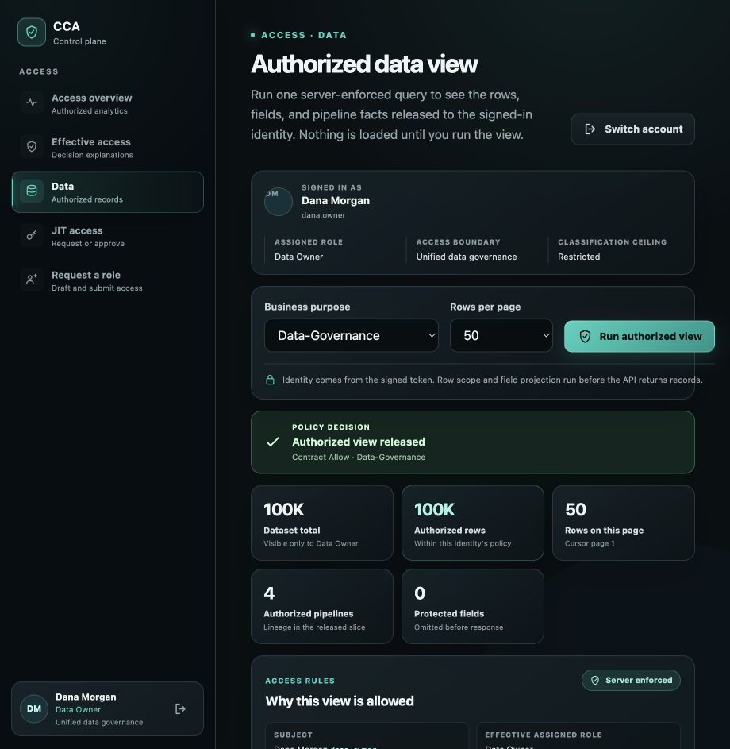
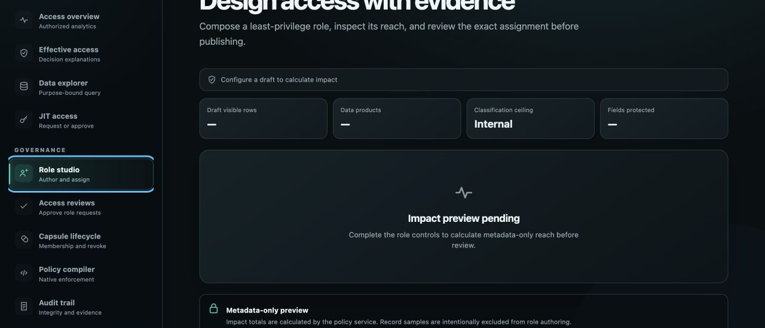
CCA
PRODUCT PROOF
08
The console shows policy, not authority
Permission-aware navigation, inherited scope, safe previews, and clear operational states.
AUTHORIZED DATA VIEW + RECEIPT
ROLE REQUEST + DUAL REVIEW
Verified build: tested with 100K synthetic records · four pipelines · ten humans · 194 automated checks.
Notes:
[Sources]
- Authentic local-product screenshots embedded in the source deck; no generated or external UI asset.
- Internal automated verification on 16 August 2026: 194 tests across core, API, and web.
[Proof boundary]
Authorization isolation is tested with 100,000 deterministic synthetic records across four modeled pipeline families, one local SQLite target, ten human identities, and three workload identities. The screenshots illustrate the authorized data and Role Studio surfaces; the automated gate—not the image—proves the tested authorization behaviors.

Slide 9
CCA
SECURITY PROOF
09
Missing context means deny
The hardened path minimizes both authority and data at every boundary.
DENY
IDENTITY
Exact principal + live assignment fingerprint; signed HS256 issuer/audience/time/JTI/purpose/assurance.
DECISION
Persona action + capsule membership + matching contract or bounded approved JIT.
when identity, purpose, scope, classification, or explicit fields do not resolve
DATA
Allowlist intersection, deny union, classification ceiling, purpose-scoped rows.
MUTATION
Failed writes roll back; restart and symlink-safe local backup/restore are verified.
Notes:
[Sources]
- Internal security: docs/SECURITY.md.
- Internal regression tests: packages/cca-core/test and apps/api/test.
- OWASP Authorization Cheat Sheet: https://cheatsheetseries.owasp.org/cheatsheets/Authorization_Cheat_Sheet.html
[Boundary]
Production mode validates the documented signed HS256 broker contract. This does not claim sender-constrained tokens or a replay cache. Current tokens are revalidated against exact server-side identity and assignment state on every protected request. Failed mutations roll back; local backup/restore is integrity-checked and symlink-safe, but external immutable audit anchoring and offsite DR remain future work.

Slide 10
CCA
ENGINEERING PROOF
10
The local release gate is green
Tests exercise local policy, API, warehouse, lifecycle, recovery, and authorization-aware UI workflows.
194
TYPECHECK
All workspaces
BUILD
Production bundles
PASSING TESTS
RUNTIME AUDIT
0 vulnerabilities
57 core / 83 API / 54 web
WEB UX
Automated flows
PALETTE
No purple family
Local preflight only; no live SAP, BW, Elasticsearch, ADF, or BI target is exercised.
Notes:
[Sources]
- Internal verification: npm run preflight on 16 August 2026 — 57 core, 83 API, and 54 web tests; 194 total.
- Production-only and full dependency audits — 0 vulnerabilities.
- Palette test: apps/web/src/palette.test.ts.
[Evidence boundary]
The automated gate proves local code paths only. It does not exercise a live SAP authorization object, BW analysis authorization, Elasticsearch role, ADF identity, warehouse-native policy, or BI semantic model.

Slide 11
CCA
PRODUCTION BOUNDARY
11
Working product, explicit enterprise boundary
The pilot is a real control plane—not a claim that external targets have already been changed.
WORKING NOW
REQUIRED NEXT
Single-node product
Enterprise rollout
Durable state, restart recovery, and verified local backup/restore
OIDC/BFF + SCIM, catalog, owner, classification, and lineage
PDP + parameterized row/field enforcement tested with 100K synthetic records
One certified apply/revoke/read-back/drift connector
Dual approval, versioned SoD, bounded JIT, audit, and revoke
Transactional shared store + outbox + multi-replica PDP
Manual assignment-bound human recertification; lazy expiry
External audit anchor + encrypted offsite/regional recovery
Notes:
[Sources]
- Internal current/target boundary: README.md, docs/ARCHITECTURE.md, and docs/SECURITY.md.
- Local recovery runbook: docs/runbooks/control-plane-backup-restore.md.
[Current]
Single-node durable state, rollback/restart, symlink-safe local backup/restore, parameterized row/field enforcement, dual approval, three versioned demo SoD rules, bounded JIT, and manual assignment-bound human recertification are implemented. Recertification is lazy-on-access, has no scheduler/notifications, and does not auto-revoke overdue or review workload identities.
[Target]
OIDC/BFF, enterprise metadata and owner inputs, one certified connector, a transactional shared store/outbox, external audit anchoring, and encrypted offsite/regional recovery.

Slide 12
CCA
ARCHITECTURE
12
One control plane, many enforcement points
One business authorization model governs every application; target-native enforcement stays at the edge.
01
02
03
Trust context
CCA control plane
Enforcement fabric
Who, why, and which business scope?
Where are access and lifecycle governed?
How does each application enforce it?
Demo login and registered metadata today; production requires IdP/SCIM plus catalog, ownership, classification, and lineage.
Canonical model, frozen requests, versioned SoD, dual review, PDP/JIT, assignment review, audit, and compilers.
Web/API/SQLite enforce locally; SAP, BW, ES, ADF, and BI stay blocked until apply, read-back, and drift are certified.
Current: Web → API/PDP → SQLite warehouse. Target artifacts have empty apply, revoke, and read-back plans.
Notes:
[Sources]
- Internal architecture: docs/ARCHITECTURE.md.
- Internal compiler: packages/cca-core/src/compiler.ts.
- NIST SP 800-207 PDP/PEP model: https://csrc.nist.gov/pubs/sp/800/207/final
- OpenID AuthZEN Authorization API 1.0: https://openid.net/specs/authorization-api-1_0.html
[Architecture reading]
Trust inputs describe who, why, and which business scope; the control plane freezes and reviews policy, decides access, manages JIT and human recertification, audits, and compiles; local Web/API/SQLite enforces now. External SAP/BW/Elasticsearch/ADF/BI plans remain blocked with empty apply, revoke, and read-back arrays until certified adapters prove fidelity and drift control.

Slide 13
CCA
ARCHITECTURE ASSURANCE
13
Robust by design; extensible by contract
The working core is test-backed; every live target must pass an explicit safety contract.
EXECUTIVE + PLATFORM
DEVELOPER CONTRACT
Why the core is robust
Target definition of done
Missing identity, purpose, scope, classification, or fields fails closed
Translate predicates, classification, and fields exactly—or reject
Requester, target, Data Owner, and Governance Admin remain distinct
Produce deterministic plans; apply and revoke idempotently
Assignment-bound recertification prevents remove/re-add evidence reuse
Read back effective target state; detect and reconcile drift
Failed writes roll back; restart and local backup/restore are test-backed
Pass conformance, retry, rollback, and recovery gates before certification
Notes:
[Sources]
- Internal assurance: docs/SECURITY.md and docs/ARCHITECTURE.md.
[Executive assurance]
Missing context fails closed; requester, target, Data Owner, and Governance Admin remain distinct; assignment IDs prevent recertification evidence reuse after remove/re-add; failed writes roll back; restart and local recovery are tested.
[Developer contract]
A target adapter must translate exactly or reject, generate deterministic plans, apply/revoke idempotently, read back effective state, detect drift, and pass conformance, retry, rollback, and recovery gates before certification.

Slide 14
CCA
DECISION QUESTIONNAIRE
14
Decision questionnaire for a bounded pilot
Answer these before the first connector moves from preview to enforcement.
BUSINESS FIT
POLICY DEFINITION
ENFORCEMENT PROOF
Why this access?
What is allowed?
How will we prove it?
Which risk and outcome?
Who owns + classifies it?
Which first PEP/connector?
Which dataset and teams?
Exact rows, fields, purpose?
Can it apply + read back?
Who accepts residual risk?
Which SoD, JIT, review rules?
Identity, drift, recovery gates?
One dataset + purpose, two personas, one connector. Scale only after allow/deny, read-back, drift, identity, and recovery pass.
Notes:
[Sources]
- Full stakeholder questionnaire: docs/cca-complete-brief.html#stakeholder-questionnaires
- Internal bounded-pilot guidance: README.md and docs/ARCHITECTURE.md.
[Facilitation]
Ask the business owner, Data Owner/steward, IAM/security, platform/application team, and operations/audit audience to answer the full questionnaire. Begin with one dataset and purpose, two personas, and one connector. Do not scale until identity, correct allow/deny, revocation read-back, drift, lifecycle evidence, and recovery all pass.

