Slide 1

A-List Data Structures
by David Piepgrass

Slide 2
A-LIST = All-purpose List
An open-source data structure that I wrote
Implements IList<T>
this[index], Add, Insert, RemoveAt, etc.
Inspired by B+ Tree
“Semi-persistent”
Mucho functionality

Slide 3
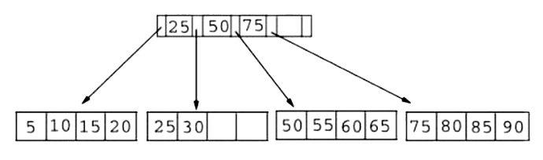
A-LIST = All-purpose List:
B+ Tree
large fan out (fan-out of 50 ⇒​ 2500 items in 2 levels)
two node types (leaf and internal; data in leaves only)
​sorted items (A-Lists are not necessarily sorted)
​disk storage (A-Lists are in memory in this version)

Slide 4
A-LIST = All-purpose List:
B+ Tree
large fan out (fan-out of 50 ⇒​ 2500 items in 2 levels)
two node types (leaf and internal; data in leaves only)
​sorted items (A-Lists are not necessarily sorted)
​disk storage (A-Lists are in memory in this version)
+
Semipersistence
Fast cloning & freezing
But what is persistence?

Slide 5
A-LIST = All-purpose List:
Semipersistence
Fast cloning & freezing
// linked list node inside public-facing PList<T>
class PNode<T> {
public PNode(T value, PNode<T>? next) {…}
public readonly T Value;
public readonly PNode<T>? Next;
}
public struct PList<T> : IEnumerable<T>
{
private PNode<T>? _node;
private PList(PNode<T> n) => _node = n;
public void Add(T item)
{
_node = new PNode<T>(item, _node);
}
public T Head => _node.Value;
public PList<T> Tail => new PList<T>(_node.Next);
public bool IsEmpty => _node == null;
public IEnumerator<T> GetEnumerator()
{
PNode<T> n = _node;
while (n != null) {
yield return n.Value;
n = n.Next;
}
}
IEnumerator IEnumerable.GetEnumerator()
=> GetEnumerator();
}

Slide 6
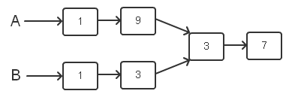
A-LIST = All-purpose List:
Semipersistence
Fast cloning & freezing
PList<int> A = new PList<int>();
A.Add(7);
A.Add(3);
PList<int> B = A;
A.Add(9);
A.Add(1);
B.Add(3);
B.Add(1);

Slide 7
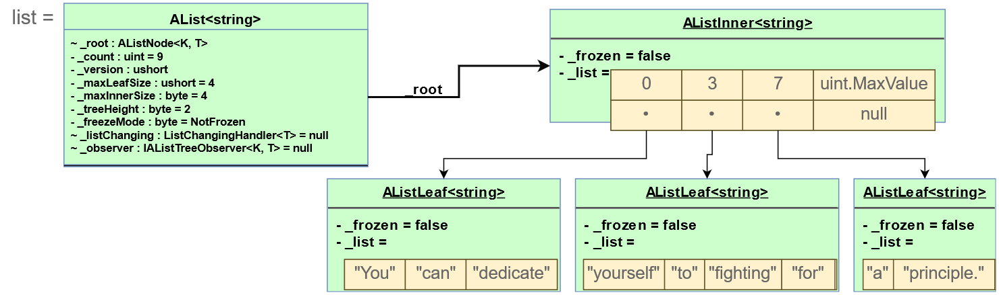
A-LIST = All-purpose List:
Semipersistence
Fast cloning & freezing
var list = new AList<string>(4); // Max node size 4 (default is 64)
list.AddRange("[…] You can dedicate yourself to fighting for a principle.".Split(' '));
list.RemoveAt(0);

Slide 8
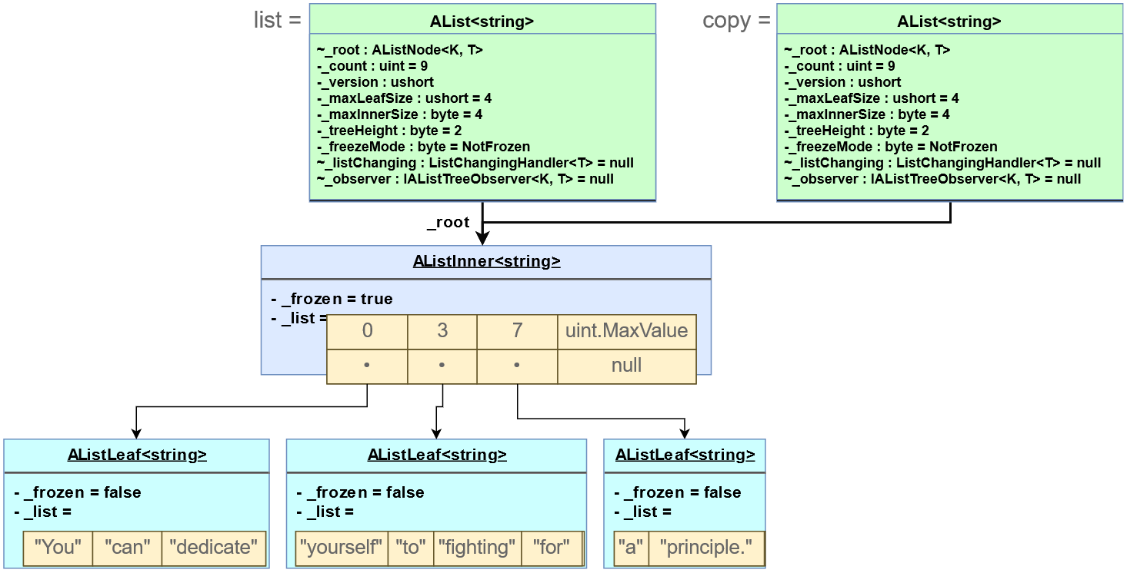
A-LIST = All-purpose List:
Semipersistence
Fast cloning & freezing
var copy = list.Clone(); // after this
copy.Add("Bret Victor");
copy.Add("Inventing on Principle");

Slide 9
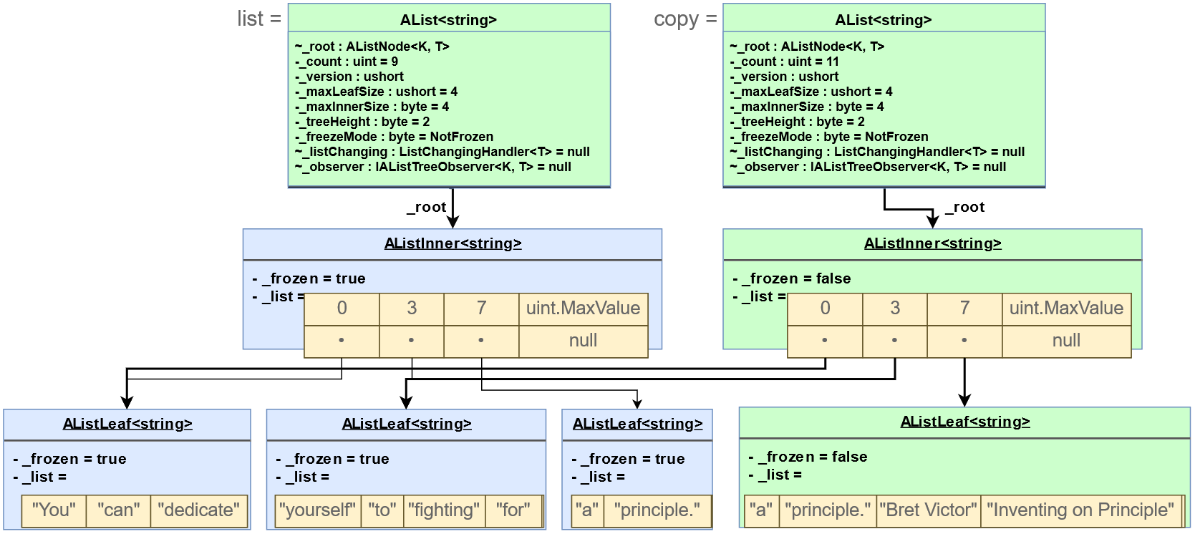
A-LIST = All-purpose List:
Semipersistence
Fast cloning & freezing
var copy = list.Clone();
copy.Add("Bret Victor");
copy.Add("Inventing on Principle");
// here

Slide 10
A-LIST = All-purpose List:
B+ Tree
large fan out (e.g. fan-out of 50 ⇒​ 2500 items in 2 levels)
two node types (leaf and internal; data in leaves only)
​sorted items (A-Lists are not necessarily sorted)
​disk storage (A-Lists are in memory in this version)
Semipersistence
Fast cloning & freezing
Bonus features
Variants
+
+
+

Slide 11
A-LIST = All-purpose List:
B+ Tree
large fan out (e.g. fan-out of 50 ⇒​ 2500 items in 2 levels)
two node types (leaf and internal; data in leaves only)
​sorted items (A-Lists are not necessarily sorted)
​disk storage (A-Lists are in memory in this version)
Semipersistence
Fast cloning & freezing
Bonus features
Observability
Fast split & merge (O(log N))
Slicing
Variants
Sorted, sparse, indexed…
Handy methods
+
+
+

Slide 12
A-LIST Bonus Methods
Bonus features
Observability
Fast split & merge (O(log N))
Slicing
Handy methods
Bonus methods:
Fast bulk changes: AddRange, InsertRange, RemoveRange
e.g. AddRange(L) takes O(log(this.Count) + L.Count) time
Freeze(): blocks future changes (via ReadOnlyException; clones are unfrozen)
Fast merge: Prepend, Append, InsertRange
Fast split: RemoveSection (removes a sublist and returns it)
Fast partial clone: CopySection (marks part of tree as frozen)
Views: ReverseView, Slice(start, count)
TryGet, TrySet: easier and faster than “if (i >= 0 && i <= Count) { use list[i] }”
Sort(): custom algorithm for AList<T>
Observability / tree observers: ListChanging event / AddObserver, RemoveObserver
More stuff: First, Last, IndexesOf(T), Swap(AList<T>), RemoveAll(Predicate<T>)

Slide 13
A-LIST Bonus Methods
Bonus features
Observability
Fast split & merge (O(log N))
Slicing
Handy methods
var list = new List<int>(Enumerable.Range(0, 999999));
var alist = new AList<int>(Enumerable.Range(0, 999999));
var tracker = alist.StatisticTracker(i => (double)i);
tracker.Statistic.StdDeviation(); // cause initial calculation
void Report(Statistic stat, int millisec)
{
WriteLine($"Time (ms): {millisec}");
WriteLine($" Average: {stat.Avg()}");
WriteLine($" Std Dev: {stat.StdDeviation()}");
WriteLine();
}
var timer = new SimpleTimer();
alist[12345] = 54321;
Report(tracker.Statistic, timer.Restart());
Time (ms): 0
Average: 499999.041976042
Std Dev: 288674.922399532
list[12345] = 54321;
Report(list.Aggregate(new Statistic(),
(s, i) => { s.Add(i); return s; }), timer.Restart());
Time (ms): 31
Average: 499999.041976042
Std Dev: 288674.922398887

Slide 14
A-List pros & cons
Advantages vs List<T>:
Disadvantages vs List<T>:
List<T> is usually faster (except insert/remove)
Semipersistence
Fast cloning & freezing
Bonus features
Observability
Fast split & merge (O(log N))
Slicing
Variants
Sorted, sparse, indexed…
Handy methods

Slide 15
A-LIST Variants
Variants
Sorted, sparse, indexed…
BList<T>: sorted list
Like AList<T>, but keeps list sorted (has no Insert method)
Uses less memory than SortedDictionary<K,V>
Can find nearest item with FindLowerBound, FindUpperBound
More bonus methods: DoRange, IndexOfExact

Slide 16
A-LIST Variants
Variants
Sorted, sparse, indexed…
BDictionary<K,V>: sorted dictionary
Implements IDictionary<K,V>, IReadOnlyDictionary<K, V>
Uses less memory than SortedDictionary<K,V>
Can find nearest item with FindLowerBound, FindUpperBound
More bonus methods: AddIfNotPresent, ReplaceIfPresent, SetAndGetOldValue

Slide 17
A-LIST Variants
Variants
Sorted, sparse, indexed…
BMultiMap<K,V>: allows duplicate keys
Implements IReadOnlyDictionary<K, BMultiMap<K,V>.ValueList>)
Uses less memory than SortedDictionary<K,V>
Can find nearest item with FindLowerBound, FindUpperBound
Derived from BList<KeyValuePair<K, V>>
More bonus methods: AddIfUnique, IndexOfExact, ...

Slide 18
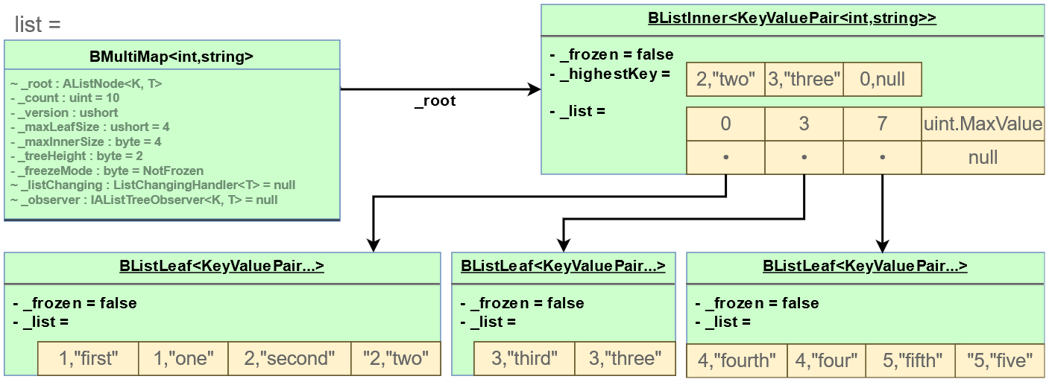
A-LIST Variants
Variants
Sorted, sparse, indexed…
list = new BMultiMap<int, string>(4) {
{ 1, "one" },
{ 1, "first" },
{ 2, "two" },
{ 2, "second" },
{ 3, "three" },
{ 3, "third" },
{ 4, "four" },
{ 4, "fourth" },
{ 5, "five" },
{ 5, "fifth" },
};

Slide 19
Sorted A-LIST pros & cons
BDictionary vs SortedDictionary:
Saves memory
Can find nearby items (FindLowerBound, FindUpperBound)
Handy bonus methods
Slower at small sizes
BMultiMap vs Dictionary<K, List<V>>:
Easier to use
Saves lots of memory when the lists are very short
(SortedList<T>? Always avoid!)

Slide 20
A-LIST Variants
Variants
Sorted, sparse, indexed…
IndexedAList<T>: accelerates IndexOf(T), Remove(T), Contains(T)
Allows finding items in O(log N) time
Index consumes extra time & memory
Can deactivate: IsIndexed=false

Slide 21
A-LIST Variants
Variants
Sorted, sparse, indexed…
SparseAList<T>: allows “empty spaces” between elements
Spaces consume no memory
Implements ISparseListEx:
InsertSpace, ClearSpace
NextHigherItem, NextLowerItem, IsSet(index)
InsertRange(index, ISparseListSource<T>): preserves sparseness
Items() extension method => sequence of KeyValuePair<int, T>

Slide 22
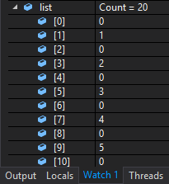
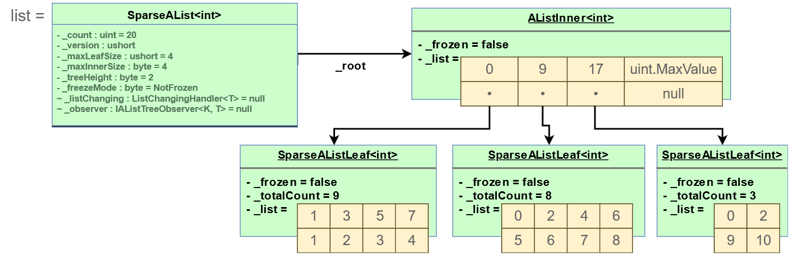
A-LIST Variants
Variants
Sorted, sparse, indexed…
var list = new SparseAList<int>(4);
for (int i = 1; i <= 10; i++) {
list.AddSpace(1);
list.Add(i);
}

Slide 23
Opportunities to use A-Lists
Slowness-proofing
for (int i = list.Count - 1; i >= 0; i--)
if (list[i] > 2)
list.RemoveAt(i);
list.InsertRange(index, list2);
if (list.Contains(item)) {...} // fast if IndexedAList<T>
List<int> sublist = new List<int>();
for (int i = start; i < start+count; i++)
sublist.Add(list[i]);
➔ var sublist = list.CopySection(start, count);
➔ var slice = list.Slice(start, count);

Slide 24
Opportunities to use A-Lists
2. Fast Clone()
To efficiently send a list to another thread
To explore a solution space
“try out” permutations of a long list; what-if/incrementals analysis
To save an old version of a list
Undo/redo (But see my UndoStack class for undo/redo)
“Time-travel debugging” (e.g. PSE?)
Node size performance tradeoff:
Large leaf nodes => faster read access
Medium-size nodes => faster changes after cloning
Small nodes => slower, more memory shared

Slide 25
Opportunities to use A-Lists
3. For convenience
✘ T value = i >= 0 && i < list.Count
? list[i]
: default(T);
✔T value = list.TryGet(i);
✘ if (i >= 0 && i < list.Count)
list[i] = newValue;
else
Log("Index out of range");
✔if (!list.TrySet(i, newValue))
Log("Index out of range");
✘ var last = list[list.Count - 1];
✔var last = list.Last;
// Limited BCL equivalents*
✔var s = list.Slice(start, count);
✔var r = list.ReverseView;
// * .NET Core 3 has Spans of arrays. // Enumerable’s methods like Reverse(), // Skip() and Take() do not return lists

Slide 26
Opportunities to use A-Lists
3. For convenience
// BMultiMap<K,V> vs Dictionary<K,List<V>>
✘ int key;
if (dict.ContainsKey(key))
dict[key].Add(value);
else
dict[key] = new List<T>(value);
✔multimap[key].Add(value);
✘ if (dict.TryGetValue(key, out var list)) {
list.Remove(value);
if (list.Count == 0)
dict.Remove(key);
}
✔multimap[key].Remove(value);
✘ if (!dict.ContainsKey(key))
dict.Add(key, value);
✔bdict.AddIfNotPresent(key, value);
✘ if (dict.ContainsKey(key))
dict[key] = value;
✔bdict.ReplaceIfPresent(key, value);

Slide 27
Opportunities to use Sorted A-Lists
4. You need other special functionality or properties
FindLowerBound(key), FindUpperBound(key)
Sparseness (SparseAList)
Observable dictionary (BCL has only ObservableCollection)
Lower memory usage (than Dictionary and SortedDictionary)
Lower maximum latency
Fast insert/remove at any location

Slide 28
Performance tests
AList is rarely the fastest.
Why? Perhaps the many checks:
List frozen? Nodes frozen?
ListChanging handler? Tree observer?
Concurrent modification?
Method call overheads, dynamic dispatch to different node types
B-Lists are sorted
Hashing beats sorting!

Slide 29
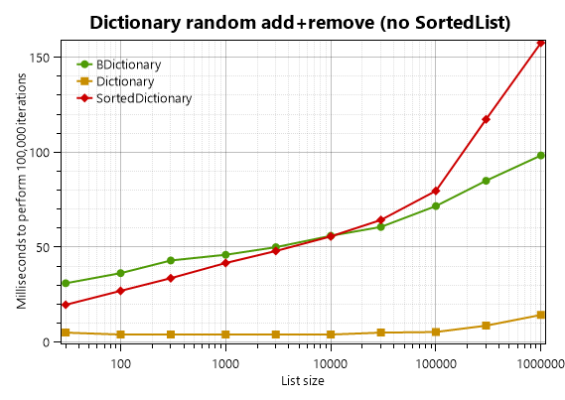
Performance tests
BDictionary vs SortedDictionary vs Dictionary (O(log N) = O(log N) > O(1))

Slide 30
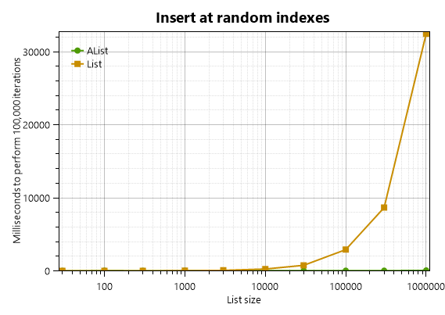
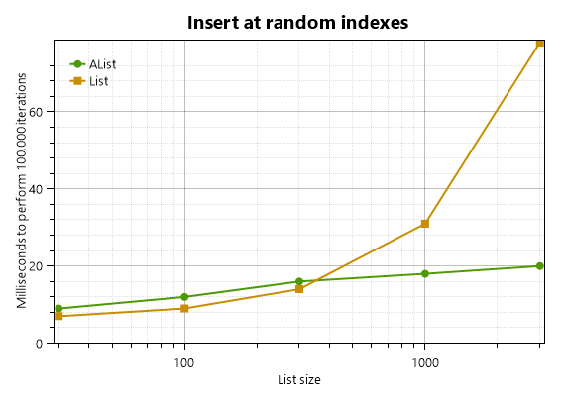
Performance tests
AList vs List<T> (O(log N) < O(N))

Slide 31
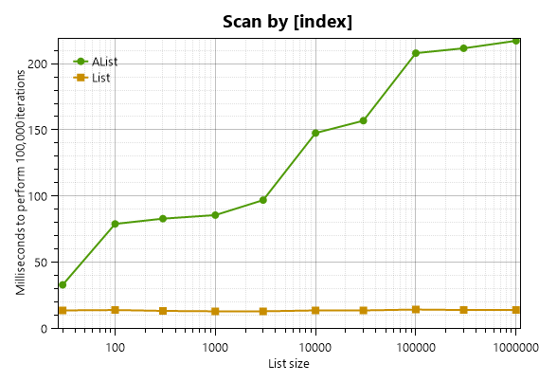
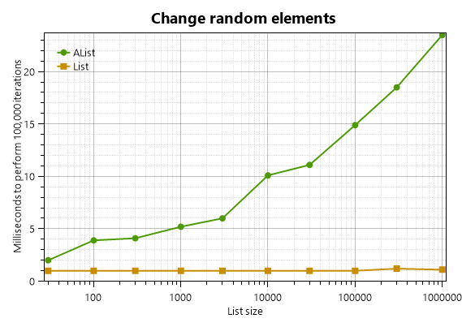
Performance tests
AList vs List<T> (O(log N) > O(1))
int i = _r.Next(max);
list[i++] = iteration;
list[i] = iteration;
for (int i = 0; i < list.Count; i++)
sum += list[i];

Slide 32
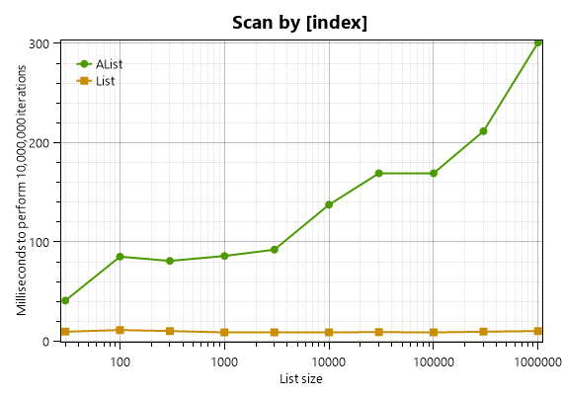
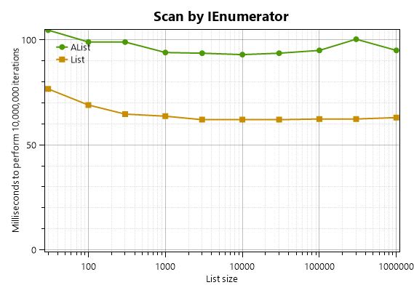
Performance tests
AList vs List<T> (O(N log N) > O(N))
for (int i = 0; i < list.Count; i++)
sum += list[i];
for (...)
avg = list.Average();

Slide 33
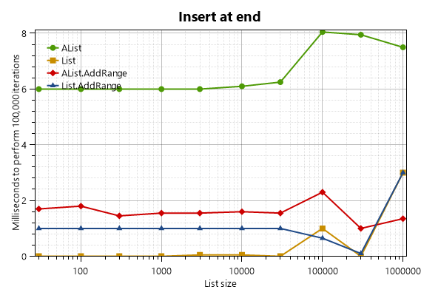
Performance tests
AList vs List vs AList.AddRange
for (int i = 0; i < Iterations; i++)
alist.Add(i);
alist.AddRange(list2);

Slide 34
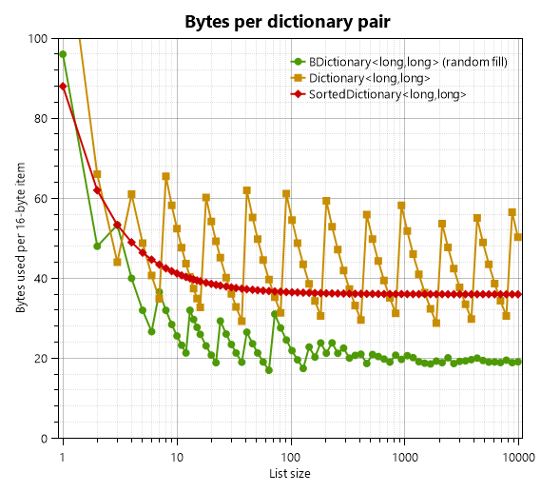
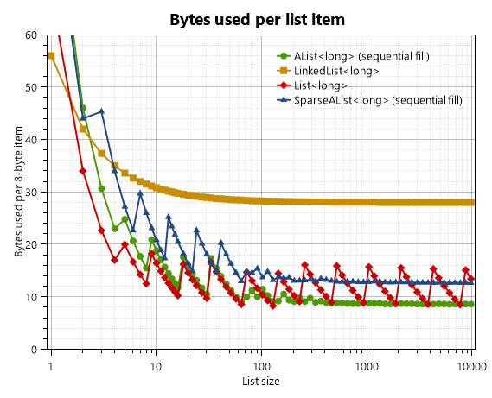
MEMORY TESTS
AList vs List vs LinkedList vs SparseAList
AList vs SortedDictionary vs Dictionary

Slide 35
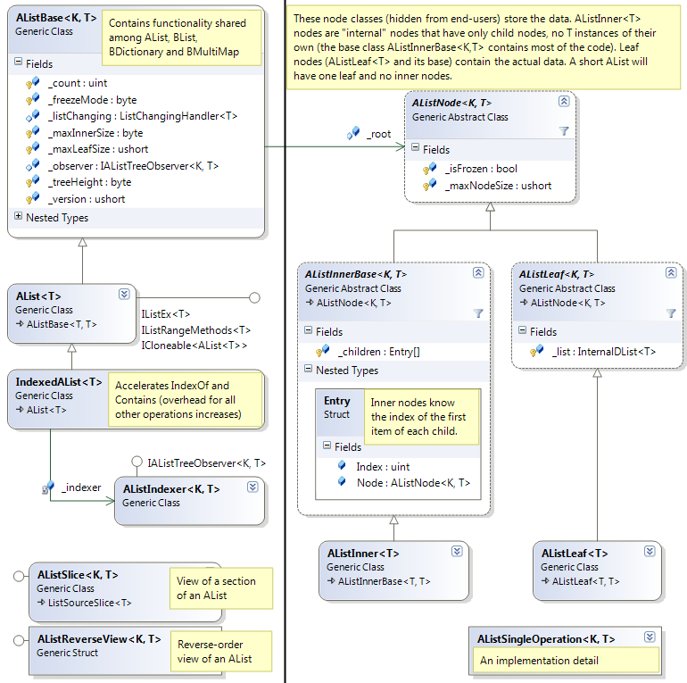
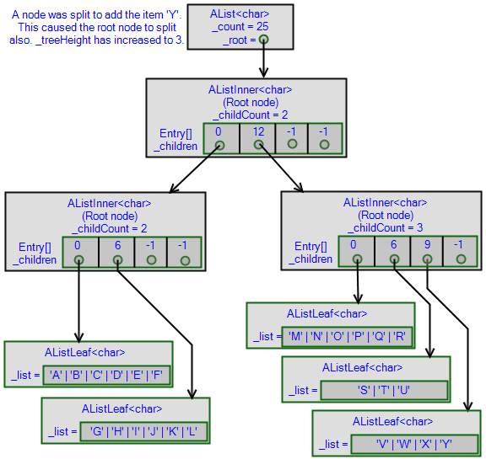
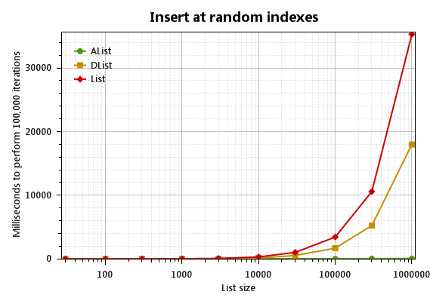
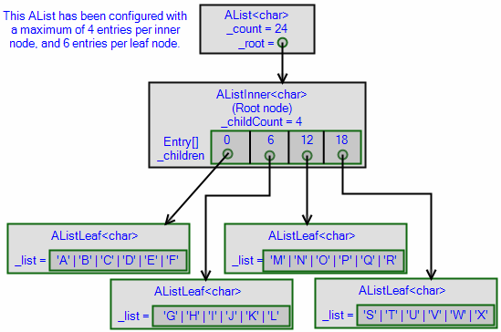
There you have it.
Detailed documentation: core.loyc.net/collections
Find it on NuGet: Loyc.Collections

Slide 36
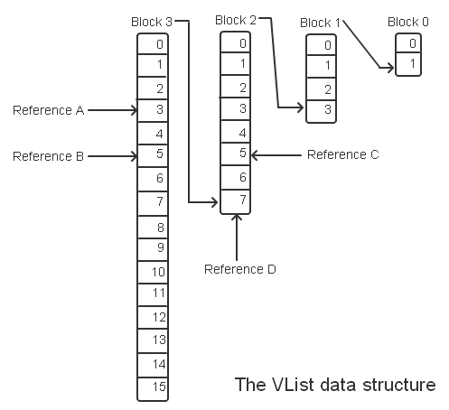
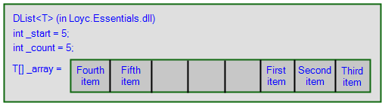
I maDe MORE DATA TYPES!
Open-source Lists (C#)
DList = Deque (simple circular queue)
And InternaalDList (low-level building block)
VList = Another list type
simpler than Alist, more complex than DList
WList = Mutable VList
Convert VList ⟺ WList in constant time

Slide 37
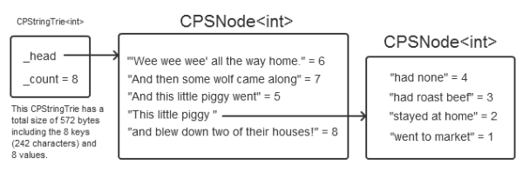
I maDe MORE DATA TYPES!
Open-source Dictionaries & Sets
CPTrie = Compact Patricia Trie (C#)
Great for large collections of URLs
Versions: CPIntTrie<V>, CPStringTrie<V>, CPByteTrie<V>
Semipersistent hash sets (C#)
Immutable: Map<T>, Set<T>, InvertibleSet<T>
Mutable: MMap<T>, MSet<T>
Semipersistent B+ tree (TypeScript)
! Unfrozen copy _root!
** IsFrozen=true |
|
+---------+---------+----+----+---------+---------+
| | | | | |
0x2** 0x3** 0x6** 0x7** 0x9! 0xF**
| | |
+--+--+ | +--+--+
| | | | |
0x13 0x73 0x57 0x09** 0x59**

Slide 38
I make other things too!
More collection stuff (C#)
Interfaces
Slice types & adapters
Extension methods
Linq-to-collections
Helper classes for building collection types
Simple logging “Message Sinks” (C#)
Simple internationalization helper (C#)
Symbols in C# (like Ruby, Lisp, ES6)
Math & geometry generics (C#)

Slide 39
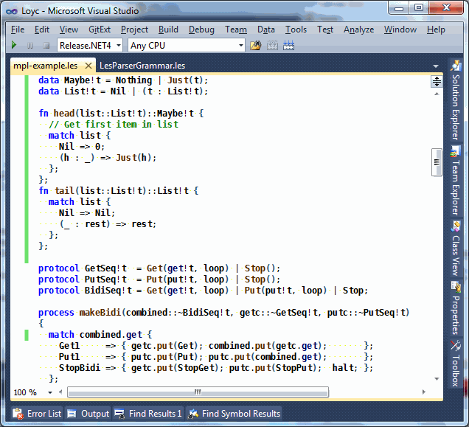
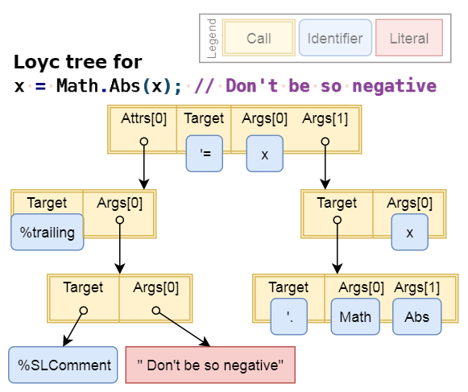
I make other things too!
LES & Loyc trees
Loyc tree = Universal syntax tree
LES = C-like syntax, JSON compatible

Slide 40
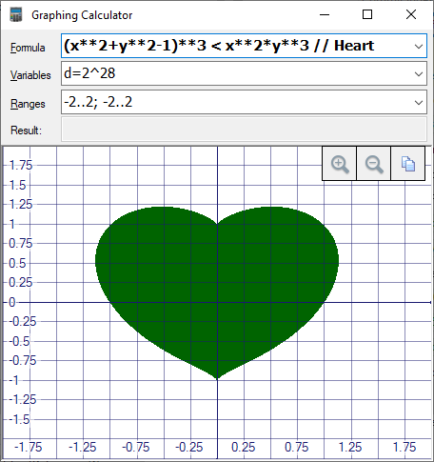
I make other things too!
LES & Loyc trees
Loyc tree = Universal syntax tree
LES = C-like syntax, JSON compatible

Slide 41
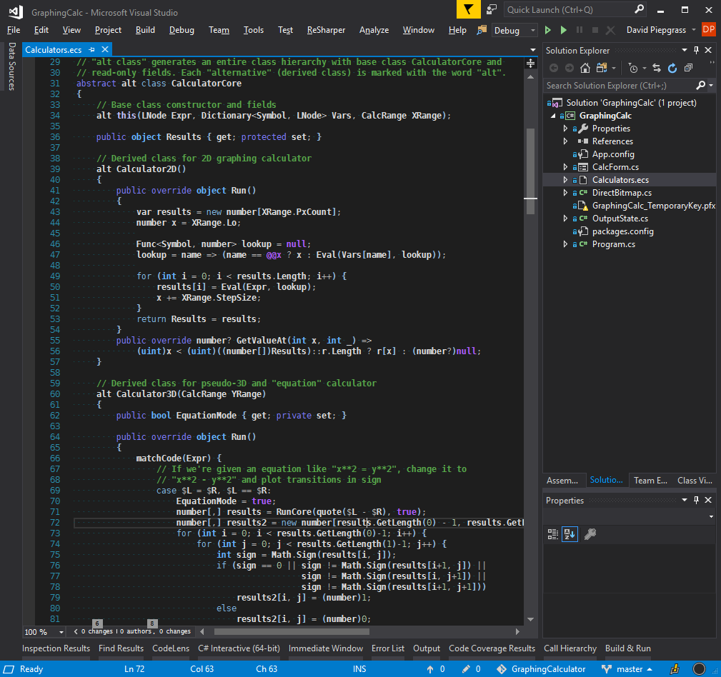
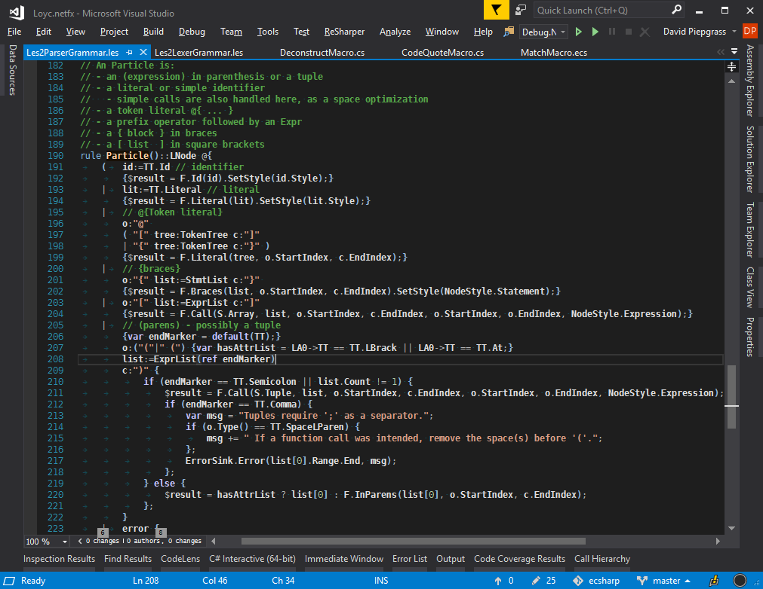
I make other things too!
Enhanced C# & LeMP
Preprocessor for C#
Parser Generator for C#: LLLPG

Slide 42
I make other things too!
If you’re at all interested in any of this, let’s chat!
qwertie256 gmail.com

