Slide 1

Insights
Consumer Goods
Atliq Hardwares
MB

Slide 2
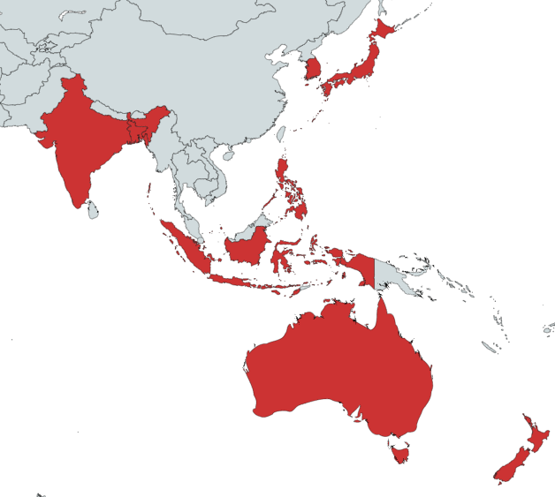
Question: Provide the list of markets in which customer "Atliq Exclusive" operates its business in the APAC region.
South Korea
Atliq Exclusive is operating in 8 out of 23 countries of the APAC region.
Atliq Exclusive’s presence is in 2/5 most influential nations: Japan and India.
Top 3 APAC countries are USA, Russia and China.
India
Japan
Bangladesh
Indonesia
Philippines
Australia
New Zealand

Slide 3
Question: What is the percentage of unique product increase in 2021 vs. 2020? The final output contains these fields, unique_products_2020 unique_products_2021 percentage_chg
Unique Products 2021 | Unique Products 2020 | Percentage Change
334 | 245 | 36.33
The company’s emphasis on innovation is seen in an increase in the unique product line.

Slide 4
Question: Provide a report with all the unique product counts for each segment and sort them In descending order of product counts. The final output contains 2 fields, segment, product_count
Product Count | Segment
129 | Notebook
116 | Accessories
84 | Peripherals
32 | Desktop
27 | Storage
9 | Networking
Notebooks, Accessories, and Peripherals dominate the unique product count

Slide 5
Question: Which segment had the most increase in unique products in 2021 vs 2020? The final output contains these fields, segment, product_count_2020, product_count_2021 difference
Segment | Product_Count_2021 | Product_count_2020 | Difference
Accessories | 103 | 69 | 34
Desktop | 22 | 7 | 15
Networking | 9 | 6 | 3
Notebook | 108 | 92 | 16
Peripherals | 75 | 59 | 16
Storage | 17 | 12 | 5

Slide 6
Question: Get the products that have the highest and lowest manufacturing costs. The final output should contain these fields: product_code, product, manufacturing_cost
Product_code | Product | Manufacturing_cost
A6120110206 | AQ HOME Allin1 Gen 2 | 240.5364
A2118150101 | AQ Master wired x1 Ms | 0.8920
AQ HOME Allin1 Gen 2 comes under the Desktop segment.
AQ Master wired x1 Ms is a Network segment product.
In general, the desktop segment has higher manufacturing cost compared to others. Thus resulting in a lower unique product count.

Slide 7
Question: Generate a report which contains the top 5 customers who received an average high pre_invoice_discount_pct for the fiscal year 2021 and in the Indian market. The final output contains these fields, customer_code, customer, average_discount_percentage
Customer_code | Customer | Average_discount_percentage
90002009 | Flipkart | 30.83
90002006 | Viveks | 30.38
90002003 | Ezone | 30.28
90002002 | Croma | 30.25
90002016 | Amazon | 29.33
Population vise, the Indian market is the biggest in which Atliq Hardwares operates.
The average percentage discount ranges between 29% to 31% for the top 5 customers.

Slide 8
Question: Get the complete report of the Gross sales amount for the customer “Atliq Exclusive” for each month. This analysis helps to get an idea of low and high-performing months and take strategic decisions. The final report contains these columns:,Month, Year, Gross sales Amount
Month | Year | Gross Sale Amount
September | 2019 | 9092670.34
October | 2019 | 10378637.6
November | 2019 | 15231894.97
December | 2019 | 9755795.06
January | 2020 | 9584951.94
February | 2020 | 8083995.55
March | 2020 | 766976.45
April | 2020 | 800071.95
May | 2020 | 1586964.48
June | 2020 | 3429736.57
July | 2020 | 5151815.4
August | 2020 | 5638281.83
September | 2020 | 19530271.3
October | 2020 | 21016218.21
November | 2020 | 32247289.79
December | 2020 | 20409063.18
January | 2021 | 19570701.71
February | 2021 | 15986603.89
March | 2021 | 19149624.92
April | 2021 | 11483530.3
May | 2021 | 19204309.41
June | 2021 | 15457579.66
July | 2021 | 19044968.82
August | 2021 | 11324548.34
The upward-tilted dotted line illustrates the positive trend of Gross Sale Amount from Sep 2019 to Aug 2021.

Slide 9
Question: In which quarter of 2020, got the maximum total_sold_quantity? The final output contains these fields sorted by the total_sold_quantity, Quarter, total_sold_quantity
Quarter | Total Sold Quantity
Quarter 1 | 10091151
Quarter 2 | 2075087
Quarter 3 | 5042541
Quarter 4 | 14476194
The Quarter 2 Fall in total sold quantity is due to the pandemic and supply–demand shortage.
The good news is the rise of Quarter 3 and 4 total sold quantity values.

Slide 10
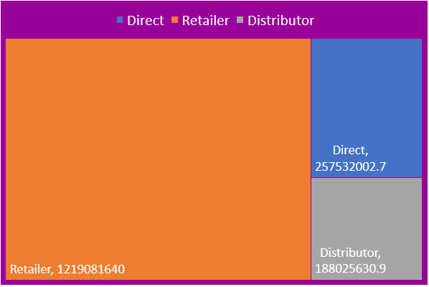
Question: Which channel helped to bring more gross sales in the fiscal year 2021 and the percentage of contribution? The final output contains these fields, channel, gross_sales_mln, percentage
Channel | Gross Sales Mln | Percentage
Direct | 257532002.6536 | 15.47
Retailer | 1219081639.9472 | 73.23
Distributor | 188025630.9348 | 11.30
Heavy dependency on the Retailer.
Should emphasize on Direct channel.

Slide 11
Question: Get the Top 3 products in each division that have a high total_sold_quantity in the fiscal_year 2021? The final output contains these fields, division, product_code, product, total_sold_quantity, rank_order
Divison | Product_code | Product | Total_sold_quantity | Rank_order
N & S | A7219160201 | AQ Wi Power Dx2 | 275328 | 1
N & S | A7220160203 | AQ Wi Power Dx2 | 277299 | 2
N & S | A7321160301 | AQ Wi Power Dx3 | 281363 | 3
P & A | A3920150304 | AQ LION x3 | 33523 | 1
P & A | A3718150102 | AQ LION x1 | 34022 | 2
P & A | A3718150105 | AQ LION x1 | 34080 | 3
PC | A6018110106 | AQ Home Allin1 | 2281 | 1
PC | A6119110202 | AQ HOME Allin1 Gen 2 | 2285 | 2
PC | A6119110204 | AQ HOME Allin1 Gen 2 | 2286 | 3
N & S are from the Accessories Segment, N & S are from the peripherals segment and PC are from the Desktop segment.

Slide 12
Thank You

