Slide 1
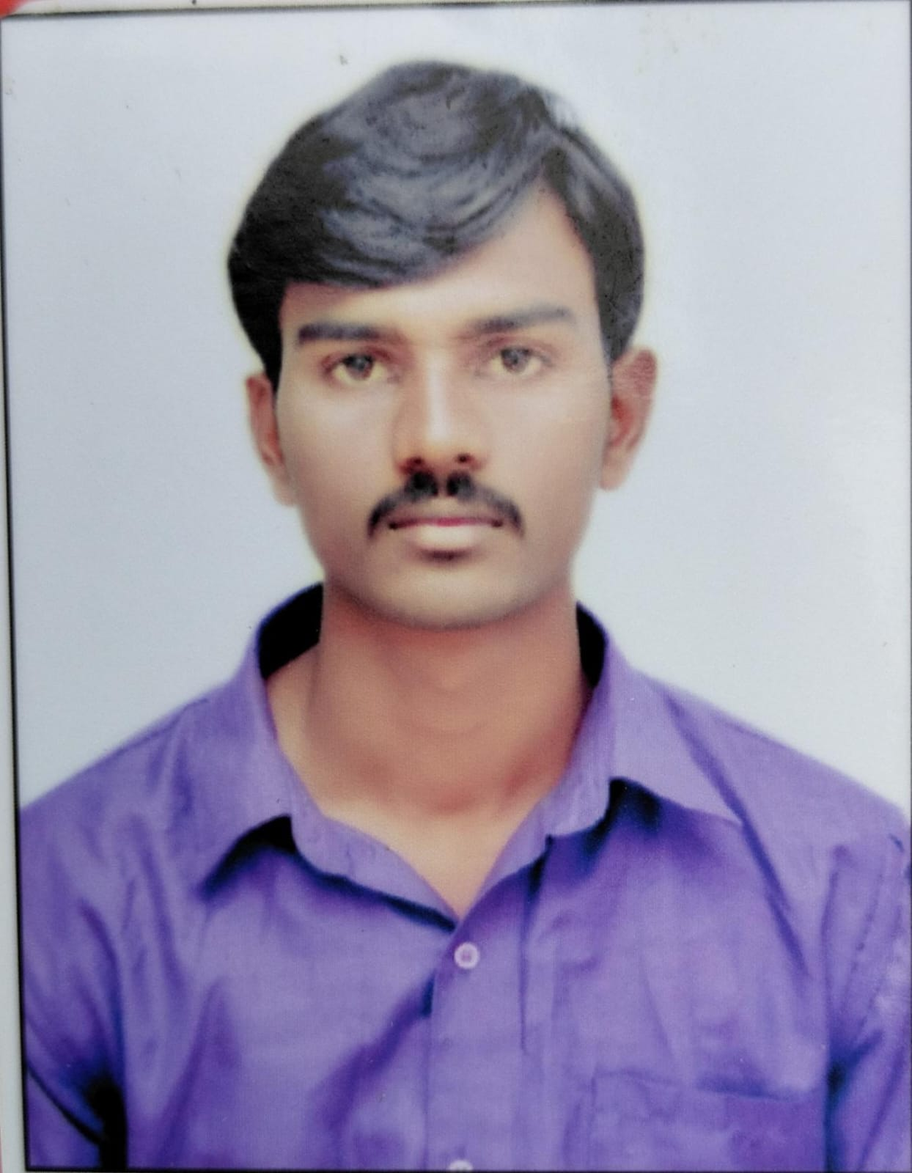
Name
Summary:
Graduated with Bachelor of Engineering in Electronics & Communication Engineering (2015 - 2019).
5 years of working experience in customization & configuration on PLM Windchill.
Worked on Windchill upgrades, updates, customization & configuration.
Well-versed in project requirement analysis, solid background in project management and support services.
Photo
Tools and Technology
Experience Summary
Languages | Java
Frameworks | HTML, Servlets, JSP, JS, JS AJAX, JS JSON,
Technologies | PLM Windchill Development
Domains | Product Implementation, Engineering Units, Manufacturing units and Health Care units.
PLM Windchill Developer with over 5+ years of experience in PLM Windchill

