Slide 1


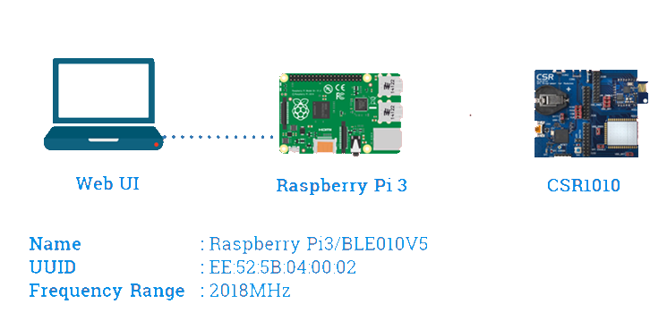


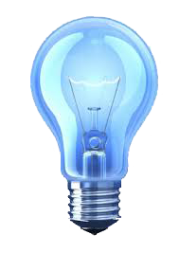
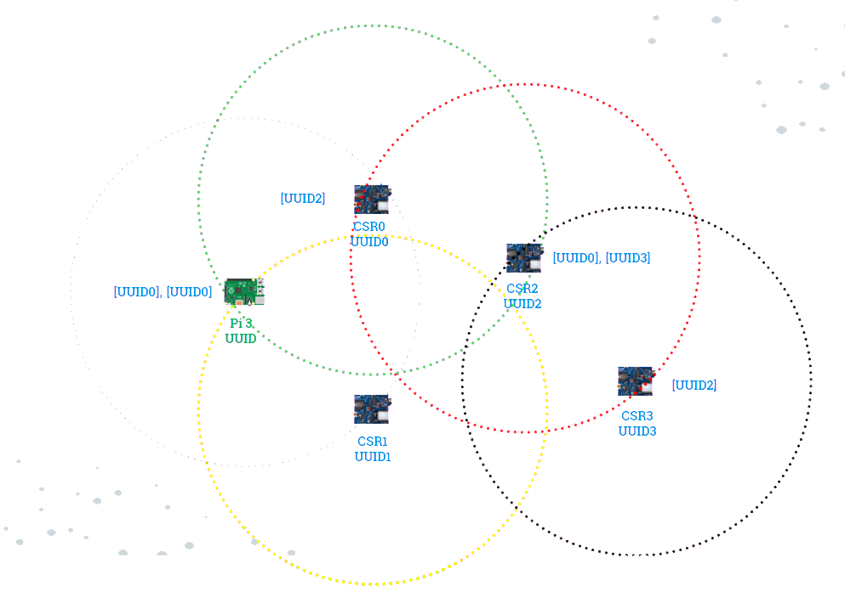
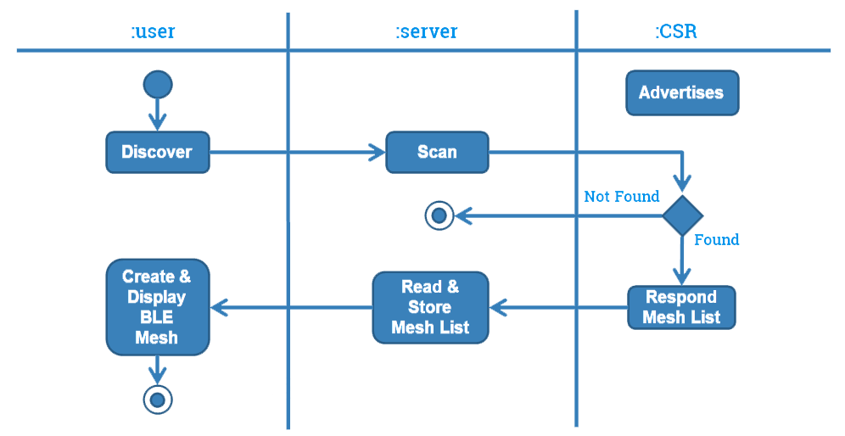
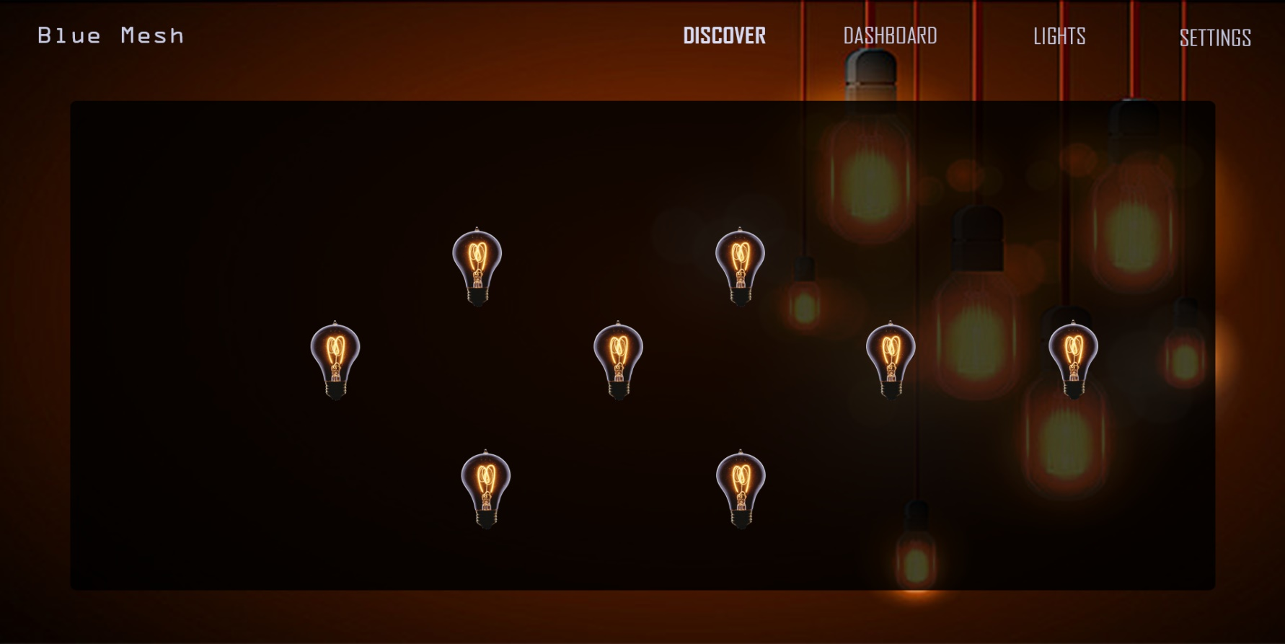
ALGORITHM AND SYSTEM DESIGN
SMART LED LIGHT
LUETOOTH MESH NETWORK
CSR101x:
Flooding algorithm is designed and implemented to provide connection to every device which are even at the distant proximity.
Performs following operations: Advertise(), Connect(), Disconnect(), CreateList().
Gaurav Kamireddi | Mohan Karigondanahalli | Nikitha Naini | Soumya Peruri | Kewei Sha
College of Science and Engineering | University of Houston Clear Lake
Mentor: Mr. Yiming Yang | CMVision Technologies
Raspberry Pi 3:
Acts as a web server that receives requests from Web UI for following operations: Discovery(), Control(), MeshStorage(), Path().
INTRODUCTION AND MOTIVATION
What if you are standing at the pavilion and want to switch on lights on the other end of the stadium? Would you prefer going in person to a set of switches located on the other end or would you consider switching them on from the pavilion through a Web User Interface?
Bluetooth Low Energy (BLE) supports a mesh topology to establish many-to-many (m:m) device communications. The BLE mesh capability is optimized for creating large-scale device networks and is ideal for building automation, sensor network, and asset tracking solutions.
Using the BLE mesh networking technology, we are able to connect each light via Bluetooth and control them from a centralized location through a Web User Interface.
RESULTS
Algorithm:
Step 1: Initiate the discovery of BLE devices in mesh network from web server (Raspberry Pi 3).
Step 2: Connect and request for mesh list from peripherals.
Step 3: Each peripheral discovers other peripherals in its vicinity and build a mesh list.
Step 4: Peripherals send back the mesh list to the webserver.
Webserver adds each Mesh node into an XML file.
Web UI is able to discover all the BLE devices.
Mesh topology of the BLE devices is built and displayed in the Web UI.
User will be able to control the Light’s ON/OFF through the Web UI.
CHALLENEGES
Displaying dynamic view of mesh network in Web UI.
Managing flooding technique to deliver messages efficiently.
Developing industrial standards Web UI with node interactions where nodes acting as CSR1010 modules.
REFERENCES
http://eeca2.sogang.ac.kr/publications/international/BLEmesh_A%20Wireless%20Mesh%20Network%20Protocol%20for%20Bluetooth%20Low%20Energy%20Devices.pd
file:///C:/Users/soumy/Downloads/csr101x-product-brief%20(1).pdf
https://blog.bluetooth.com/introducing-bluetooth-mesh-networking
https://developer.qualcomm.com/hardware/csr101x/qc-ble-starter-development-kit
CONCLUSION
We are successfully able to communicate with the CSR1010 device from the Webserver (Raspberry Pi 3).
We successfully designed the Mesh Network for the given nodes.
We are able to extend the nodes for the existing network.
We have made the Web UI more flexible and user friendly.
WEB UI
Web UI provides a real-time visualization of the LED lights as a mesh network. Logical view of all the functionalities are displayed according to the entity type. Every element is exhibited as a separate control and are selected by appropriate tabs.
Page features:
Discovering Mesh
ON/OFF operations
Light Details

