Slide 1
Path-Linearizing the Simplified Model
Mitchell Cobb
12/10/2018

Slide 2
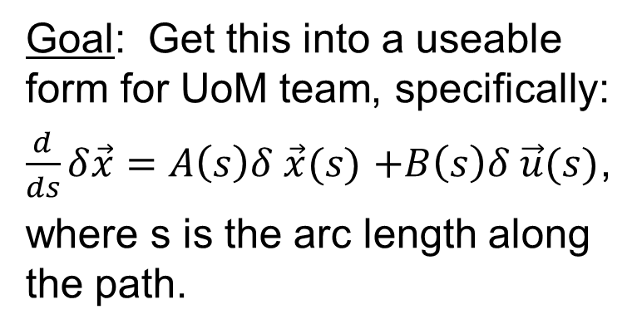
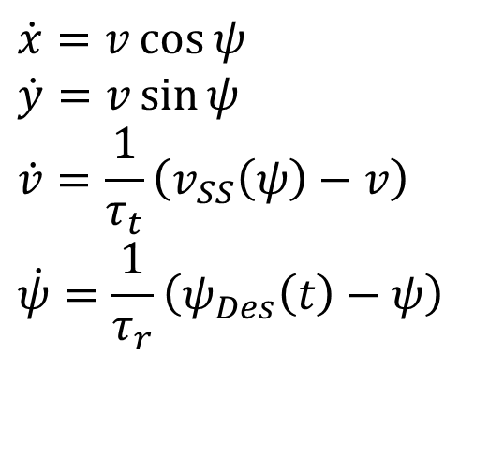
Nonlinear Model
X Position
$$\dot{x}=v\cos{ψ}$$
$$\dot{y}=v\sin{ψ}$$
$$\dot{v}=\frac{1}{τ_{t}}\left(v_{SS}\left(ψ\right)−v\right)$$
$$\dot{ψ}=\frac{1}{τ_{r}}\left(ψ_{Des}\left(t\right)−ψ\right)$$
Goal: Get this into a useable form for UoM team, specifically:
$\frac{d}{ds}δ\vec{x}=A\left(s\right)δ \vec{x}(s)$ $+B\left(s\right)δ \vec{u}(s)$,
where s is the arc length along the path.
Y Position
Speed
Heading

Slide 3
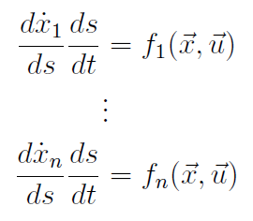
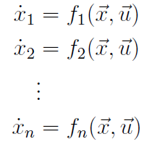
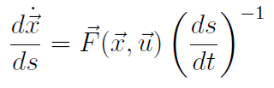
Start with generic state space model:
Chain Rule
Vector form:

Slide 4
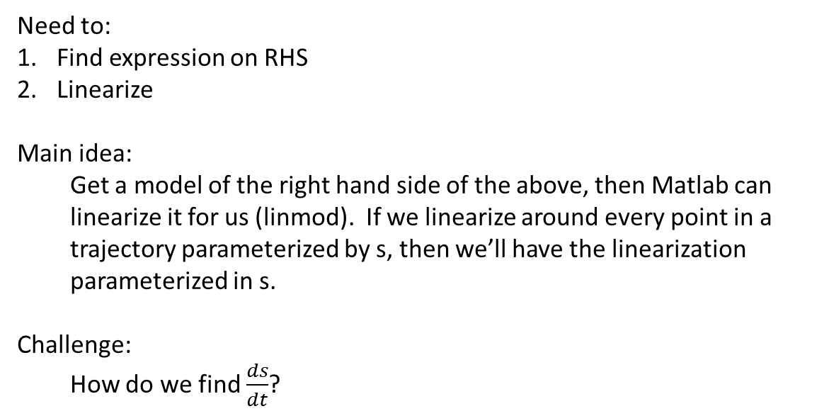
Vector form:
Need to:
Find expression on RHS
Linearize
Main idea:
Get a model of the right hand side of the above, then Matlab can linearize it for us (linmod). If we linearize around every point in a trajectory parameterized by s, then we’ll have the linearization parameterized in s.
Challenge:
How do we find $\frac{ds}{dt}$?
How to find this?

Slide 5
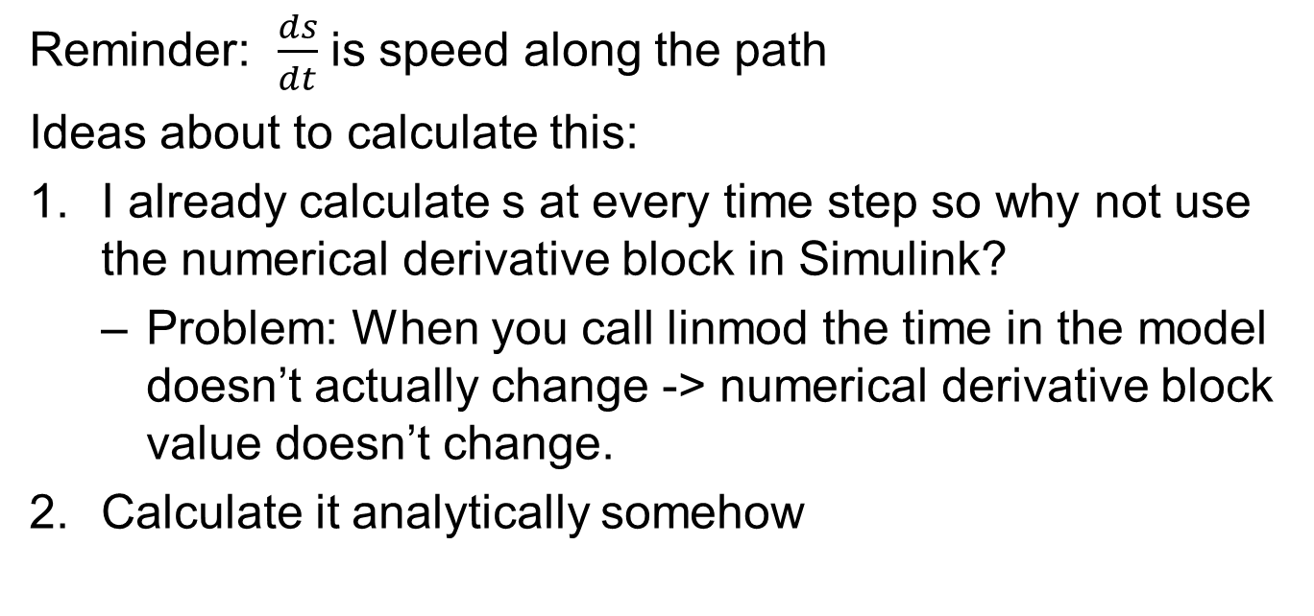
Reminder: $\frac{ds}{dt}$ is speed along the path
Ideas about to calculate this:
I already calculate s at every time step so why not use the numerical derivative block in Simulink?
Problem: When you call linmod the time in the model doesn’t actually change -> numerical derivative block value doesn’t change.
Calculate it analytically somehow

Slide 6



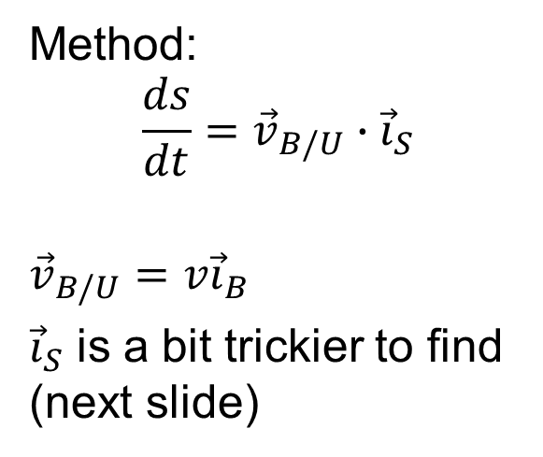







Calculating $\frac{ds}{dt}$ Analytically
Problem setup:
Method:
$$\frac{ds}{dt}={\vec{v}}_{B/U}∙{\vec{i}}_{S}$$
$${\vec{v}}_{B/U}=v{\vec{i}}_{B}$$
${\vec{i}}_{S}$ is a bit trickier to find (next slide)
$${\vec{i}}_{B}$$
$${\vec{j}}_{U}$$
$${\vec{i}}_{S}$$
$$B$$
$$S$$
$${\vec{j}}_{B}$$
$$U$$
$${\vec{i}}_{U}$$
$$s$$
(lower case)

Slide 7
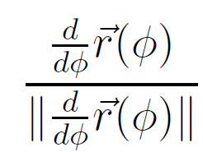

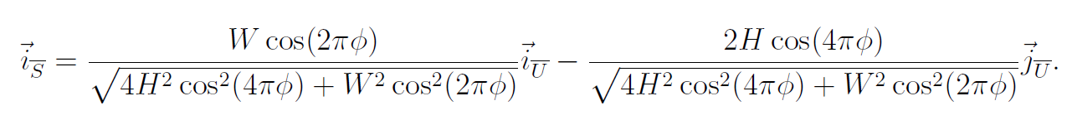

Calculating ${\vec{i}}_{S}$
For a generic path $\vec{r}(φ)$ the tangent vector is given by
In our case:
Which works out to:
Note that this is in terms of $φ$, so we still need to know, what $φ$?

Slide 8
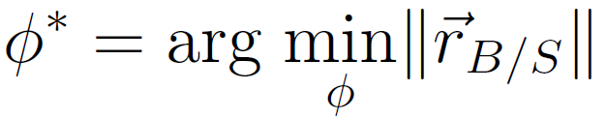

What $φ$?
Position of the point B (the body) relative to a point S on the path
1D minimization problem
> Solve numerically

Slide 9

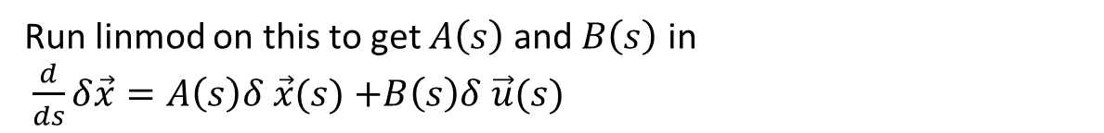
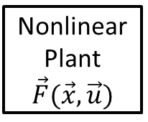








Summary: Block Diagram
Vector form:
$$\vec{u}$$
$$\frac{d\vec{x} }{dt}$$
Nonlinear Plant
$$\vec{F}(\vec{x},\vec{u})$$
$$×$$
$$÷$$
$$\vec{x}$$
$$\frac{d\vec{x} }{ds}$$
Calculate $v{\vec{i}}_{B}$
Dot Product
$$\frac{ds }{dt}$$
1D Minimization
$$φ^{∗}$$
Calculate ${\vec{i}}_{S}$
Run linmod on this to get $A\left(s\right)$ and $B\left(s\right)$ in
$\frac{d}{ds}δ\vec{x}=A\left(s\right)δ \vec{x}(s)$ $+B\left(s\right)δ \vec{u}(s)$

