Slide 1
Simplified AWE System Model
Mitchell Cobb
10/8/2018

Slide 2
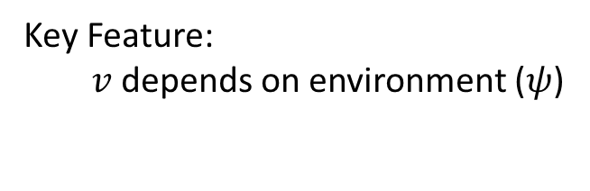
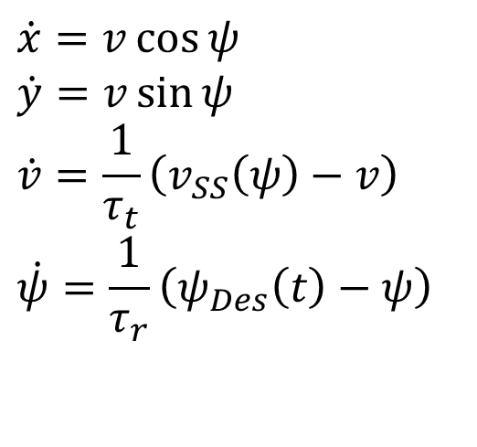
Nonlinear Model
X Position
$$\dot{x}=v\cos{ψ}$$
$$\dot{y}=v\sin{ψ}$$
$$\dot{v}=\frac{1}{τ_{t}}\left(v_{SS}\left(ψ\right)−v\right)$$
$$\dot{ψ}=\frac{1}{τ_{r}}\left(ψ_{Des}\left(t\right)−ψ\right)$$
X Position
Key Feature:
$v$ depends on environment ($ψ$)
Speed
Heading

Slide 3
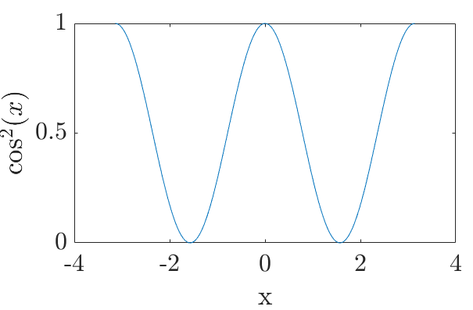
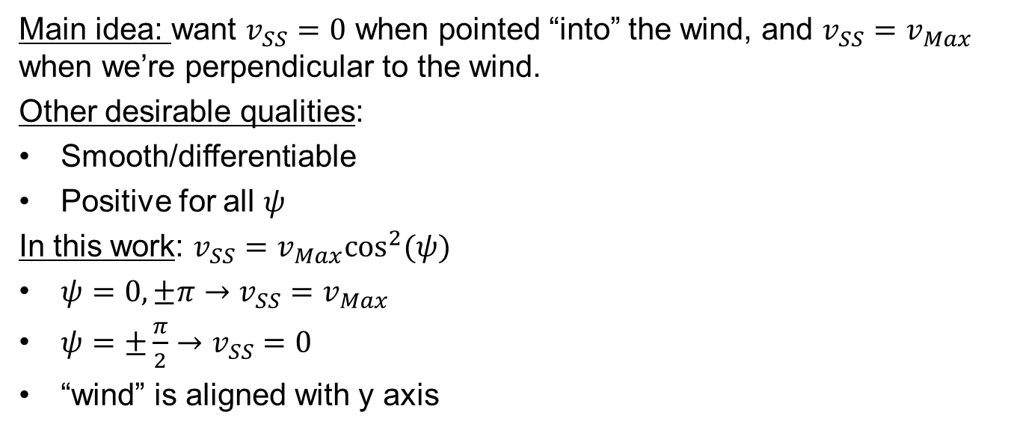

What to pick for $v_{SS}\left(ψ\right)$?
Main idea: want $v_{SS}=0$ when pointed “into” the wind, and $v_{SS}=v_{Max}$ when we’re perpendicular to the wind.
Other desirable qualities:
Smooth/differentiable
Positive for all $ψ$
In this work: $v_{SS}=v_{Max}\cos^{2}(ψ)$
$ψ=0,±π→v_{SS}=v_{Max}$
$ψ=±\frac{π}{2}→v_{SS}=0$
“wind” is aligned with y axis

Slide 4
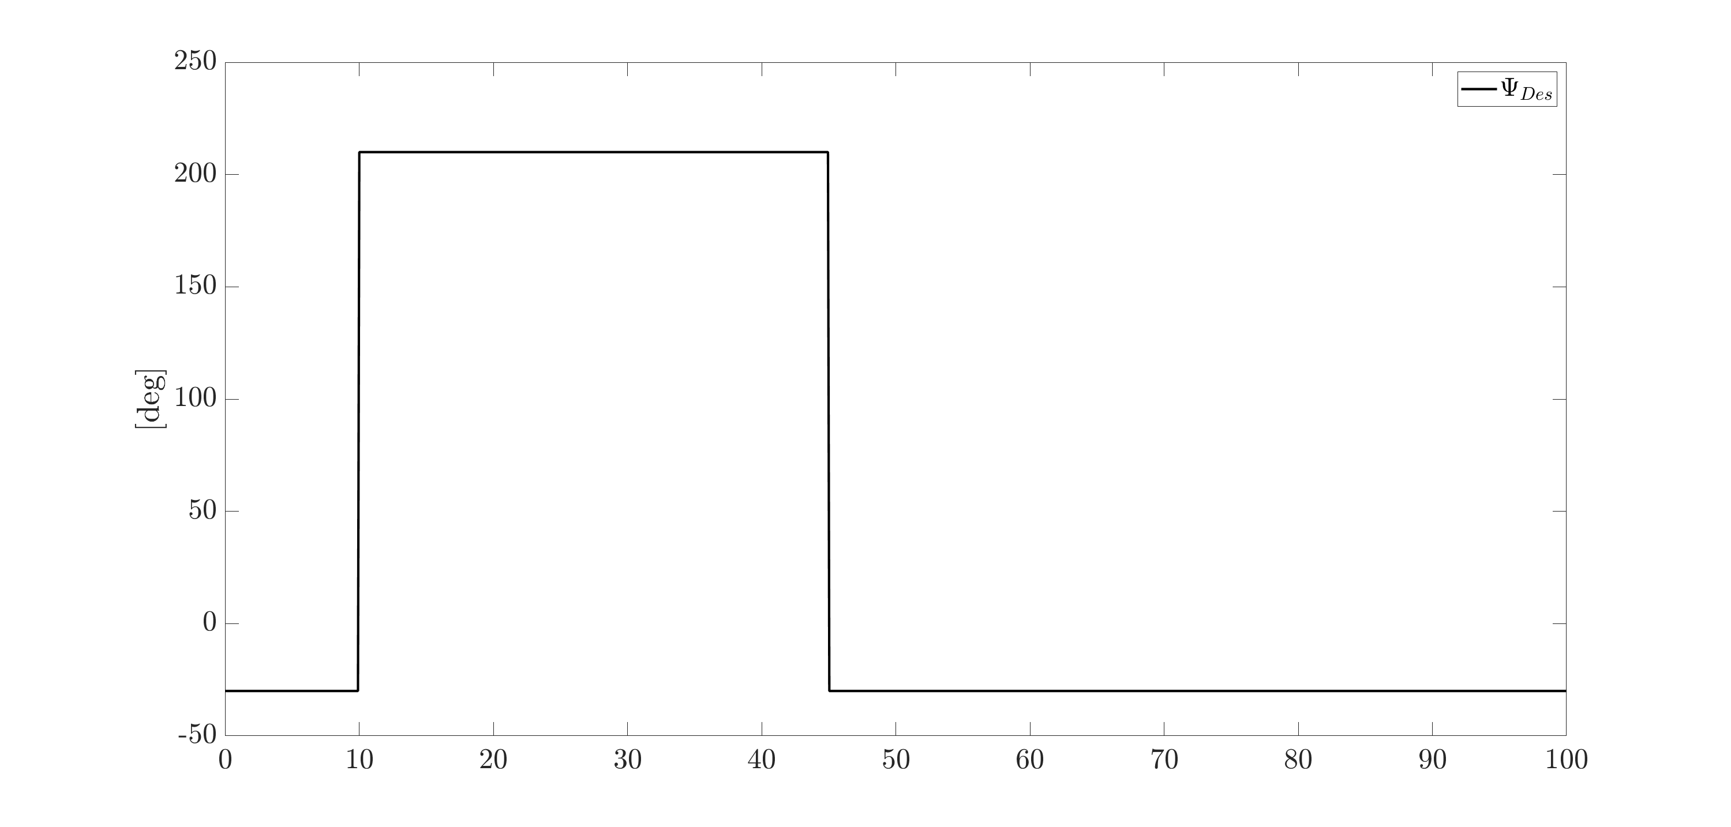

Finding an initial $ψ_{Des}\left(t\right)$
Method: (educated) guess and check
Results:
y
x

Slide 5
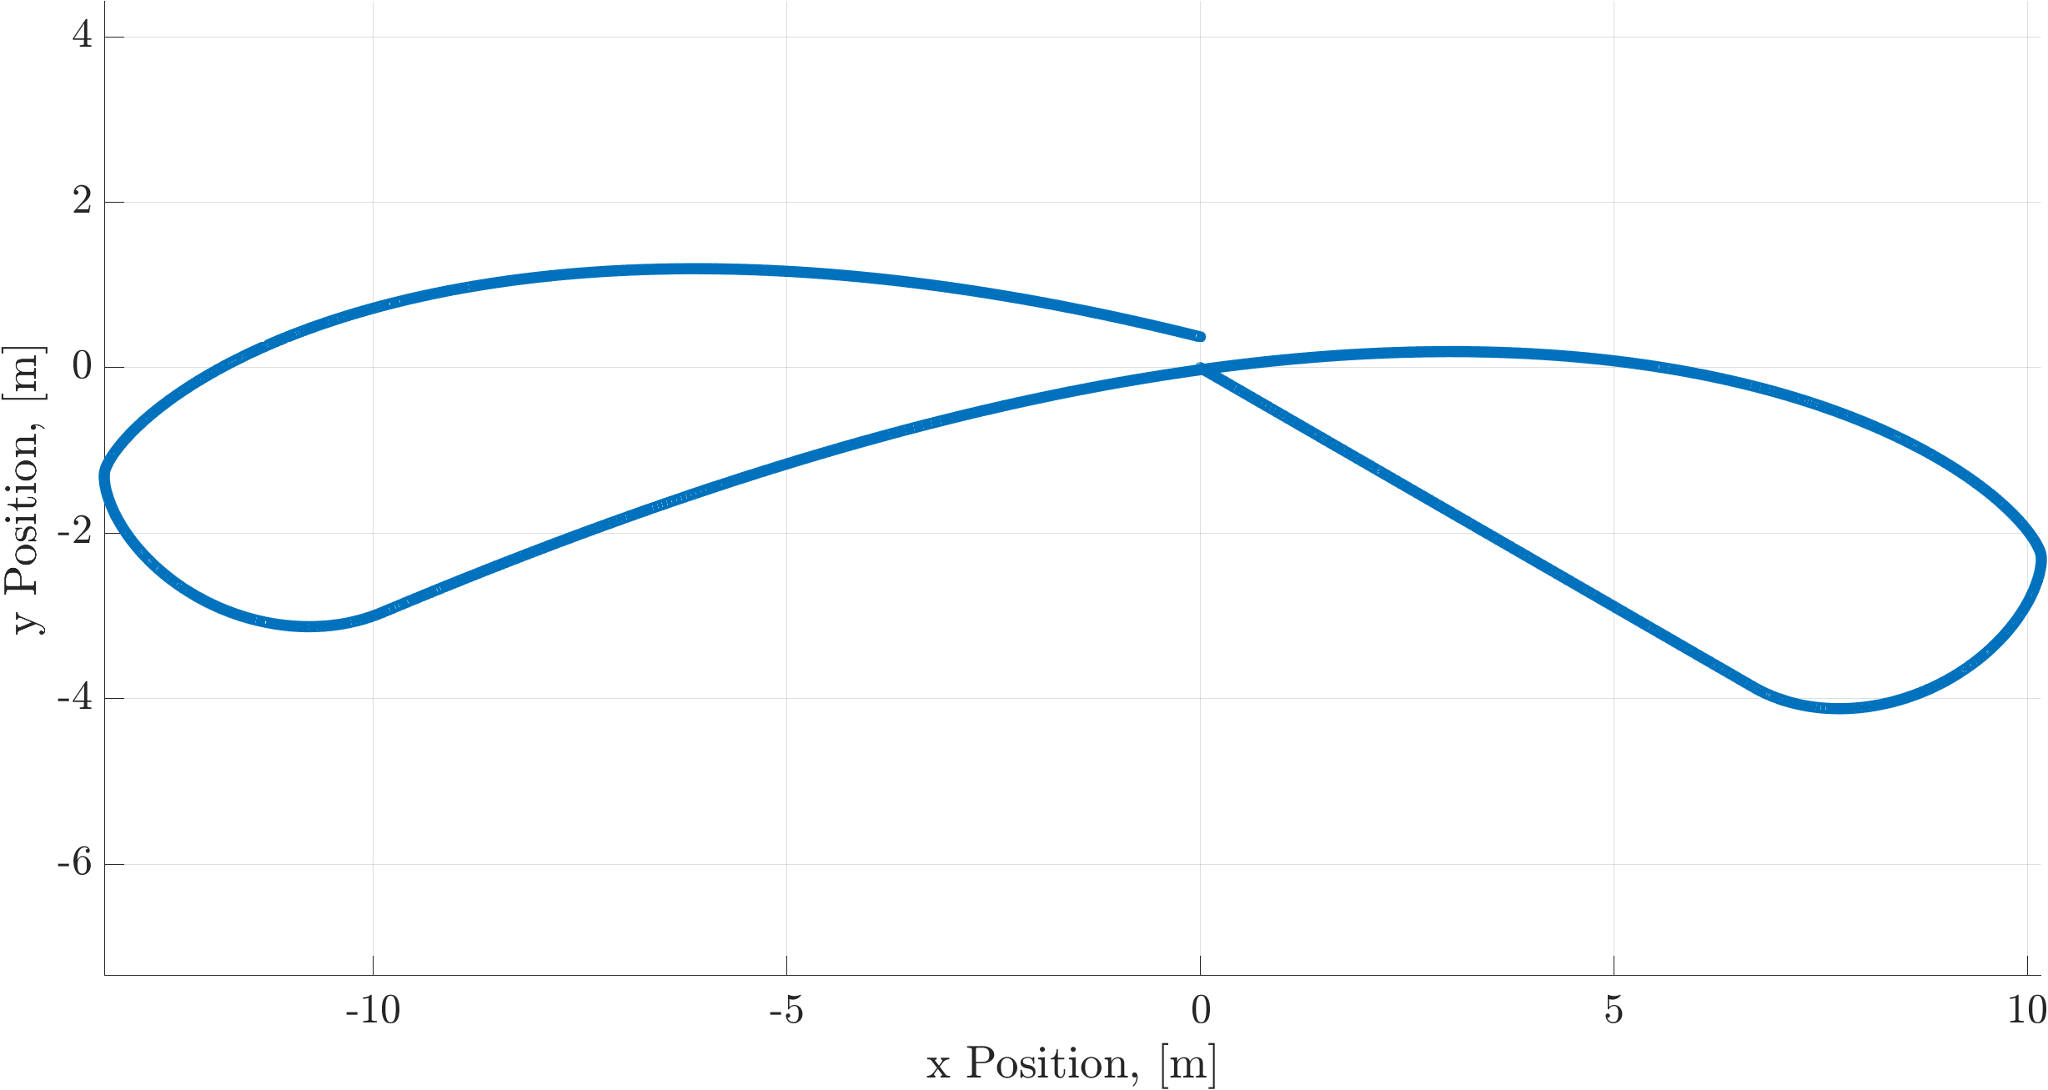
Achieved Path

Slide 6
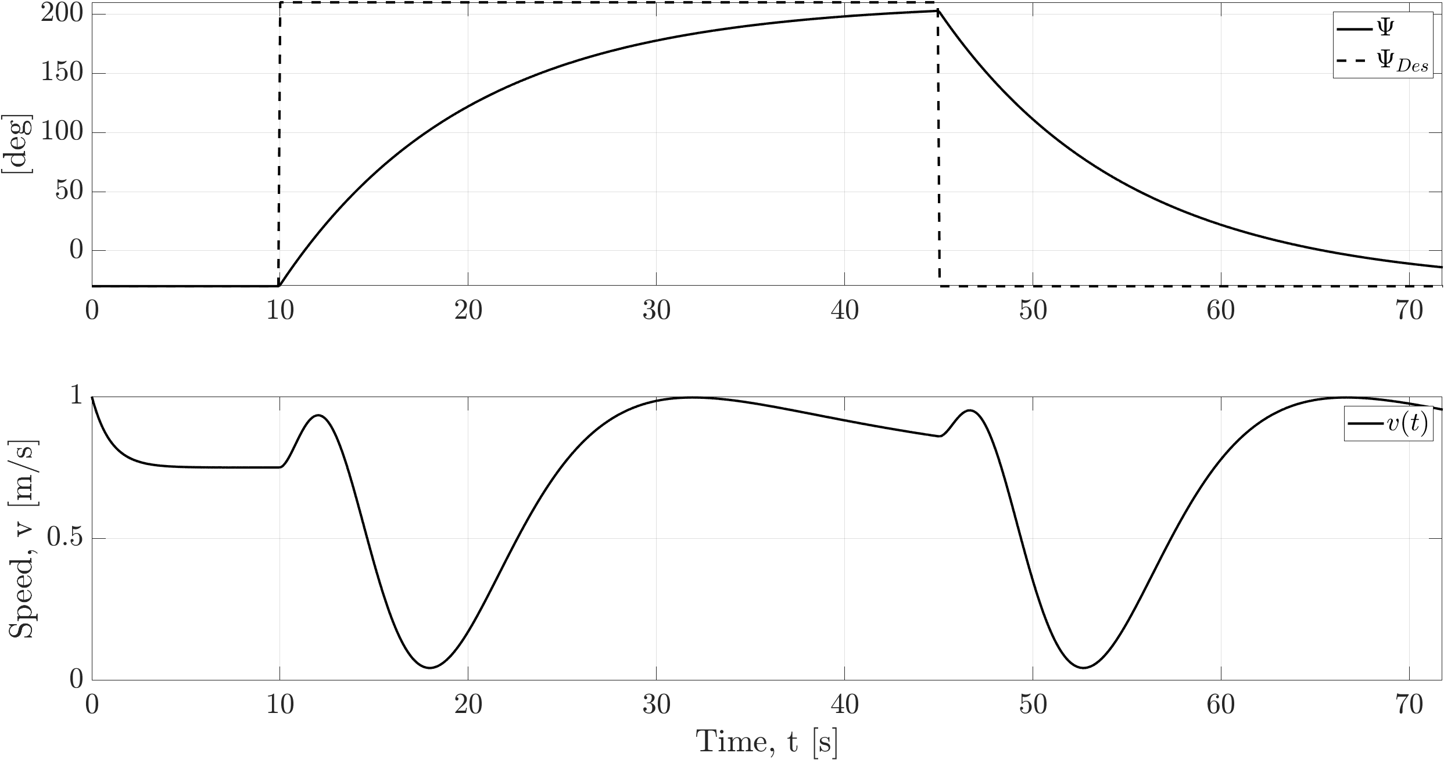
The Other States

Slide 7
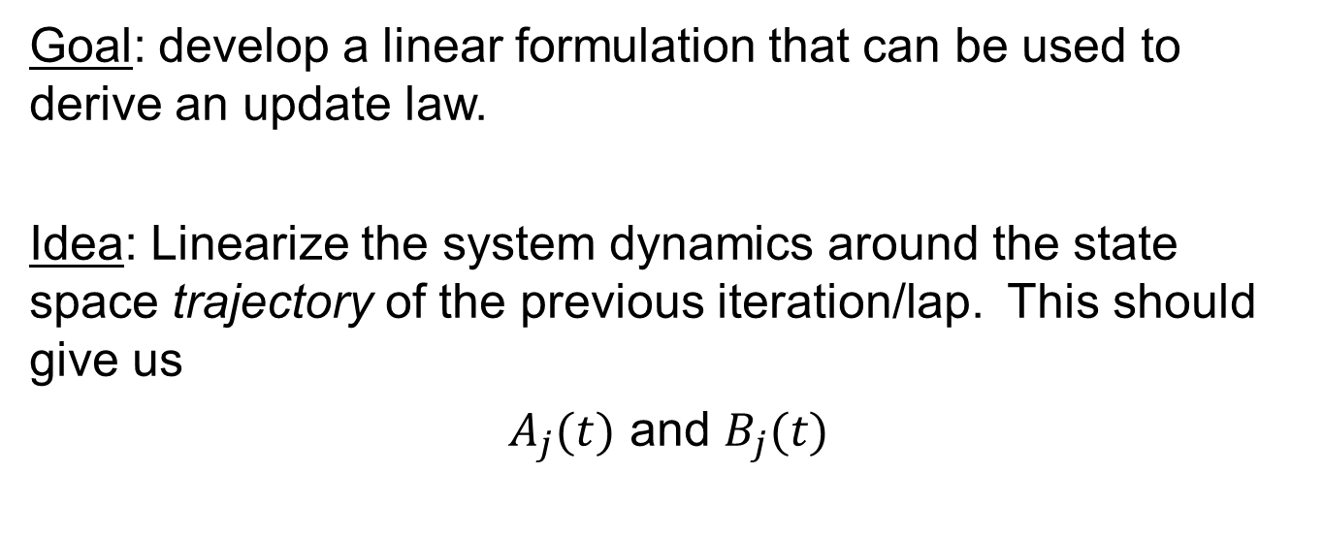
How to use this in ILC framework?
Goal: develop a linear formulation that can be used to derive an update law.
Idea: Linearize the system dynamics around the state space trajectory of the previous iteration/lap. This should give us
$A_{j}(t)$ and $B_{j}(t)$

Slide 8
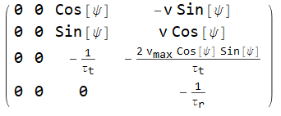


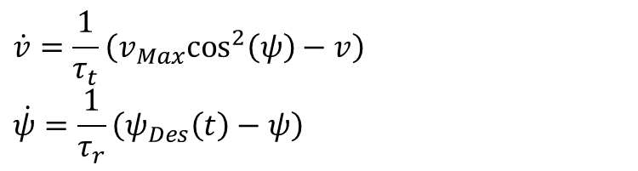

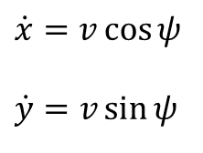


Trajectory Linearization
$$\dot{v}=\frac{1}{τ_{t}}\left(v_{Max}\cos^{2}\left(ψ\right)−v\right)$$
$$\dot{ψ}=\frac{1}{τ_{r}}\left(ψ_{Des}\left(t\right)−ψ\right)$$
$$\dot{x}=v\cos{ψ}$$
$$\dot{y}=v\sin{ψ}$$
Nonlinear
$$\vec{x}\left(t\right)≈{\vec{x}}_{0}(t)+A_{0}(t)(\vec{x}(t)−{\vec{x}}_{0}(t))+B_{0}(t)(ψ_{Des}(t)−ψ_{Des,0}(t))$$
$$A_{0}\left(t\right)=A\left({\vec{x}}_{0}\right)$$
$$B_{0}\left(t\right)=B\left({\vec{x}}_{0}\right)$$
Linear
$$A\left(t\right)=$$
$$B\left(t\right)=$$

Slide 9
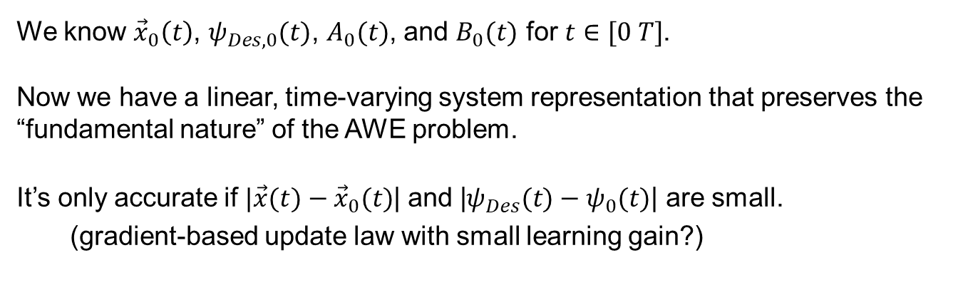
Summary
$$\vec{x}\left(t\right)≈{\vec{x}}_{0}(t)+A_{0}(t)(\vec{x}(t)−{\vec{x}}_{0}(t))+B_{0}(t)(ψ_{Des}(t)−ψ_{Des,0}(t))$$
We know ${\vec{x}}_{0}\left(t\right)$, $ψ_{Des,0}(t)$, $A_{0}(t)$, and $B_{0}(t)$ for $t∈[0 T]$.
Now we have a linear, time-varying system representation that preserves the “fundamental nature” of the AWE problem.
It’s only accurate if $|\vec{x}(t)−{\vec{x}}_{0}(t)$| and |$ψ_{Des}(t)−ψ_{0}(t)$| are small.
(gradient-based update law with small learning gain?)

