Slide 1

Presentation on MERN STACK CRUD OPERATIONS
Presented By
Mahesh
Engineering Intern at Skill-lync

Slide 2
MERN STACK CRUD OPERATIONS
In this project, we are performing the crud operations like Create, Read, Update and Delete.
For the crud operations, we are using MERN technology means MongoDB, Express.js, React and NodeJs.
MongoDB is a source-available cross-platform document-oriented database program. Classified as a NoSQL database program, MongoDB uses JSON-like documents with optional schemas.
Express.js, or simply Express, is a back end web application framework for building RESTful APIs with Node.js, released as free and open-source software under the MIT License.

Slide 3
MERN STACK CRUD OPERATIONS
React is a free and open-source front-end JavaScript library for building user interfaces based on components.
Node.js is a cross-platform, open-source server environment. Node.js is a back-end JavaScript runtime environment, runs on the V8 JavaScript Engine, and executes JavaScript code outside a web browser.

Slide 4
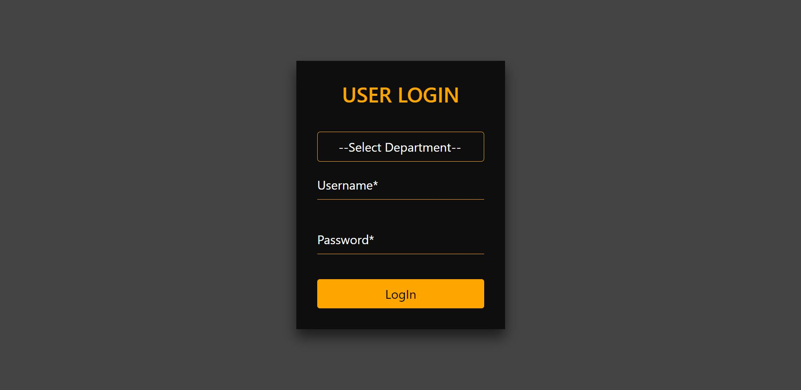
Login Page

Slide 5
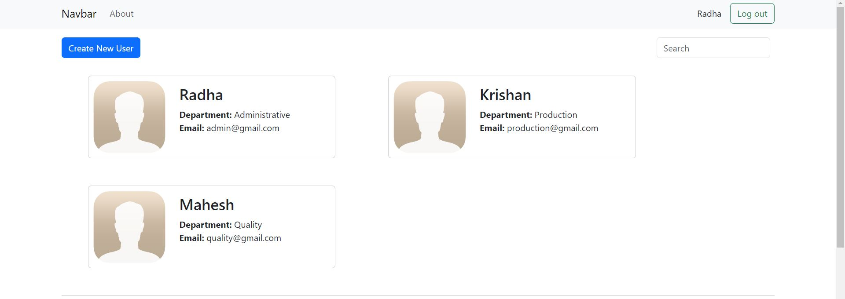
Admin Account: Read All User Account

Slide 6
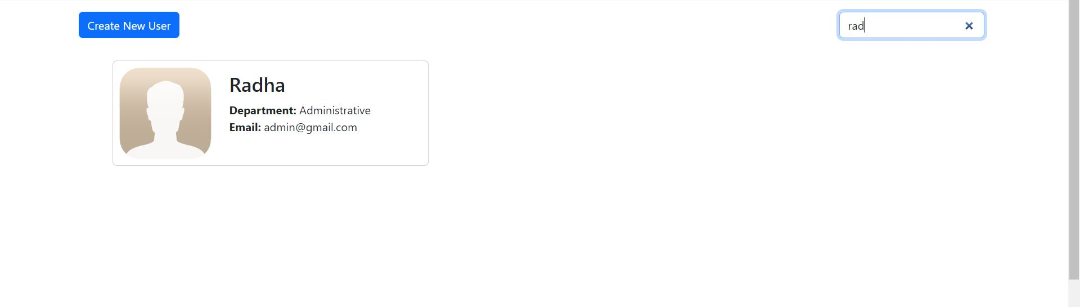
Search User Account
Search

Slide 7
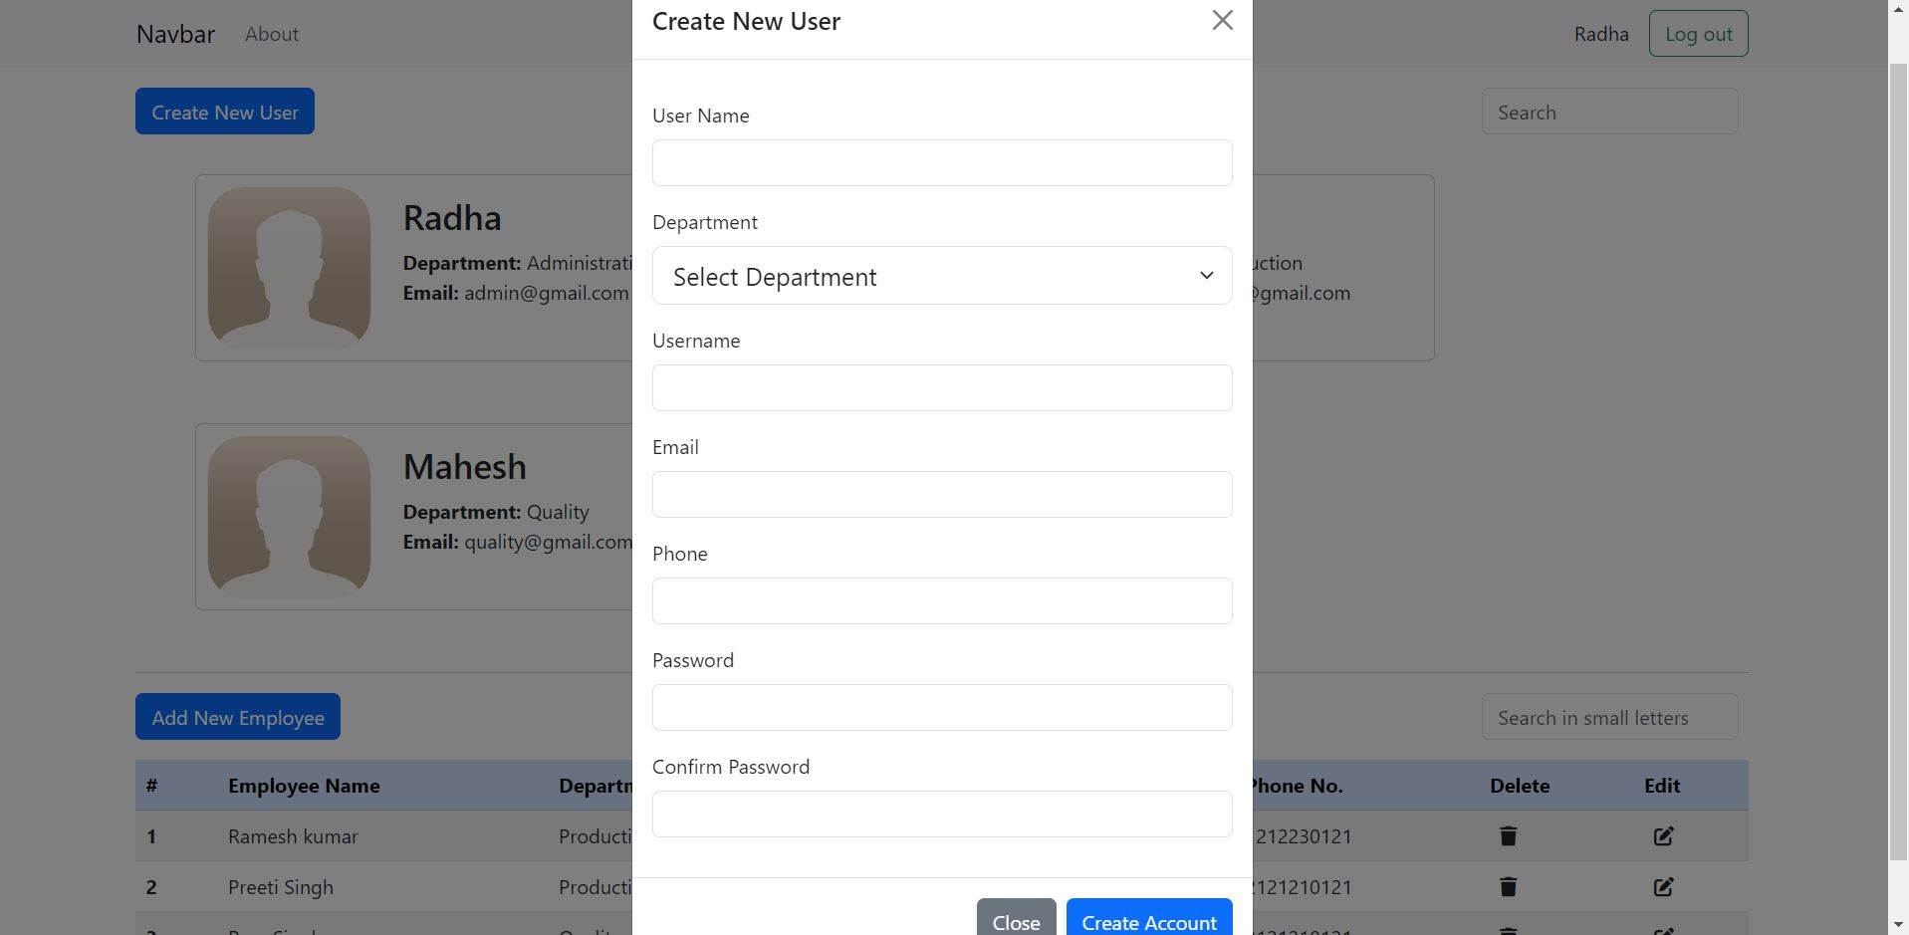
Create New User: Modal
Click

Slide 8
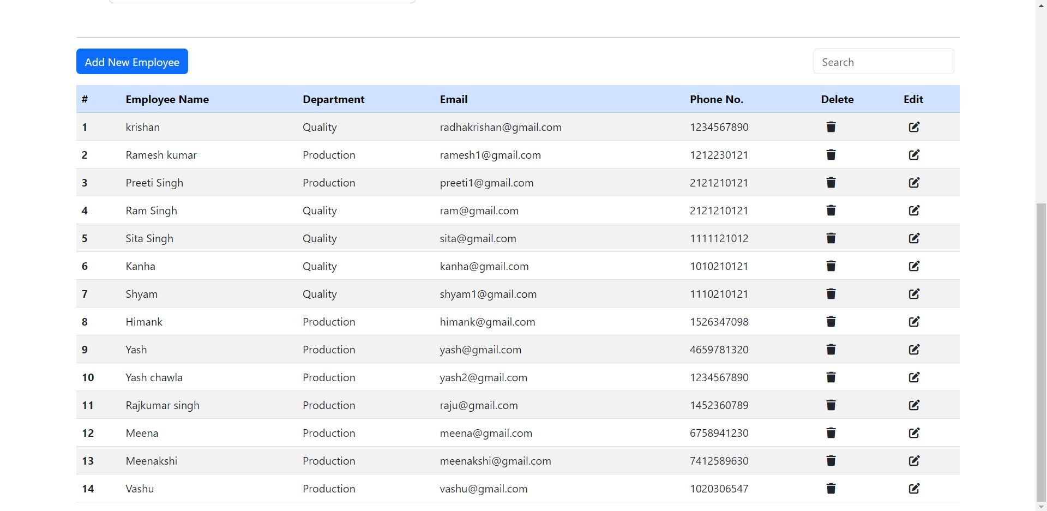
Read All Employees Data

Slide 9
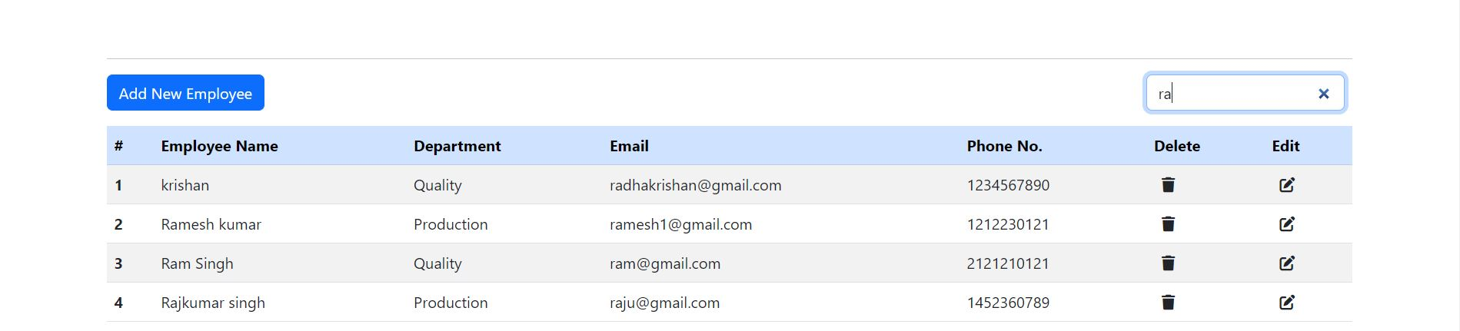
Search Employees Data
Search

Slide 10
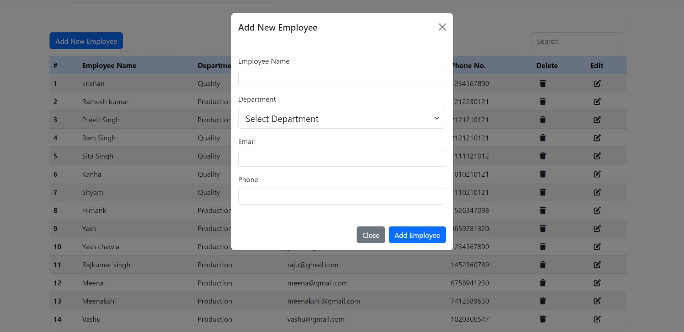
Create Employee Data
Click

Slide 11
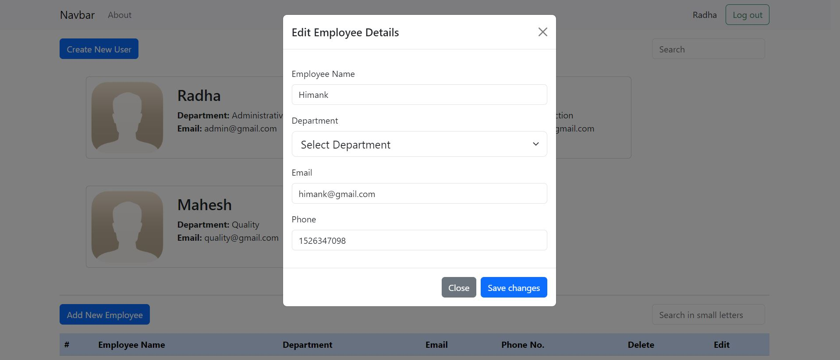
Edit Employee Data
Click

Slide 12
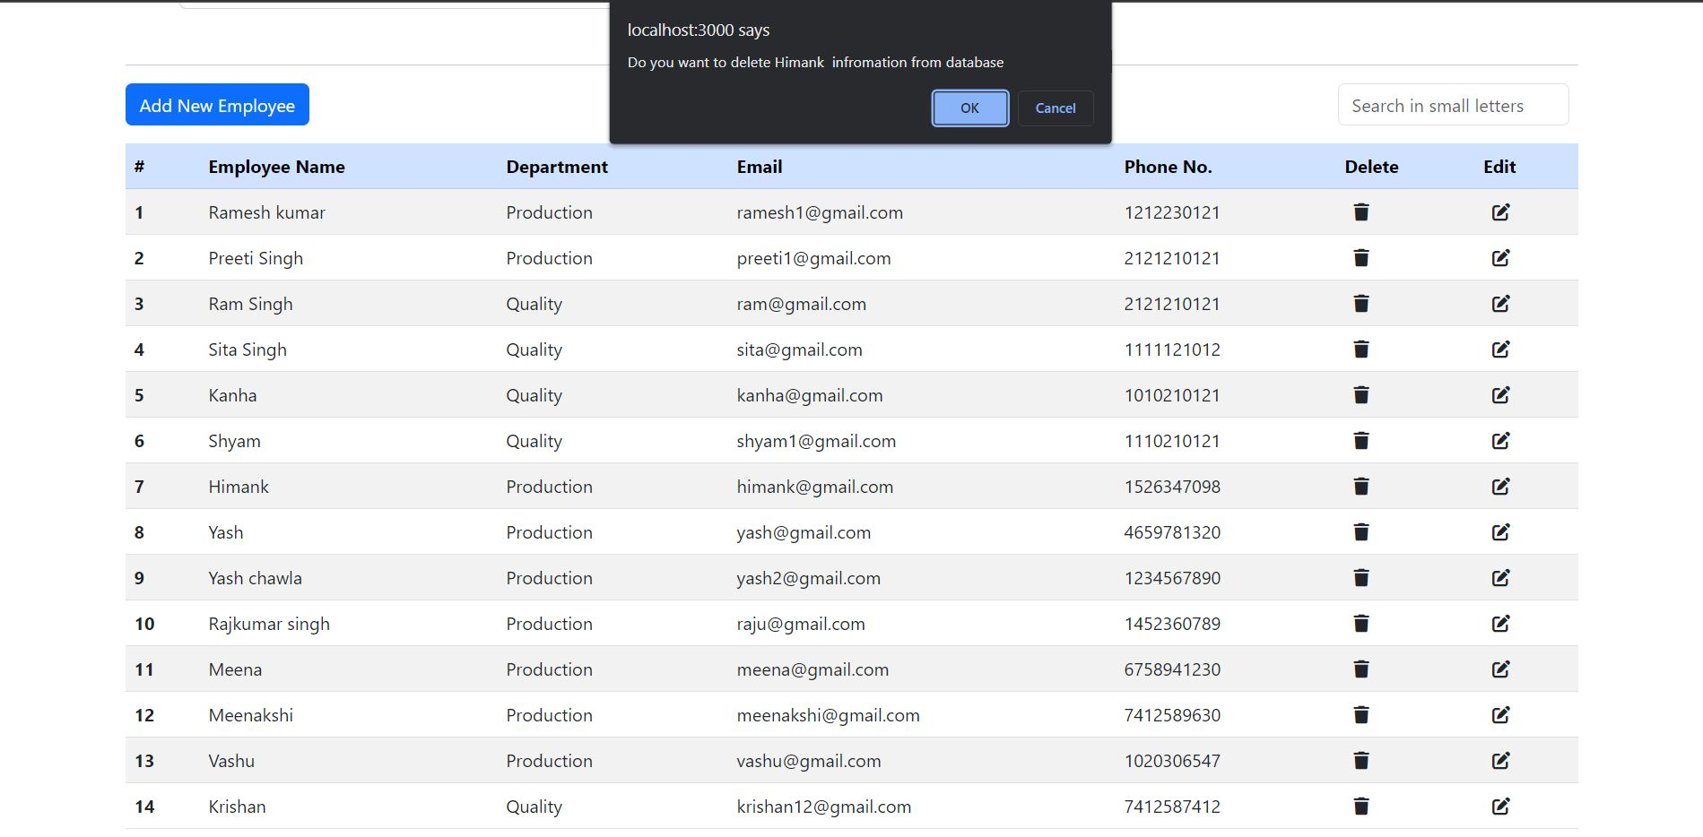
Delete Employee Data
Click

Slide 13
Thank You

