Slide 1
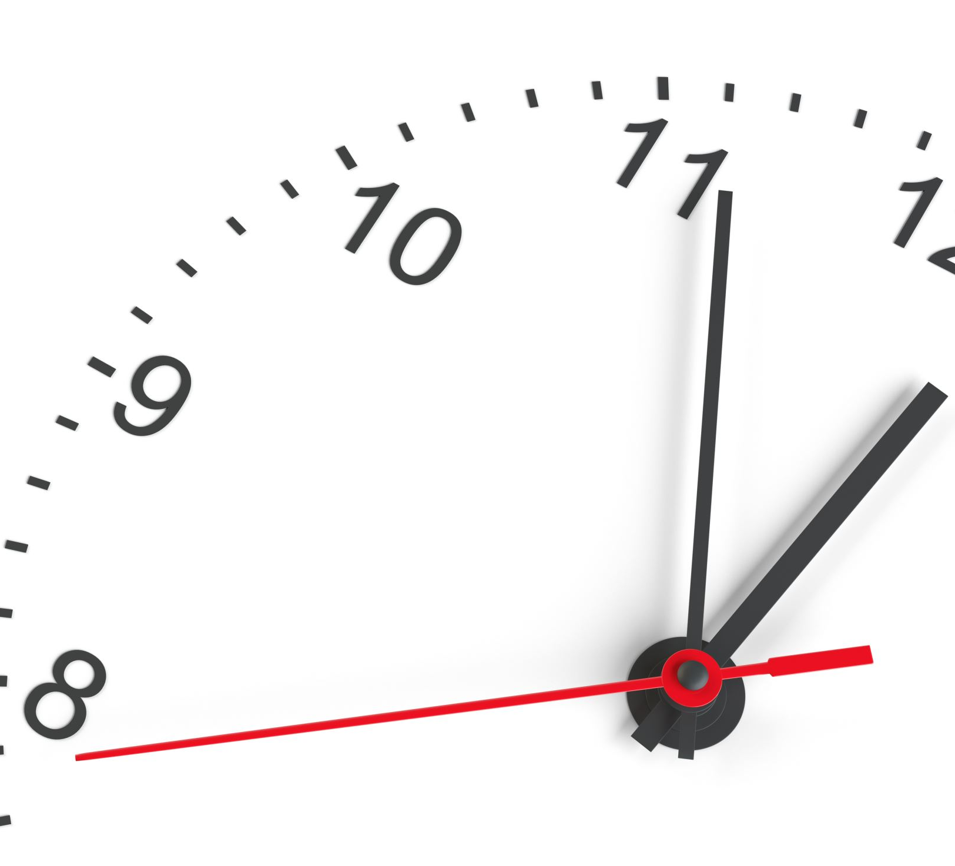
TIMELINE ANALYSIS OF RAMAYANA.
GROUP - 10
Supervisor - Prof. Arnab Bhattacharya
Ashutosh Patel(21111018)
Deepak B Hegde(21211402)
Harishchandra Patidar(21111029)
Mandar Dhake(21111405)

Slide 2
Problem Statement
Determining the syntactic and semantic properties, such as tense, parts of speech, etc., of the Ramayana data-set in Hindi.
01
Using the information retrieved to perform timeline analysis and temporal ordering of the events.
02

Slide 3
Web Scraping and Data Preprocessing.
Creation of two HINDI RAMAYANA datasets through different methods for accuracy measure(using translators, tesseract and OCR)
Creation of Knowledge Graph from ITIHASA dataset, Hence taken in account.
OCRing through 2621 images.
Creation of 585 chapters by merging all 7 Kandas of RAMAYANA.
Also experimented with translating the existing ITIHASA dataset from English to Hindi using translators python lib.

Slide 4
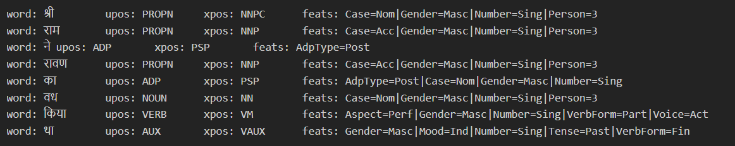
Past, Present, Future Sentence Judgement.
Since this is area of less research, there is no model to perform such tasks efficiently.
Hence, we have used Stanza python lib to get the required results.
Below image shows the tokenization and type of tense.

Slide 5
Past, Present, Future Sentence Judgement (contd...)
Gone through all the sentences present in Ramayana Hindi dataset and tried to find the type of tense.
Dataset contains all simple and compound sentences. Hence, some sentences couldn't be captured by the lib efficiently.
Created three lists which stores Past, Present and Future Sentences respectively in chronological order.
The above created list will be used in BM-25 model to know the temporal ordering of events.

Slide 6
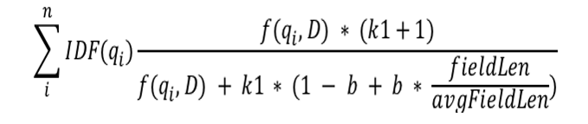
BM25 to find relevant position of past events.
Searching for events and finding when this event has been happened in past.
Given a query Q, containing keywords {q_{1},...,q_{n}}, the BM25 score of a document D is:
where f (qi, D) is qi’s term frequency in the document D in words, avgFieldLen is the average document length in the text collection from which documents are drawn. k and b are hyper-parameters which are set to 2 and 0.75 respectively.

Slide 7
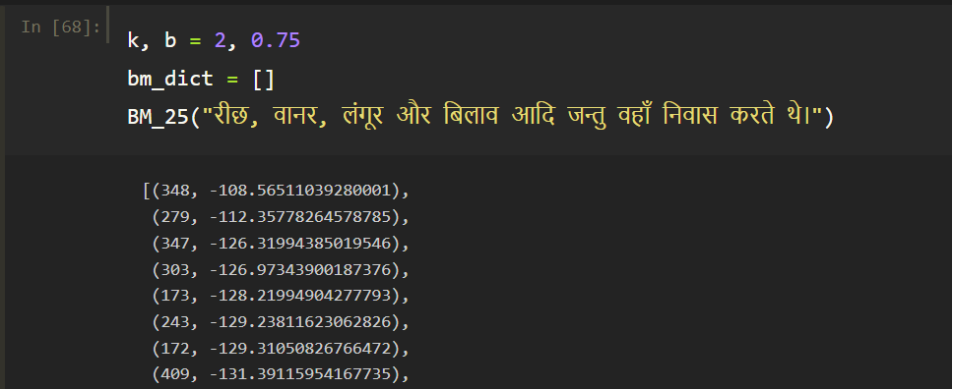
BM25 to find relevant position of past events.(contd...)
Below example shows how we're performing temporal ordering of events -
Here, We are passing 1 sentence of chapter 348 and model BM-25 returns chapter name
And score related to that query. Further, we pick the top 8 chapters and if it is found in
the chapters less than 348 then, we can say it has been happened in the past somewhere.

Slide 8
Analysis using Knowledge Graph.
Knowledge graph represents network of subject, object and their relationship.
Used to show the dependency and the relationships between various events across past, present and the future for better understanding.
Eg. We use nodes like 'RAMA', but to which 'BROTHER' does this node refer?
We may deduce that it is one of the four brothers.
Relationship(Brother)
Rama
Lakshmana

Slide 9
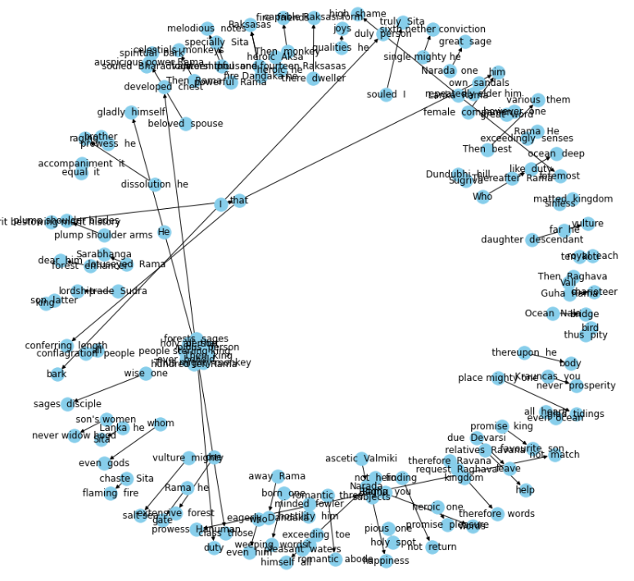
Knowledge graph of Ramayana dataset instances.
*networkx doesn't support Hindi lang.

Slide 10
Analysis and Results.
Tense determination works efficiently for simple sentences but sometimes results aren't that effective for compound sentences.
Translation is not always a good option because sometimes transliteration happens instead of translation.
The past events that has nothing to do with Ramayana and it has been happened before Ramayana but discussed in Ramayana, BM-25 is not efficient to capture those sentences.
Data generation and processing data is not that efficient, and it could affect the whole implementation process.

Slide 11
Future work.
We did not use any meta data or external resources to solve the problem; we only used the raw data set, which does not account for the approach of using meta data.
The addition of meta data provides additional information about the occurrence of an event that was not present in the raw data set. The approach of adding meta data to the data set, such as the year of a particular popular event, and then performing temporal ordering using those timed events is yet to be explored.

Slide 12
Conclusion
Without specific temporal information such as time, date, duration, and set, there has been very little progress in the temporal ordering of events in ancient historical literature.
This is a relatively new and difficult research area.
We demonstrated how to retrieve the temporal order of multiple correlated events using the dependency parsing technique, tagging the parts of speech, and knowledge graphs.
This will serve as a good comprehensive approach to the problem statement in the absence of good temporal information.

Slide 13

Thank You.

