Slide 1
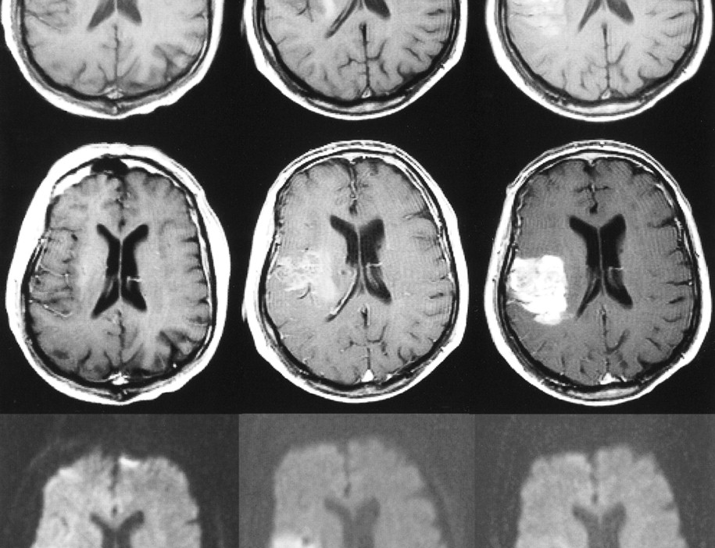
3D BraiN STROKE SEGMENTATION using U-NET
GitHub link →
Mirko Di Biase
ID 792726
m.dibiase2@campus.unimib.it
Data Science Lab, Medicine module - project work

Slide 2
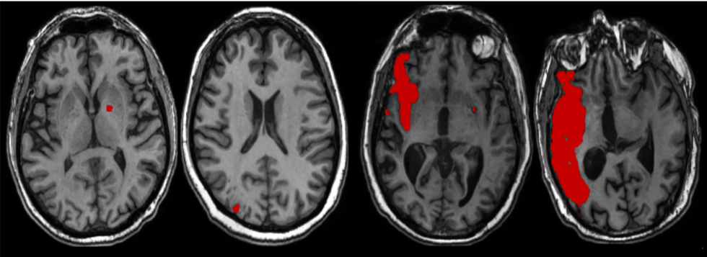
BRAIN STROKE INTRODUCTION
Neurological deficit related to an acute focal injury of the central nervous system by a vascular cause [Sacco et al. 2013]
Two main different types of stroke do exist [Gomes, Wachsman, 2013]:
ischemic due to vessels occlusion, leading to the blood flow interruption to brain areas
hemorragic due to vessels bleeding causing direct damage to brain tissue
Stroke-related impairments could be [Jambi et al. 2024]:
Physical: paralysis, balance and coordination deficits affecting mobility and daily activities
Cognitive: memory, attention, reasoning and decision-making difficulties
Communication: aphasia, speech and swallowing disorders limiting interaction

Slide 3
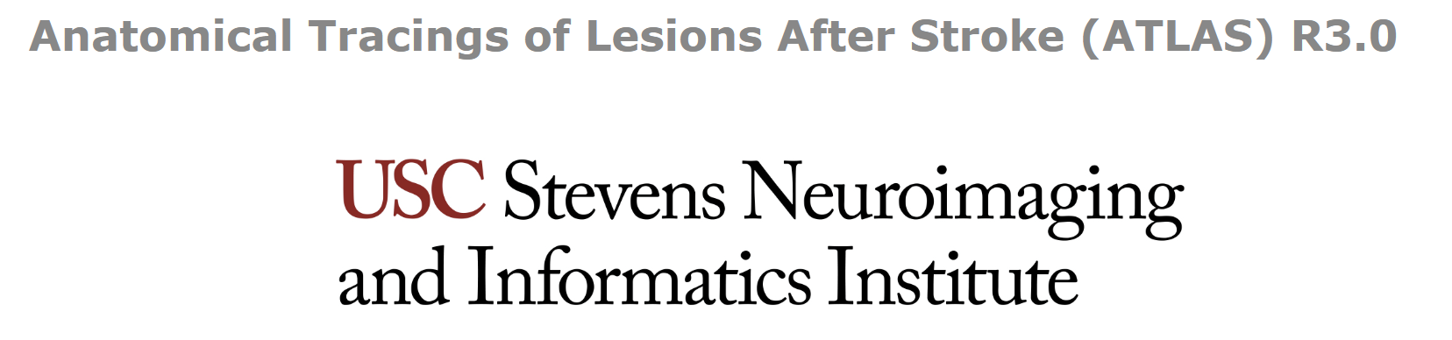
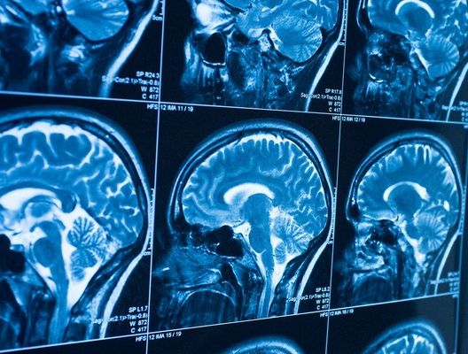
DATASET PRESENTATION & references
The 3rd release of the dataset includes:
1453 T1-weighted MRI scans
1453 corresponding binary masks for stroke lesion mapping
1453 metadata csv files
It can be downloaded by making request to → https://docs.google.com/forms/d/e/1FAIpQLSclH8padHr9zwdQVx9YY_yeM_4OqD1OQFvYcYpAQKaqC6Vscg/viewform
Raw data have been taken into account
Original paper is edited by Liew et al. 2018 → https://www.nature.com/articles/sdata201811

Slide 4
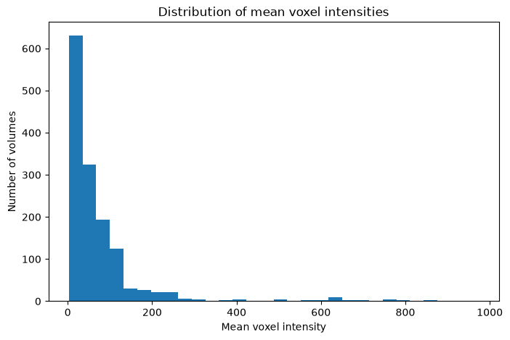
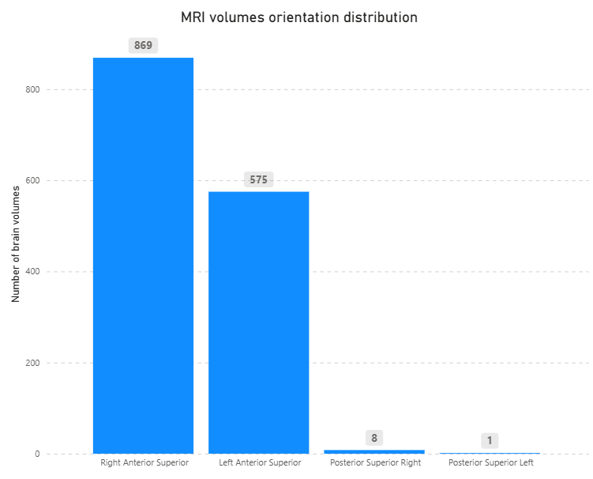
Exploratory data analysis (1)
The majority of MRI volumes are acquired in the Right Anterior Superior (RAS) orientation, for about the 60% out of the total
Nevertheless, a significative Left Anterior Superior (LAS) cluster of volumes (about 39%) is observed
Other orientation spaces are detected through extremely rare
Voxel values are highly heterogeneous across volumes
While most of the volumes have a mean intensity below 87, out of a third of them show values up to 20k (the graph above is truncated at 1000)

Slide 5
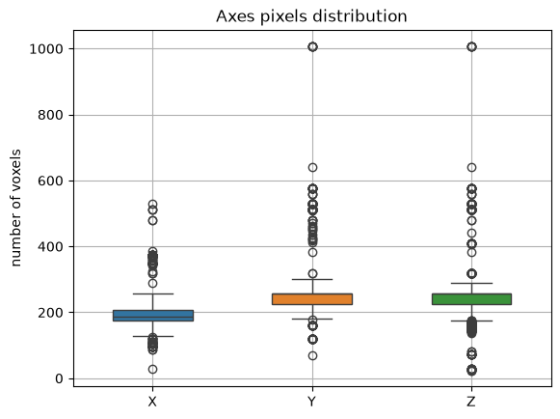
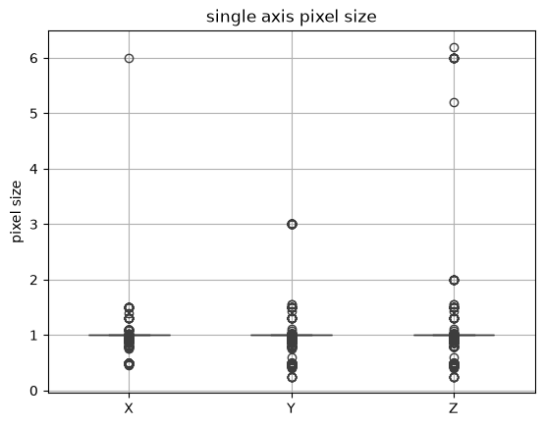
Exploratory data analysis (2)
Variability in volume dimensions is shown, especially along Y and Z axes
Even if the majority of volumes highlight a shape centered towards 188 x 256 x 256, heavy right tails up to 1008 voxels (Y and Z dim) are detected
Volumes tend to share a common spatial resolution along axes (1mm x 1mm x 1mm)
Anisotropic resolutions are shown as well: extreme cases reveal voxel sizes up to 6 mm

Slide 6
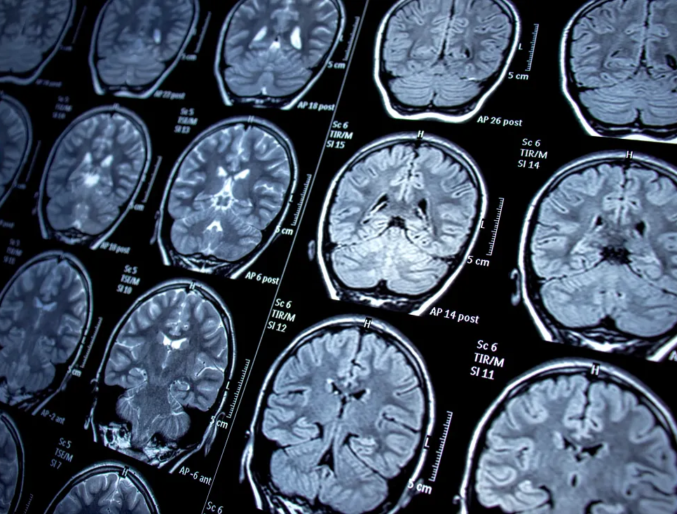
Project workflow

Slide 7
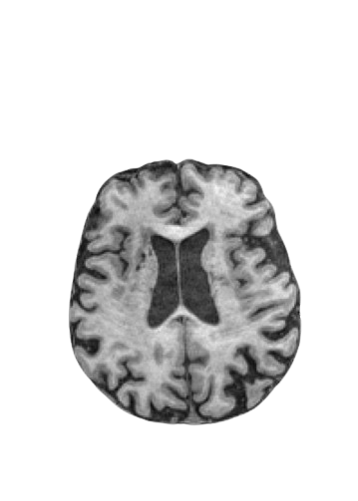
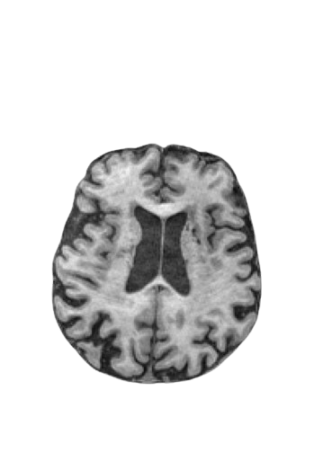
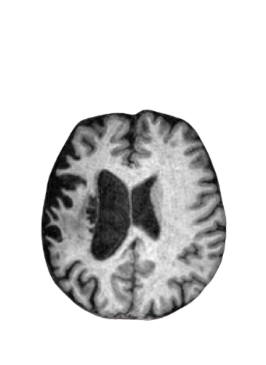
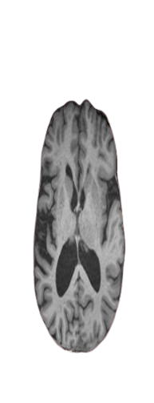
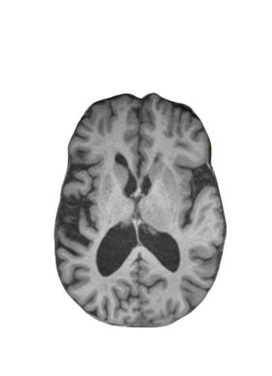
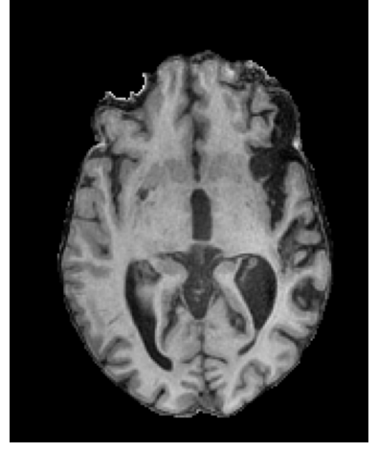
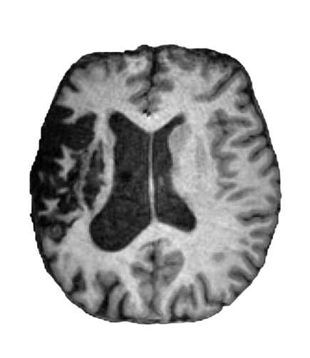
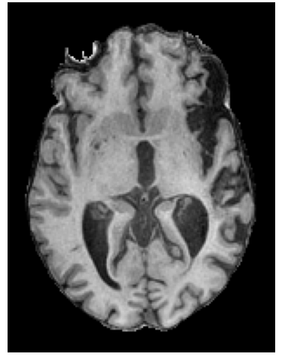
DETERMINISTIC preprocessing STEPS
Raw data
Dataset cleaning
Orientation space normalization
Pixel space normalization
Foreground cropping
Intensity normalization
Preprocessed data
Volumes with max/min zoom ratio greater than 1.5 are considered as anisotropic
136 out of 1453 are discarded
All brain volumes are aligned to RAS orientation space
Volumes are resampled to a homogeneous voxel space of 1mm per dimension
Unnecessary background is removed to preserve anatomical context (max margin = 10 voxels)
Voxel values across volumes are transformed into z-scores

Slide 8
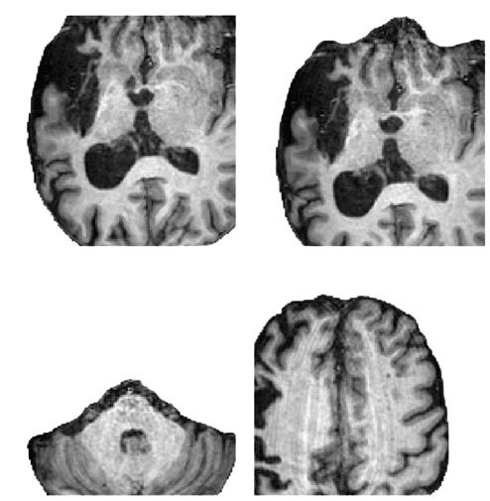
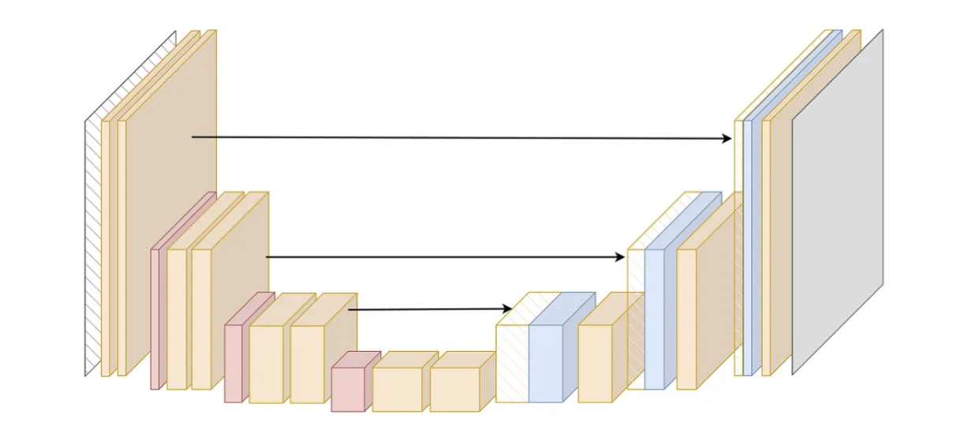
SIMPLE MODEL INPUT
train data
Random cropping
train data loader building
Random extraction of 3D patches (128×128×64 voxels) from images for memory porpouses
1:1 positive-to-negative ratio is taken into account to increase representation of target regions.
U-NET training loop
train: 80%
val: 10%
test: 10%
Preprocessed data
Train/val/test split
val/test data
val/test data loader building

Slide 9
MODEL SPECIFICATION
(*)
Conv 3D
kernel size (3,3,3)
Feature map norm
U-NET architecture
Dropout
Encoder
Decoder
PReLU
Single residual unit blocks: after the 3D convolution,values of each single feature map are normalized. Dropout of rate 0.2 is performed and eventually a non linearity function is applied
(*)
Encod block1
32 filters
Decod block 1
Skip conn, 32 filters
Encod block 2
64 filters
Decod block 2
Skip conn, 64 filters
Object | Parameter | Value
Model | Feature maps | 32,64,128,256,512
 | Strides | 2,2,2,2
 | Residual units | 4
 | Dropout | 0.2
Optimizer | AdamW | -
 | Learning rate | 0.001
 | Weight decay | 0.0001
Loss function | DiceCELoss | -
Training loop | Epochs | 50
 | Batch size | 2
Encod block3
128 filters
Decod block 3
Skip conn, 128 filters
Encod block 4
256 filters
Decod block 4
Skip conn, 256 filters
Bottleneck
512 filters

Slide 10
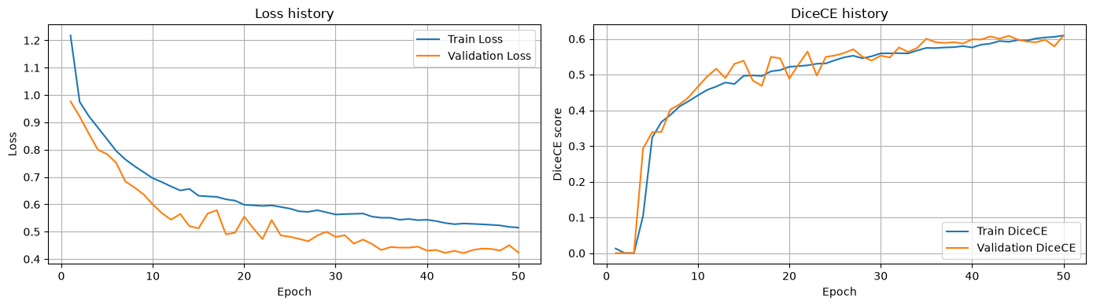
TRAINING PERFORMANCE
Training and validation losses decrease across epochs, suggesting convergence achievement
Evaluation metric improves in a quite overlapping behavior between train and validation set, suggesting the absence of overfitting
The highest evaluation metric score is 0.60

Slide 11
AUGMENTED MODEL INPUT
train data
Random cropping
Data augmentation
train data loader building
Random extraction of 3D patches (128×128×64 voxels) from images for memory porpouses
1:1 positive-to-negative ratio is taken into account to increase representation of target regions.
U-NET training loop
train: 80%
val: 10%
test: 10%
Preprocessed data
Train/val/test split
val/test data
val/test data loader building

Slide 12
DATA AUGMENTATION STEPS
Train random cropped data
Random flip
Random affine
Random gaussian noise
Random contrast
Augmented train data
Volumes are randomly flipped along X and Y axes, at a certain probability rate
Applies random affine transform:
Rotation around the spatial axes
Scaling (zoom in/out)
Spatial shift
Gaussian noise with zero mean and a defined standard deviation is added to voxel intensities
Each voxel intensity is randomly adjusted according to a gamma transformation.

Slide 13
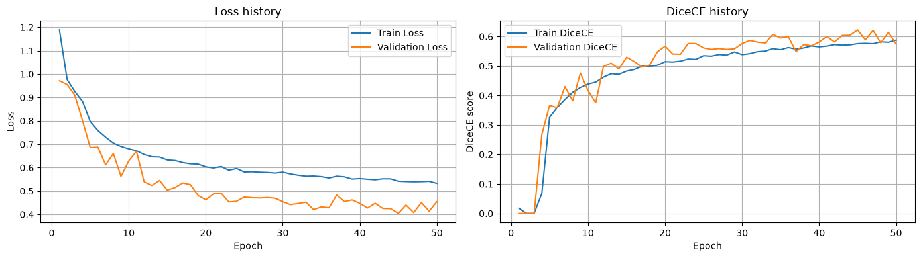
TRAINING PERFORMANCE
Results are overlapping with respect to the simple model
The highest evaluation metric score is 0.62

Slide 14
Navigating Q&A sessions
Know your material in advance
Anticipate common questions
Rehearse your responses
Maintaining composure during the Q&A session is essential for projecting confidence and authority. Consider the following tips for staying composed:
Stay calm
Actively listen
Pause and reflect
Maintain eye contact

Slide 15
Dynamic delivery
Learn to infuse energy into your delivery to leave a lasting impression
One of the goals of effective communication is to motivate your audience
Impact factor | Measurement | Target | Achieved
Audience interaction | Percentage (%) | 85 | 88
Knowledge retention | Percentage (%) | 75 | 80
Post-presentation surveys | Average rating | 4.2 | 4.5
Referral rate | Percentage (%) | 10 | 12
Collaboration opportunities | # of opportunities | 8 | 10

Slide 16
Final tips and takeaways
Consistent rehearsal
Strengthen your familiarity
Refine delivery style
Pacing, tone, and emphasis
Timing and transitions
Aim for seamless, professional delivery
Practice audience
Enlist colleagues to listen & provide feedback
Seek feedback
Reflect on performance
Explore new techniques
Set personal goals
Iterate and adapt

Slide 17
Speaking engagement metrics
Impact factor | Measurement | Target | Achieved
Audience interaction | Percentage (%) | 85 | 88
Knowledge retention | Percentage (%) | 75 | 80
Post-presentation surveys | Average rating | 4.2 | 4.5
Referral rate | Percentage (%) | 10 | 12
Collaboration opportunities | # of opportunities | 8 | 10

Slide 18
Thank you
Mirko Di Biase
ID 792726
m.dibiase2@campus.unimib.it

