Slide 1


Replication of evolutionary algorithms in the Prisoner's Dilemma

Slide 2
Prisoner’s Dilemma
 |  | PLAYER ONE
 |  | Cooperate | Defect
PLAYER TWO | Cooperate | 3, 3 | 0, 5
 | Defect | 5, 0 | 1, 1
Invented by Merrill Flood and Melvin Dresher in the 1950s
You and your partner in crime are arrested and held in separate cells with no communication.
Your sentence (or points) depends on if you and your partner choose to cooperate and stay quite OR one or both of you rat each other out.

Slide 3
The Goal:
“Rationally” defecting can potentially get you the most points (5 points), while also avoiding getting zero points.
However, by constantly defecting your partner will likely defect too, and you both end up getting fewer points overall.
What is the best strategy for maximizing points?
Can we encourage cooperation between the strategies?
I am interested in the manipulation of the fitness function, as it greatly impacts what type of strategy that evolves (i.e., does that strategy elicit cooperation or not)

Slide 4
Past Work:
Robert Axelrod organized Prisoner’s Dilemma tournaments at the University of Michigan, where people could submit strategies to play in a round robin tournament against one another.
In each tournament the strategy with the highest average score was Tit for Tat (Axelrod, 1984)
Axelrod then used a GA to evolve strategies for the Prisoner’s Dilemma (Axelrod,1988)
He included 8 strategies that would evolve over 40 different runs of 50 generations.
Afterward, most strategies looked like Tit for Tat, but some scored even higher.

Slide 5
The Strategies:
Tit for Tat: Next move will be whatever the partner did in the previous game
Random decision: Randomly assign C or D to each index
Defect (“Rational”): Always defect
Cooperate: Always cooperate
Bias for Cooperation: If partner has cooperated in at least 1/3 games, will cooperate.
Copy Majority: If partner C on 2/3 of the last games, then C. If partner D on 2/3 of the last games, then D.

Slide 6
Coding the Prisoner’s Dilemma
64 possible combinations of 3 previous games
(Dictionary)
CC CC CC
CC CC CD
CC CC DD
.
.
.
DD DD DD
Strategy = a 64-length string
ex = tit4tat
C
D
D
.
.
.
D
Memory:
Each strategy saves the last three games played, which it uses to decide its next move by looking up in the dictionary to get index for their choice
Notes:
The first letter represents your “choice” the second letter represents your partners “choice”

Slide 7
The Tournaments:
Each strategy will play every other strategy 1 time per round robin (randomized)
Running five rounds per tournament (for data presented in class)
40 simulations of a tournament (taken from Axelrod, 1988)
Within each game the strategies play for 50 moves/decisions
Recombination fixed at .3
Mutation fixed at 0% (for the data presented in class)
Fitness Function Changes (presenting 2 for class)

Slide 8
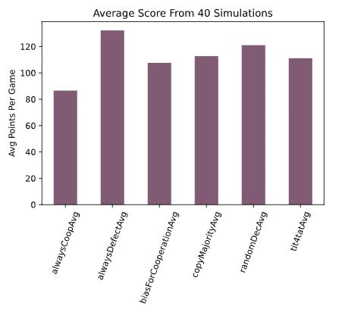
Fitness Function 1
This fitness function evaluated which strategy had the most points after every game
The strategy that lost the current game went through recombination, potentially taking on the genes of the winning strategy
Therefore, some strategies had gone though recombination before their second game
Initial Run: Who wins if no recombination?
Notes:
For all of the results I will be showing today, I had each strategy play against every other strategy 1 time, they played a total of 100 moves. I think simulated the experiment to get idea of the final
As we can see here in this initial run all of the strategies are performing fairly well on average points across 40 simulations. Except cooperating always which can have you earning zero points everytime your partner defects…

Slide 9
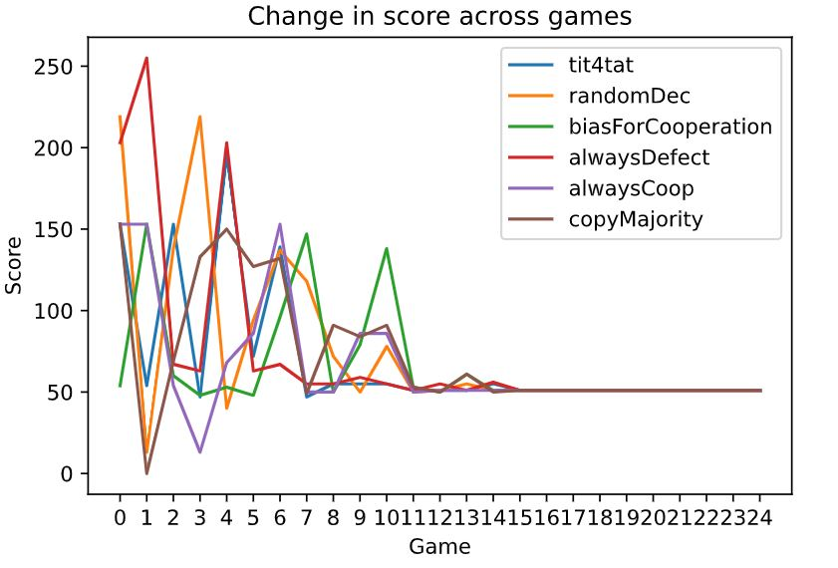
Fitness Function 1 cont.
Notes:
For a single run or simulation

Slide 10
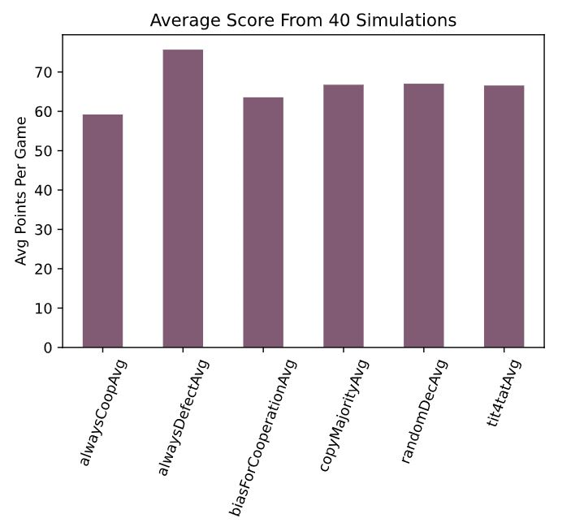
Fitness Function 1 cont.
Looking at the final strategy strings after running this simulation, the strategies look similar to one another and are all biased toward defection
Technically, the strategies are averaging less points per game than they started off, potentially due to mutual defection (1 point each) rather than cooperation (3 points each)
The fitness function is operating at a game level, so a strategy that does bad against a particular strategy is going through recombination despite it potentially winning more games overall
Notes:
Eventually the strategies do start to converge

Slide 11

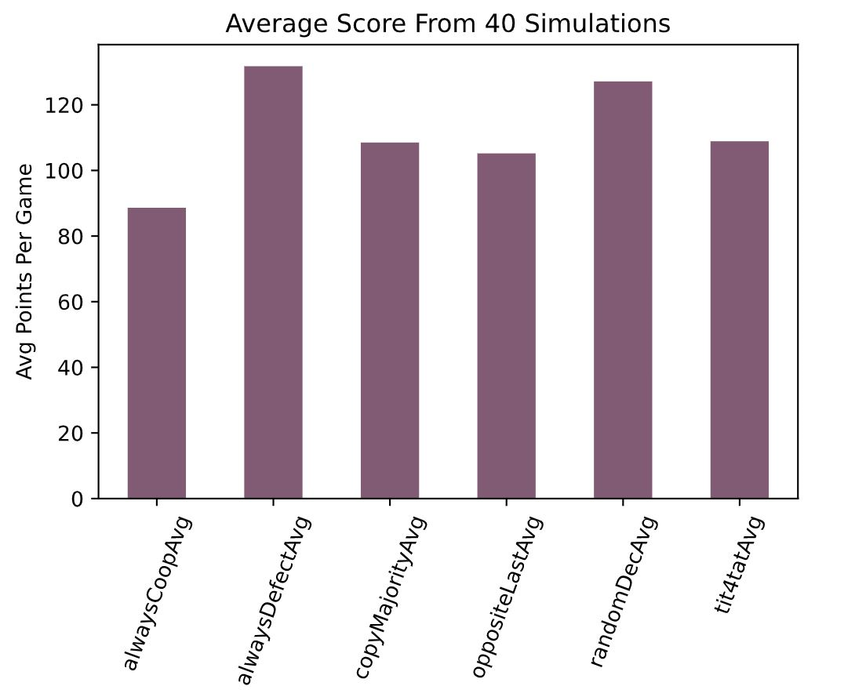
Fitness Function 2
Fitness calculated based on how many wins each strategy had following one round robin (play every other strategy one time)
The strategy with the most wins “infects” all other strategies with its genes (at recombination probability of .3)
Therefore, strategies do not go through recombination at every game, but after each round robin
Notes:
For all of the results I will be showing today, I had each strategy play against every other strategy 1 time, they played a total of 100 moves. I think simulated the experiment to get idea of the final

Slide 12
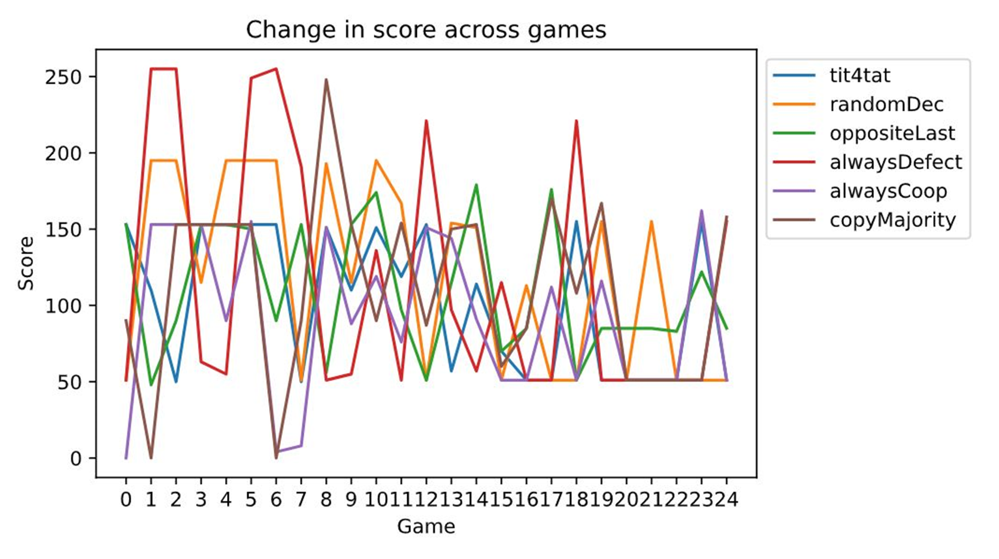
Fitness Function 2 cont.

Slide 13
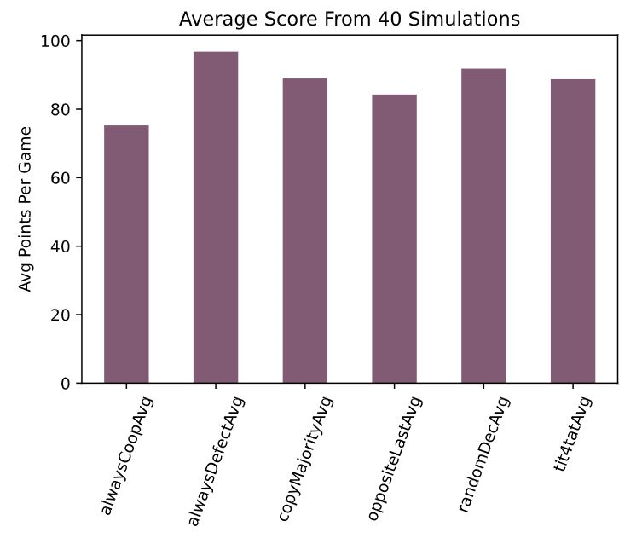
Fitness Function 2 cont.
Looking at the final strategy following the 40 simulations, many of the strategies are similar to tit for tat.
They are not necessarily “deciding” based off the last move of their opponent, but they are punishing defecting with defecting and reciprocating cooperation
Overall, these strategies have a higher average score across the 40 simulations compared to the previous simulation
This suggests some level of cooperation amongst the strategies is reached

Slide 14
Conclusions
The strategies you put into the tournament greatly impact the individual games, who goes through recombination and subsequently what type of strategy you end up with
For example, if you have two strategies that are opposite of one another they can tie or even “get stuck” defecting the entire game. Greatly impacts average performance
As discussed previously the fitness function also influences what the strategies look like at the end of the simulations (i.e. are the strategies cooperating?)

Slide 15
References
Axelrod, R. (1984). The evolution of cooperation. New York: Basic Books.
Axelrod, R., & Dion, D. (1988). The further evolution of cooperation. Science, 242(4884), 1385–1390. http:// doi.org/10.1126/science.242.4884.1385.

