Slide 1
Human Immunodeficiency Virus & Acquired Immunodeficiency Syndrome (AIDS)
And targets for its treatment
By: Matt Doherty

Slide 2
HIV Background
Lentivirus, member of retroviruses
Genome is single stranded RNA that converts to double stranded DNA by reverse transcription
Responsible for Acquired Immunodeficiency Syndrome (AIDS)
Notes:
ETIOLOGY
Epidemiology

Slide 3
U.S. Statistics
More than 1.1 million people in the United States are living with HIV infection

Slide 4
Global Statistics
As of 2012, 35.3 million are currently living with HIV/AIDS.
More than 25 million people have died of AIDS worldwide since the first cases were reported in 1981.
While cases have been reported in all regions of the world, almost all those living with HIV (97%) reside in low- and middle-income countries, particularly in sub-Saharan Africa.

Slide 5
Diagnosis
Rapid Antibody Tests
Antibody/antigen Tests
RT-PCR
Notes:
Rapid antibody tests. Most of these are blood tests for HIV antibodies. Some can detect antibodies in saliva. Results are available in under 30 minutes and are as accurate as standard tests.
Antibody/antigen tests. These tests are recommended by the CDC and can detect HIV up to 20 days earlier than standard tests. They check for HIV antigen, a part of the virus that shows up 2-4 weeks after infection. These tests can also detect HIV antibodies. A positive result for the antigen allows treatment to begin earlier and the patient to avoid infecting others. These are blood tests only.

Slide 6
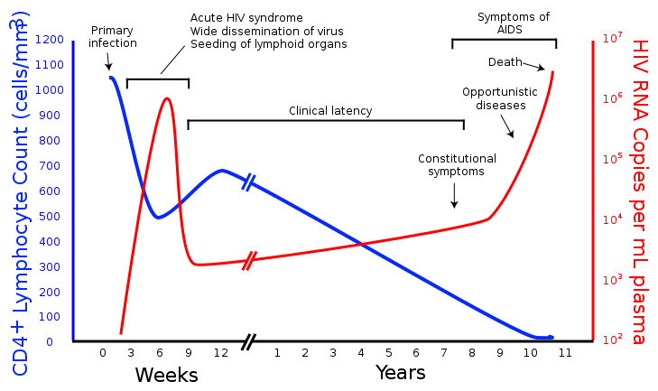
Progression of Illness
Notes:
CLINICALLY:APPEARS AS Fever/FLU-LIKE SYMPTOMS
Headache
Muscle aches
Rash
Chills
Sore throat
Mouth or genital ulcers
Swollen lymph glands, mainly on the neck
Joint pain
Night sweats
Diarrhea
AIDS Soaking night sweats
Shaking chills or fever higher than 100 F (38 C) for several weeks
Cough
Shortness of breath
Chronic diarrhea
Persistent white spots or unusual lesions on your tongue or in your mouth
Headaches
Persistent, unexplained fatigue
Blurred and distorted vision
Weight loss
Skin rashes or bumps

Slide 7
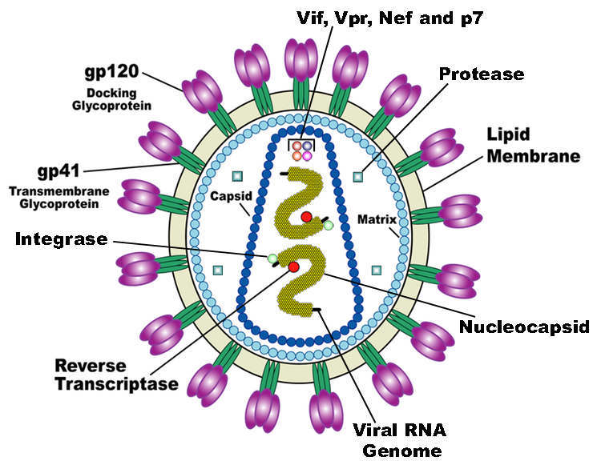
Structure
Notes:
spherical with a cell-derived lipid bi-layer
Envelope protein used to enter host cell.
Reverse Transcriptase for replication
Viral protease (not shown) also carried in capsule

Slide 8
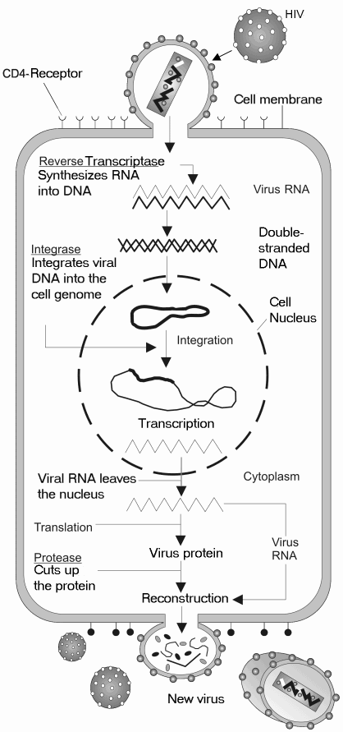
Replication Cycle
Attaches to the target cell by binding to the CD4 receptor
leads to membrane fusion and virus entry
reverse transcription turns viral RNA into proviral DNA
Provirus integrates into host cells and begins making new virus RNA/proteins/genome

Slide 9
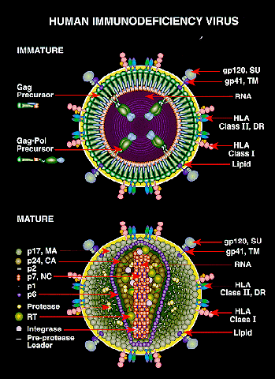
Viral genomic mRNA is transported to the membrane where it is packaged with other viral proteins and is released
Protease/Maturase converts virus into infectious form.

Slide 10
Treating HIV
Prevention/vaccination still the best option, but no vaccine yet…
Drugs used to treat HIV target key steps in the replication cycle
Primary treatment is Highly Active Antiretroviral Therapy (HAART)
Uses 3+ drugs from 2+ antiretroviral drug classes

Slide 11
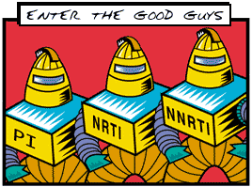
Antriretrovirals Classes
Nucleos(t)ide Reverse Transcriptase Inhibitors (N(t)RTIs)
Non-nucleoside Reverse Transcriptase Inhibitors (NNRTIs)
Protease/Maturation Inhibitors
Integrase Inhibitors
Entry Inhibitors

Slide 12
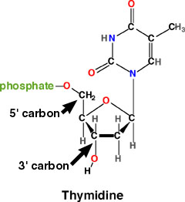
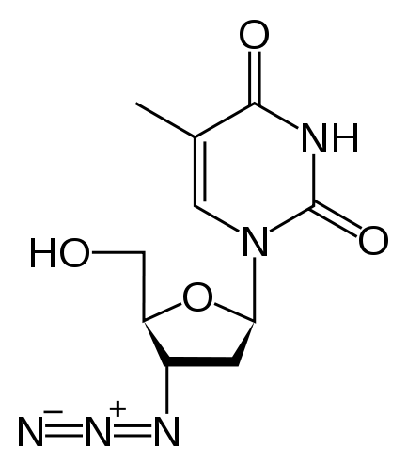
NRTIs
Competitive inhibitors that act as chain terminators
Target the functions of the RT enzyme:
Recognition and binding
Formation of a phosphodiester bond
Cause chain termination by altering the 3’ hydroxyl group.
No 3’ hydroxyl = no elongation
Azidothymidine (AZT)

Slide 13
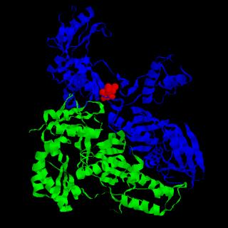
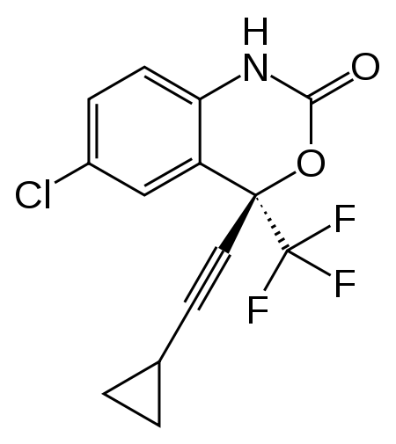
NNRTIs
Allosteric noncompetitive inhibitors that bind noncovalently away from the active site
Stop RT activity by somehow altering the active site
Example: Efavirenz

Slide 14
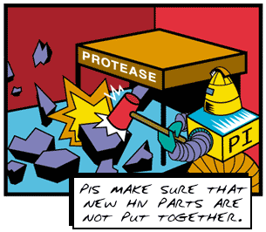
Protease and Integrase Inhibitors
Protease Inhibitors
Integrase Inhibitors
Prevent integration of provirus into host genome
Example: Raltegravir
Ex: Ritonavir
Notes:
HIV protease is a symmetric homodimer
PIs competitively inhibit by reversibly binding the active site
PIs prevent the cleavage of important viral proteins and result in less infectious virus

Slide 15
Entry Inhibitors
Block any of the stages in entry
Attachment
Co-receptor binding
Ex: Maraviroc
Membrane fusion
Ex: Enfuvirtide

Slide 17
Immunization Recommendation
Vaccine would be recommended IF IT EXISTED!
Control Measures
Practice Safe Sex/ Use PrEP
Abstain
Don’t share IV drug equipment
Don’t share items that may have blood on them

Slide 18
Education
http://www.cdc.gov/hiv/
http://www.aids.gov/hiv-aids-basics/

Slide 19
Works Cited
Emini, Emilio A. (edt.). The Human Immunodeficiency Virus: Biology, Immunology, and Therapy. Princeton University Press. Princeton, NJ. 2002.
Kibler, Karen V., Akiko Miyazato, Venkat R. K. Yedavalli, Andrew I. Dayton, Bertram L. Jacobs, George Dapolito, Seong-jin Kim and Kuan-Teh Jeang. 2004. Polyarginine inhibits gp160 processing by furin and suppresses productive human immunodeficiency virus type 1 infection. J. Biol. Chem., Vol. 279, Issue 47, 49055-49063, November 19, 2004. Epub 2004 Sep 14 on Entrez PubMed and www.jbc.org.
http://www.emc.maricopa.edu/faculty/farabee/BIOBK/HIV.gif
http://www.chemistry.wustl.edu/~edudev/LabTutorials/HIV/DrugStrategies.html
http://www.univie.ac.at/qccd/hpsc/2002/Wolschann_pharm2/erwin3.htm
http://www.treathiv.com/patient_info/howhiv_page5.html
http://www.innovations-report.de/html/berichte/biowissenschaften_chemie/bericht-20683.html
http://www.aids.gov/hiv-aids-basics/
http://www.cdc.gov/hiv/
Images taken from wikipedia commons unless otherwise indicated

Slide 20
My Research on HIV
New potential integrase inhibitor developed on campus assayed for anti-HIV activity by time of addition assay
Cells infected and treated with drug at different times
One drug* shown to act early, ie. under 2 hours post infection
*
Figure 1. L-Chicoric acid and potent disulfone inhibitors of HIV-IN in pilot studies.

Slide 21
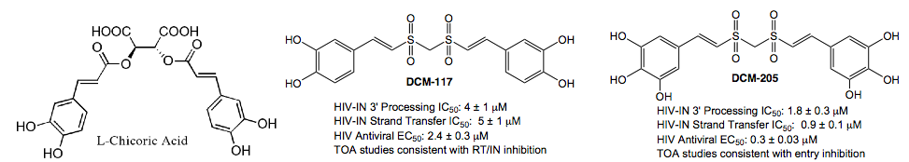
Direct Inactivation
Notes:
Figure 2. Direct inactivation of HIV-1 by DCM205 in the absence of a cellular target. (A) Chemical structure of DCM205. (B) Inhibitory effects of preincubation of HIV-1 particles with DCM205 for 2 h prior to the addition to HeLa H1-JC.37 cells. Infectivity was measured by the FIA. (C) A similar preincubation experiment was performed with T20 as a negative control. (D) Preincubation experiment with DCM205 and 3TC (negative control) in HeLa H1-JC.37 cells, CEMx174 cells, and human PBMCs by a p24 antigen-capture ELISA for the detection of virus production at 5 days post infection. Data are representative of three independent experiments, and error bars represent the standard error of the mean. From Duong et al. 2007. Antimicrob Agents Chemother 51:1780-6.

Slide 22
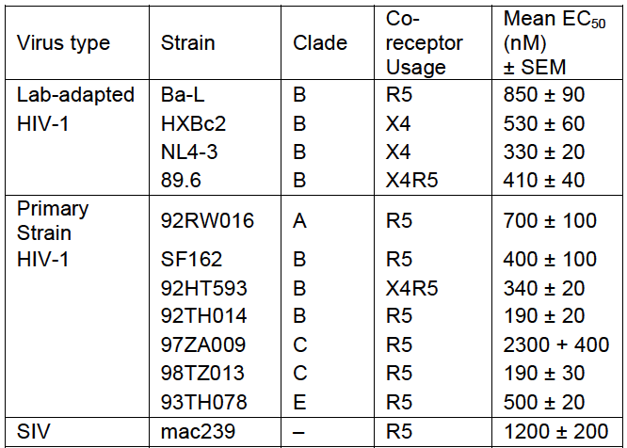
Wide Range of Activity
Notes:
DCM205’s activity was evaluated against a broad spectrum of primary isolates and laboratory-adapted virus that included R5, X4, and dual tropic viruses from clades A, C, and E as well as SIVmac239. DCM205 had a broad range of potency with EC50 values ranging from 190-850 nM for all but one HIV-1 isolate tested. There was no correlation between tropism or clade and DCM205 activity. DCM205 was also active against SIVmac239, but was less potent with an EC50 value of 1200 nM. This suggests that DCM205 targets a conserved region involved in virus-target cell interactions. Only one primary C clade, R5 tropic primary isolate (97ZA009) was relatively resistant to DCM205 (~8 fold, EC50 2300 nM) and was found to have a R296G substitution in the base of the V3 loop. Further analysis of this substitution is in progress to determine its impact on DCM205 activity. From Duong et al. 2007. Antimicrob Agents Chemother 51:1780-6.

Slide 23
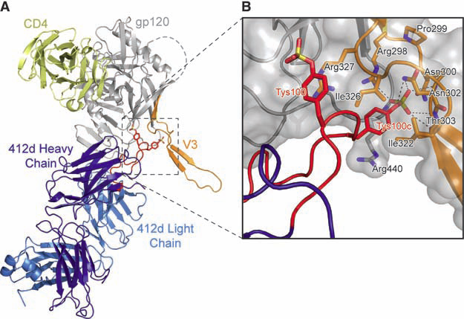
Proof of Concept?
Prior resistance studies indicated that DCM205 might bind at the base of the V3 loop

Slide 24
What Happened Next?
Funding ran out
Hoped to develop as a microbicide
Some already in development
Questions?

Slide 25
HIV Websites
http://www.trimeris.com/science/hivfusion.html (has videos depicting membrane fusion)
http://www.chemistry.wustl.edu/~edudev/LabTutorials/HIV/DrugStrategies.html (more info on drug strategies)
http://www.treathiv.com/patient_info/howhiv_page1.html (how HIV works in the body)

