Slide 2
Windo Group Scheduling App server & api
:
CS460 - Mohonri Dorff

Slide 3
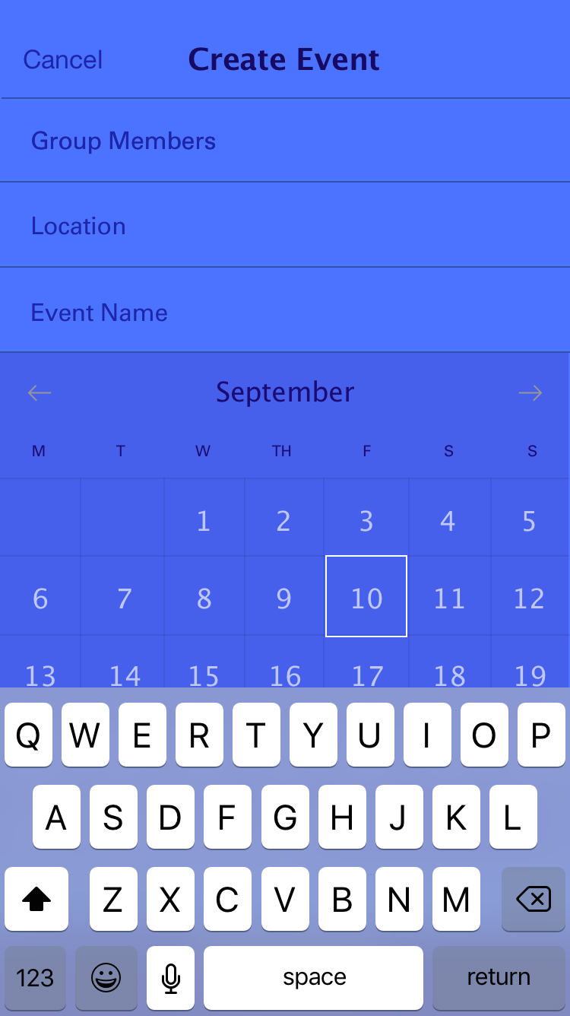
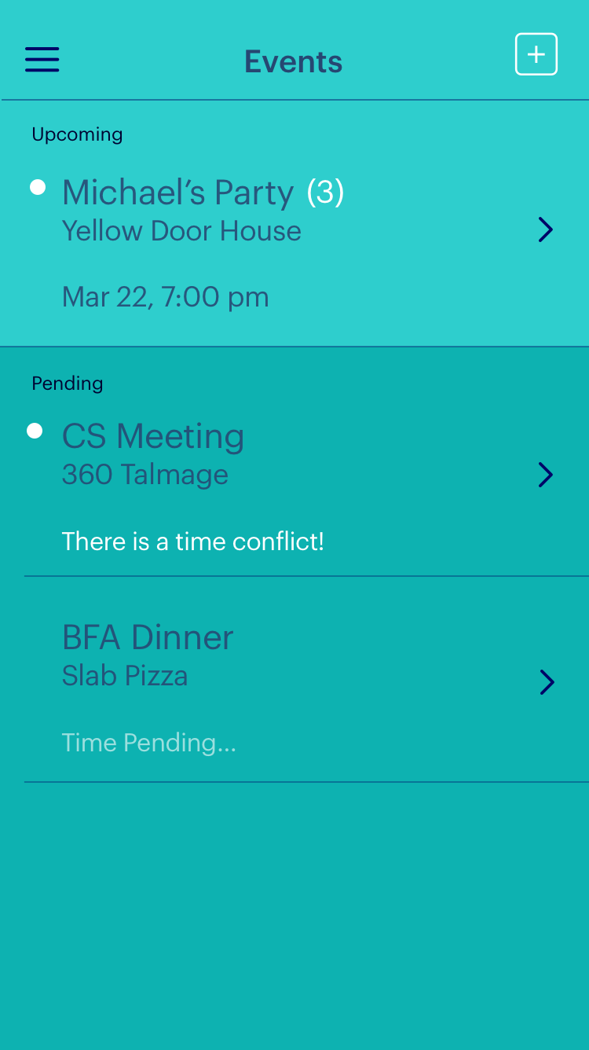
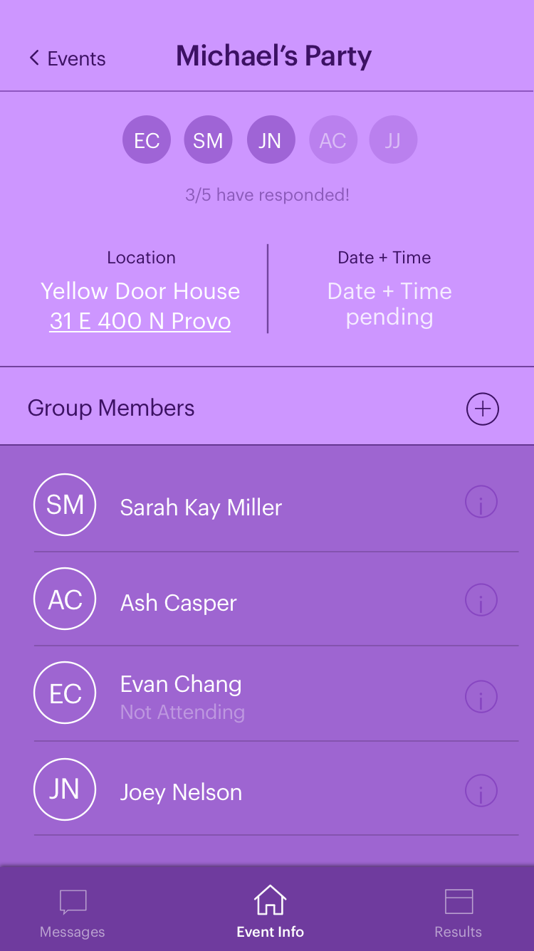
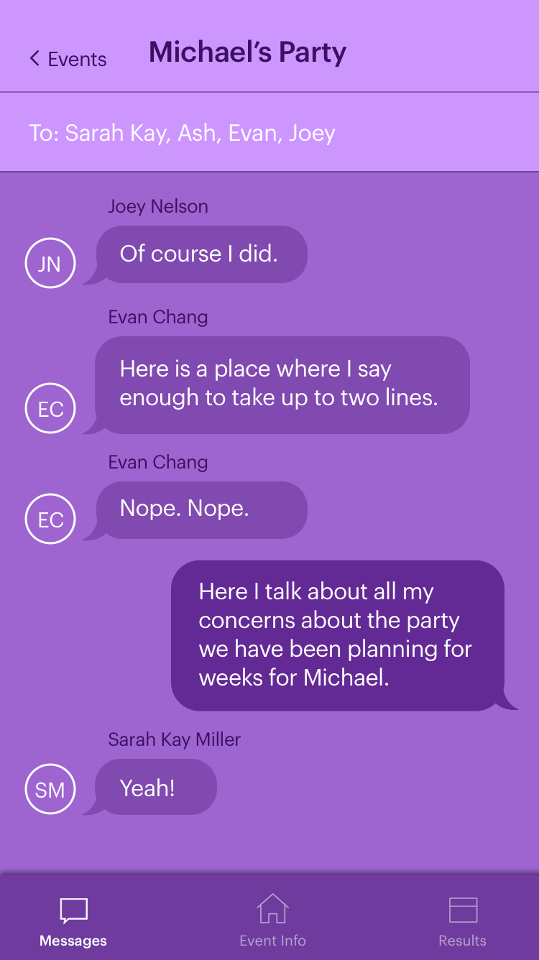
Overview
Notes:
2nd place at app design competition at BYU with Yuki, Joey, Me and some other girl

Slide 4
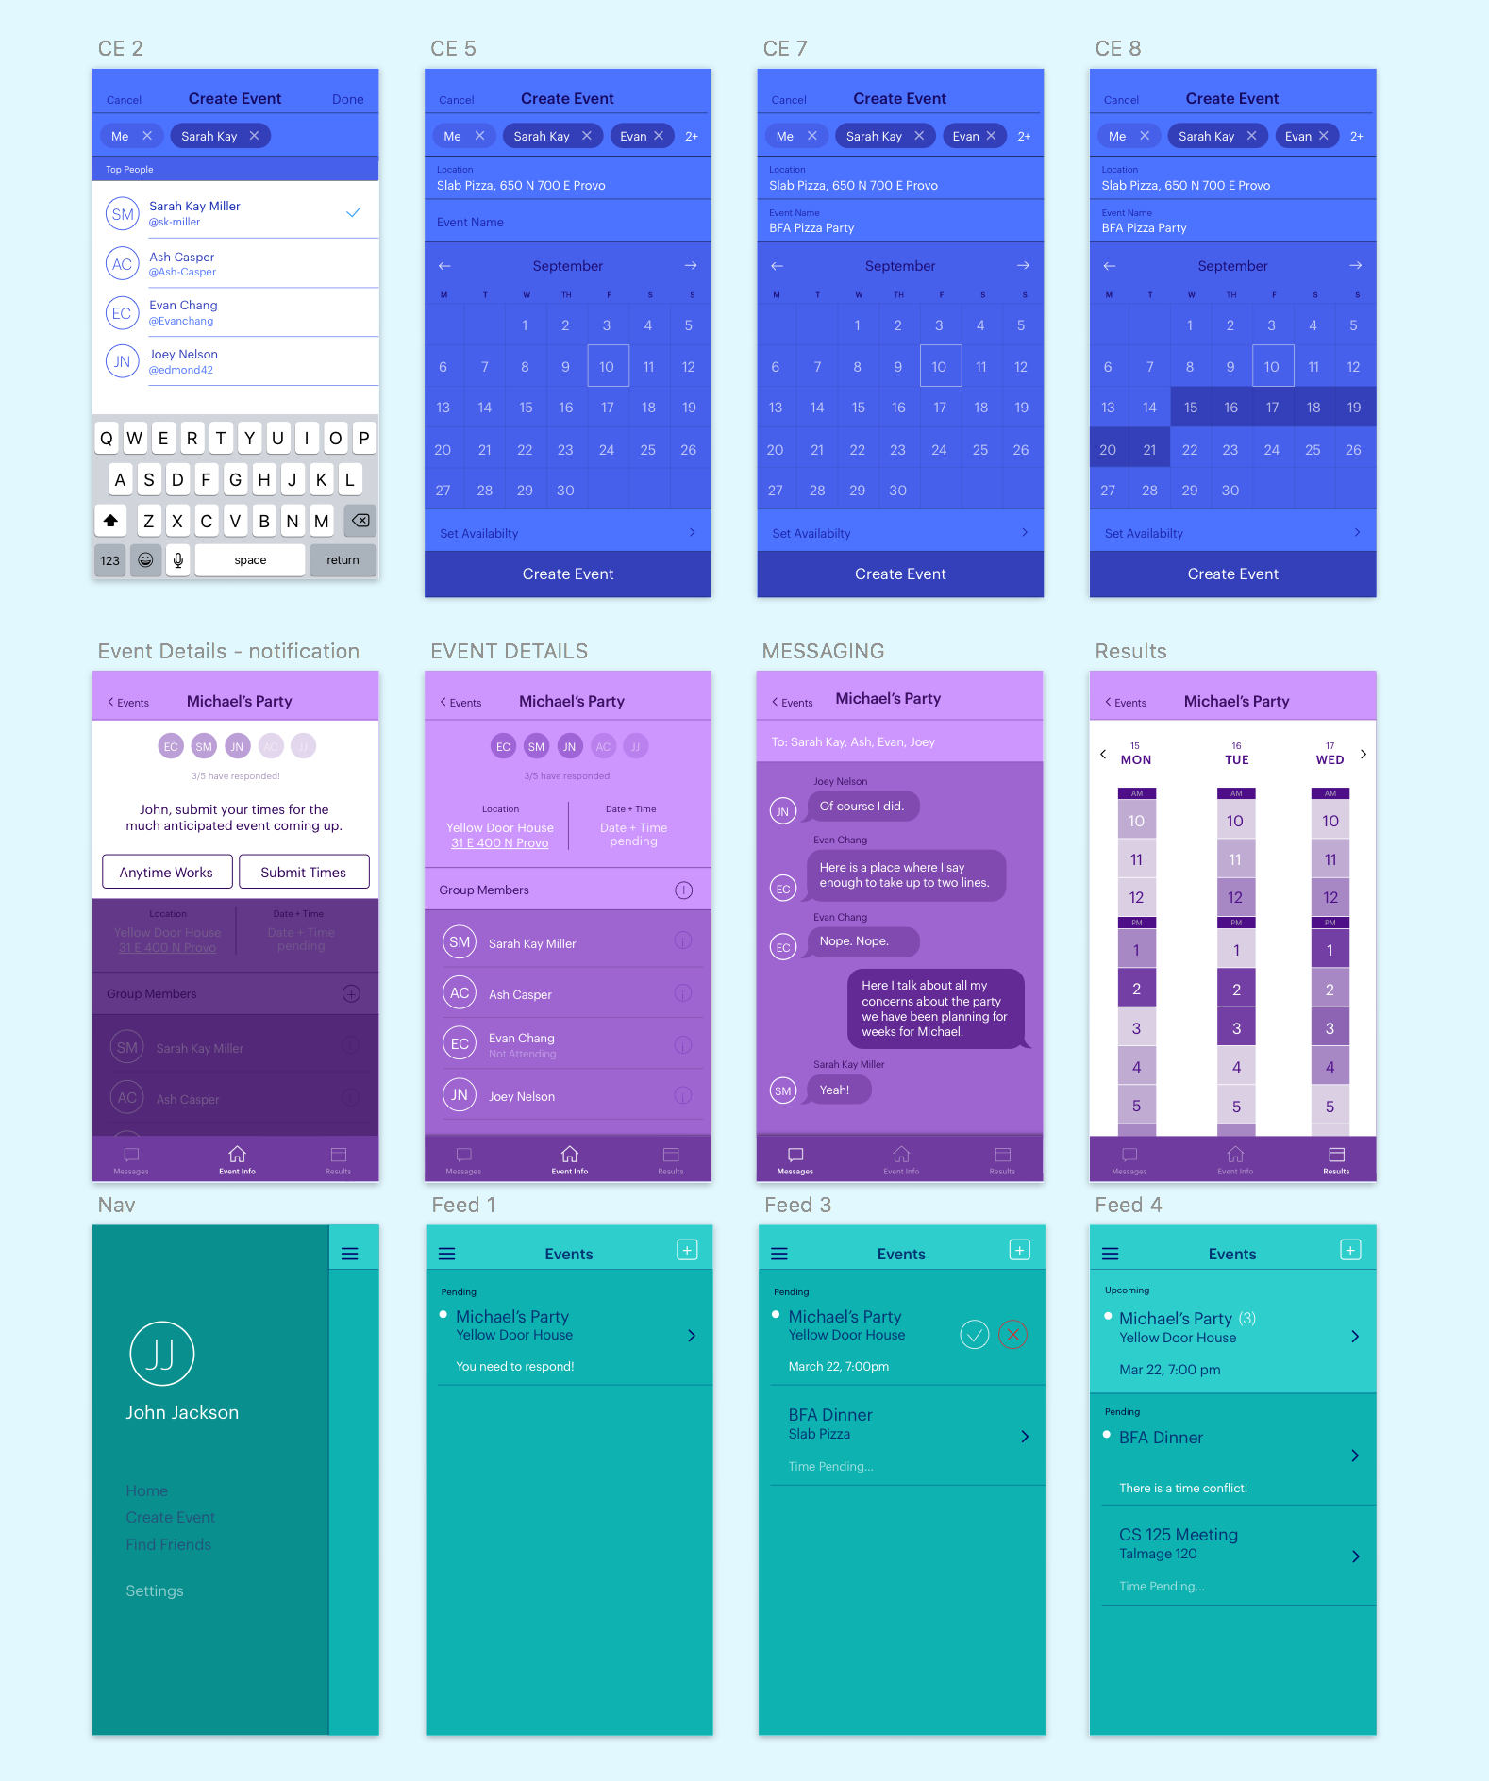
Notes:
Here are some more pictures if you want

Slide 5
New Things
HTTP Protocol
Node.js
Express
MongoDB
Postman
ES6
AWS

Slide 6
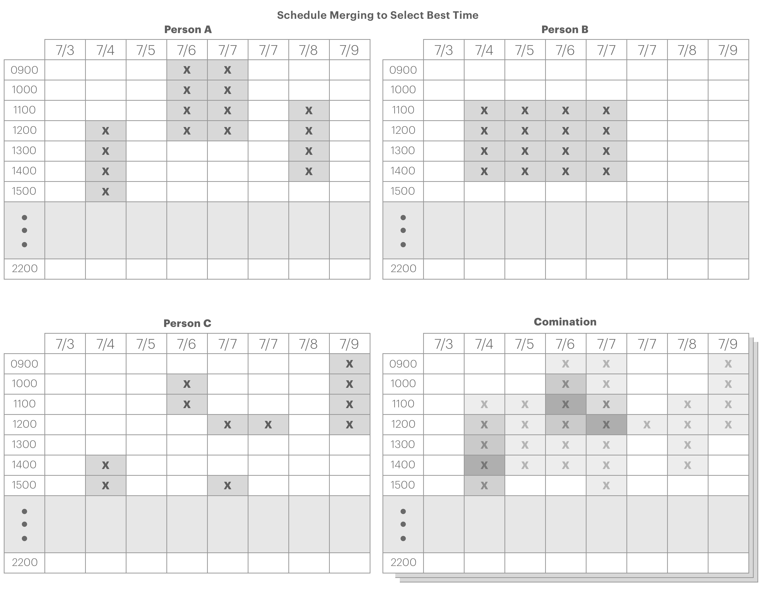
Server & Api
{ id : { type: Number, required: true }, name : { type: Number, required: true }, status : { type: String, default: 'pending' }, location : String, time : { type: Date, default: undefined }, members : { type: String, required: true }, possibleDays : { type: String, required: true }, timeGrid : String }
members: JSON.stringify([“Array of members”])
possibleDays: JSON.stringify([Date, Date, Date])
timeGrid: JSON.stringify([
{"name01": [1491235623012, 1491235643012, ...]},
{"name02": [1491235823012, 1491235833012]}
]
Notes:
Mohonri

Slide 7
Api Docs?
GET /events
Returns list of all events
GET/POST /events/:eventID
Get or alter particular event information
POST /events/create-event
Create a new event
GET/POST /events/:eventID/time-submit
Most valuable information goes here. We want
to take everyone’s time and match what works
best. We grab the possible times from here and
submit the times that work for us.
Notes:
Mohonri

Slide 8
Scope Beyond
Authentication (Passport)
iOS native app
Web Interface
More robust
Extend API
/signup
/login
/app vs /api
/events/:eventID/results
/events/:eventID/messages

