Slide 1
Introduction to Quantitative Research
Course: JOURN 8006
Instructor: Michael W. Kearney

Slide 2
Agenda
Today’s topics

Slide 3
Agenda
Introductions
Syllabus
IRB certification
Quantitative research
Characteristics of scientific research
Projects for mass media research
Final paper

Slide 4
1. Introductions
Names, backgrounds, interest area(s)

Slide 5
Introductions
My name is _____________.
This is my __ (1st,2nd,etc.) year in __ (program/degree).
I am interested in ____ (interest/topic/study area).
I currently have __ (a,b,c) about my final project.
a) no idea
b) a weak idea
c) a strong idea

Slide 6
2. Syllabus
Also on Canvas

Slide 7
Syllabus
<see Canvas and/or handout>

Slide 8
3. IRB Certification
Human Subjects Research

Slide 9
Institutional Review Board (IRB)
Assignment: acquire IRB certification
Points: required
Due: 3:30pm by Jan. 28th
IRB website: research.missouri.edu/irb

Slide 10
IRB Training
Login at ecompliance.missouri.edu
Click Institutional Review Board
Under Prequisites select Take IRB training
Complete CITI IRB Training (follow instructions; this may take multiple hours)
When complete, take screenshot of certificate and upload to Canvas

Slide 11
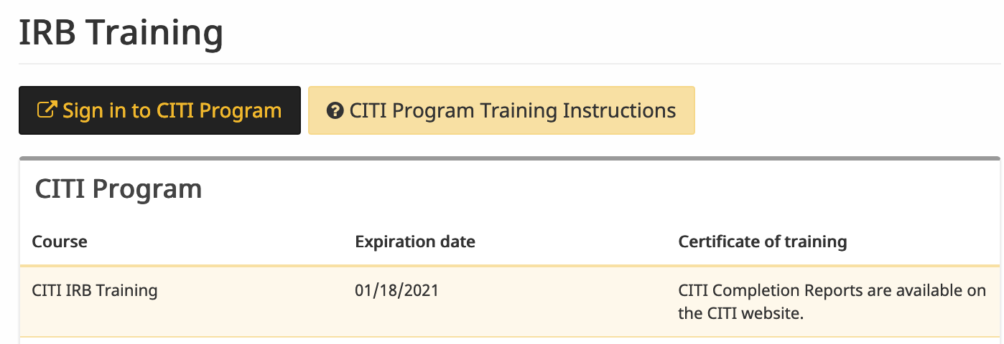
Example screen shot

Slide 12
4. Quantitative Research
Introduction to Quantitative Research

Slide 13
Research
Research is “an attempt to discover something” (Wimmer & Dominick, 2011, p. 2)
Scientific research is “an organized, objective, controlled, qualitative or quantitative empirical analysis of one or more variables” (Wimmer & Dominick, 2011, p. 9)

Slide 14
Social Science
Social science is ”the science of people or collections of people, such as groups, firms, societies, or economies, and their individual or collective behaviors” (Bhattacherjee, 2012, p. 1)

Slide 15
Types of Scientific Research
Exploratory
Scope out, form hunches, test feasibility
Descriptive
Careful measurement, reports–e.g., US census
Explanatory
Makes and explains connections

Slide 16
Methods of knowing
Tenacity:
true because it’s always been
Intuition:
true because it is self evident
Authority:
true because qualified source says so
Scientific:
true because studies provisionally support it

Slide 17
Scientific Knowledge
Scientific knowledge is the accumulation of laws and theory to explain phenomena
Laws are the observed patterns
Theories are explanations (mechanisms) of the underlying phenomena

Slide 18
Theory
Theory is “a set of related propositions that presents a systematic view of phenomena by specifying relationships among concepts” (Wimmer & Dominick, 2011, p. 13)

Slide 19
Scientific Reasoning
Inductive research takes observations (small) and infers theoretical insights (big) from them
Small → big
Deductive research takes theories (big) and applies them to observations (small)
Big → small

Slide 20
Scientific Method
Scientific method describes the general process of conducting scientific research
There are lots of flow charts and listicles of the different ”characteristics” of the scientific method

Slide 21
Characteristics (1/3)
Scientific research is public
Science is objective
Science is empirical
Science is systematic and cumulative
Science is predictive
- (Wimmer & Dominick, 2011)

Slide 22
Characteristics (2/3)
Scientific research is empirical
Scientific research is replicable
Scientific research is provisional
Scientific research is objective
Scientific research is systematic
- (sciencing.com, 2018)

Slide 23
Characteristics (3/3)
Logical: Scientific inferences must be based on logical principles of reasoning
Confirmable: Inferences derived must match with observed evidence.
Repeatable: Other scientists should be able to independently replicate or repeat a scientific study and obtain similar, if not identical, results
Scrutinizable: The procedures used and the inferences derived must withstand critical scrutiny (peer review) by other scientists
- (Bhattacherjee, 2012, p. 5)

Slide 24
Research Values
Research should strive to be valid and reliable
Validity: accuracy of findings
Reliability: consistency of findings
Post-positivism
Researcher cannot be divorced from research
Empirical ideals are not discrete; they exist on a continuum

Slide 25
Mass Media
Mass media are “any form of communication that simultaneously reaches a large number of people, including but not limited to radio, TV, newspapers, magazines, billboards, films, recordings, books, and the Internet” (Wimmer & Dominick, 2011, p. 2)

Slide 26
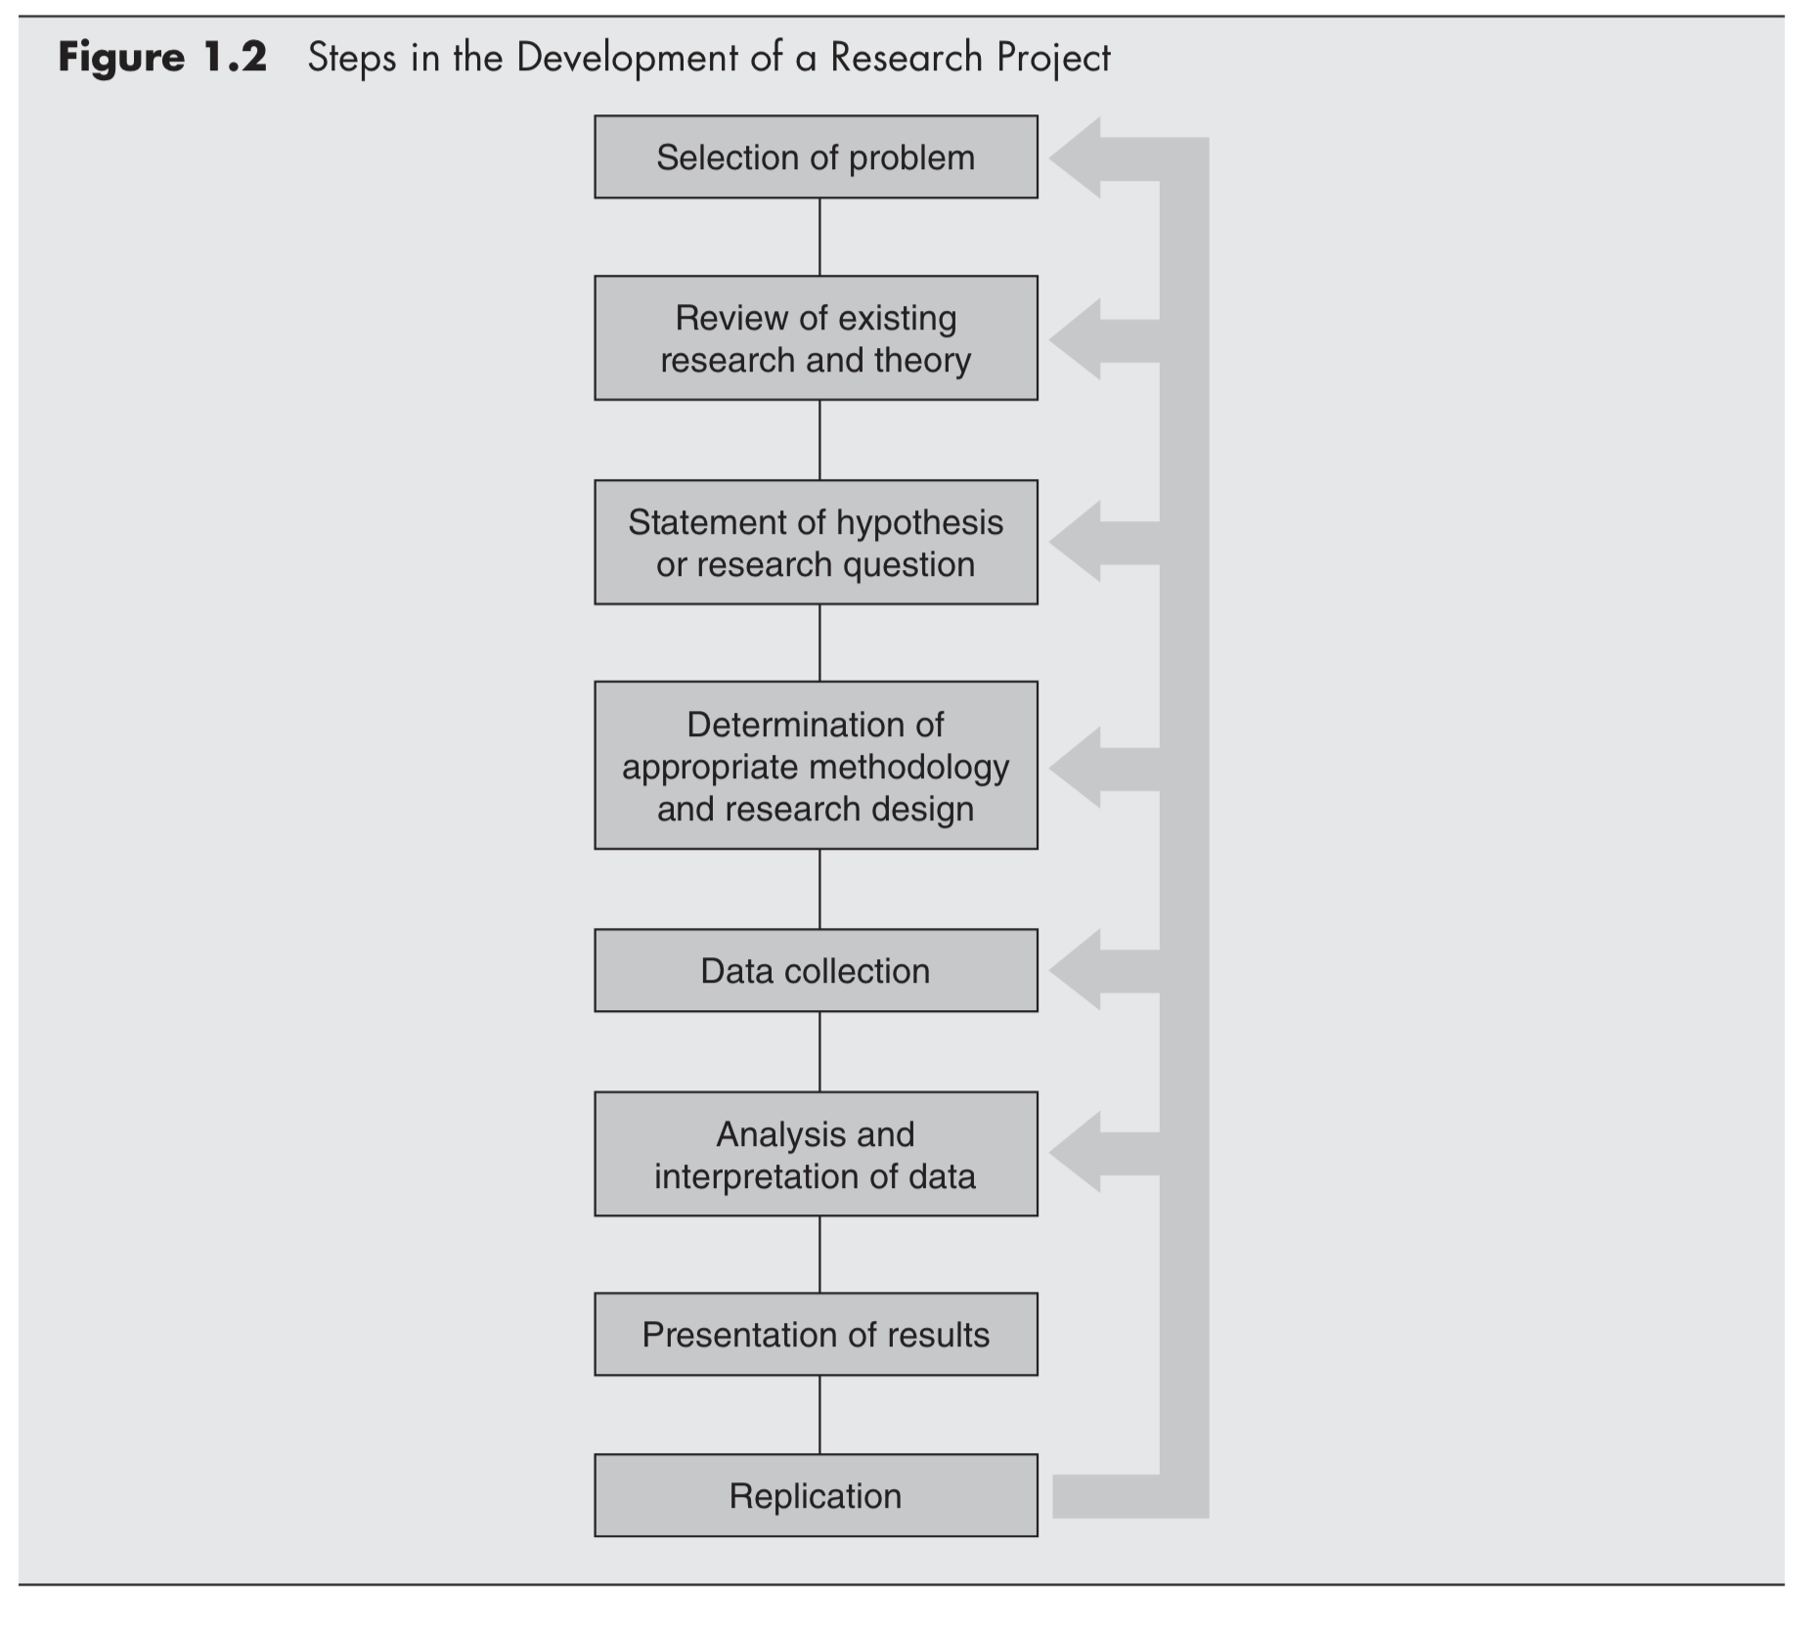
Research Process

Slide 27
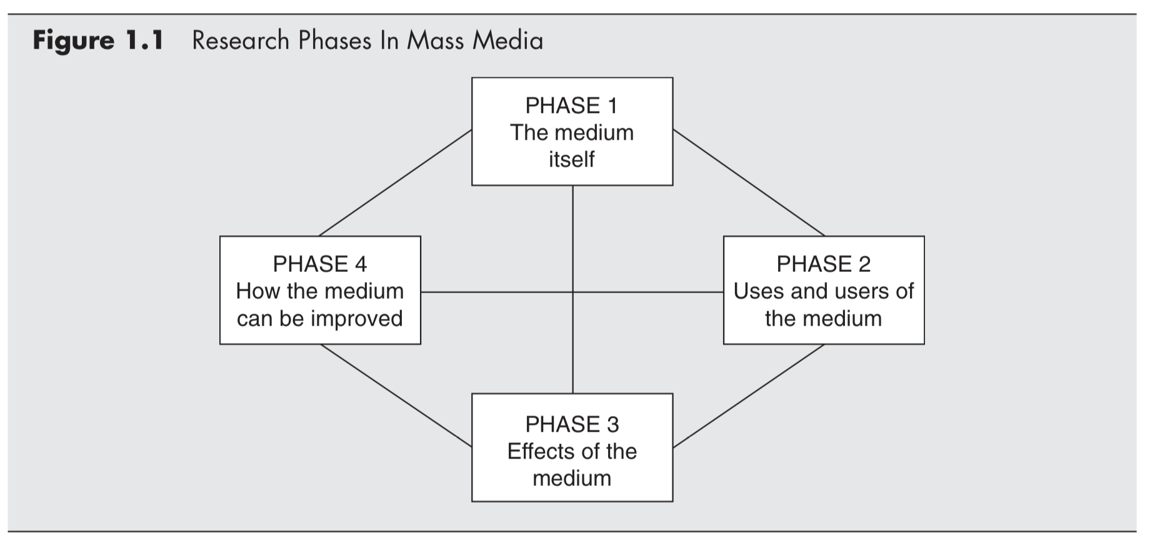
Research phases

Slide 28
5. Final Paper
Research Proposal

Slide 29
Research Paper I
The final paper is a research proposal, which will include…
Statement of value or need of the study
Brief summary of pertinent literature
Identification of applicable theories
But is primarily about your research design, methods, and plan of data analyses

Slide 30
Research Paper II
Topic is chosen by you, in consultation with me.
Research questions and/or hypotheses are due at course midpoint.
Presentations (with Q&A) during final three weeks
Final paper is due during finals week

Slide 31
Course Preview
Two days (weeks) each:
Survey methods
Experimental methods
Observational methods
---------<midterm>-----------
Statistical methods
Day #1: introduce topic/concepts (homework assigned)
Day #2: application (homework due)

Slide 32
Statistical concepts
Sampling/probability
Descriptive statistics
Describing your sample
Inferential statistics
Association: Correlation/regression
Categorical: Chi-square test, t-test, ANOVA

Slide 33
Questions?
📬 kearneymw@missouri.edu

