Slide 1

Is Boeing the safest airplane?
Michael Kearns

Slide 2

Introduction
Problem: Which airplanes will have the lowest to risk for the company?
Solution: Determine which plane has the lowest fatality rate per crash.

Slide 3
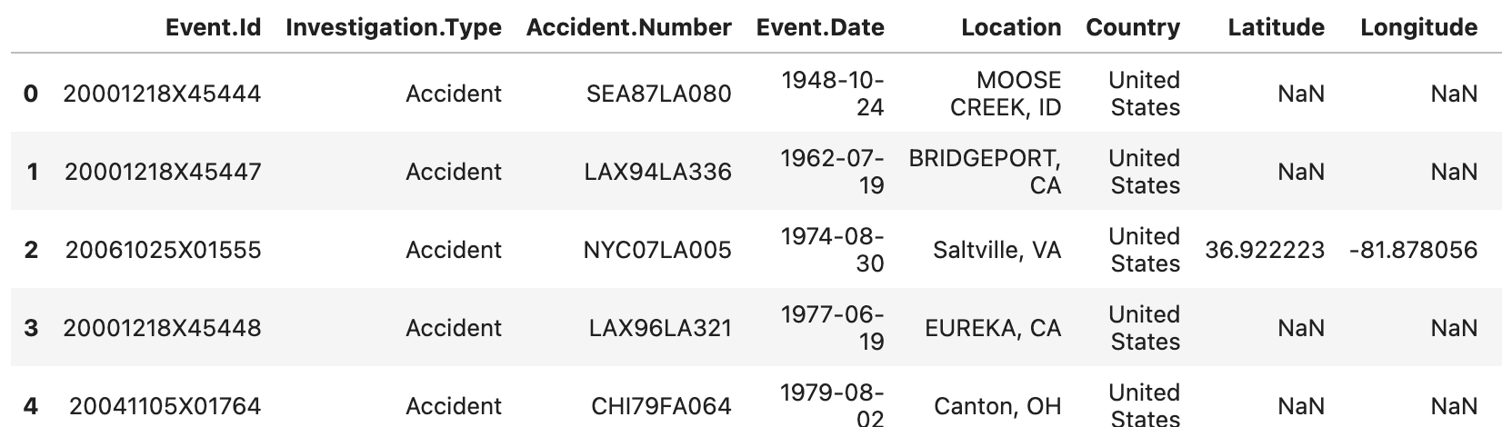
The data
Dataset from the National Transportation Safety Board
Data ranges from 1962 - 2023
Note: Not all columns are shown.

Slide 4
What’s important
Data from the last 30 years
Primary Variables from the dataset:
Make
Model
Number of Fatal Injuries
Number of Engines

Slide 5
Analysis
Descriptive Statistics is used to determine findings, i.e. Mean
Steps Taken:
Remove data older than 30 years old
Standardize “Make” data
Sort Data into primary small and large plane by “Make”

Slide 6
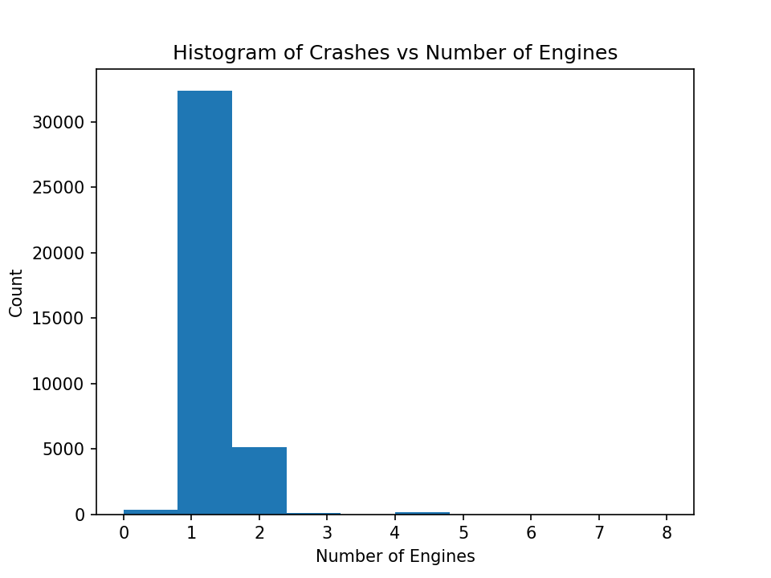
1st Finding
85% of crashes have 1 engine or less

Slide 7
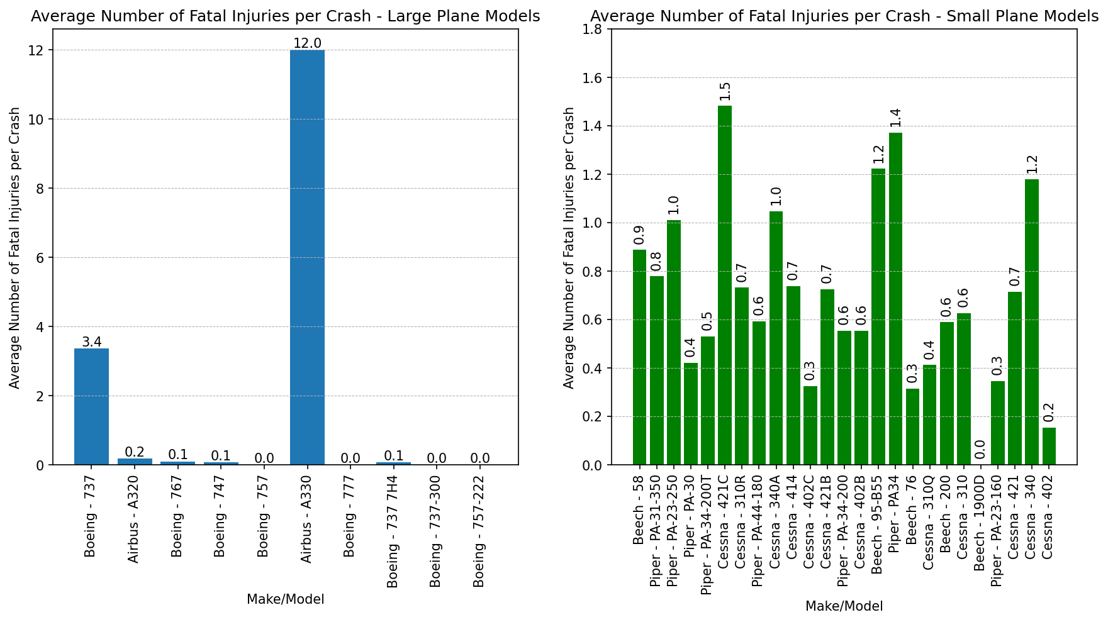
2nd Finding
Large vs Small planes
Sorted by Make/Model types with the most number of accidents

Slide 8
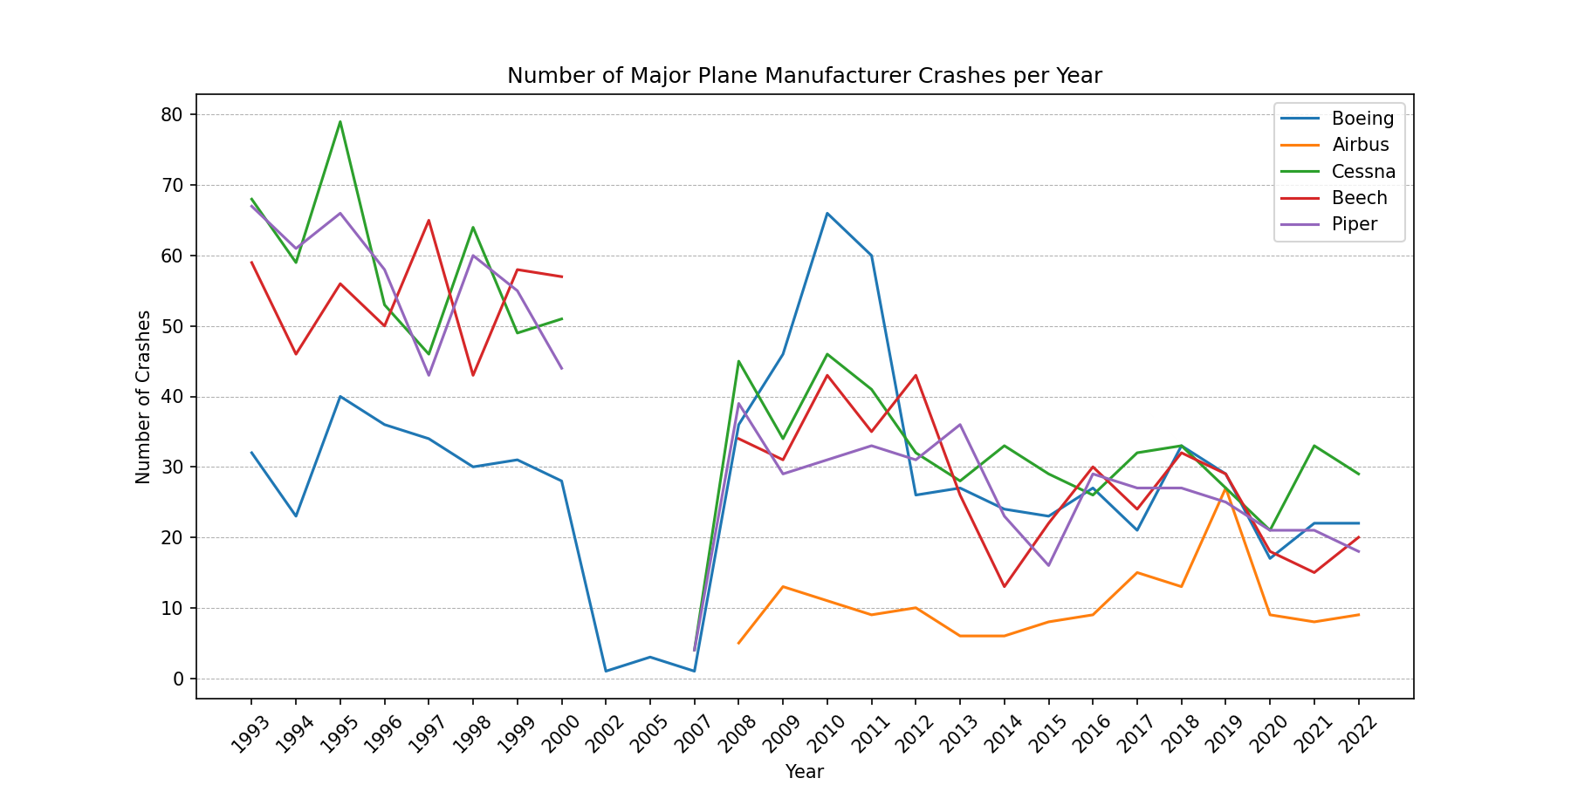
3rd Finding
Few or no accidents were reported between 2000 - 2008

Slide 9
Recommendations
Do NOT purchase airplanes with less than 2 engines.
Large planes: Boeing 757 or Airbus A319
Small planes: Beech 1900D or Cessna 40
3. Conduct safety review of company planes eveyr 10 years.

Slide 10
The next steps
What are financial impacts?
Where should our operations be?

