Slide 1
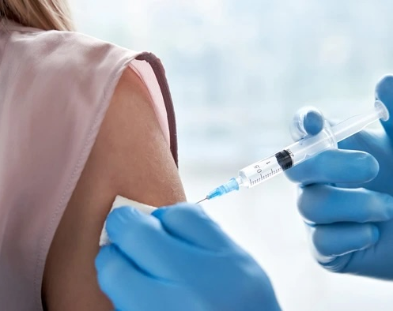
How many individuals will receive the seasonal flu vaccine?
Michael Kearns

Slide 2
Overview
Business Problem
The Data
Modeling Process
Model Evaluation
Conclusions/Next Steps

Slide 3
Business Problem
Goal: Minimize vaccine production costs and reduce waste.
Solution: Predict how many individuals will receive the seasonal flu vaccine this year based on recent data.

Slide 4
The Data
Data from the National 2009 H1N1 Flu Survey
Over 26,000 respondents
Health Behaviors & Opinions
Socioeconomic background
Personal background
Educational background
Focus on Seasonal Flu data
Sensitive features removed.

Slide 5
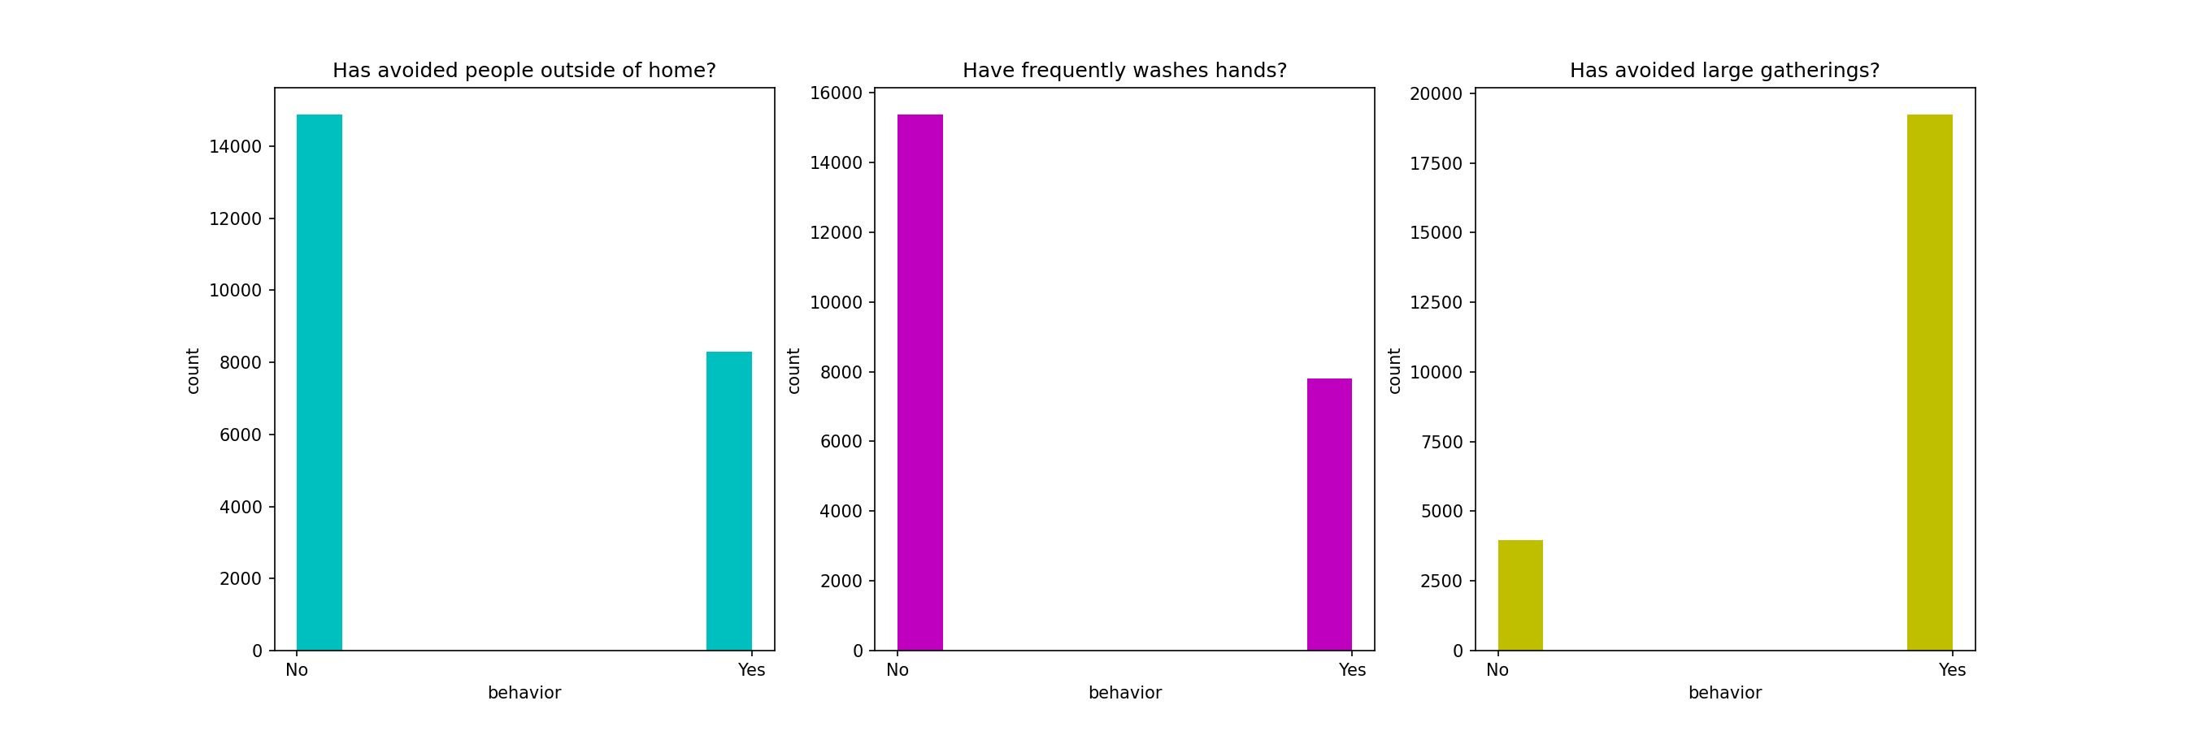
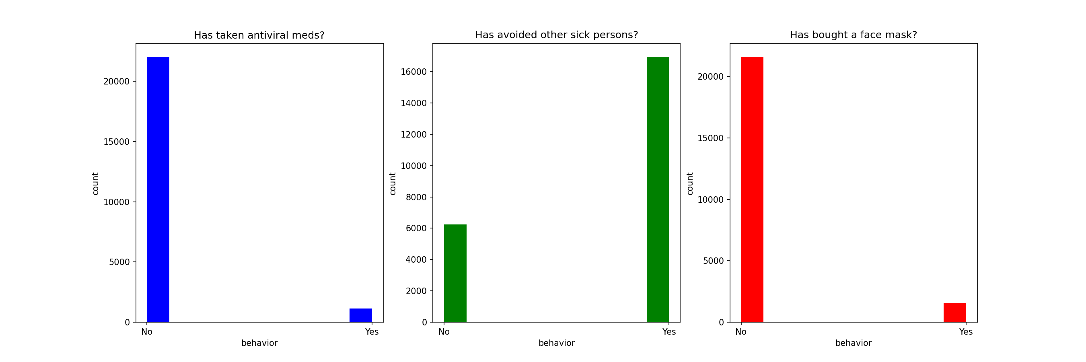
Primary Features
Health Behaviors

Slide 6
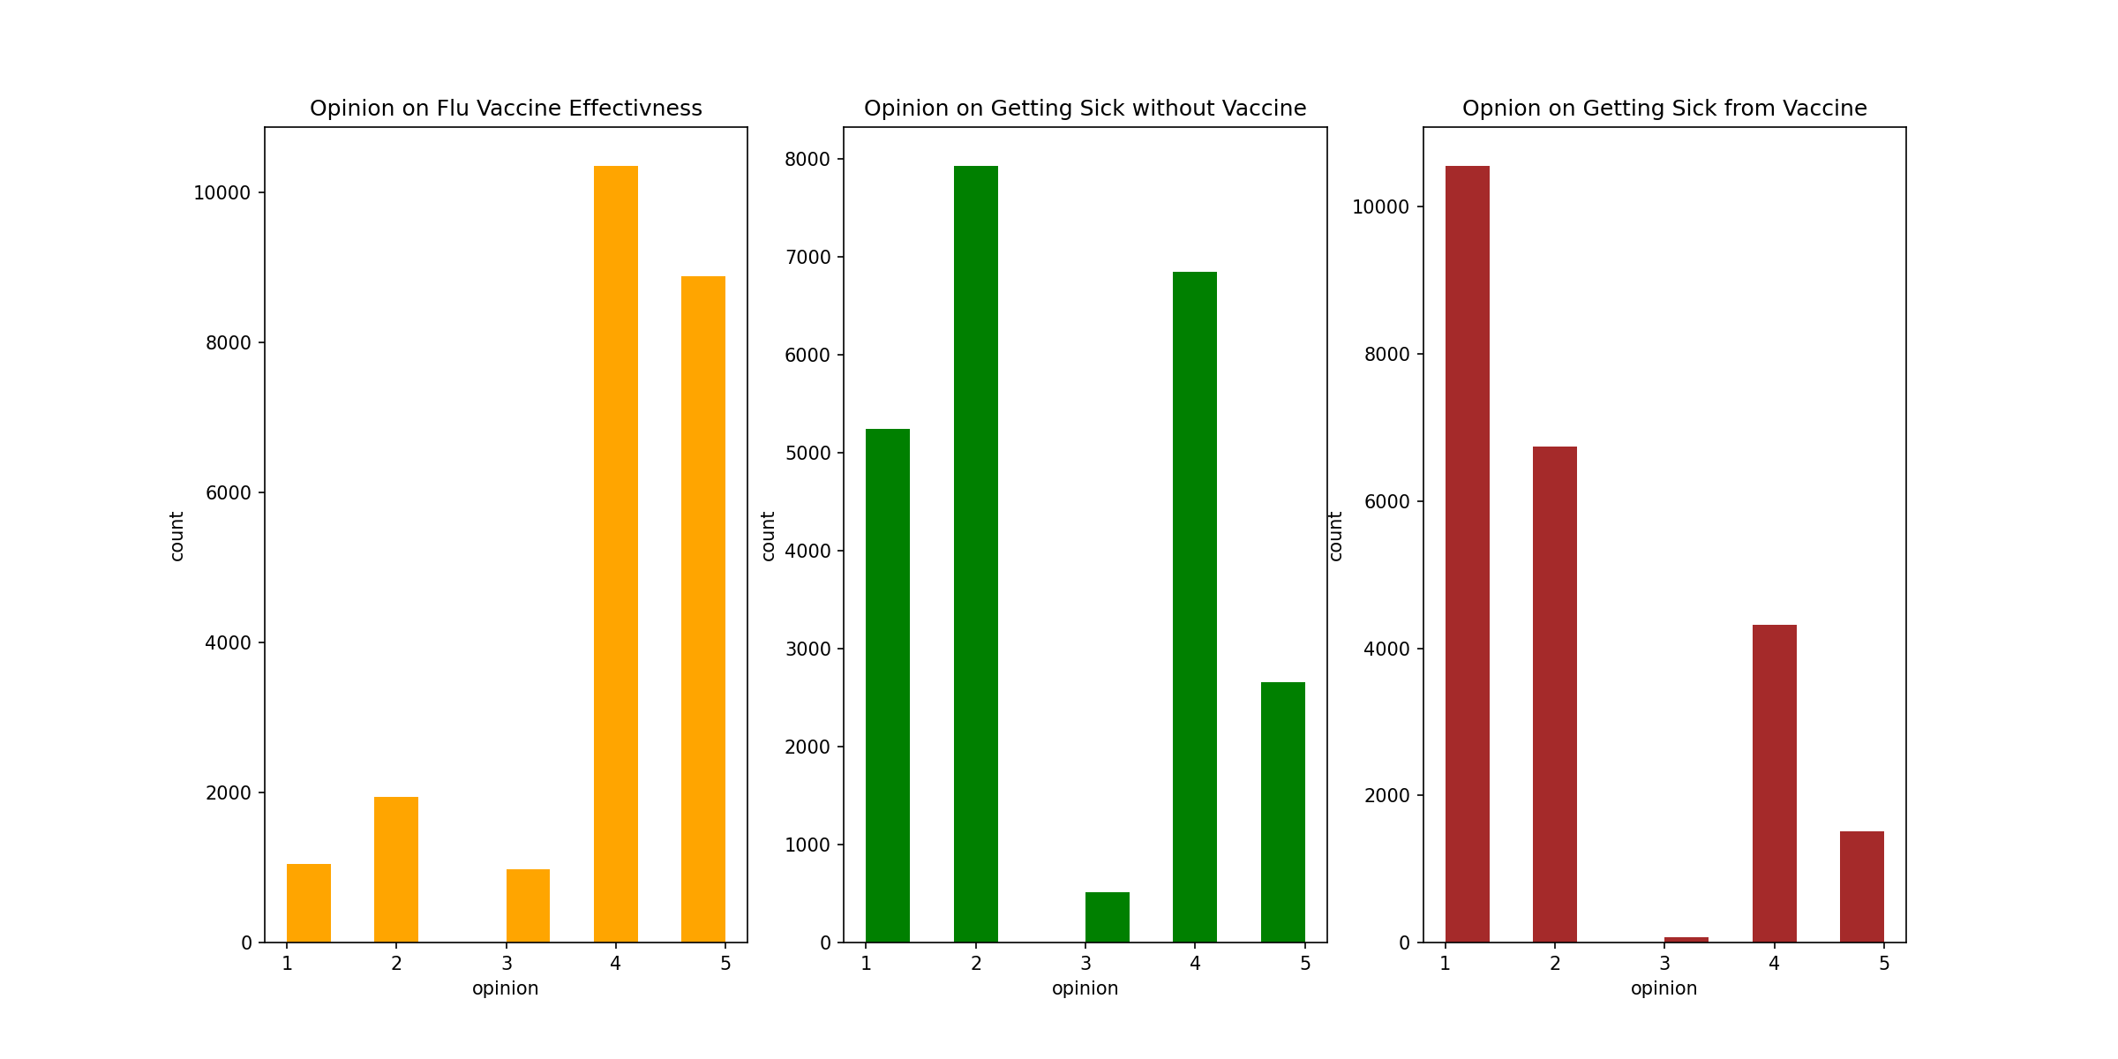
Primary Features
Health Opinions

Slide 7
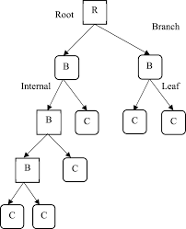
The Modeling
Classify an individual on whether or not they will receive the vaccine.
The Decision Tree Method
Primary Features:
Health Behaviors
Health Opinions

Slide 8
Model Evaluation
Evaluate Model based on Recall score.
Recall = # True Positive / Total Number of Positives
Positive = Received Vaccine
Training Recall: 0.780
Testing Recall: 0.776
Average Cross Validation Scores: 0.780

Slide 9
Conclusions/Recommendations
This Classification model performs well and can generalize data.
Apply this model to new data that collects the same information.
Example # of Vaccines to Produce = # Classified / Recall Score.
i.e) 100,000 respondents -> 65,000 classified -> 83,700 actual true cases -> can produce 16,000 fewer vaccines.

Slide 10
The next steps
Start collecting data on a sample group.
Apply model to sample group and extrapolate to larger production scale.

