Slide 1
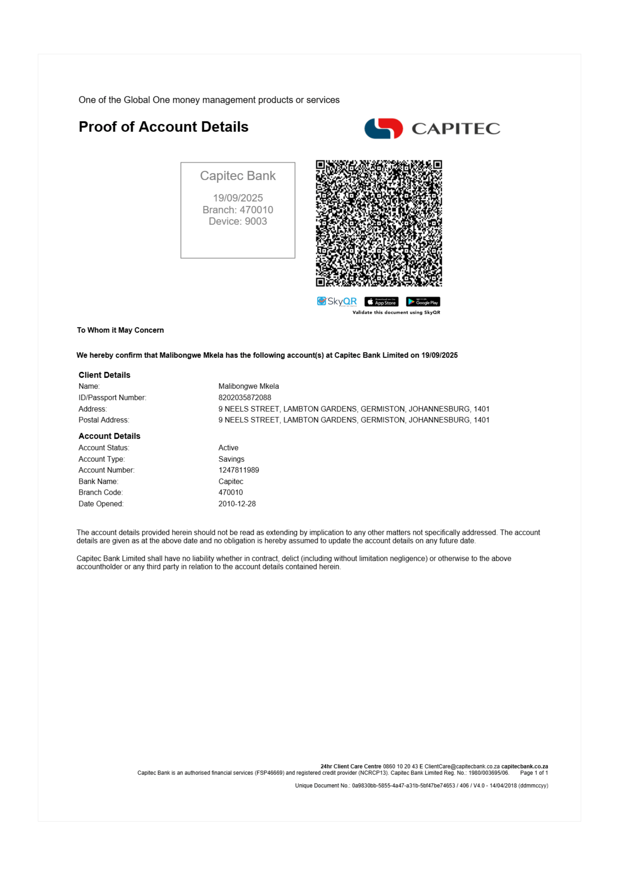
1

Slide 2
Conversion Details
Source: 1655b720-e65e-4a0d-97fd-d79d6ea12ae9_Capitec Proof of Account malibongwe mkela.pdf
Pages: 1
Converted: 2025/09/25, 19:03:50
Quality: Maximum Fidelity
Engine: PDFCraft.Pro Puppeteer Engine v2.0

