Slide 1
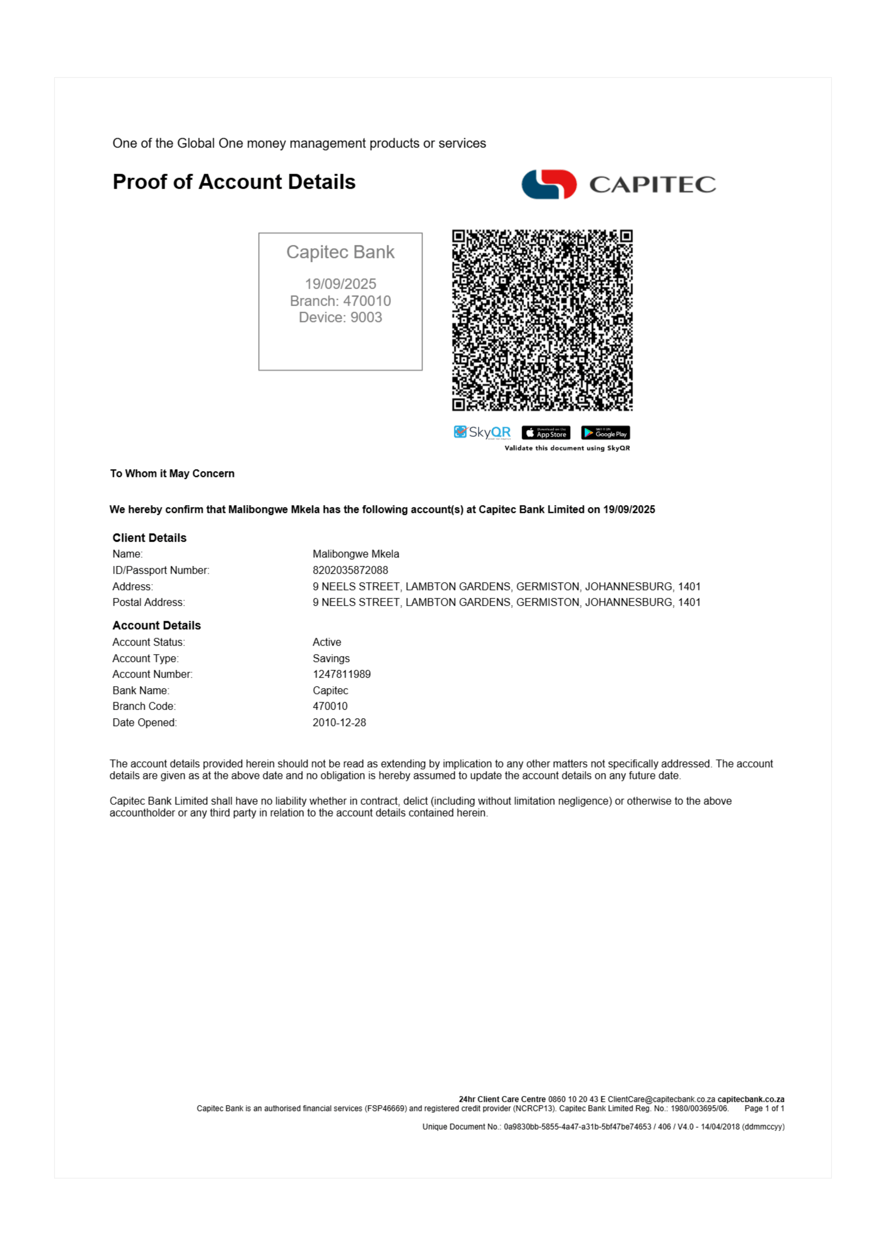
1

Slide 2
Conversion Details
Source: 5bd091a9-315b-4963-bc03-43efc3f7f784_Capitec Proof of Account malibongwe mkela.pdf
Pages: 1
Converted: 2025/09/27, 03:49:26
Quality: Maximum Fidelity
Engine: PDFCraft.Pro Puppeteer Engine v2.0

