Slide 1
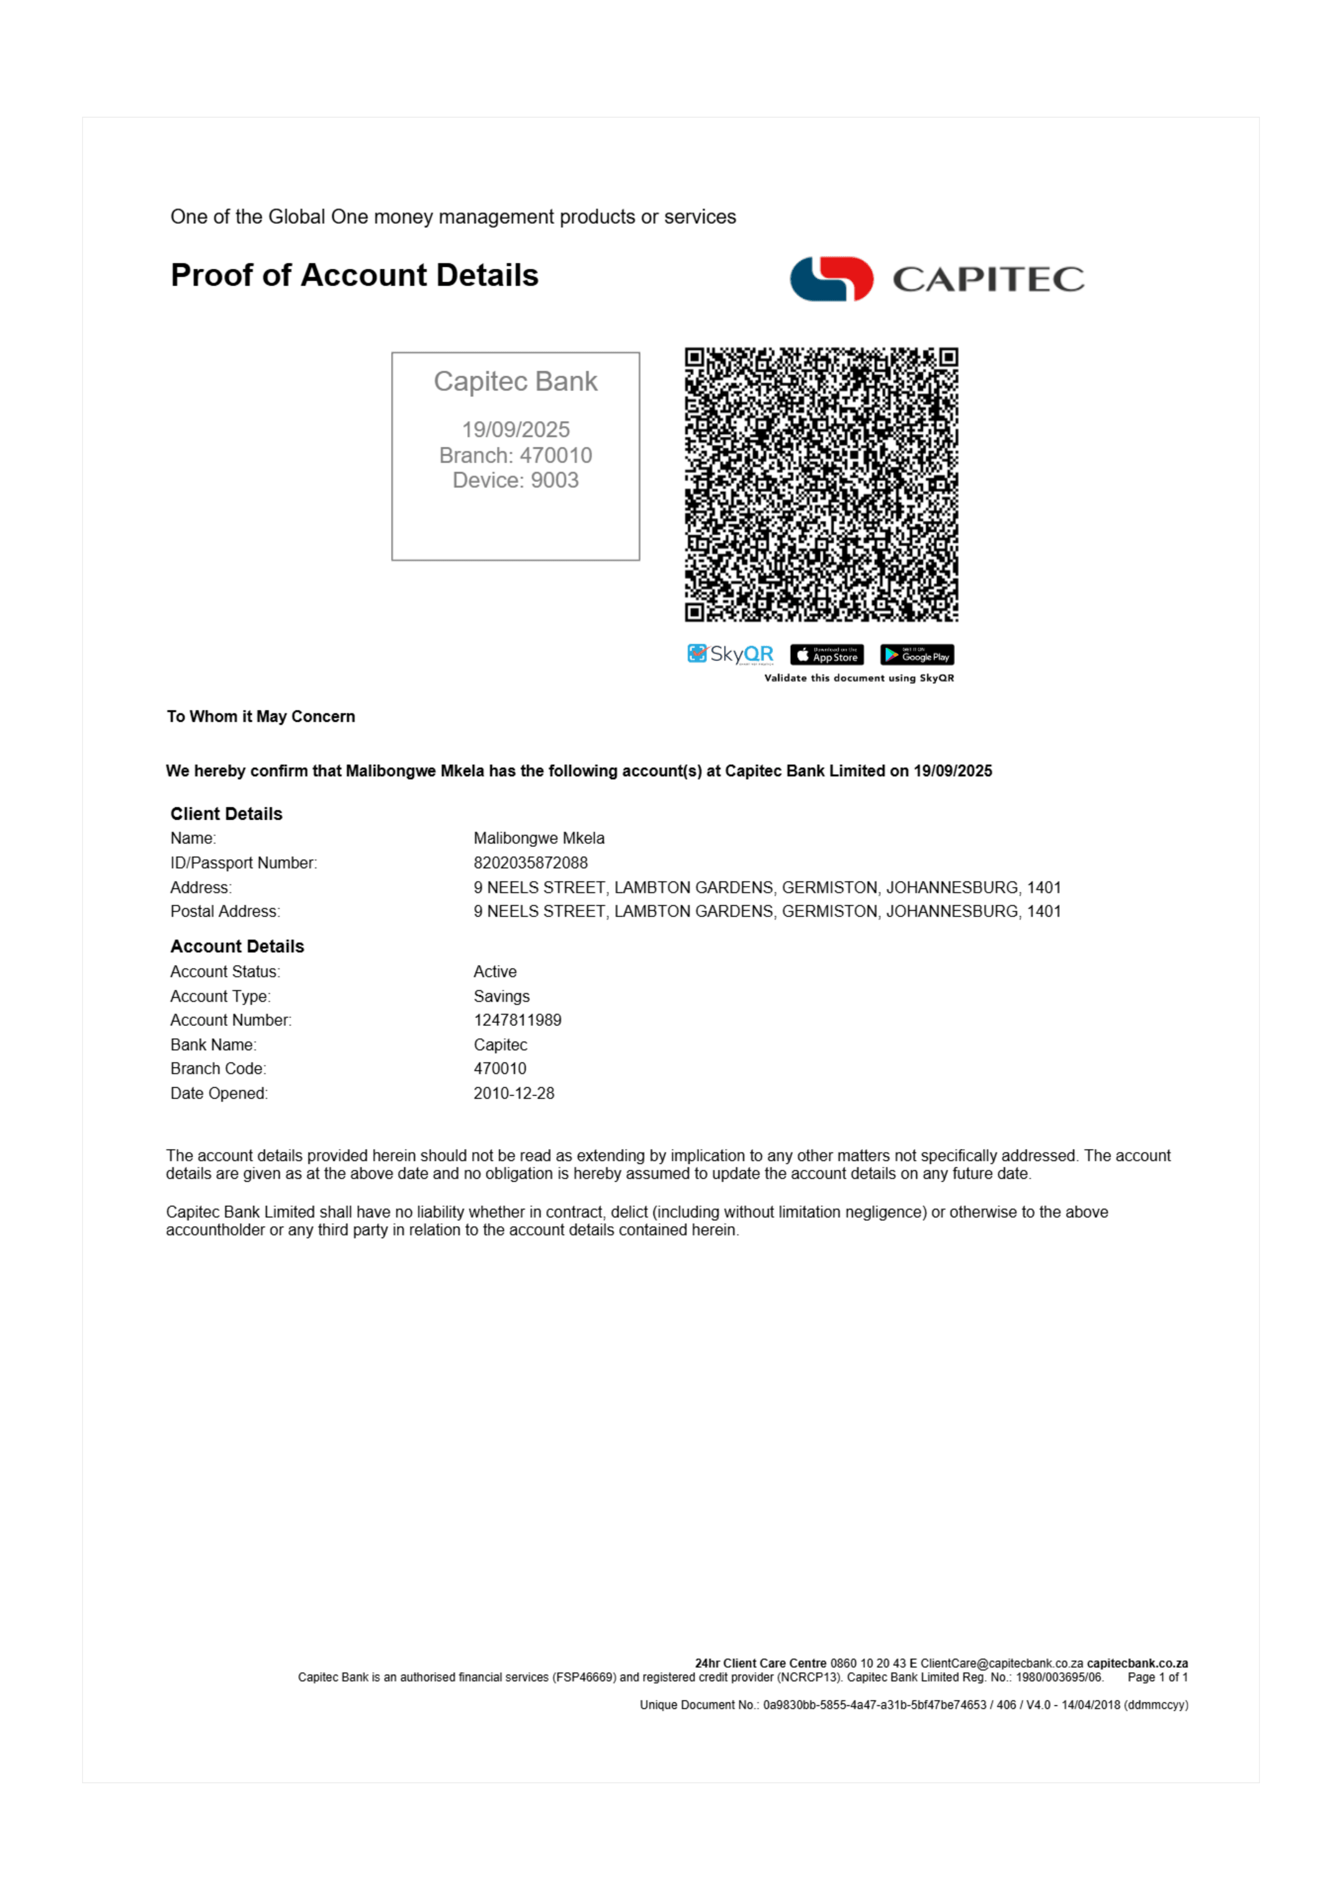
1

Slide 2
Conversion Details
Source: 02b4b58e-1a5c-4238-8793-ac9624b59a37_Capitec Proof of Account malibongwe mkela.pdf
Pages: 1
Converted: 2025/09/26, 06:56:00
Quality: Maximum Fidelity
Engine: PDFCraft.Pro Puppeteer Engine v2.0

