Slide 1
Webcam Fuzz Testing: Testing IoT Deployments
Matthew Elbert
Jeffrey Kitchen

Slide 2
Fuzz Testing
Fuzz testing (or fuzzing) is an automated method of testing by sending a program with random inputs in order to attempt to find bugs and vulnerabilities. This is particularly useful for network-facing interfaces, as they could see any random command form the Internet.
We decided to fuzz test Wireless IP cameras, as they are some of the most commercially available Internet of Things (IoT) deployments. We found these webcams use basic HTTP server to serve video.

Slide 3
Advantages of testing HTTP
Widely deployed
Many solutions available
Easy to access
Well understood
Many vulnerabilities found

Slide 4
Disadvantages of testing HTTP
Widely deployed
Many implementations are hardened from the vulnerabilities found on them

Slide 5
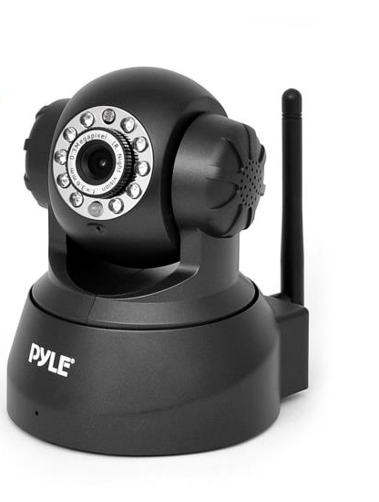
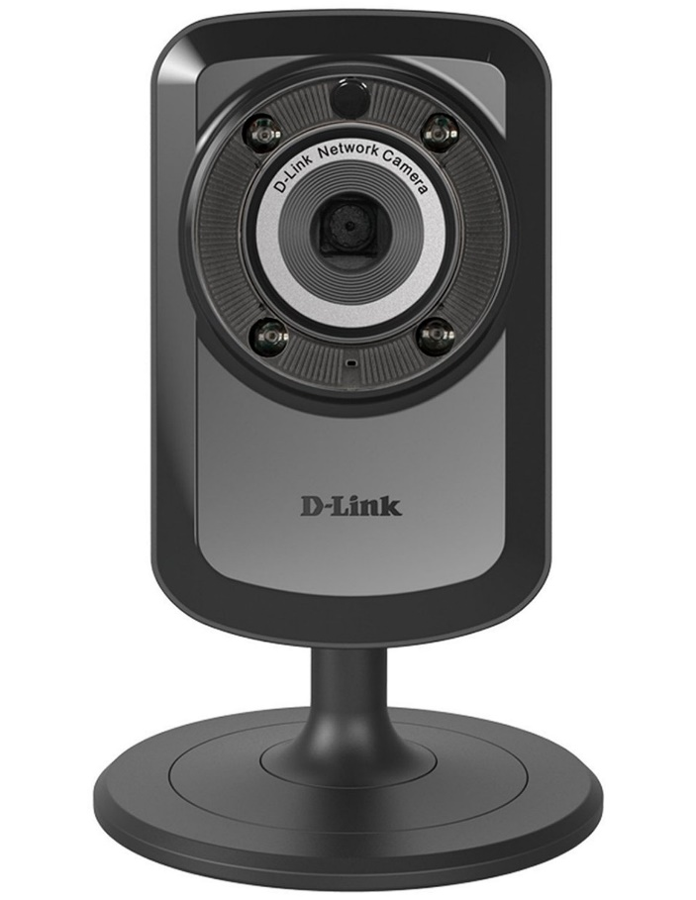
Devices Under Test
D-Link Wireless Day/Night WiFi Network Surveillance Camera
(DCS-934L)
Pyle PIPCAM5 IP Camera Surveillance Security Monitor

Slide 6
Device Under Test
IPv4, ARP, TCP, UDP, ICMP
DHCP Client
NTP Client (D-Link only)
DNS Client
DDNS Client
SMTP Client
FTP Client
HTTP Server
PPPoE
UPnP port forwarding
RTP, RTSP, RTCP (D-Link only)
LLTD (D-Link only)
GPRS (Pyle only)
Supported protocols →
Many are just for internet connectivity
Most are also clients for services that require other entities to complete (e.g. the SMTP mail client to send emails and the FTP client to send camera images to a server)

Slide 7
Available Tools
The Peach Fuzzing Platform
http://www.peachfuzzer.com/
AutoFuzz
http://autofuzz.sourceforge.net/
American Fuzzy Lop
http://lcamtuf.coredump.cx/afl/
Pathod/Pathoc
http://pathod.net/index.html

