Slide 1
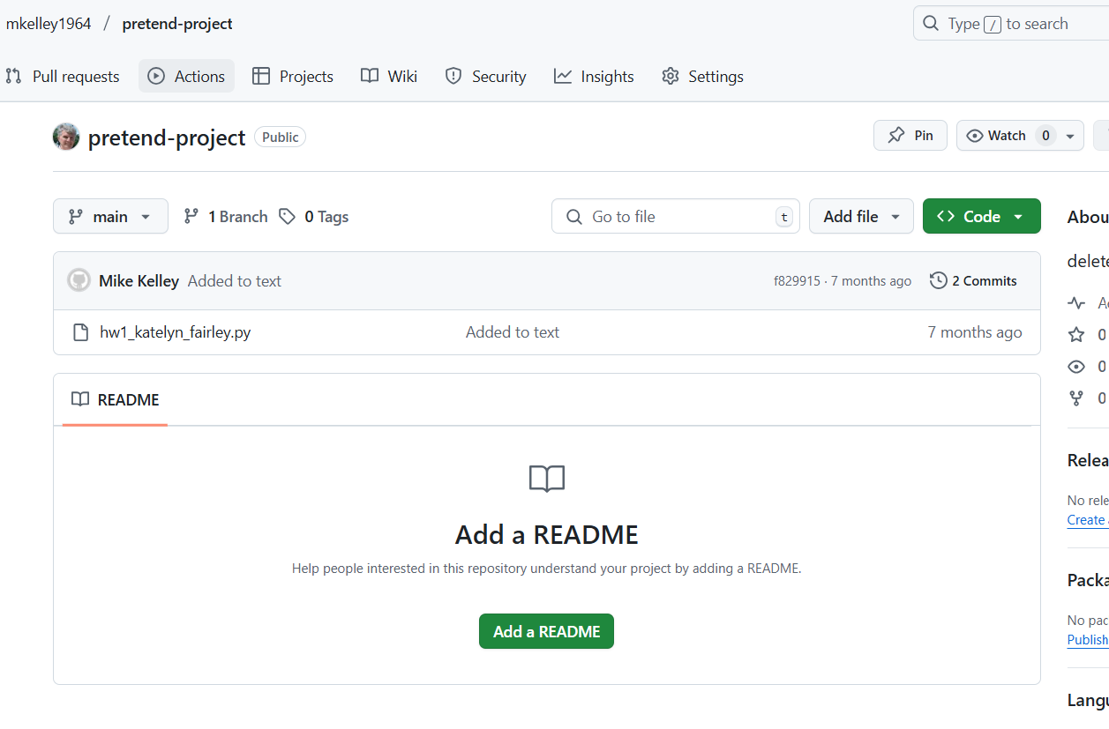
GitHub
Deleting a repository:
Navigate to home page of repository want to delete
On tool bar, click “Settings”

Slide 2
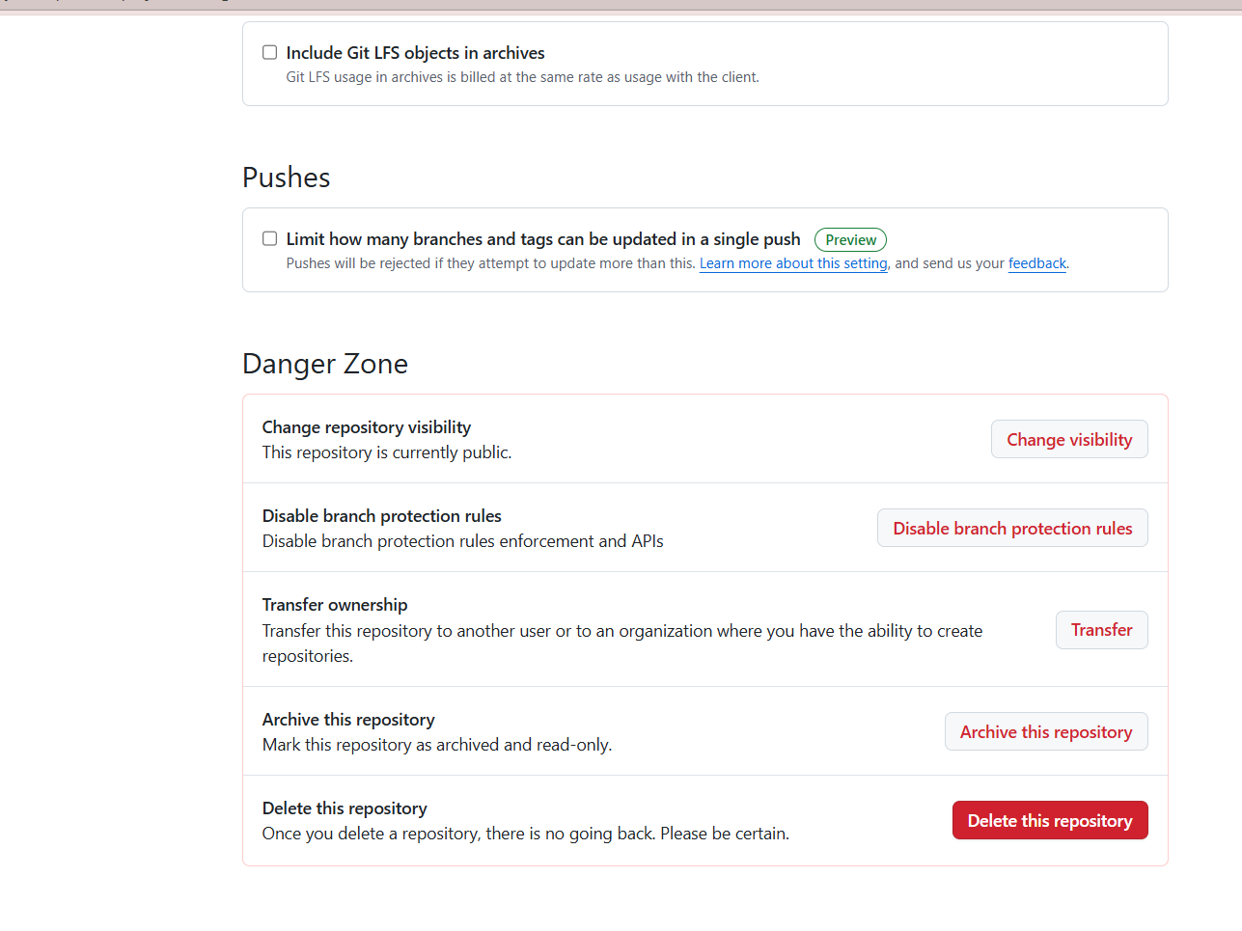
GitHub
Deleting a repository:
On the General settings page, scroll down to Danger Zone and click “Delete this repository”

Slide 3
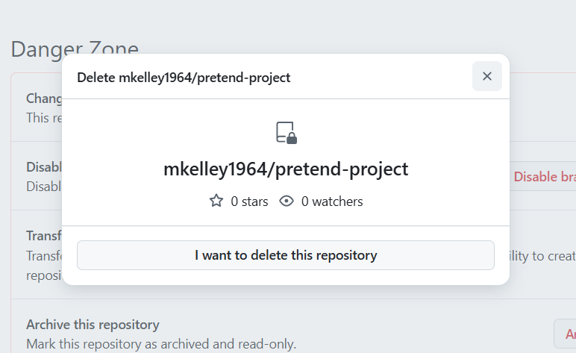
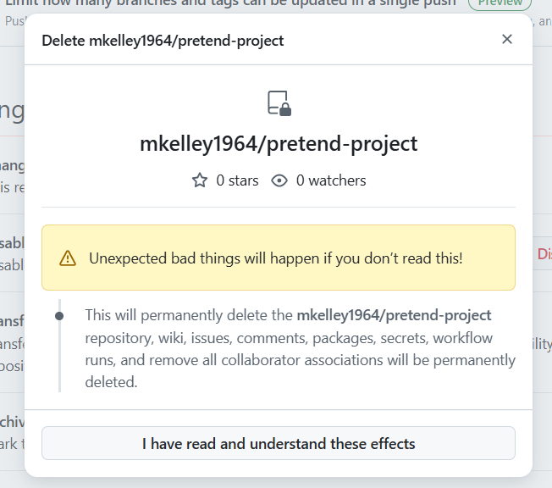
GitHub
Deleting a repository:

Slide 4
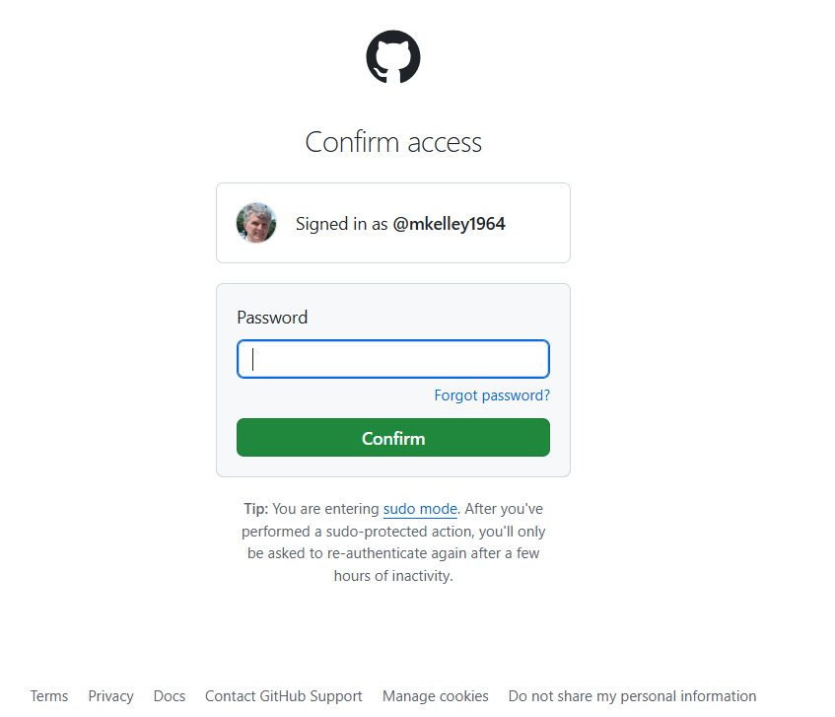
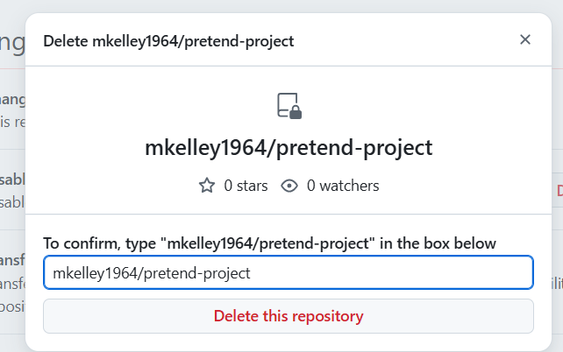
GitHub
Deleting a repository:

