Slide 1
GitHub Files Download/Upload
Download = save a copy of a repository’s files to local computer; no version control
Clone = make a full copy of a repository’s data (files and folders).
To be able to work on files locally but with version control. Can re-sync with GitHub-hosted repository.
Fork = create a new repository on GitHub linked to personal account with that shares code and visibility settings with original repository
https://docs.github.com/en/get-started/start-your-journey/downloading-files-from-github
https://docs.github.com/en/repositories/creating-and-managing-repositories/cloning-a-repository
https://docs.github.com/en/pull-requests/collaborating-with-pull-requests/working-with-forks/fork-a-repo

Slide 2
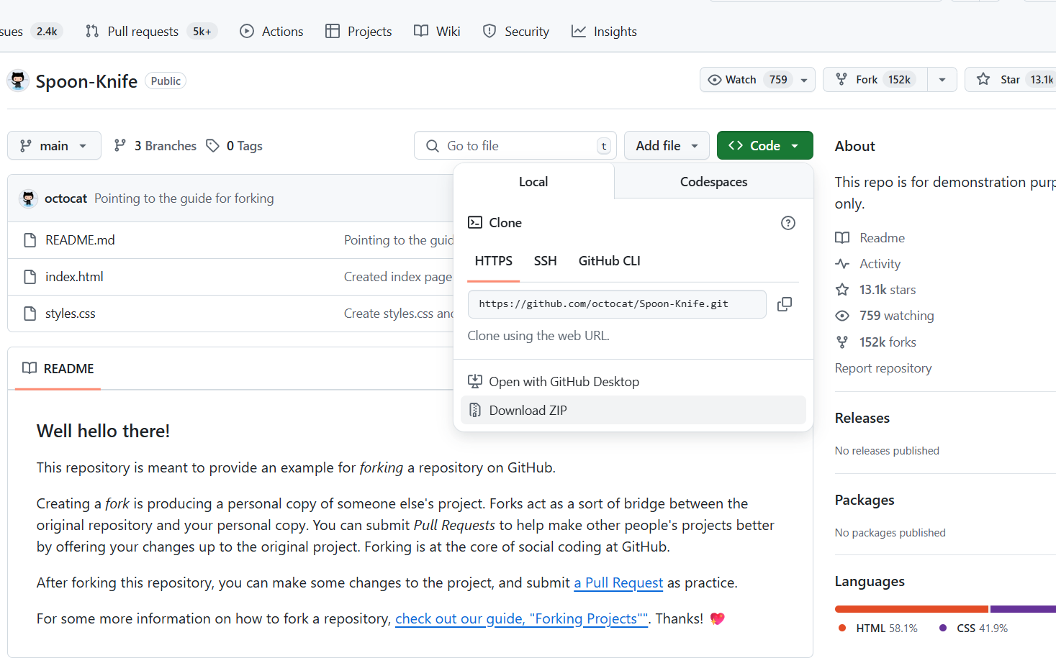
GitHub Files Download/Upload
Download files:
Navigate to a repository that want to copy files
https://docs.github.com/en/get-started/start-your-journey/downloading-files-from-github

Slide 3
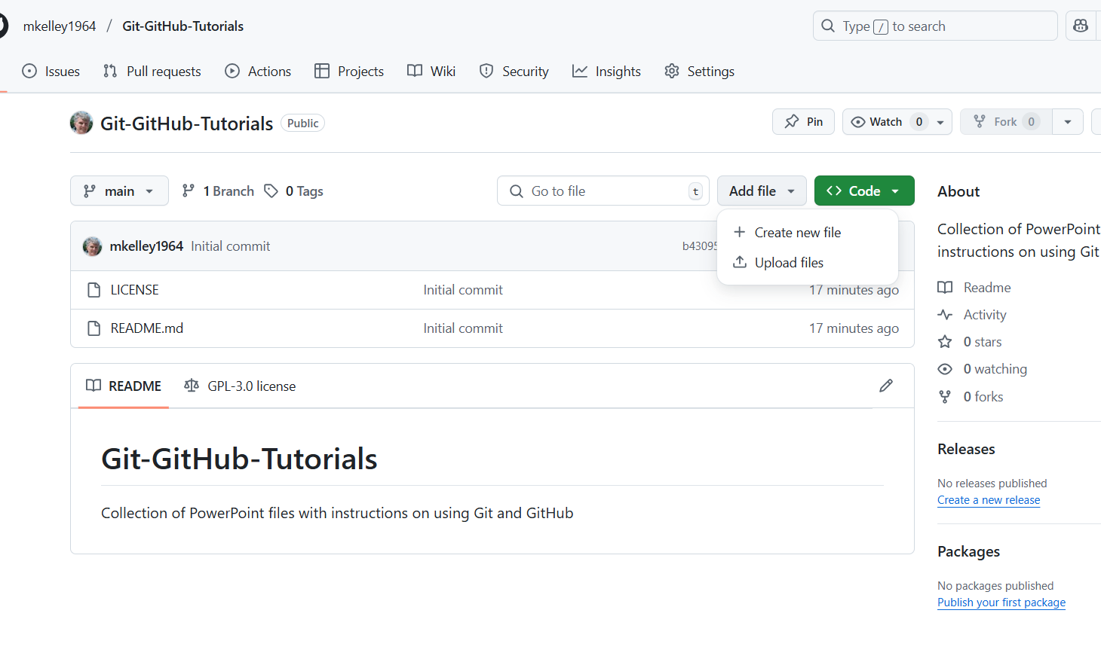
GitHub Files Download/Upload
Upload files:
Navigate to a repository that want to copy files to
Select Add file dropdown menu
Select Upload files
https://docs.github.com/en/get-started/start-your-journey/uploading-a-project-to-github

Slide 4
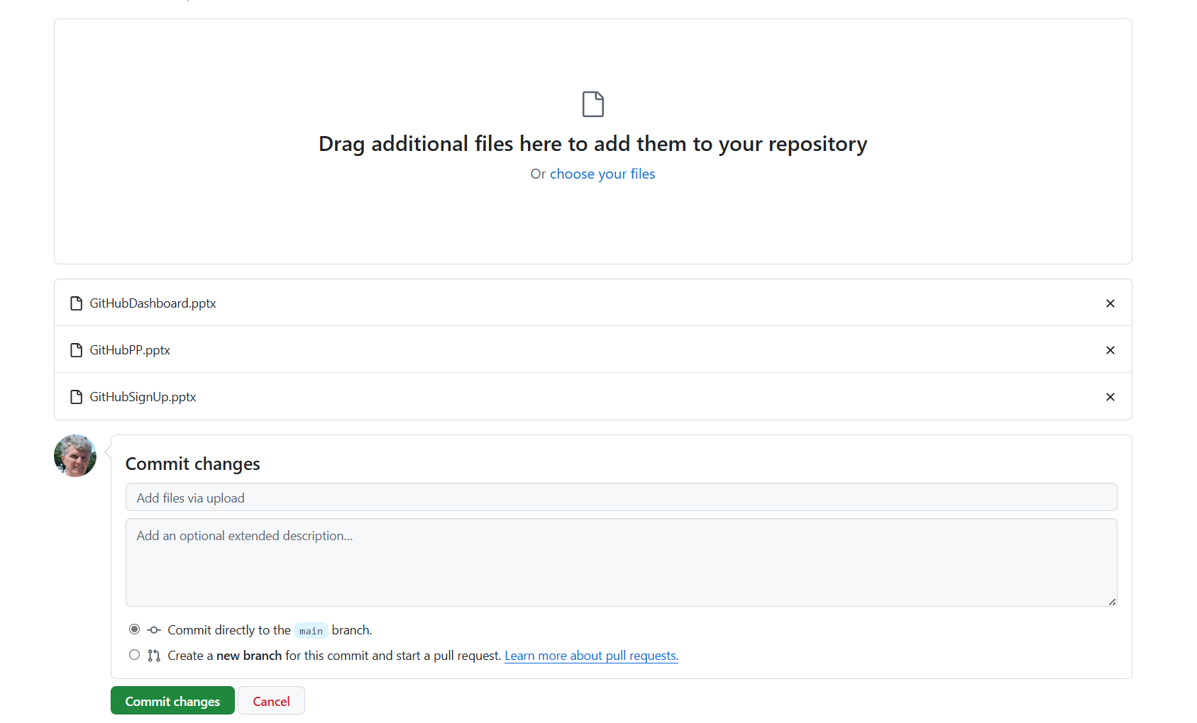
GitHub Files Download/Upload
Upload files:
Add files that want to upload
Select Commit directly to the main branch
Select Commit changes
https://docs.github.com/en/get-started/start-your-journey/uploading-a-project-to-github

Slide 5
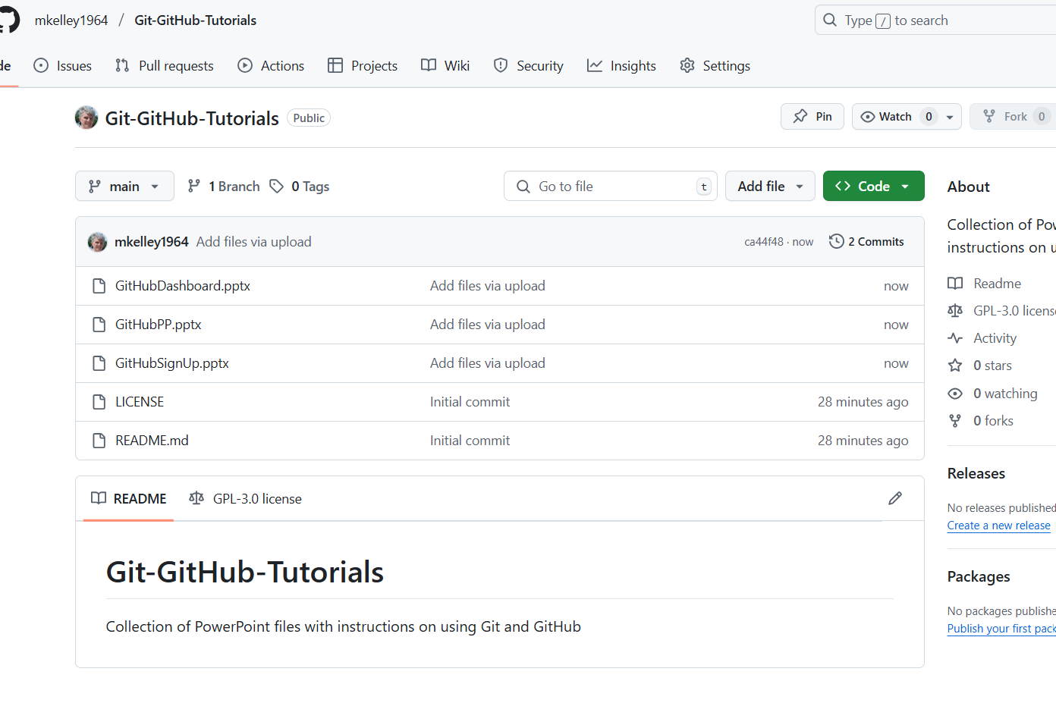
GitHub Files Download/Upload
Upload files:
Files uploaded
https://docs.github.com/en/get-started/start-your-journey/uploading-a-project-to-github

Slide 6
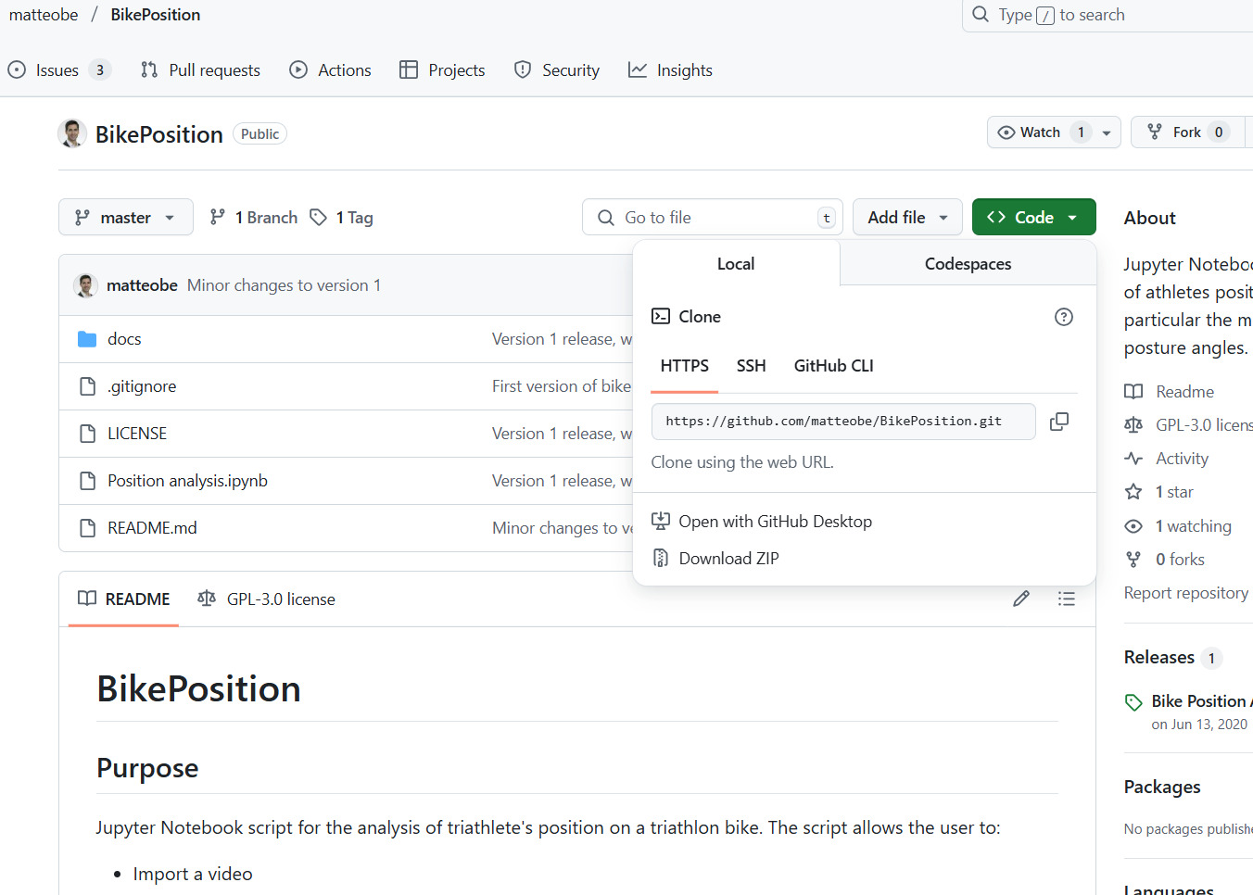
GitHub Files Download/Upload
Cloning a repository:
Select Code dropdown menu
Select repository
Copy URL
https://docs.github.com/en/repositories/creating-and-managing-repositories/cloning-a-repository

Slide 7
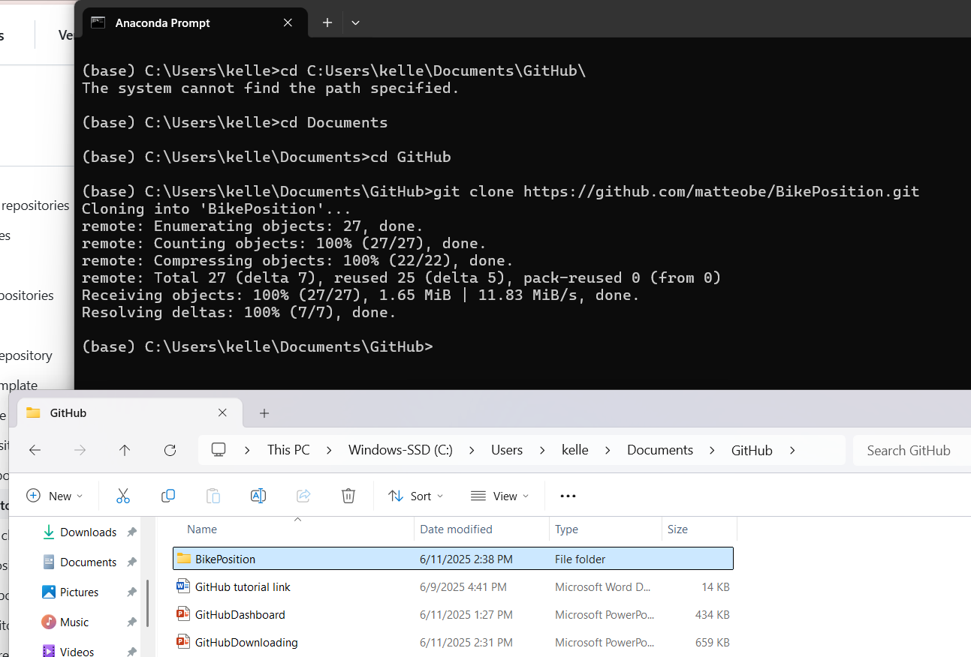
GitHub Files Download/Upload
Cloning a repository:
Open CLI
Change directory to where want to download
Type “git clone” and then paste copied URL. Press Enter
URL contents added to directory
https://docs.github.com/en/repositories/creating-and-managing-repositories/cloning-a-repository

Slide 8
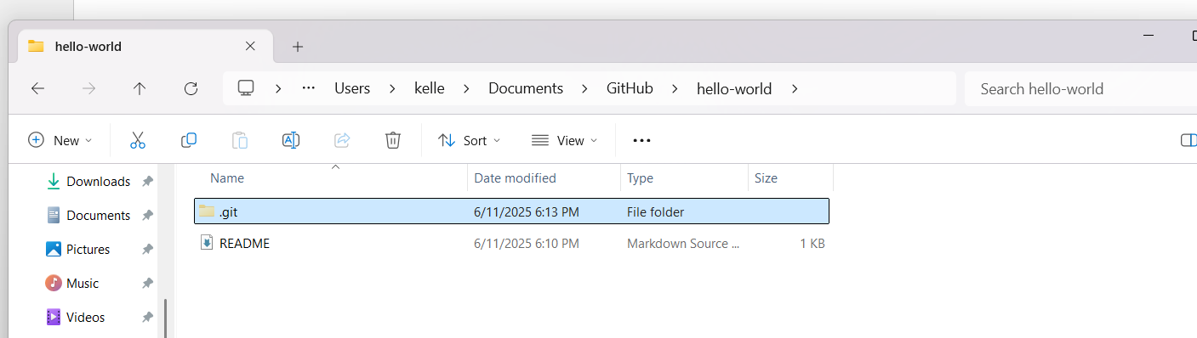
GitHub Files Download/Upload
Cloning a repository:
Files (ex. README) in folder open to Visual Studio Code. Changes made can be committed back to the main
https://docs.github.com/en/repositories/creating-and-managing-repositories/cloning-a-repository

Slide 9
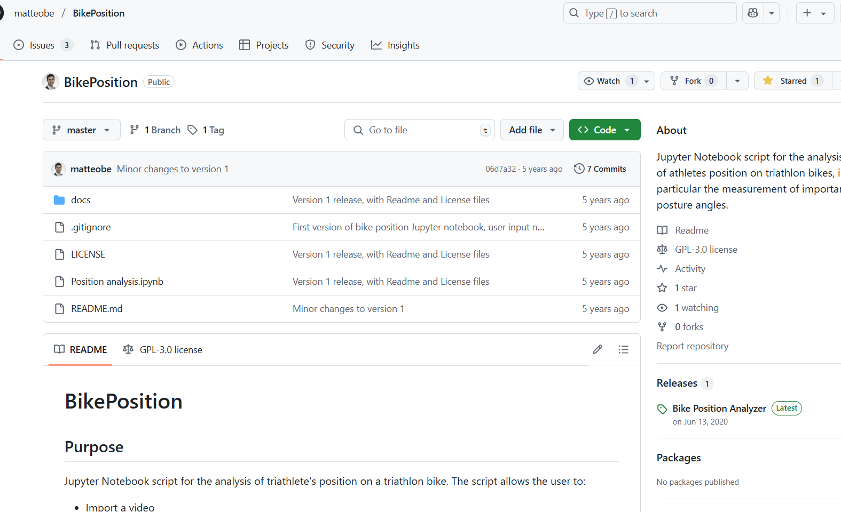
GitHub Files Download/Upload
Forking a repository:
Select repository
Click Fork
https://docs.github.com/en/pull-requests/collaborating-with-pull-requests/working-with-forks/fork-a-repo

Slide 10
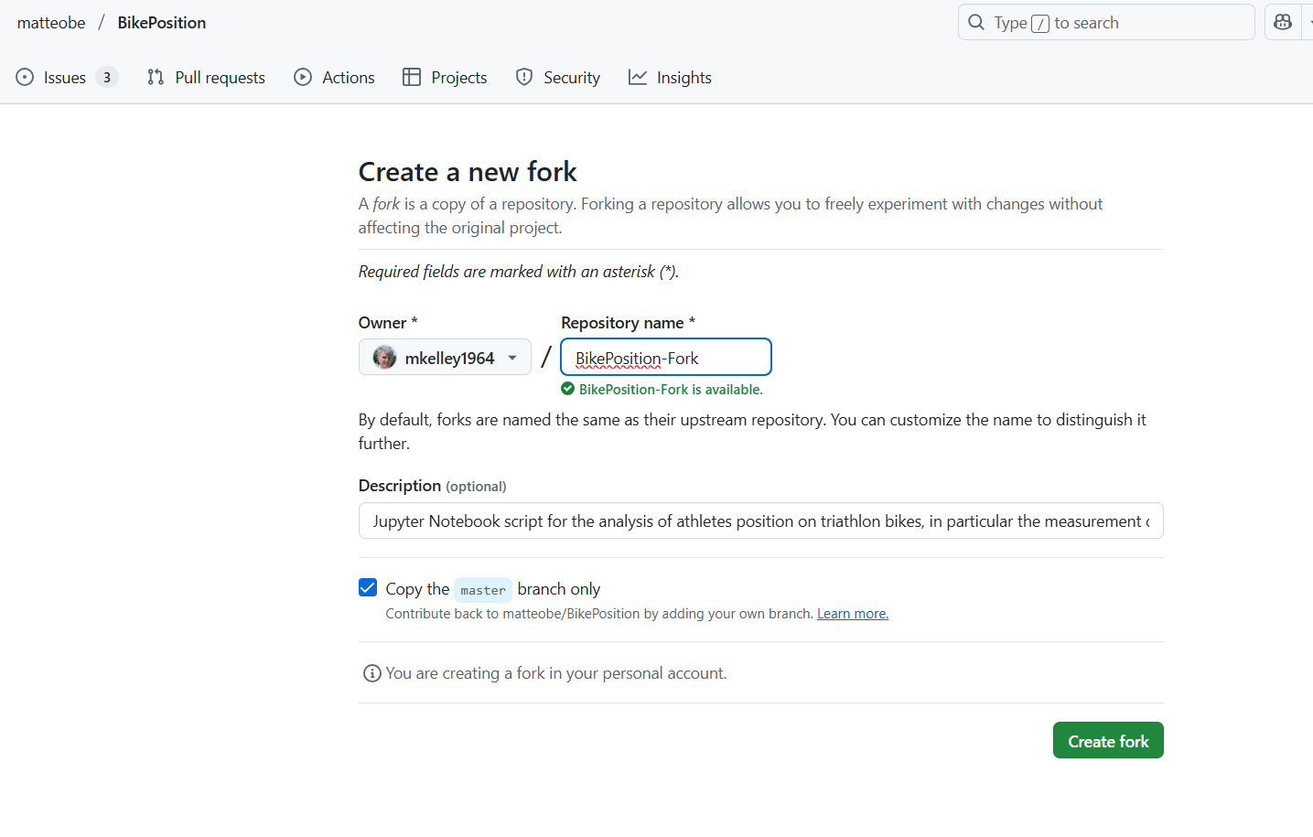
GitHub Files Download/Upload
Forking a repository:
Modify name or description (optional)
Click Create fork
https://docs.github.com/en/pull-requests/collaborating-with-pull-requests/working-with-forks/fork-a-repo

Slide 11
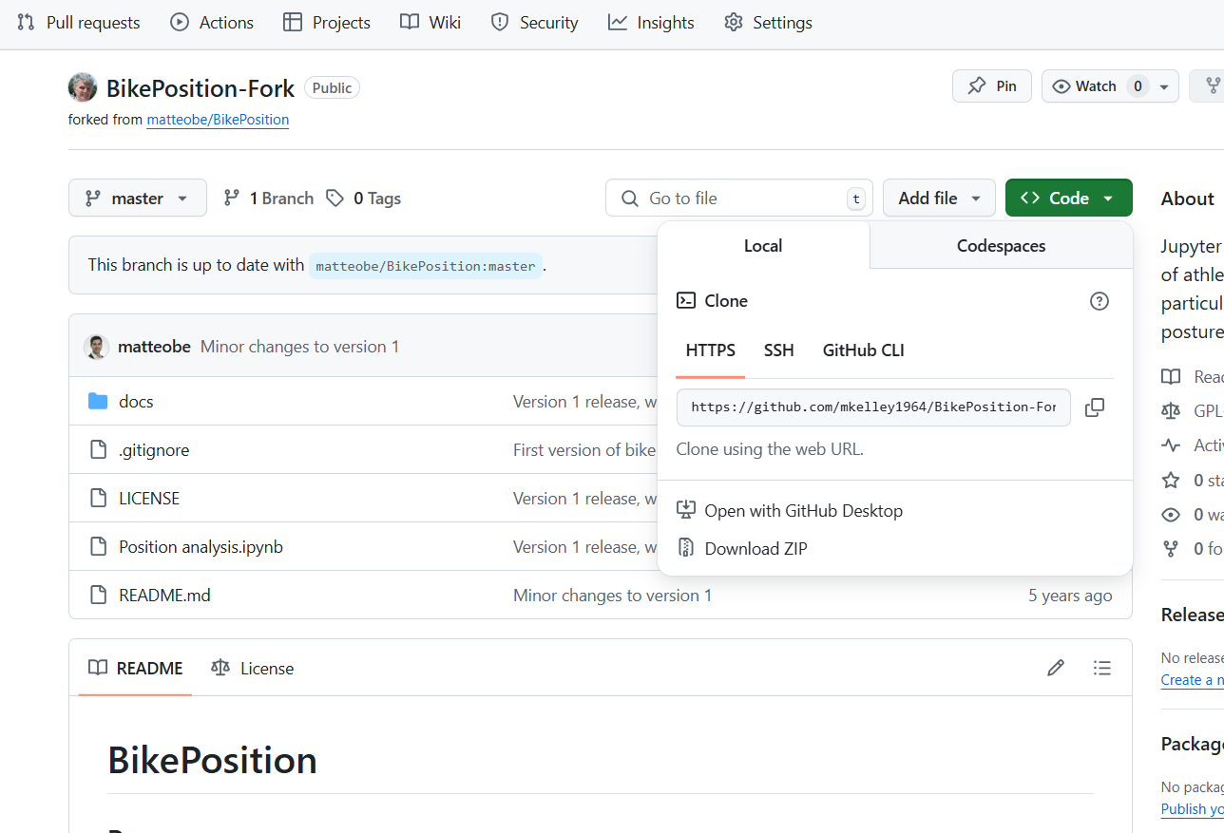
GitHub Files Download/Upload
Forking a repository: after forking complete, clone forked repository
Navigate to the forked repository
Follow same cloning steps
https://docs.github.com/en/pull-requests/collaborating-with-pull-requests/working-with-forks/fork-a-repo

