Slide 1
GitHub Dashboard
Log in:
https://github.com/mkelley1964

Slide 2
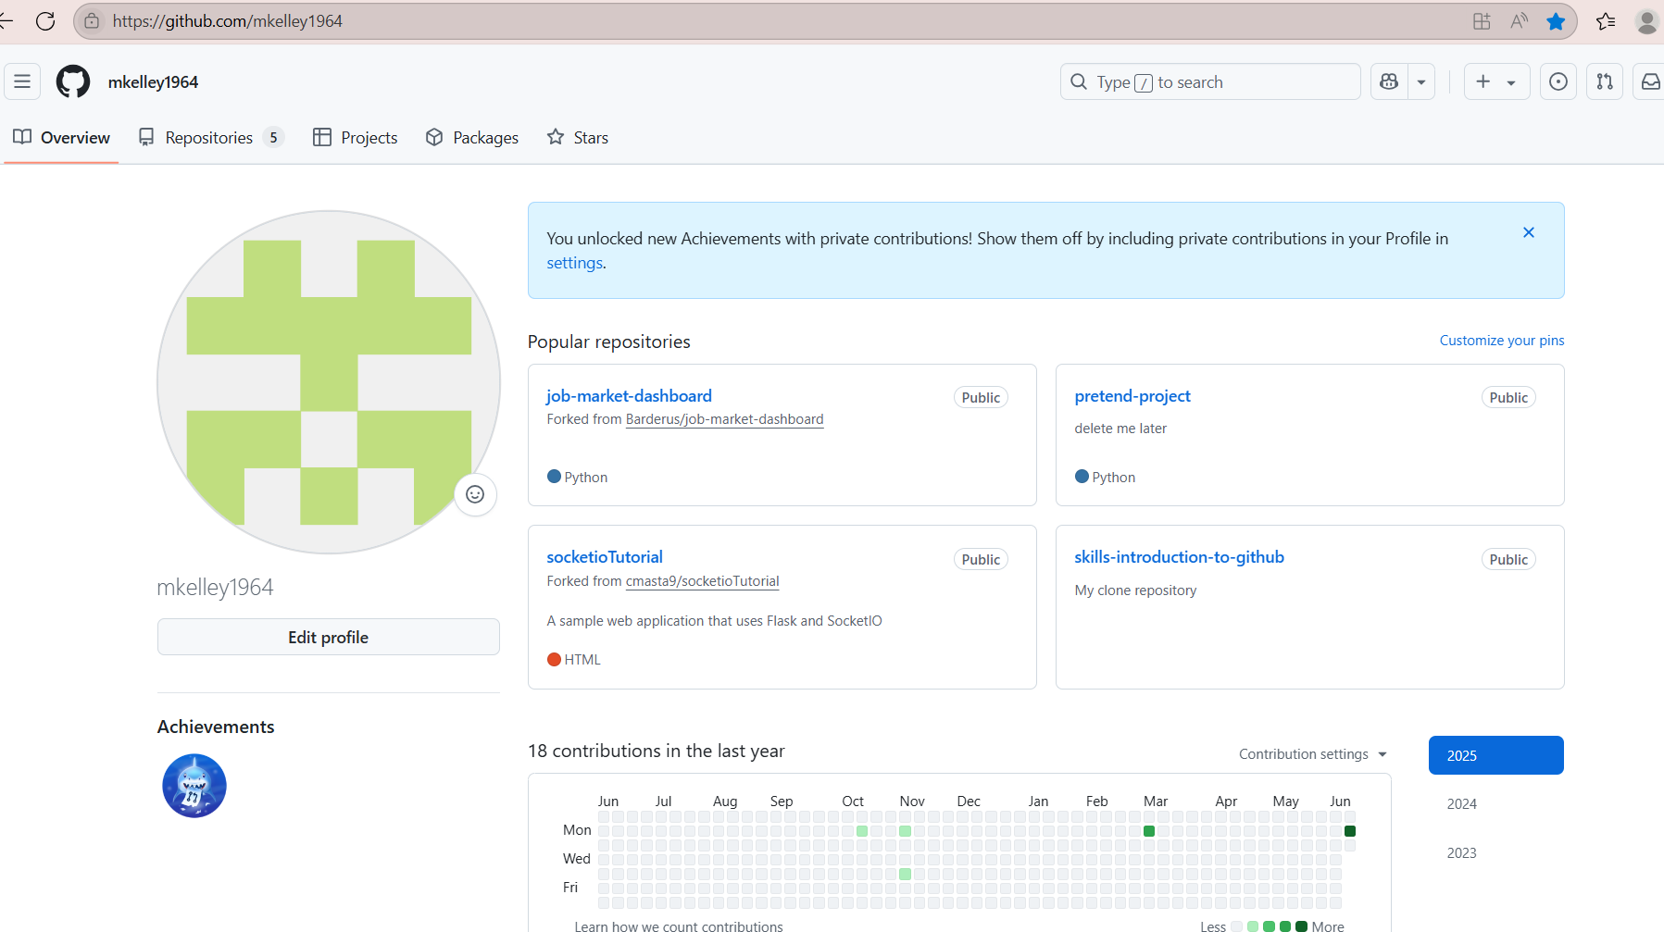
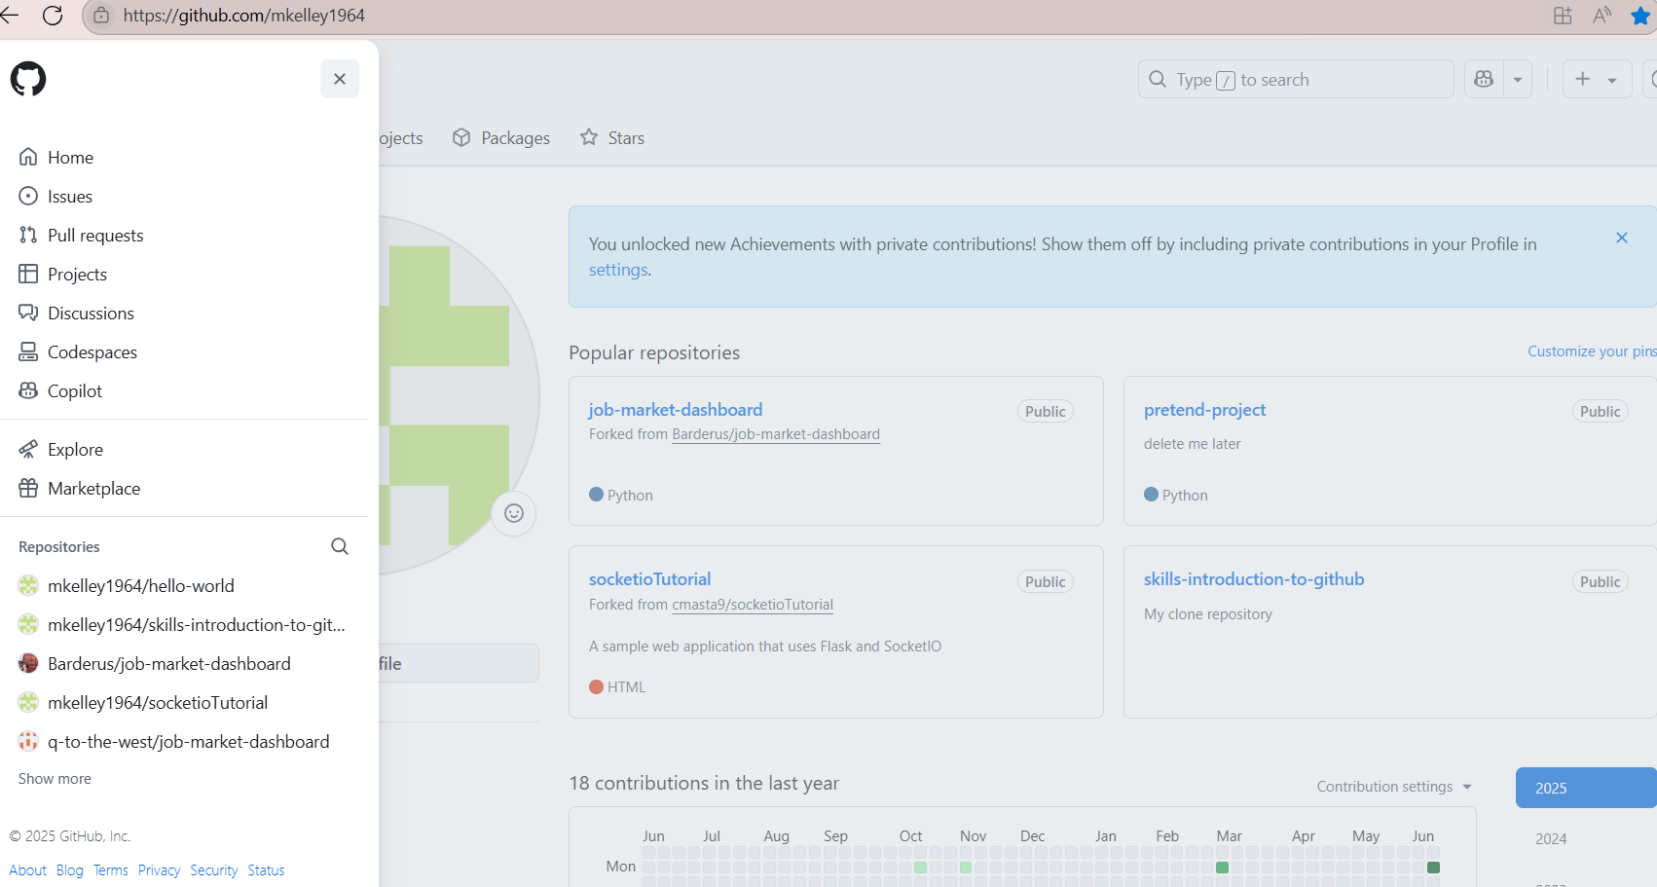
GitHub Dashboard
To get to dashboard:
Open menu
Select Home

Slide 3
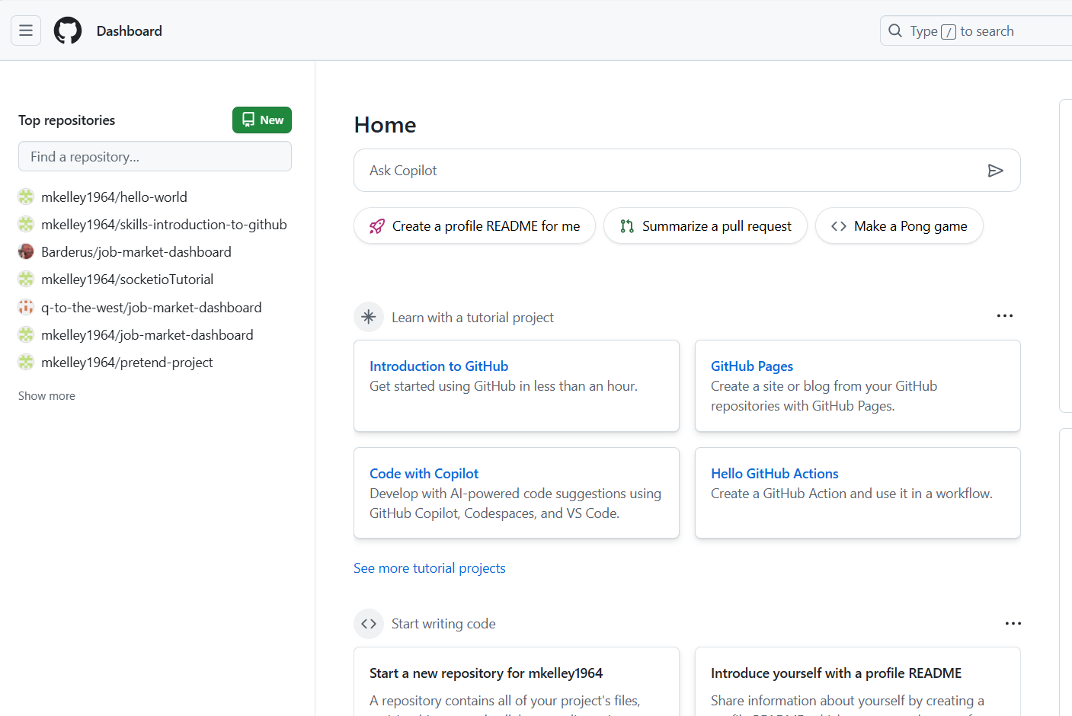
GitHub Dashboard

