Slide 1
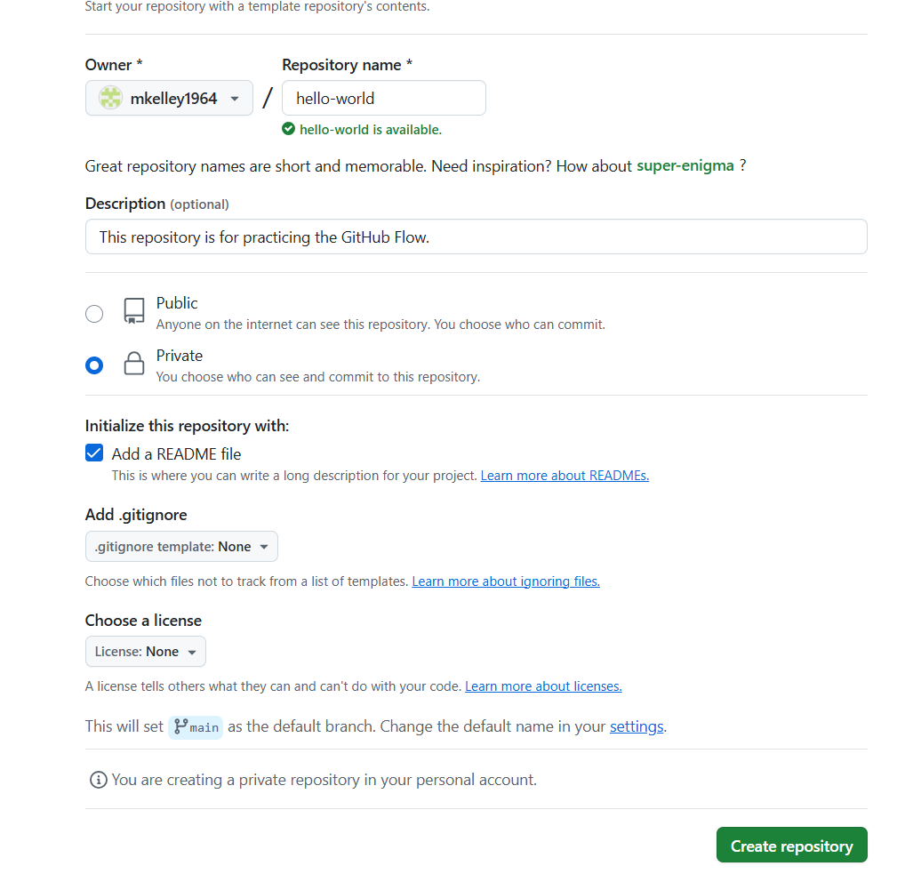
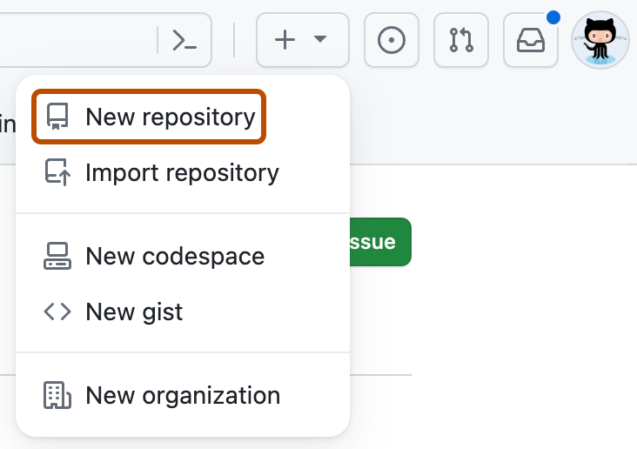
GitHub Pull Request Workflow
Create a new repository:
Type in a name for the new repository
Type in a description
Select Public or Private
Select box for README file
Select “Create repository”
https://docs.github.com/en/get-started/start-your-journey/hello-world

Slide 2
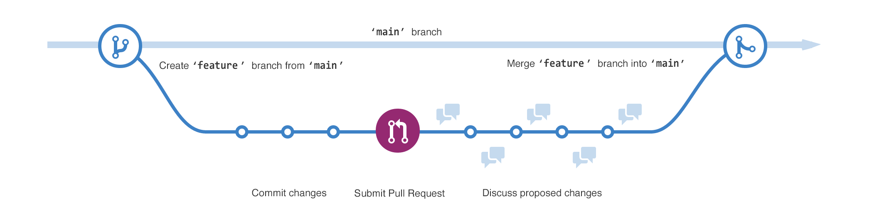
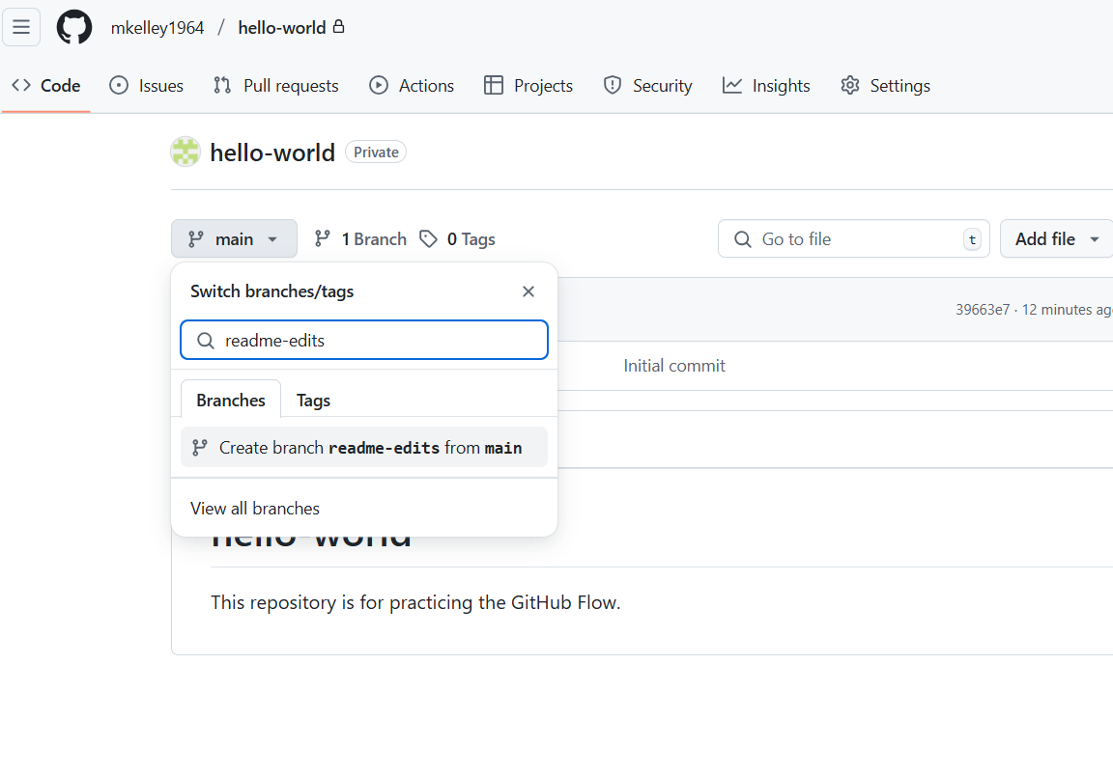
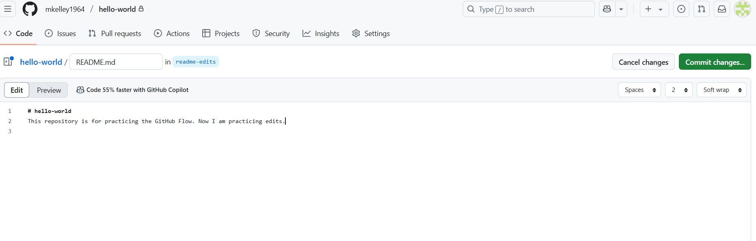
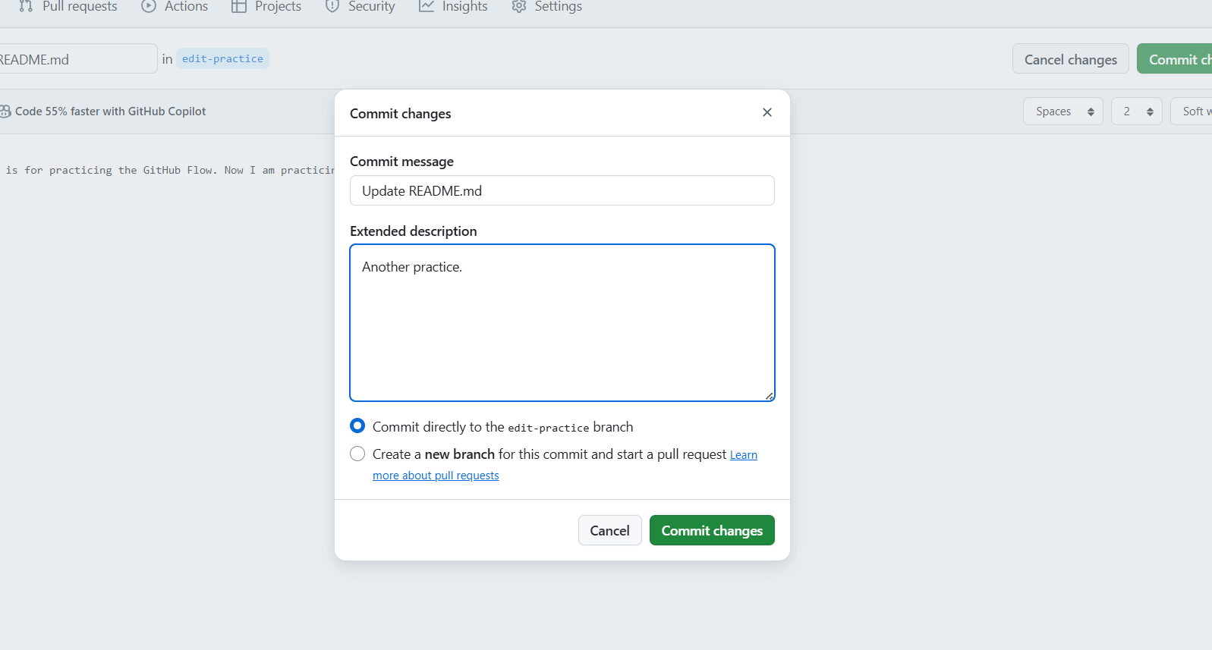
GitHub Pull Request Workflow
Creating a branch
Making a commit, push to repository
You can use branches to experiment and make edits before committing them to main.
https://docs.github.com/en/get-started/start-your-journey/hello-world

Slide 3
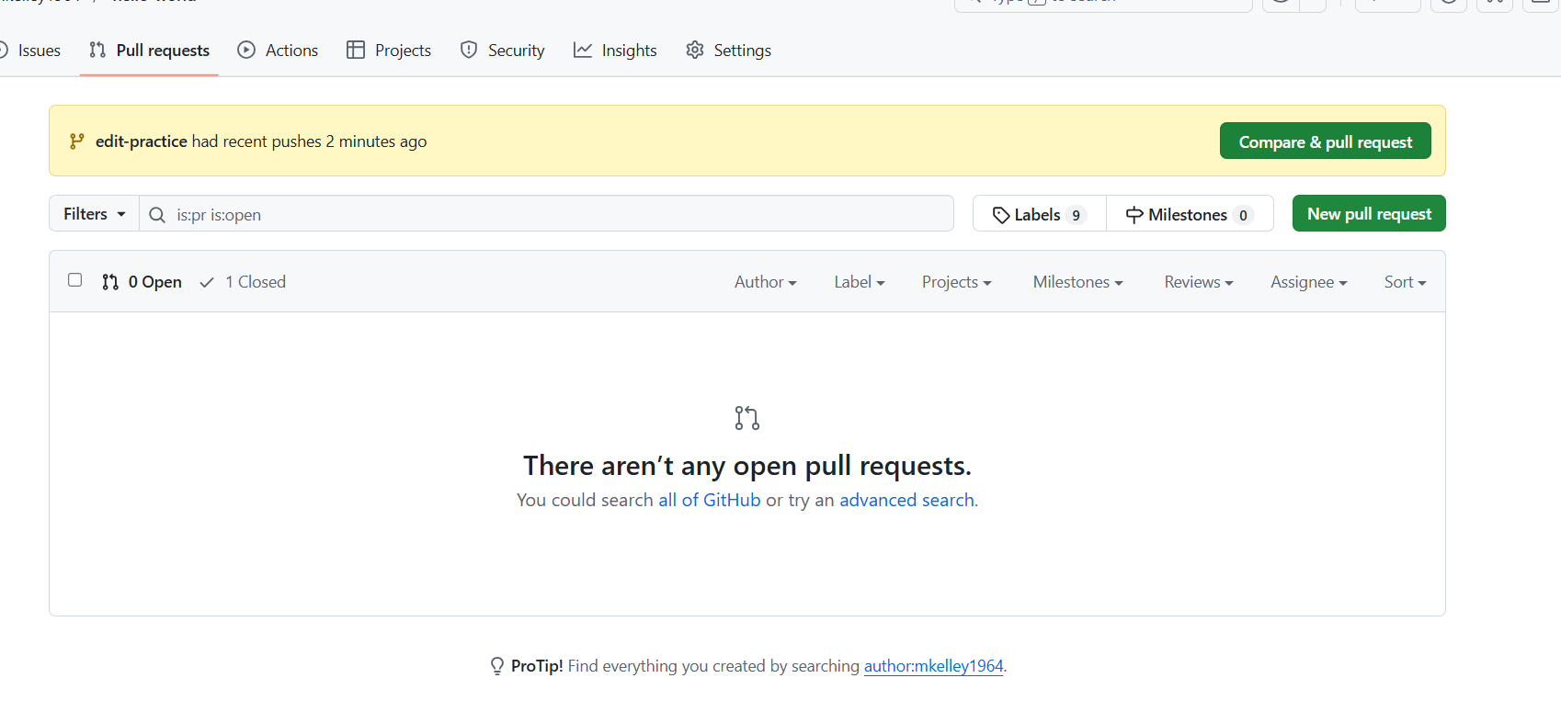
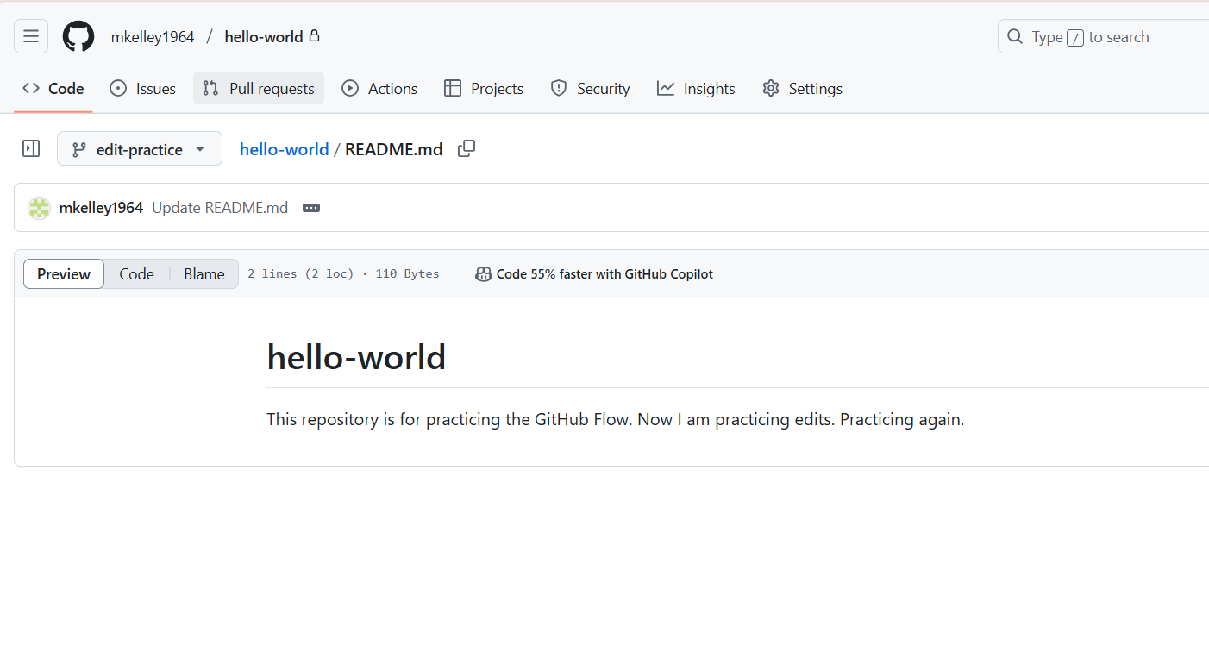
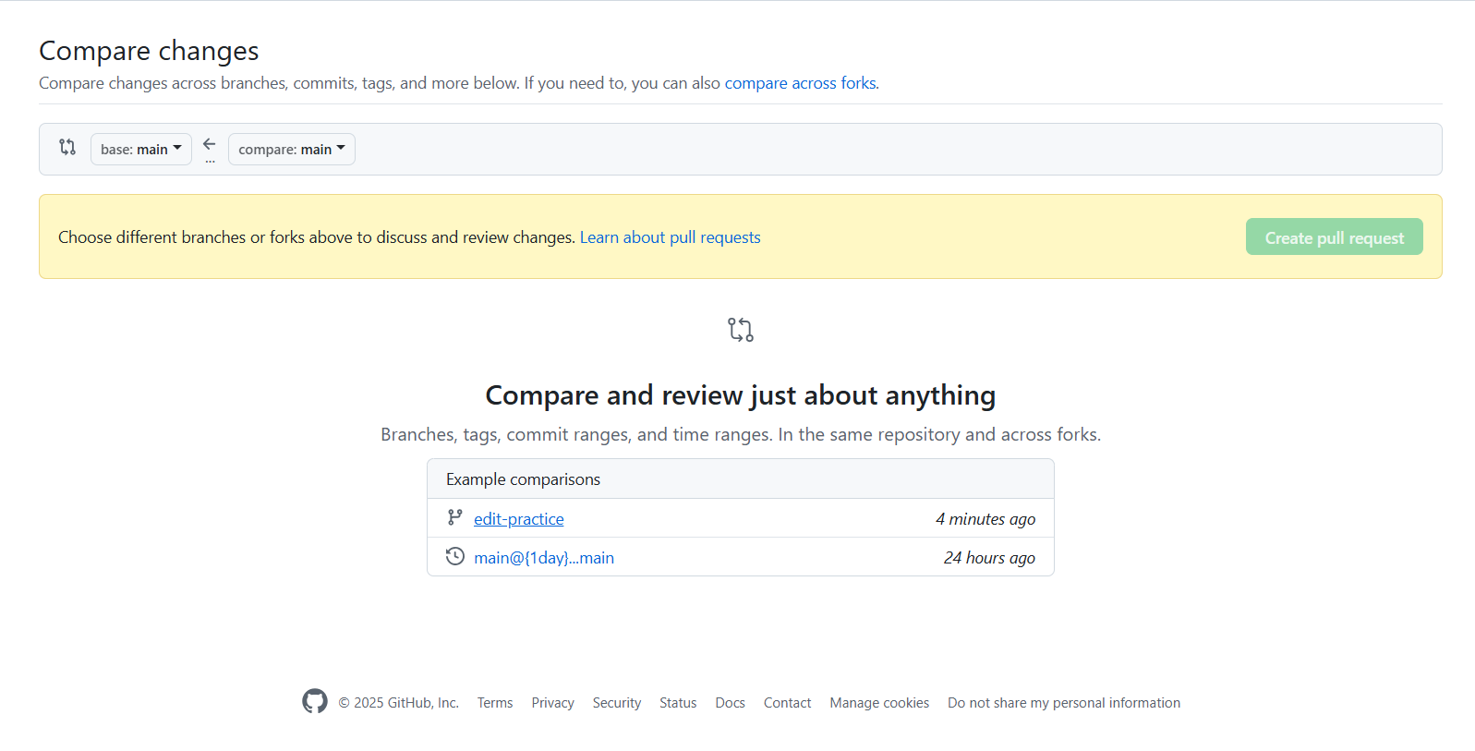
GitHub Pull Request Workflow
Making a pull request
https://docs.github.com/en/get-started/start-your-journey/hello-world

Slide 4
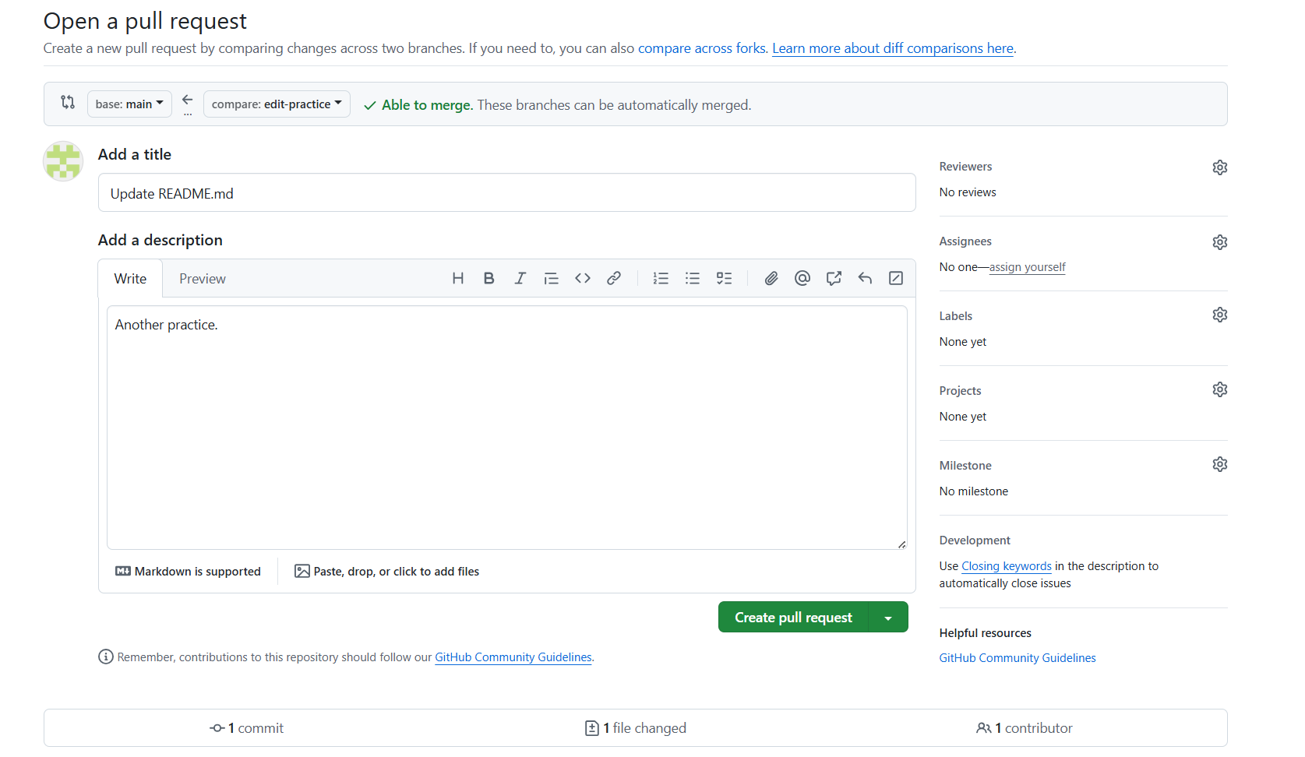
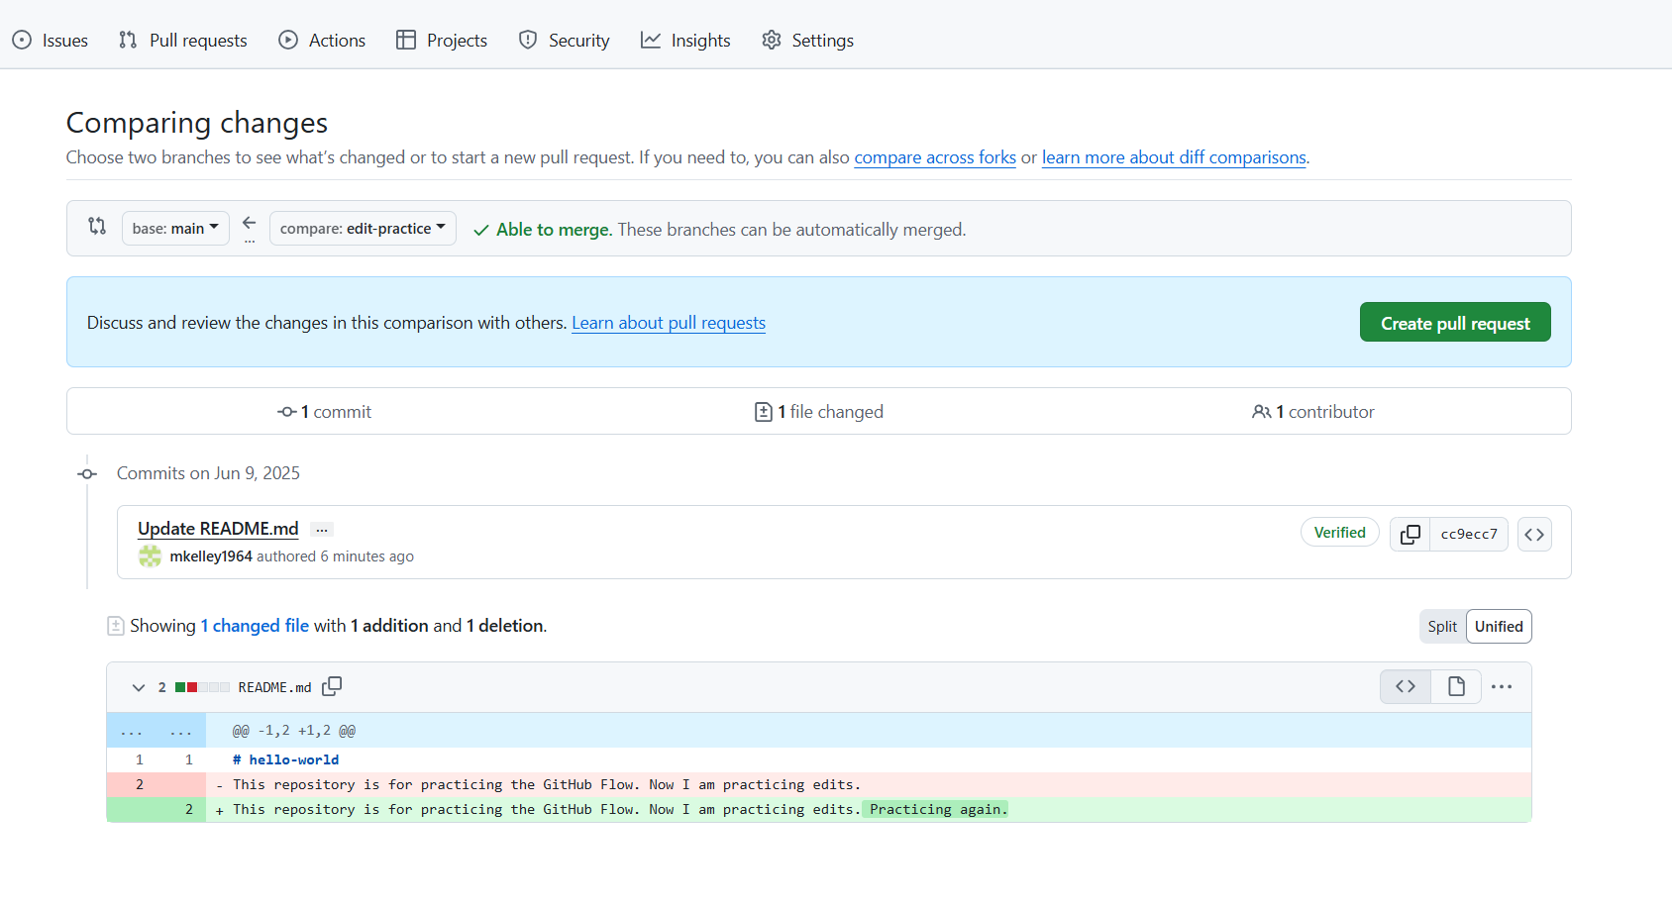
GitHub Pull Request Workflow
Making a pull request
https://docs.github.com/en/get-started/start-your-journey/hello-world

Slide 5
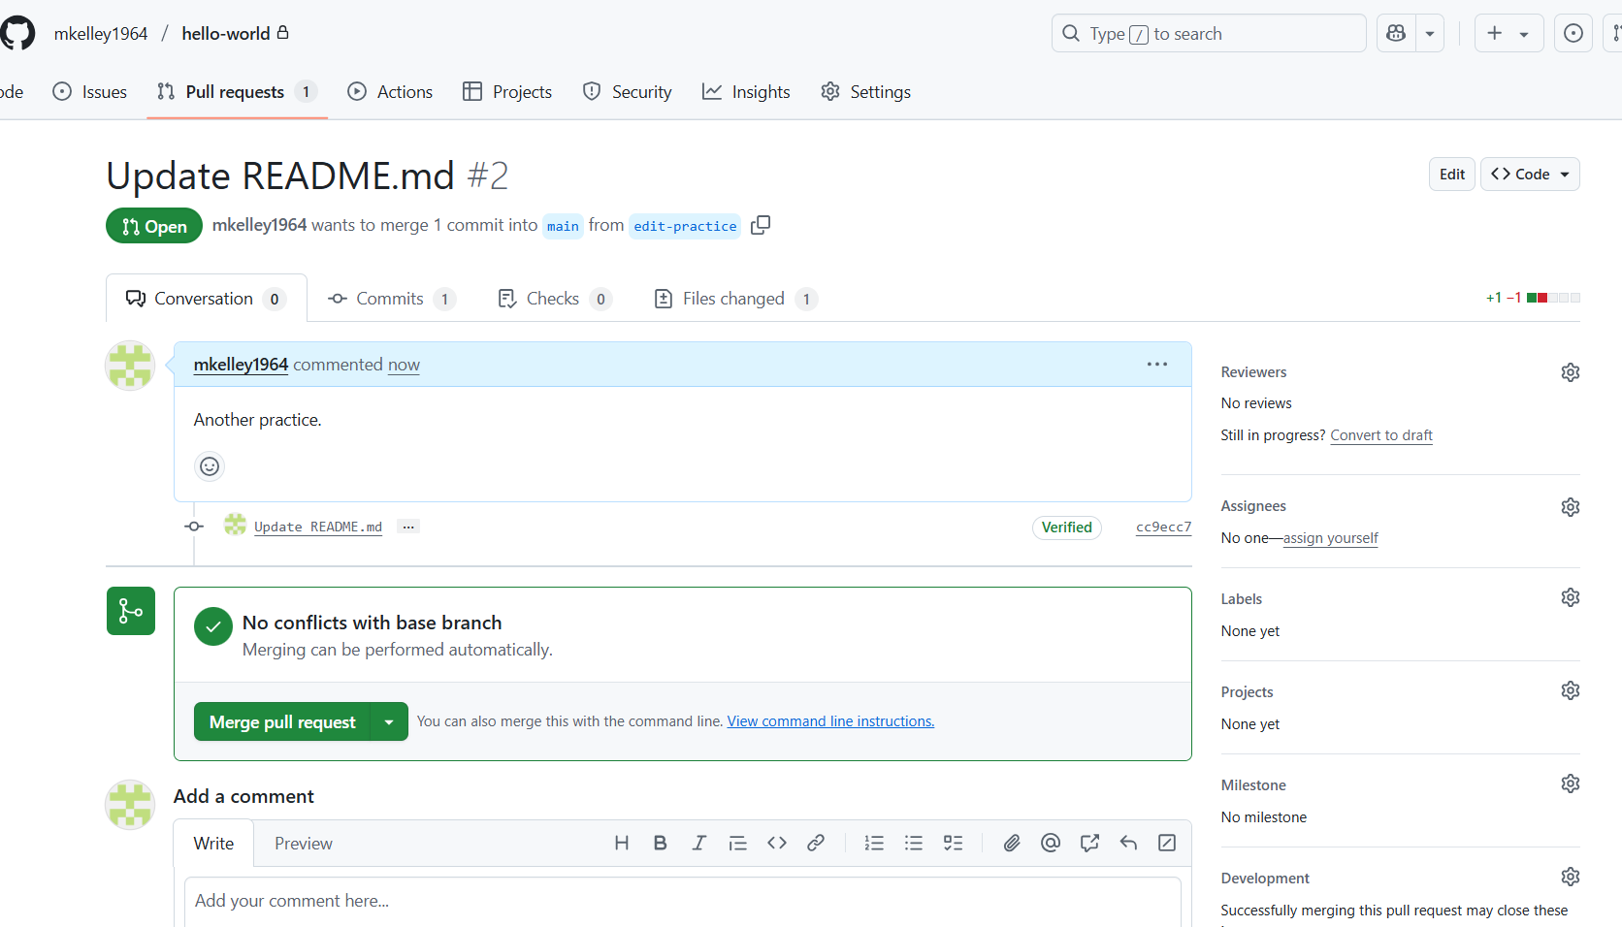
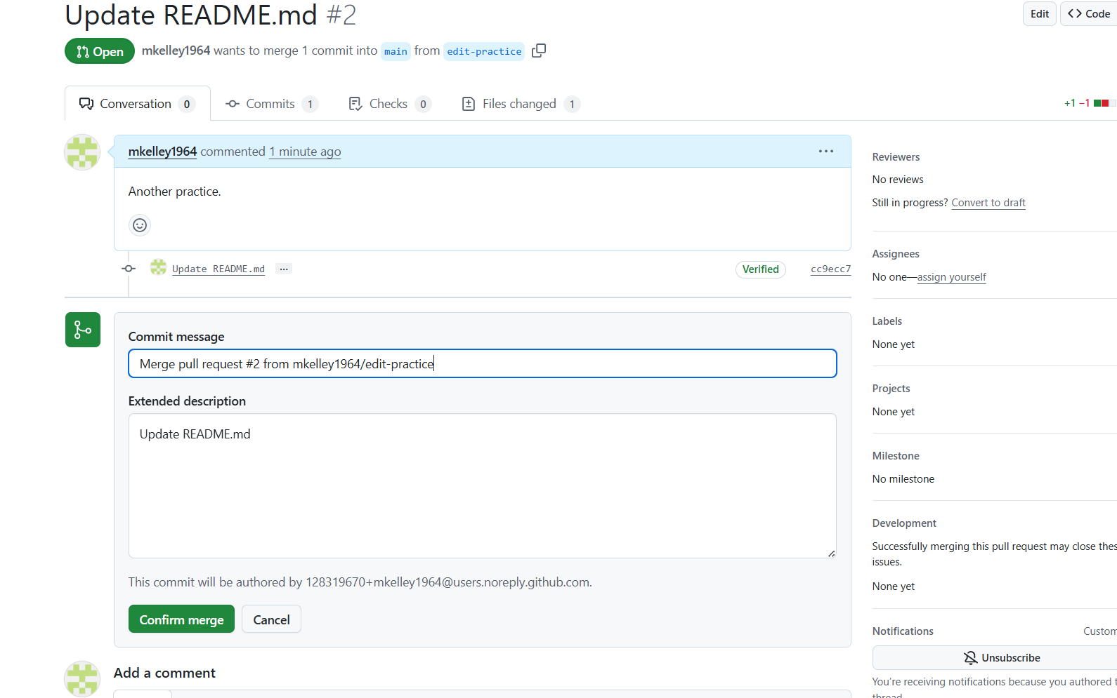
GitHub Pull Request Workflow
Merge pull request
https://docs.github.com/en/get-started/start-your-journey/hello-world

Slide 6
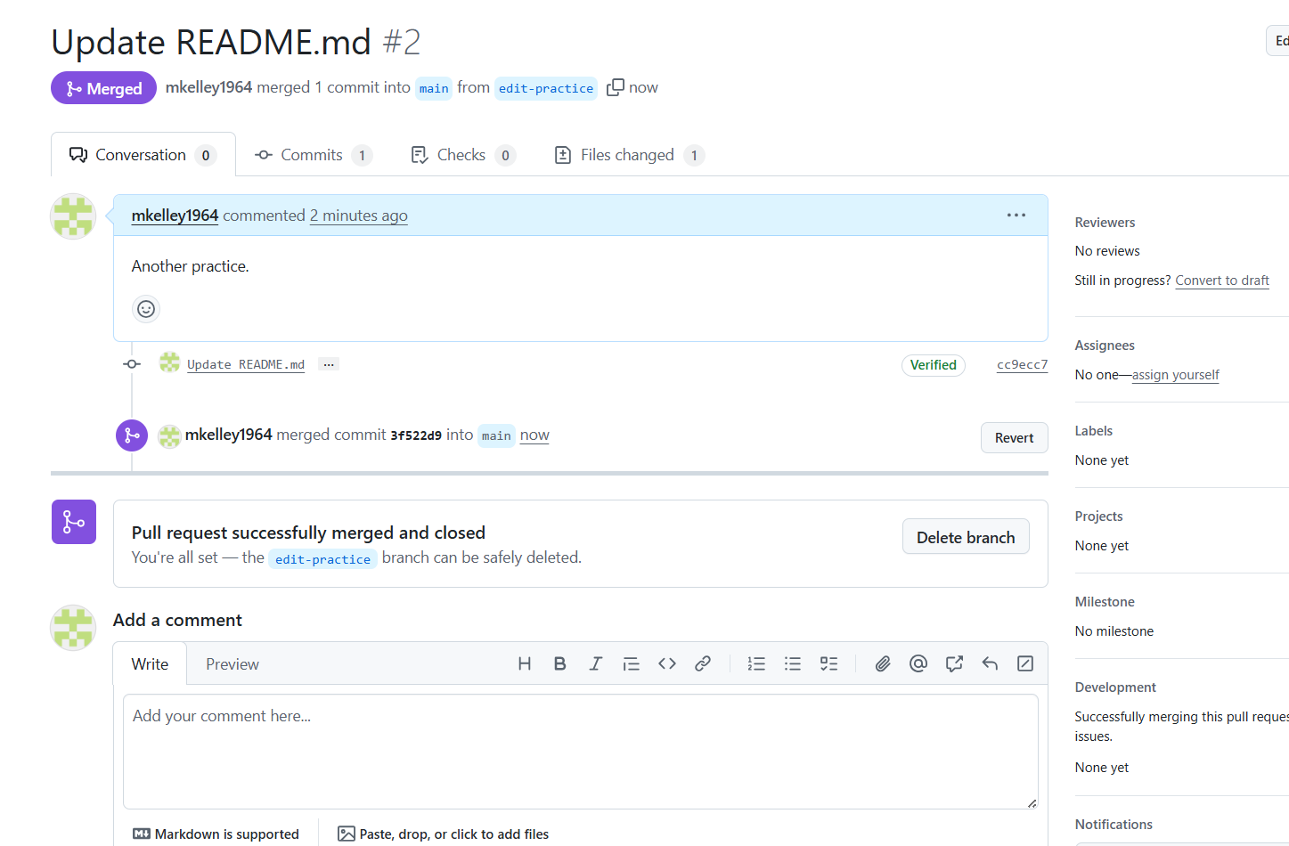
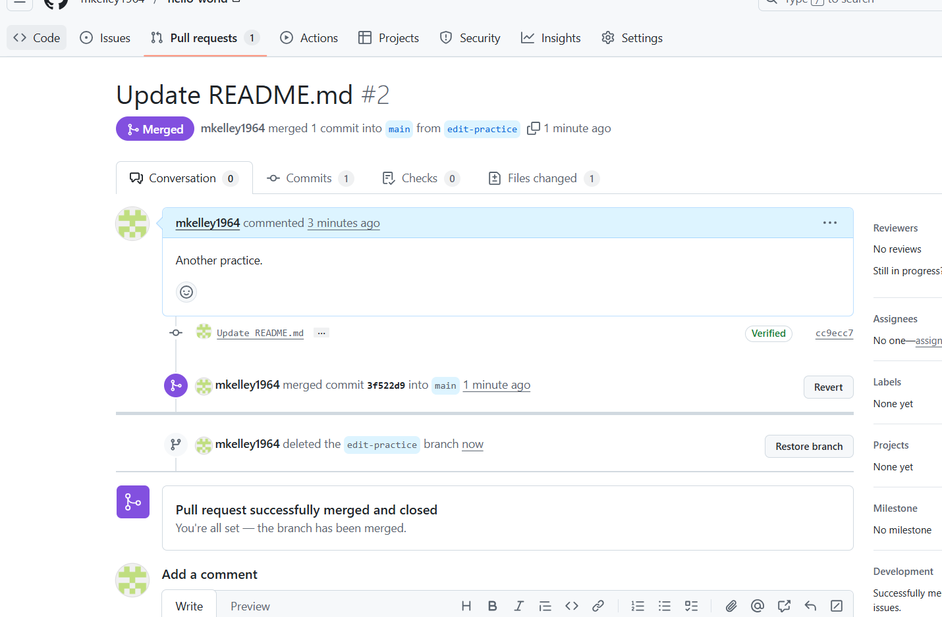
GitHub Pull Request Workflow
Delete branch
https://docs.github.com/en/get-started/start-your-journey/hello-world

Slide 7
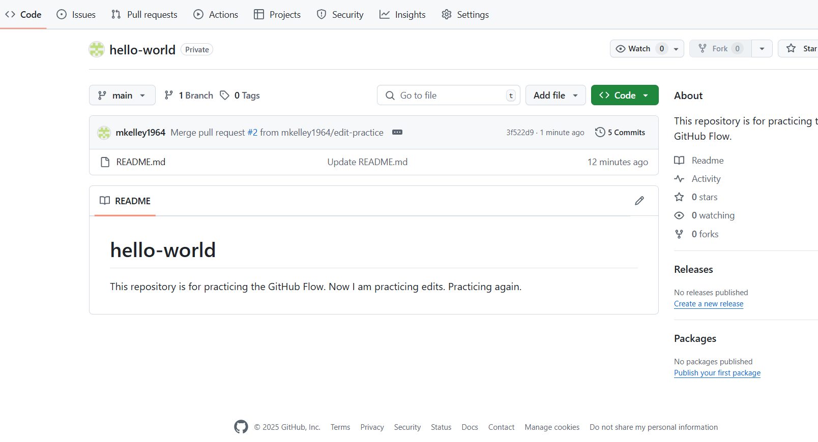
GitHub Pull Request Workflow
main branch with merged changes
https://docs.github.com/en/get-started/start-your-journey/hello-world

