Slide 1
CS 4410
Operating Systems
Prof. Sirer
Fall 2010
Cornell University

Slide 2
Course Objective
Bridge the gap between hardware and software
Establish a foundation for building higher-level programs
  How to optimize programs
  How to debug large systems
  How to deal with complexity

Slide 3
What is an Operating System?
An operating system (OS) provides a virtual execution environment on top of hardware that is more convenient than the raw hardware interface
  “All of the code you did not write”
  Simpler
  More reliable
  More secure
  More portable
  More efficient
Applications
Operating
System
Hardware

Slide 4
What do OSes do?
Manage physical resources
Provide virtual resources
Implement mechanisms and enforce policies for the control and use of resources
Mediate the interaction of mutually distrusting applications

Slide 5
What Physical Resources Do OSes Control?
CPU
Memory
Storage Devices
Networks
Input Devices (keyboard, mice, cameras)
Output Devices (printers, displays, speakers)
And many virtual resources

Slide 6
Issues In OS Design
Structure: how is an OS organized?
Concurrency: how are parallel activities created and controlled?
Sharing: how are resources shared?
Naming: how are resources named by users?
Protection: how are distrusting parties protected from each other?
Security: how to authenticate, authorize and ensure privacy?
Performance: why is it so slow?

Slide 7
More Issues
Reliability: how do we deal with failures?
Extensibility: how do we add new features?
Communication: how do we exchange information?
Scale: what happens as demands increase?
Persistence: how do we make information outlast the processes that created it?
Accounting: who pays the bills and how do we control resource usage?

Slide 8
Why Learn Operating Systems?
Provides an understanding from the bottom up
Even if few people build OSes, understanding how Oses work is crucial for building working systems
This course will go far beyond OS design to cover all aspects of computer organization, including concurrency, synchronization, input/output, filesystems, networking, routing, distributed systems and so forth
Engineering pride alone requires full understanding

Slide 9
Fact
There has never been as exciting a time to work on systems hardware and software as now!!!
The world is increasingly dependent on computer systems
  Connected, networked, interlinked
People just do not know how to build robust systems

Slide 10
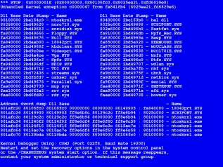
BSOD

Slide 11
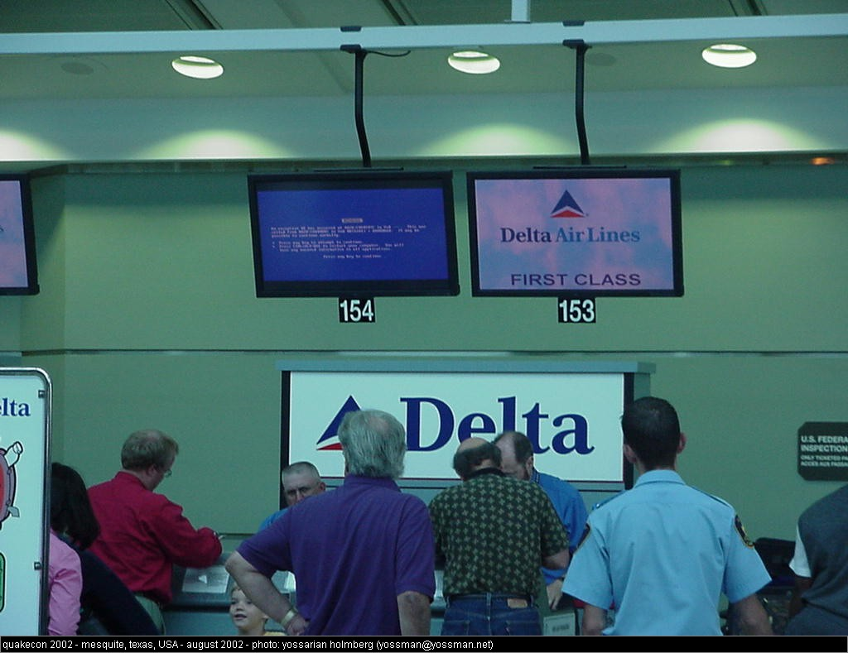
BSOD

Slide 12
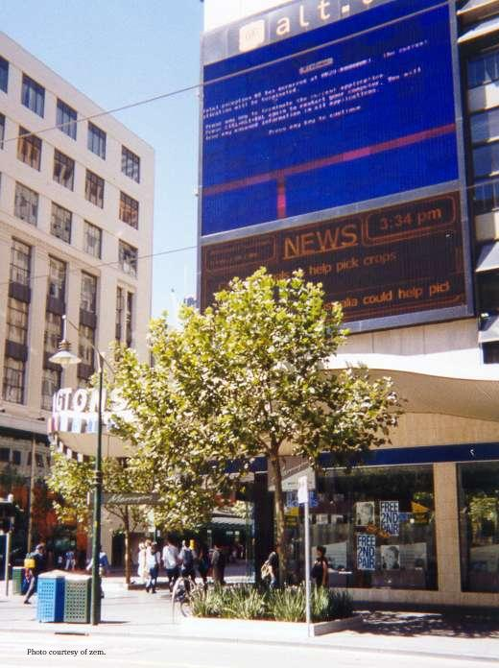
BSOD

Slide 13
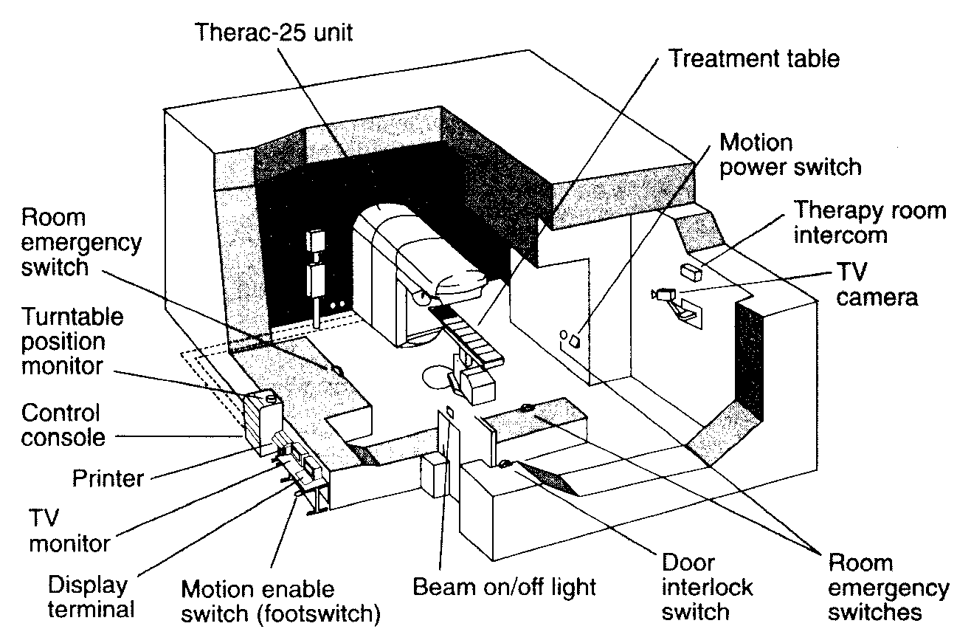
Therac-25
A safety-critical system with software interlocks
Beam controlled entirely through a custom OS

Slide 14
Therac-25
Old system used a hardware interlock
  A lever that could either be in the “zap” or “x-ray” position
New system was computer controlled
A synchronization failure was triggered when competent nurses used the back arrow to change the data on the screen “too quickly”

Slide 15
Therac-25 Outcome
Beam killed one person directly, burned others, and may have given inadequate treatment to cancer patients
Problem was very difficult to diagnose; initial fix involved removal of the back arrow key from the keyboard
People died because a programmer could not write correct code for a concurrent system

Slide 16
Denver airport
The most modern, most expensive airport in recent history
  Cost overrun in excess of $2B
Highly automated luggage handling system was supposed to deliver your luggage to you at arrival
Lack of persistence caused luggage carts to “forget” their contents, sprinkling the luggage on the runway

Slide 17
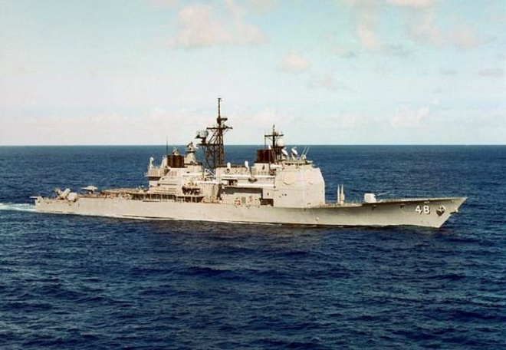
USS Yorktown
Modern guided missile cruiser off of Norfolk, VA in 1998
Crew member entered 0 for a data value
Cascade of failures led to a failure of the propulsion system
Yorktown was dead in the water for a couple of hours

Slide 18
Other Systems
FAA air traffic control system
IRS data management system
IBM “Microkernel”
Pentagon data security
Many others, too numerous to list

Slide 19
Summary
We do not have the necessary technologies and know-how to build robust computer systems
There is huge demand for people who deeply understand and can build robust systems

Slide 20
Logistics
Lectures
  Tuesday, Thursday 2:55-4:10pm, Hollister B14
Instructor
  Prof. Sirer, egs at systems.cs.cornell.edu
  Office Hours
    T/Th 4:10-5:10pm
    Or by prior appointment
TAs
  Deniz Altinbuken, Robert Escriva, Jason Wu
  Dinesh Bhat, Jian Chear

Slide 21
Communication
Course Web Page
  Office hours, assignments, lectures, and other supplemental materials will be on the web site
Email
  cs4410staff at systems.cs.cornell.edu
  The email alias goes to me and the TAs, not to the whole class

Slide 22
Administrative
Course has three components
  Lectures and Readings
  Exams
  Projects and MiniProjects
Textbook
  Silberschatz, Galvin & Gagne
  Operating System Concepts, 8th ed.
You are expected to keep up with all three

Slide 23
Grading
CS4410 Breakdown
  ~40% MiniProjects
  ~12% Prelim 1
  ~18% Prelim 2
  ~25% Final
  ~5% Flexgrade (participation, attitude, effort)
CS4411 Breakdown
  ~90% Projects
  ~10% Flexgrade
Grading will not be done on a curve
  It is my goal to be able to give everyone an A+
  Help me achieve this

Slide 24
Projects in CS4411
Projects will be done in two-person teams
  You may indicate a desired partner
  If they also indicate you, we will pair you up
  If you don’t have a preferred partner, we’ll pair you up with someone suitable
Working in groups
  Start early, time management is key
  Manage the team effort
  Part of what you are supposed to learn is how to manage to get work done in a small team

Slide 25
MiniProjects in 4410
There will be approximately 4-6 miniprojects
MiniProjects will be done individually
Working individually
  Start early, time management is key

Slide 26
Academic Integrity and Honor Code
All submitted work must be your own
  All homeworks must be your own independent work
  OK to study together
  Cannot share solutions, ever
Project groups submit joint work
  All group assignments must represent solely the work of the two people in that group
  Cannot be in possession of someone else’s solution
Violations will be prosecuted to the fullest extent
Closed-book exams, no calculators

Slide 27
Draft Syllabus
Introduction
Architectural Support for Operating Systems
Processes and Threads
Scheduling
Synchronization, Mutual Exclusion, Spin Locks, Semaphores, Condition Variables
Deadlocks, Detection and Avoidance
Memory Management
Networking, LANs, WANs, Ethernet, ARP, IP, UDP, TCP
Disks and RAID
Filesystems, UFS, LFS
Security

Slide 28
Draft Project Plan for CS4411
Threads and Concurrency
Scheduling
Basic Datagram Networking
Reliable Streaming Protocols
Routing
Filesystems

Slide 29
Questions?
And demographics…

