Slide 1
Disks and RAID

Slide 2
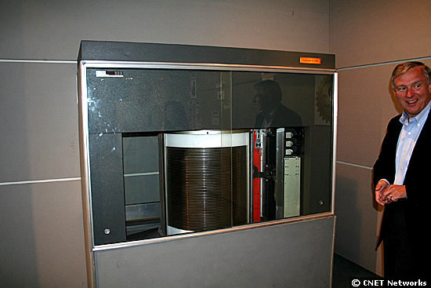
50 Years Old!
13th September 1956
The IBM RAMAC 350

Slide 3
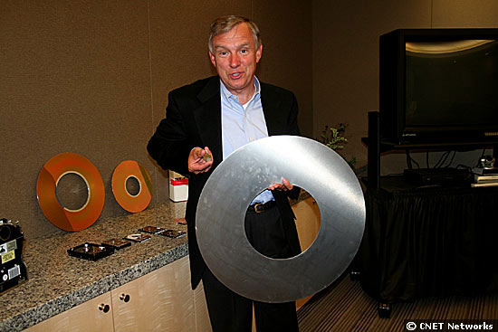
80000 times more data on the 8GB 1-inch drive in his right hand than on the 24-inch RAMAC one in his left…

Slide 4

What does the disk look like?

Slide 5
Some parameters
2-30 heads (platters * 2)
  diameter 14’’ to 2.5’’
700-20480 tracks per surface
16-1600 sectors per track
sector size:
  64-8k bytes
  512 for most PCs
  note: inter-sector gaps
capacity: 20M-100G
main adjectives: BIG, slow

Slide 6
Disk overheads
To read from disk, we must specify:
  cylinder #, surface #, sector #, transfer size, memory address
Transfer time includes:
  Seek time: to get to the track
  Latency time: to get to the sector and
  Transfer time: get bits off the disk
Track
Sector
Rotation
Delay
Seek Time

Slide 7
Modern disks
 |  | Barracuda 180 | Cheetah X15 36LP
Capacity |  | 181GB | 36.7GB
Disk/Heads |  | 12/24 | 4/8
Cylinders |  | 24,247 | 18,479
Sectors/track |  | ~609 | ~485
Speed |  | 7200RPM | 15000RPM
Latency (ms) |  | 4.17 | 2.0
Avg seek (ms) |  | 7.4/8.2 | 3.6/4.2
Track-2-track(ms) |  | 0.8/1.1 | 0.3/0.4

Slide 8
Disks vs. Memory
Smallest write: sector
Atomic write = sector
Random access: 5ms
  not on a good curve
Sequential access: 200MB/s
Cost $.002MB
Crash: doesn’t matter (“non-volatile”)
(usually) bytes
byte, word
50 ns
  faster all the time
200-1000MB/s
$.10MB
contents gone (“volatile”)

Slide 9
Disk Structure
Disk drives addressed as 1-dim arrays of logical blocks
  the logical block is the smallest unit of transfer
This array mapped sequentially onto disk sectors
  Address 0 is 1st sector of 1st track of the outermost cylinder
  Addresses incremented within track, then within tracks of the cylinder, then across cylinders, from innermost to outermost
Translation is theoretically possible, but usually difficult
  Some sectors might be defective
  Number of sectors per track is not a constant

Slide 10
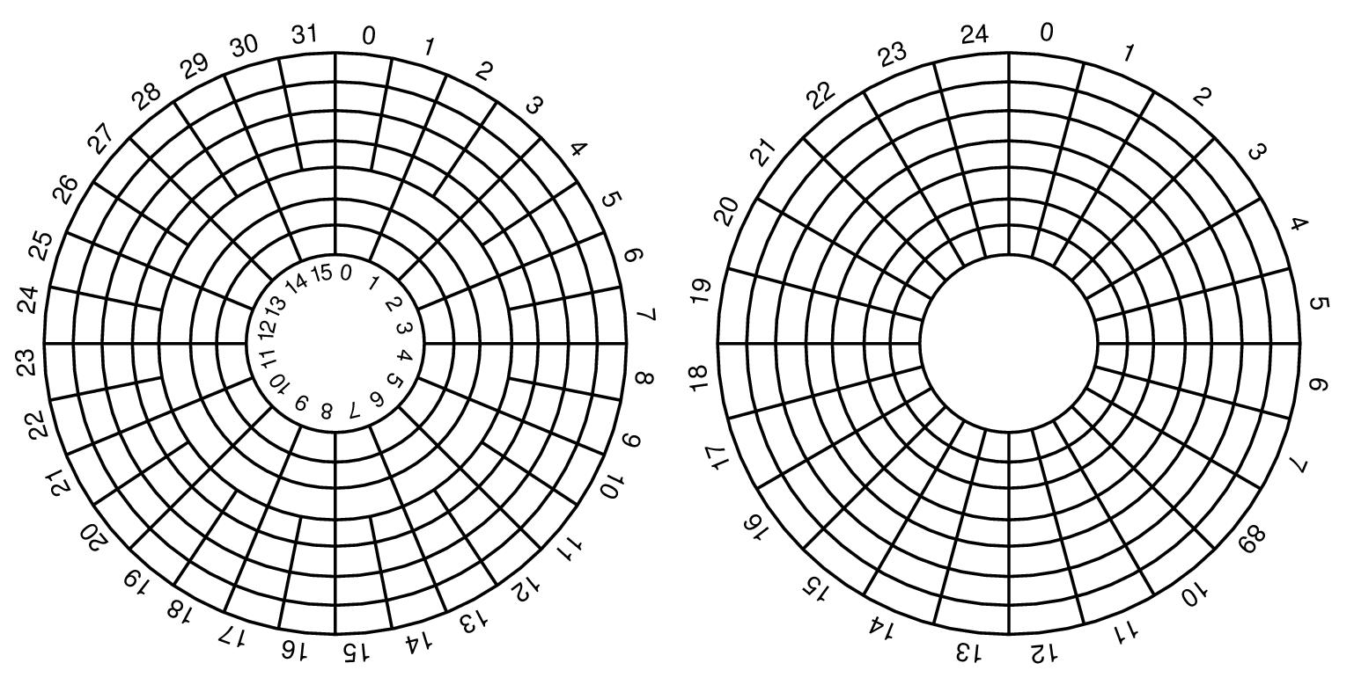
Non-uniform #sectors / track
Reduce bit density per track for outer layers (Constant Linear Velocity, typically HDDs)
Have more sectors per track on the outer layers, and increase rotational speed when reading from outer tracks (Constant Angular Velcity, typically CDs, DVDs)

Slide 11
Disk Scheduling
The operating system tries to use hardware efficiently
  for disk drives ⇒ having fast access time, disk bandwidth
Access time has two major components
  Seek time is time to move the heads to the cylinder containing the desired sector
  Rotational latency is additional time waiting to rotate the desired sector to the disk head.
Minimize seek time
Seek time ≈ seek distance
Disk bandwidth is total number of bytes transferred, divided by the total time between the first request for service and the completion of the last transfer.

Slide 12
Disk Scheduling (Cont.)
Several scheduling algos exist service disk I/O requests.
We illustrate them with a request queue (0-199).
98, 183, 37, 122, 14, 124, 65, 67
Head pointer 53

Slide 13

FCFS
Illustration shows total head movement of 640 cylinders.

Slide 14
SSTF
Selects request with minimum seek time from current head position
SSTF scheduling is a form of SJF scheduling
  may cause starvation of some requests.
Illustration shows total head movement of 236 cylinders.

Slide 15

SSTF (Cont.)

Slide 16
SCAN
The disk arm starts at one end of the disk,
  moves toward the other end, servicing requests
  head movement is reversed when it gets to the other end of disk
  servicing continues.
Sometimes called the elevator algorithm.
Illustration shows total head movement of 208 cylinders.

Slide 17

SCAN (Cont.)

Slide 18
C-SCAN
Provides a more uniform wait time than SCAN.
The head moves from one end of the disk to the other.
  servicing requests as it goes.
  When it reaches the other end it immediately returns to beginning of the disk
    No requests serviced on the return trip.
Treats the cylinders as a circular list
  that wraps around from the last cylinder to the first one.

Slide 19

C-SCAN (Cont.)

Slide 20
C-LOOK
Version of C-SCAN
Arm only goes as far as last request in each direction,
  then reverses direction immediately,
  without first going all the way to the end of the disk.

Slide 21

C-LOOK (Cont.)

Slide 22
Selecting a Good Algorithm
SSTF is common and has a natural appeal
SCAN and C-SCAN perform better under heavy load
Performance depends on number and types of requests
Requests for disk service can be influenced by the file-allocation method.
Disk-scheduling algorithm should be a separate OS module
  allowing it to be replaced with a different algorithm if necessary.
Either SSTF or LOOK is a reasonable default algorithm

Slide 23
Disk Formatting
After manufacturing disk has no information
  Is stack of platters coated with magnetizable metal oxide
Before use, each platter receives low-level format
  Format has series of concentric tracks
  Each track contains some sectors
  There is a short gap between sectors
Preamble allows h/w to recognize start of sector
  Also contains cylinder and sector numbers
  Data is usually 512 bytes
  ECC field used to detect and recover from read errors

Slide 24
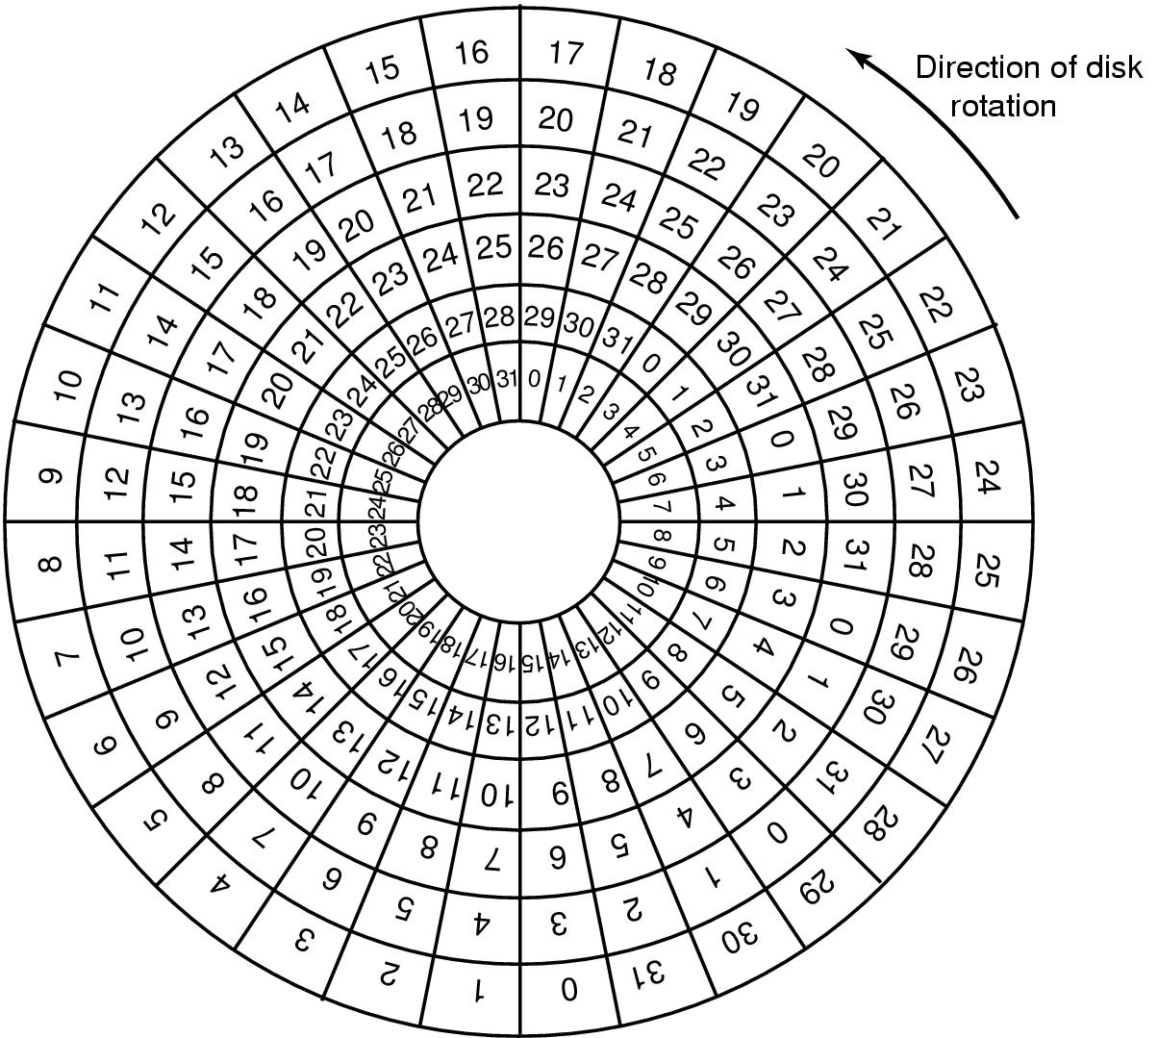
Cylinder Skew
Why cylinder skew?
How much skew?
Example, if
  10000 rpm
    Drive rotates in 6 ms
  Track has 300 sectors
    New sector every 20 µs
  If track seek time 800 µs
    40 sectors pass on seek
Cylinder skew: 40 sectors

Slide 25
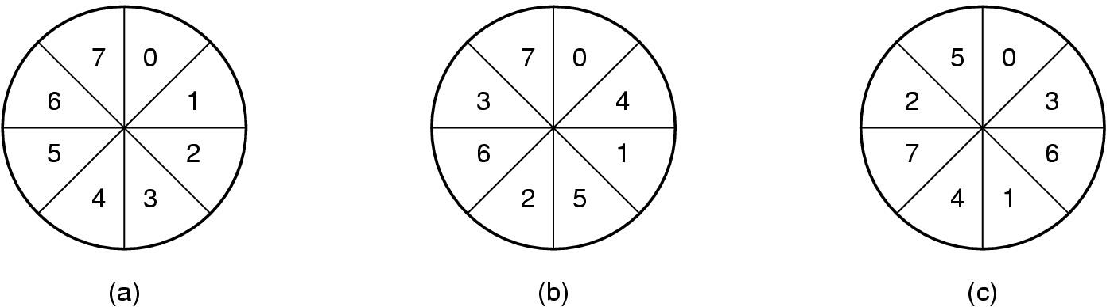
Formatting and Performance
If 10K rpm, 300 sectors of 512 bytes per track
  153600 bytes every 6 ms ⇒ 24.4 MB/sec transfer rate
If disk controller buffer can store only one sector
  For 2 consecutive reads, 2nd sector flies past during memory transfer of 1st track
  Idea: Use single/double interleaving

Slide 26
Disk Partitioning
Each partition is like a separate disk
Sector 0 is MBR
  Contains boot code + partition table
  Partition table has starting sector and size of each partition
High-level formatting
  Done for each partition
  Specifies boot block, free list, root directory, empty file system
What happens on boot?
  BIOS loads MBR, boot program checks to see active partition
  Reads boot sector from that partition that then loads OS kernel, etc.

Slide 27
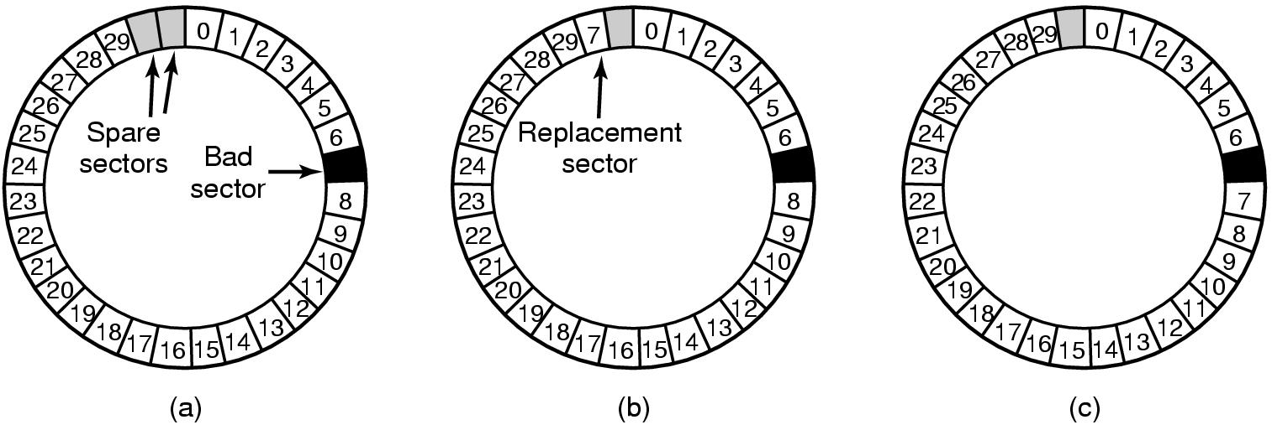
Handling Errors
A disk track with a bad sector
Solutions:
  Substitute a spare for the bad sector (sector sparing)
  Shift all sectors to bypass bad one (sector forwarding)

Slide 28
RAID Motivation
Disks are improving, but not as fast as CPUs
  1970s seek time: 50-100 ms.
  2000s seek time: <5 ms.
  Factor of 20 improvement in 3 decades
We can use multiple disks for improving performance
  By Striping files across multiple disks (placing parts of each file on a different disk), parallel I/O can improve access time
Striping reduces reliability
  100 disks have 1/100th mean time between failures of one disk
So, we need Striping for performance, but we need something to help with reliability / availability
To improve reliability, we can add redundant data to the disks, in addition to Striping

Slide 29
RAID
A RAID is a Redundant Array of Inexpensive Disks
  In industry, “I” is for “Independent”
  The alternative is SLED, single large expensive disk
Disks are small and cheap, so it’s easy to put lots of disks (10s to 100s) in one box for increased storage, performance, and availability
The RAID box with a RAID controller looks just like a SLED to the computer
Data plus some redundant information is Striped across the disks in some way
How that Striping is done is key to performance and reliability.

Slide 30
Some Raid Issues
Granularity
  fine-grained: Stripe each file over all disks. This gives high throughput for the file, but limits to transfer of 1 file at a time
  coarse-grained: Stripe each file over only a few disks. This limits throughput for 1 file but allows more parallel file access
Redundancy
  uniformly distribute redundancy info on disks: avoids load-balancing problems
  concentrate redundancy info on a small number of disks: partition the set into data disks and redundant disks

Slide 31
Raid Level 0
Level 0 is nonredundant disk array
Files are Striped across disks, no redundant info
High read throughput
Best write throughput (no redundant info to write)
Any disk failure results in data loss
  Reliability worse than SLED
Stripe 0
Stripe 1
Stripe 2
Stripe 3
Stripe 4
Stripe 5
Stripe 6
Stripe 7
Stripe 8
Stripe 9
Stripe 10
Stripe 11
data disks

Slide 32
Raid Level 1
Mirrored Disks
Data is written to two places
  On failure, just use surviving disk
On read, choose fastest to read
  Write performance is same as single drive, read performance is 2x better
Expensive
Stripe 0
Stripe 1
Stripe 2
Stripe 3
Stripe 0
Stripe 1
Stripe 2
Stripe 3
Stripe 4
Stripe 5
Stripe 6
Stripe 7
Stripe 4
Stripe 5
Stripe 6
Stripe 7
Stripe 8
Stripe 9
Stripe 10
Stripe 11
Stripe 8
Stripe 9
Stripe 10
Stripe 11
data disks
mirror copies

Slide 33
Parity and Hamming Codes
What do you need to do in order to detect and correct a one-bit error ?
  Suppose you have a binary number, represented as a collection of bits: <b3, b2, b1, b0>, e.g. 0110
Detection is easy
Parity:
  Count the number of bits that are on, see if it’s odd or even
    EVEN parity is 0 if the number of 1 bits is even
  Parity(<b3, b2, b1, b0 >) = P0 = b0 ⊗ b1 ⊗ b2 ⊗ b3
  Parity(<b3, b2, b1, b0, p0>) = 0 if all bits are intact
  Parity(0110) = 0, Parity(01100) = 0
  Parity(11100) = 1 => ERROR!
  Parity can detect a single error, but can’t tell you which of the bits got flipped

Slide 34
Parity and Hamming Code
Detection and correction require more work
Hamming codes can detect double bit errors and detect & correct single bit errors
7/4 Hamming Code
  h0 = b0 ⊗ b1 ⊗ b3
  h1 = b0 ⊗ b2 ⊗ b3
  h2 = b1 ⊗ b2 ⊗ b3
  H0(<1101>) = 0
  H1(<1101>) = 1
  H2(<1101>) = 0
  Hamming(<1101>) = <b3, b2, b1, h2, b0, h1, h0> = <1100110>
  If a bit is flipped, e.g. <1110110>
  Hamming(<1111>) = <h2, h1, h0> = <111> compared to <010>, <101> are in error. Error occurred in bit 5.

Slide 35
Raid Level 2
Bit-level Striping with Hamming (ECC) codes for error correction
All 7 disk arms are synchronized and move in unison
Complicated controller
Single access at a time
Tolerates only one error, but with no performance degradation
Bit 0
Bit 1
Bit 2
Bit 3
Bit 4
Bit 5
Bit 6
data disks
ECC disks

Slide 36
Raid Level 3
Use a parity disk
  Each bit on the parity disk is a parity function of the corresponding bits on all the other disks
A read accesses all the data disks
A write accesses all data disks plus the parity disk
On disk failure, read remaining disks plus parity disk to compute the missing data
Single parity disk can be used
to detect and correct errors
Bit 0
Bit 1
Bit 2
Bit 3
Parity
Parity disk
data disks

Slide 37
Raid Level 4
Combines Level 0 and 3 – block-level parity with Stripes
A read accesses all the data disks
A write accesses all data disks plus the parity disk
Heavy load on the parity disk
Stripe 0
Stripe 1
Stripe 2
Stripe 3
P0-3
Stripe 4
Stripe 5
Stripe 6
Stripe 7
P4-7
Stripe 8
Stripe 9
Stripe 10
Stripe 11
P8-11
Parity disk
data disks

Slide 38
Raid Level 5
Block Interleaved Distributed Parity
Like parity scheme, but distribute the parity info over all disks (as well as data over all disks)
Better read performance, large write performance
  Reads can outperform SLEDs and RAID-0
Stripe 0
Stripe 1
Stripe 2
Stripe 3
P0-3
Stripe 4
Stripe 5
Stripe 6
P4-7
Stripe 7
Stripe 8
Stripe 9
P8-11
Stripe 10
Stripe 11
data and parity disks

Slide 39
Raid Level 6
Level 5 with an extra parity bit
Can tolerate two failures
  What are the odds of having two concurrent failures ?
May outperform Level-5 on reads, slower on writes

Slide 40
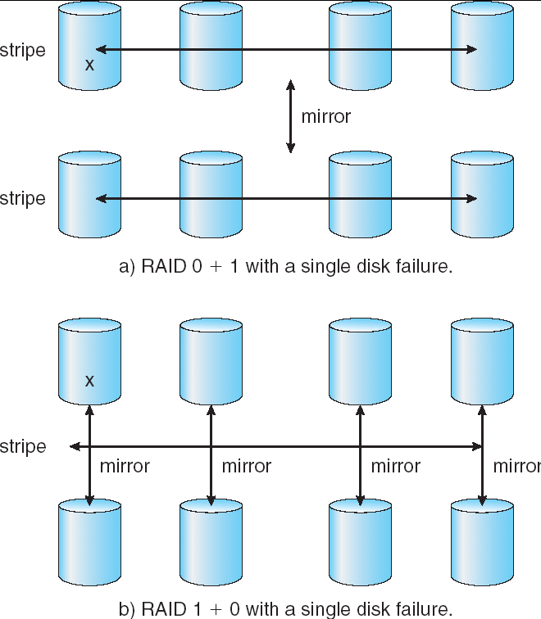
RAID 0+1 and 1+0

Slide 41
Stable Storage
Handling disk write errors:
  Write lays down bad data
  Crash during a write corrupts original data
What we want to achieve? Stable Storage
  When a write is issued, the disk either correctly writes data, or it does nothing, leaving existing data intact
Model:
  An incorrect disk write can be detected by looking at the ECC
  It is very rare that same sector goes bad on multiple disks
  CPU is fail-stop

Slide 42
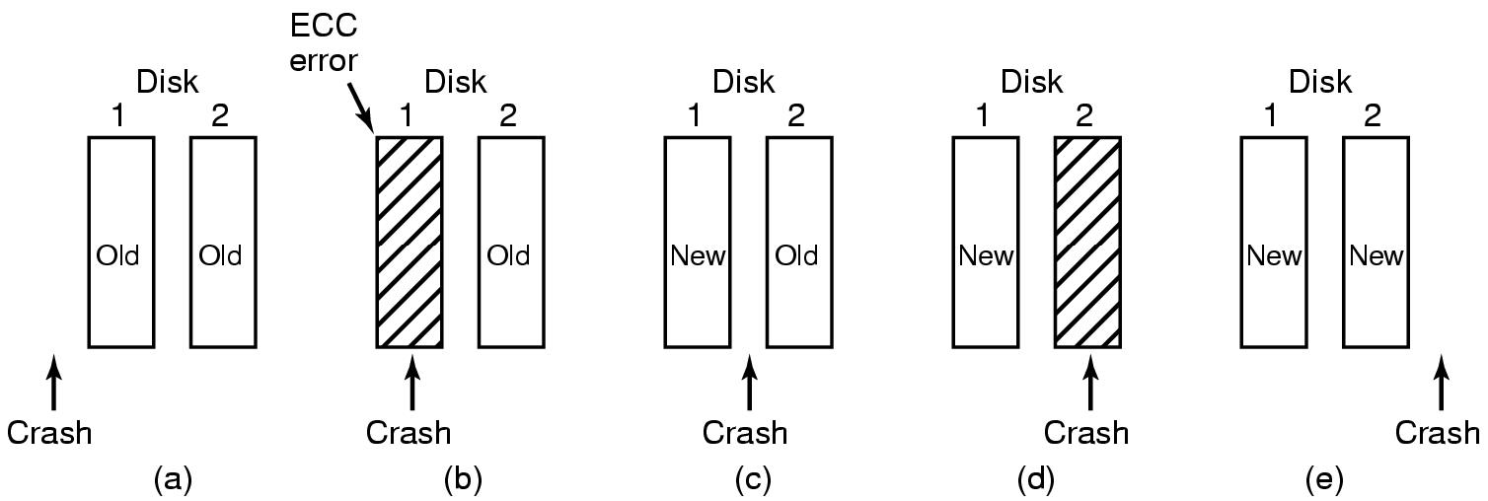
Approach
Use 2 identical disks
  corresponding blocks on both drives are the same
3 operations:
  Stable write: retry on 1st until successful, then try 2nd disk
  Stable read: read from 1st. If ECC error, then try 2nd
  Crash recovery: scan corresponding blocks on both disks
    If one block is bad, replace with good one
    If both are good, replace block in 2nd with the one in 1st

Slide 43
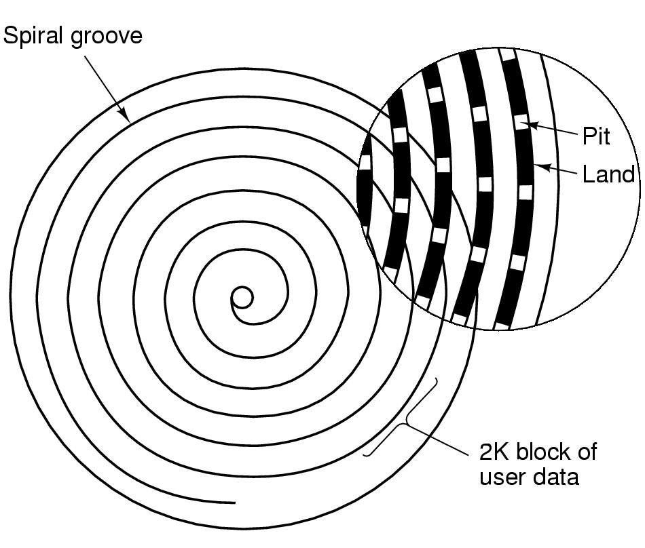
CD-ROMs
Spiral makes 22,188 revolutions around disk (approx 600/mm).
Will be 5.6 km long. Rotation rate: 530 rpm to 200 rpm

Slide 44
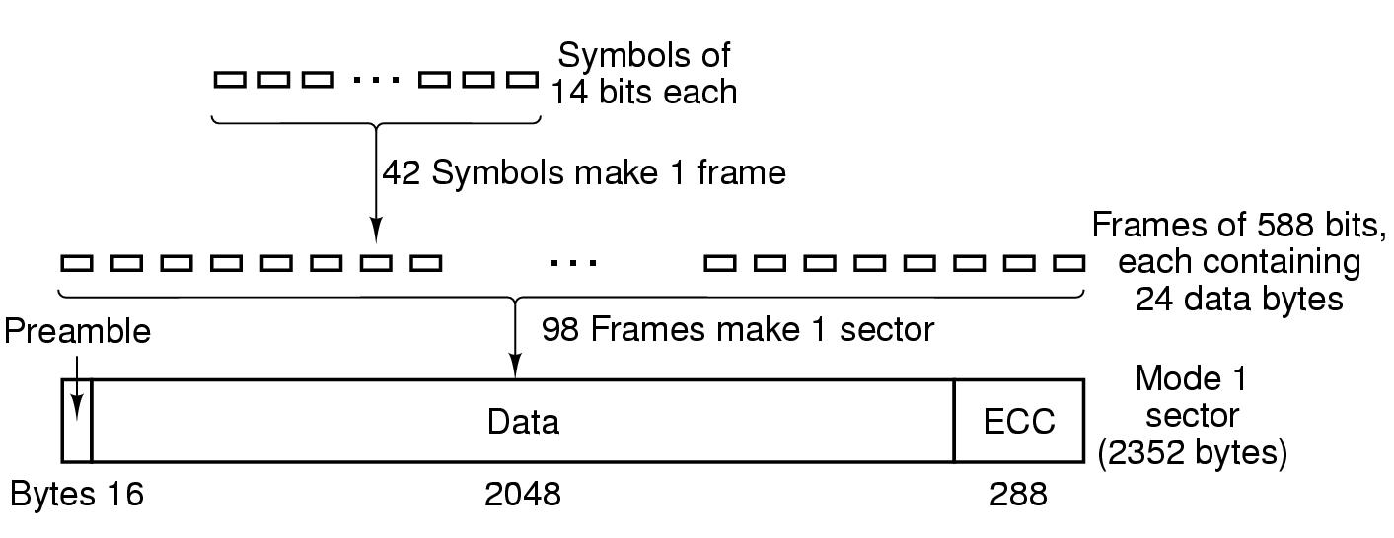
CD-ROMs
Logical data layout on a CD-ROM

